Slide 1
Toric Decoder Plots
Daniel Sun

Slide 2

Run 1
$L∈\{20,40,60,80,100\}$
$c∈\{2,4,8,16,32\}$
$T=L$
$p_{\text{initial}}=0.05$
$p_{\text{intermediate}}=0$
$η=0.1$
10000 shots

Slide 3
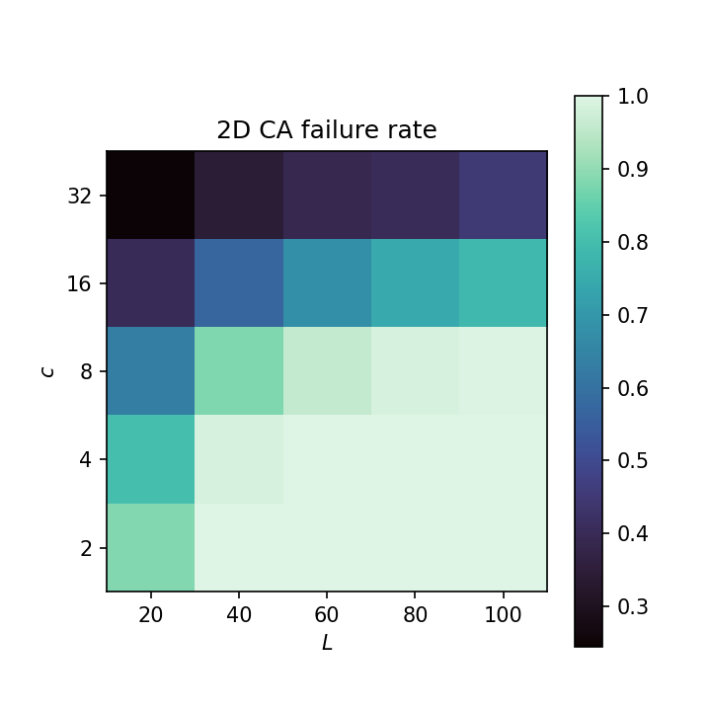
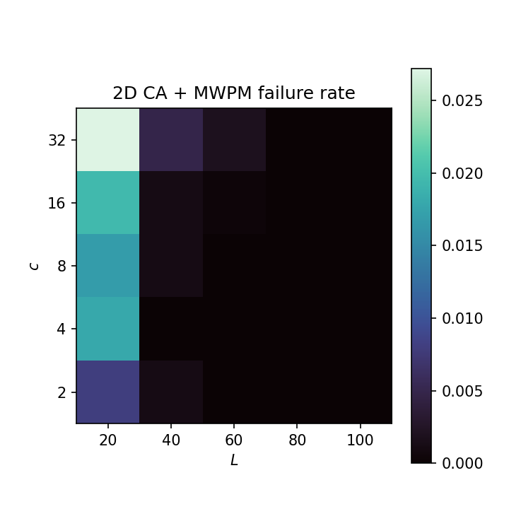
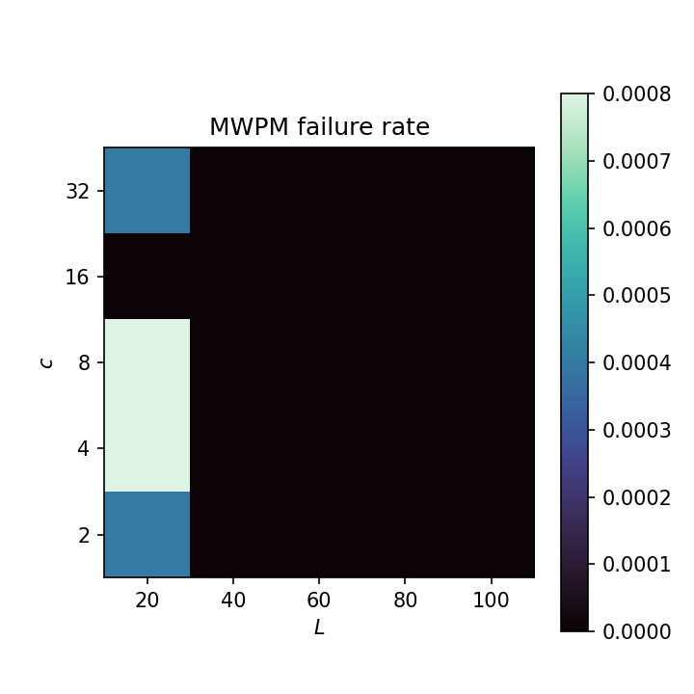
Run 1

Slide 4

Run 2
$L∈\{20,40,60,…,200\}$
$c∈\{2,4,8,…,64\}$
$T=L$
$p=0.05$
$η=0.1$
10000 shots
4 hours, 8 CPUs per task

Slide 5
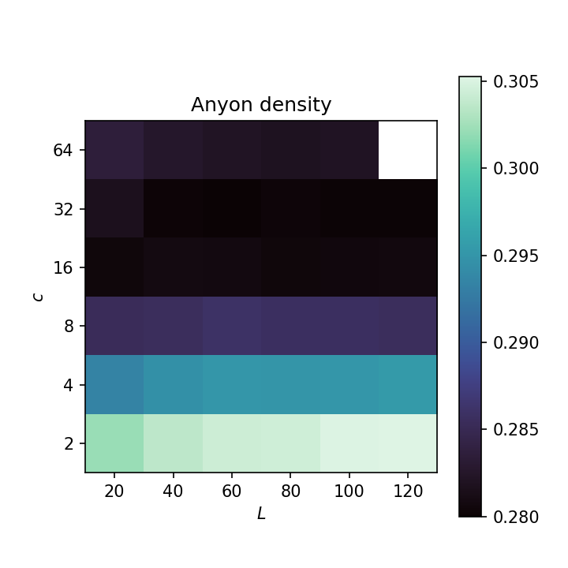
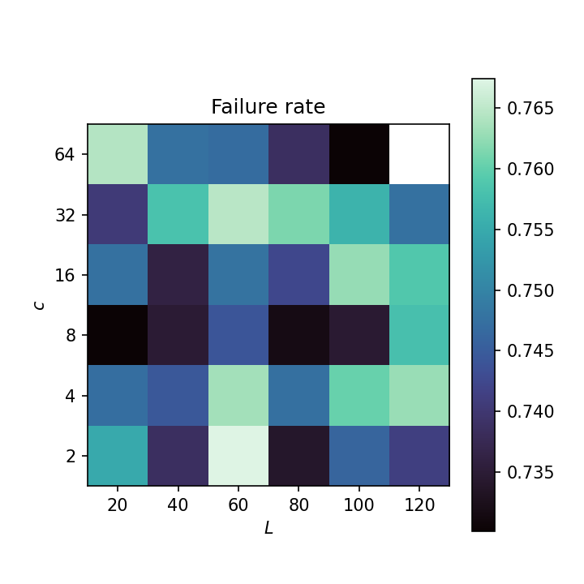
Run 2

Slide 6

Run 3
$L∈\{20,40,60,…,200\}$
$c=16$
$T=L$
$p∈\{0.01,0.02,0.03,…,0.05\}$
$η=0.1$
10000 shots
4 hours, 8 CPUs per task

Slide 7
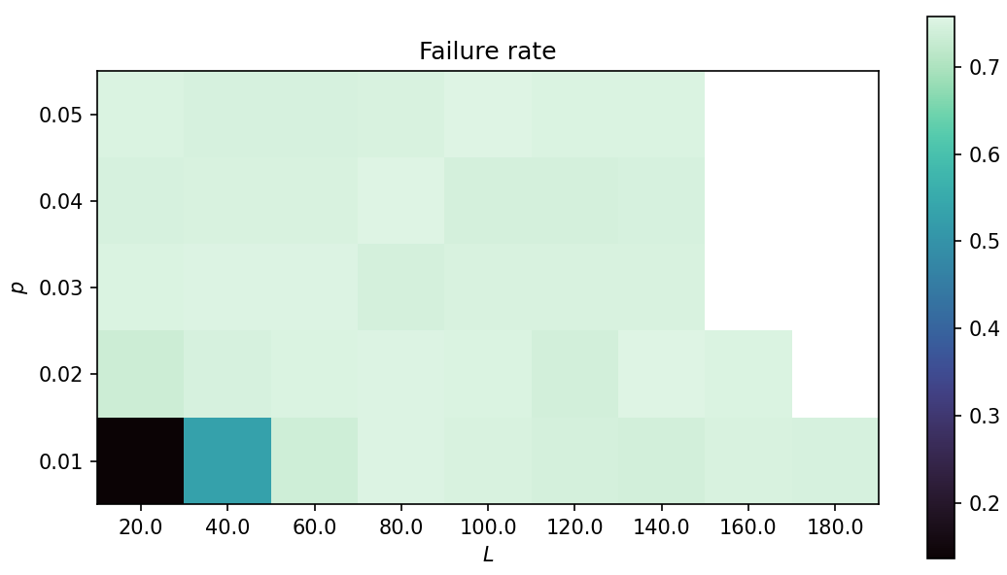
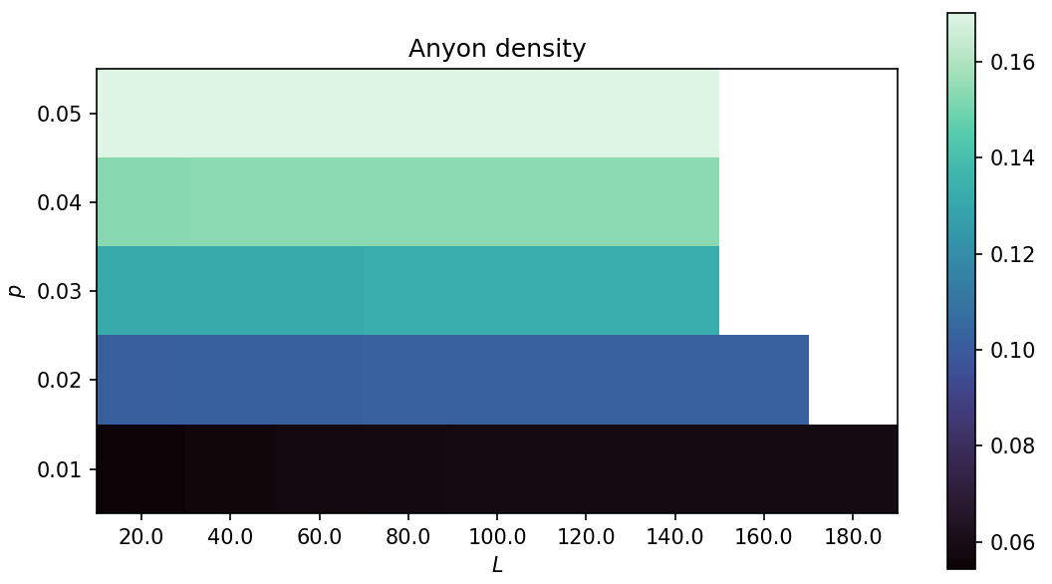
Run 3

Slide 8
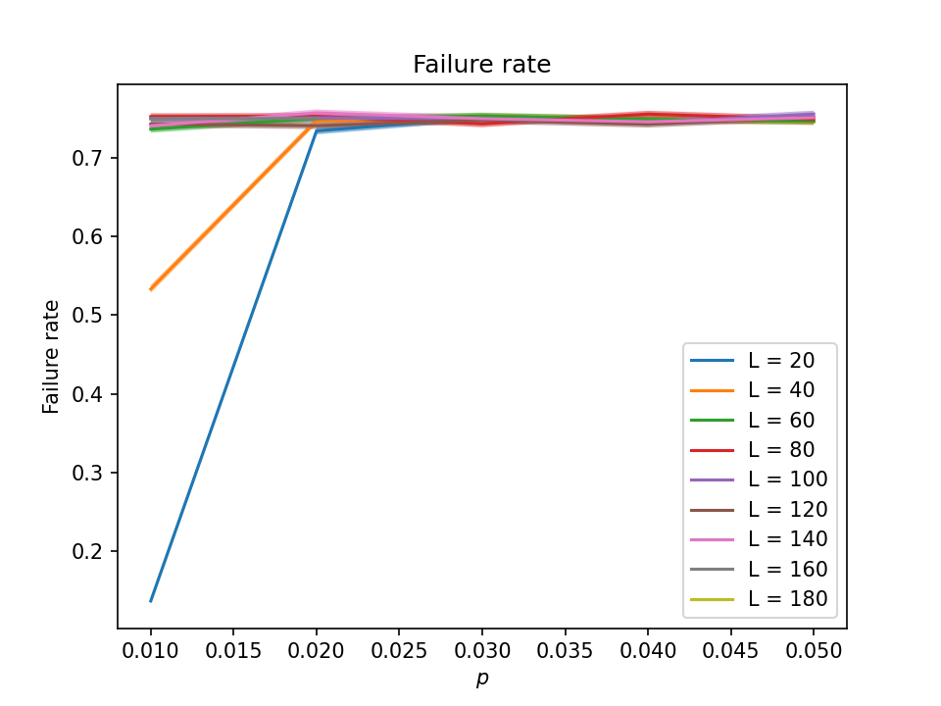
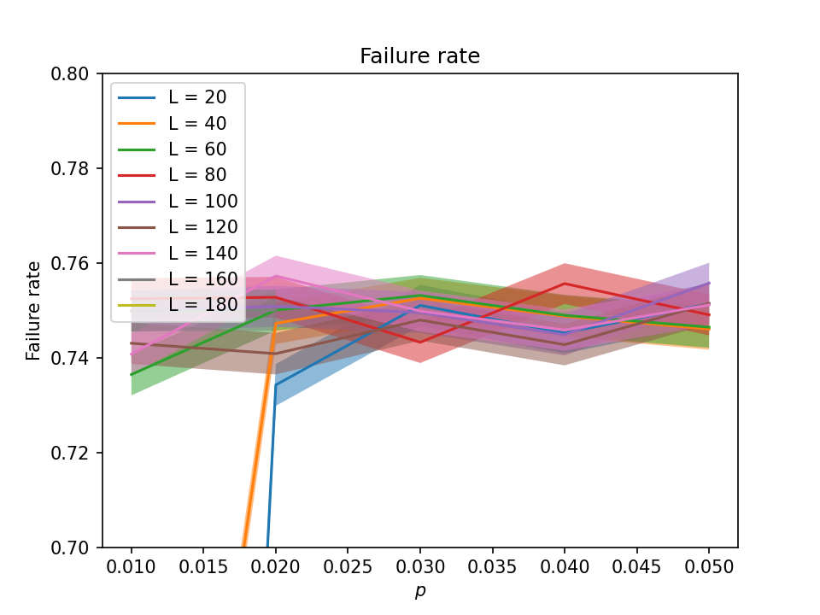
Run 3

Slide 9
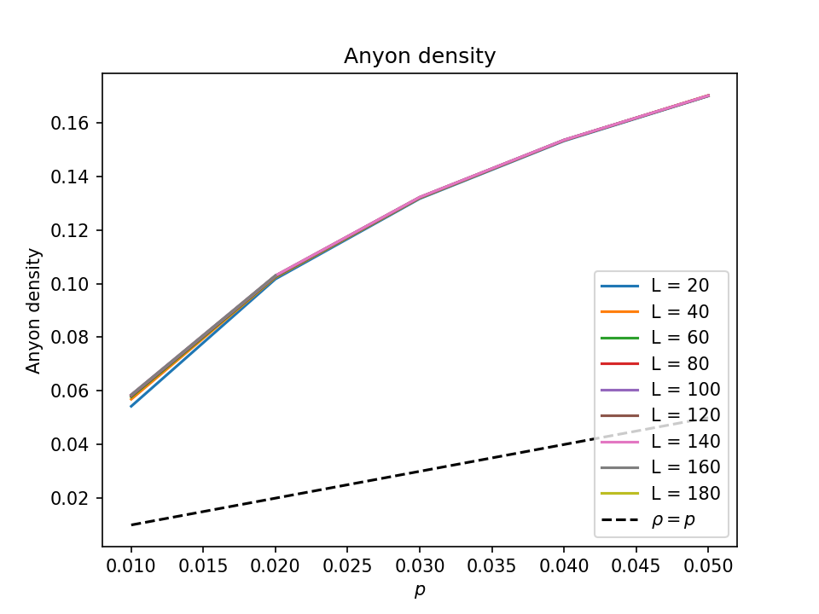
Run 3

Slide 10
Intermission – PyMatching Benchmarking
L | Anyon density | Overhead | Time per shot | Std. dev.
100 | 1% | 11 ms | 1 ms
100 | 5% |  | 2.25 ms
100 | 20% |  | 63.9 ms | 16.5 ms
200 | 1% | 37 ms | 3.11 ms
200 | 5% |  | 8.69 ms
200 | 20% |  | 10.8 s | 16 s
400 | 1% | 165 ms | 12.1 ms
400 | 5% |  | 54 ms
400 | 20% |  | TIMEOUT
Note: PyMatching struggles & performs inconsistently with high values of anyon density
These benchmarking results are averaged over 100 runs.

Slide 11
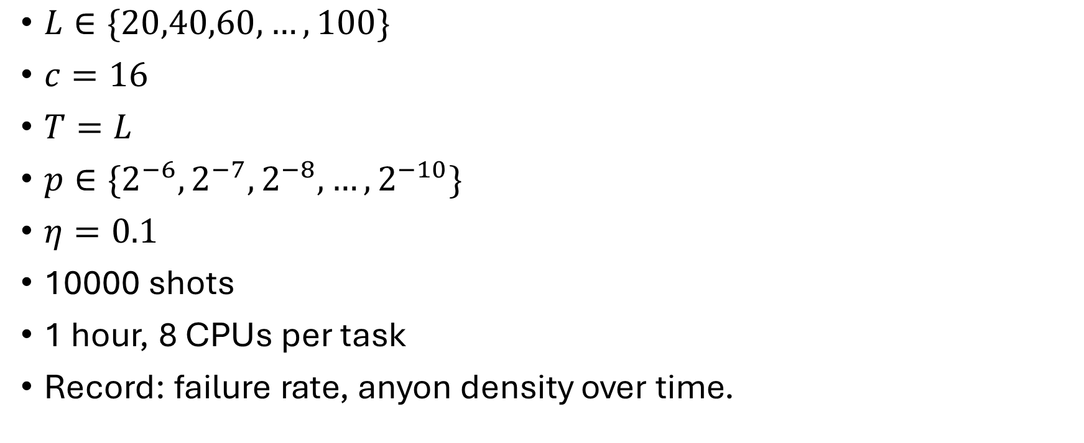
Run 4
$L∈\{20,40,60,…,100\}$
$c=16$
$T=L$
$p∈\{2^{−6},2^{−7},2^{−8},…,2^{−10}\}$
$η=0.1$
10000 shots
1 hour, 8 CPUs per task
Record: failure rate, anyon density over time.

Slide 12
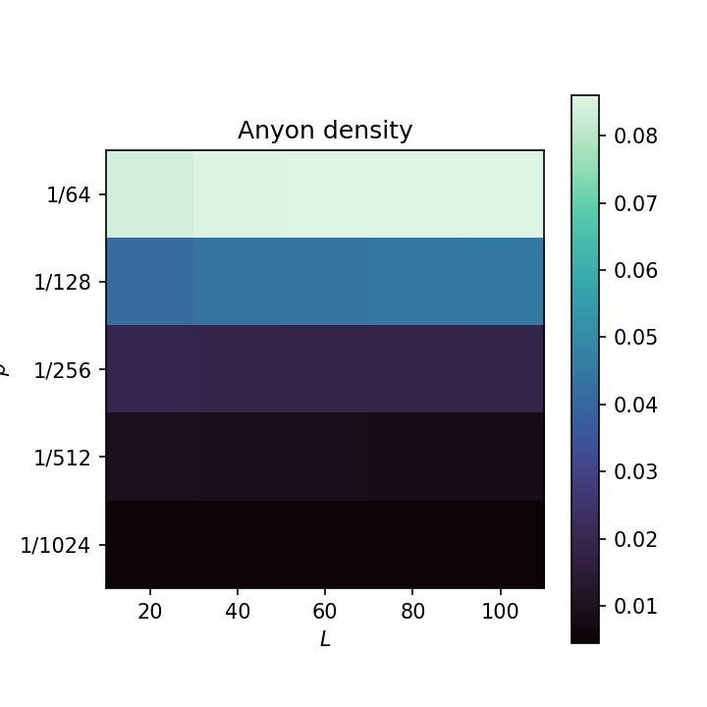
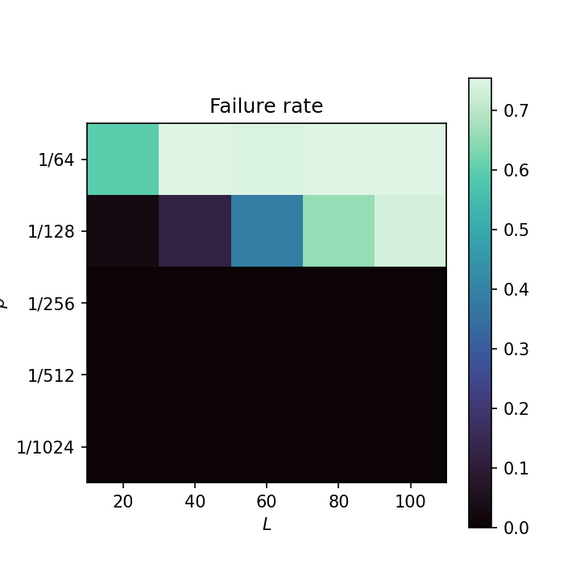
Run 4

Slide 13
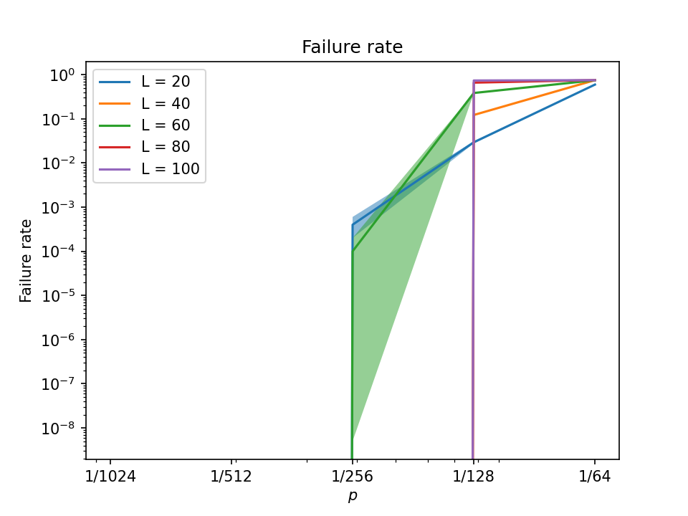
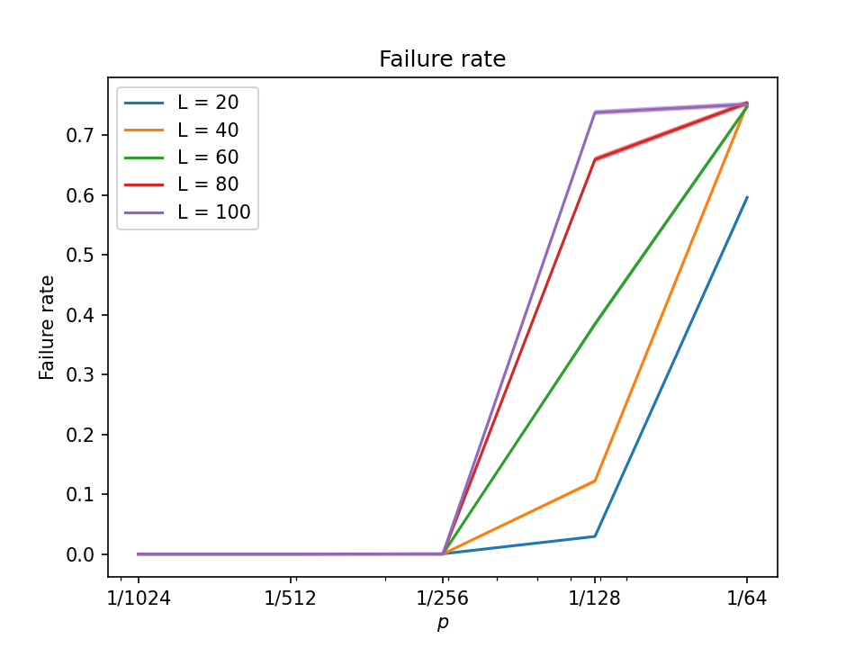
Run 4

Slide 14
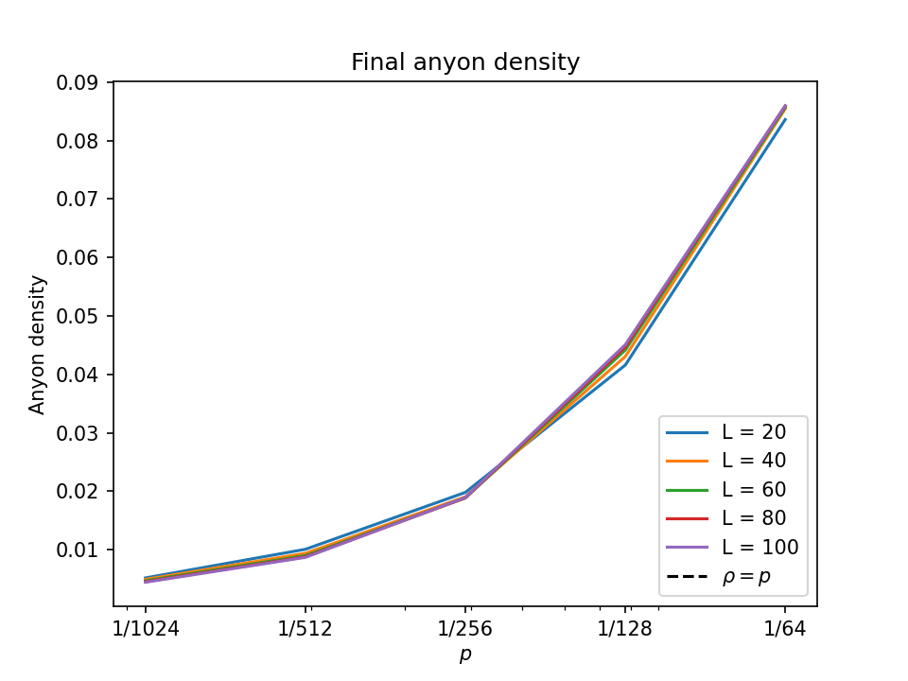
Run 4

Slide 15
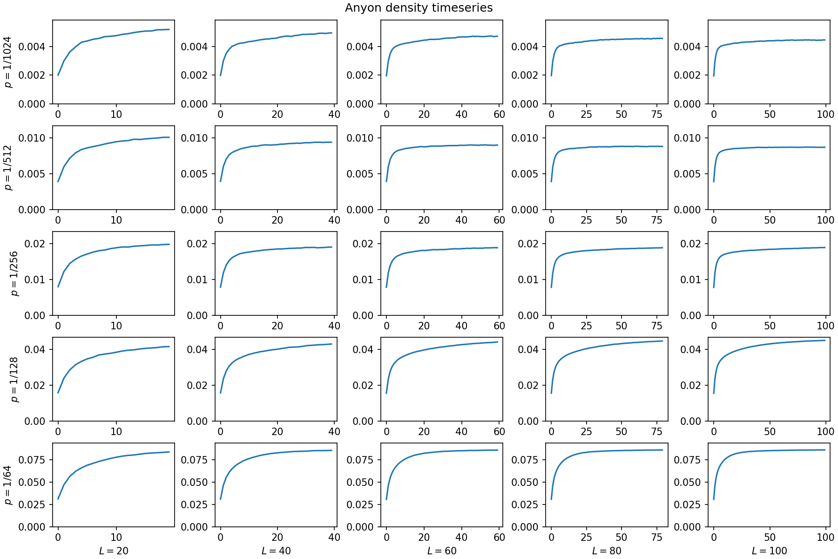
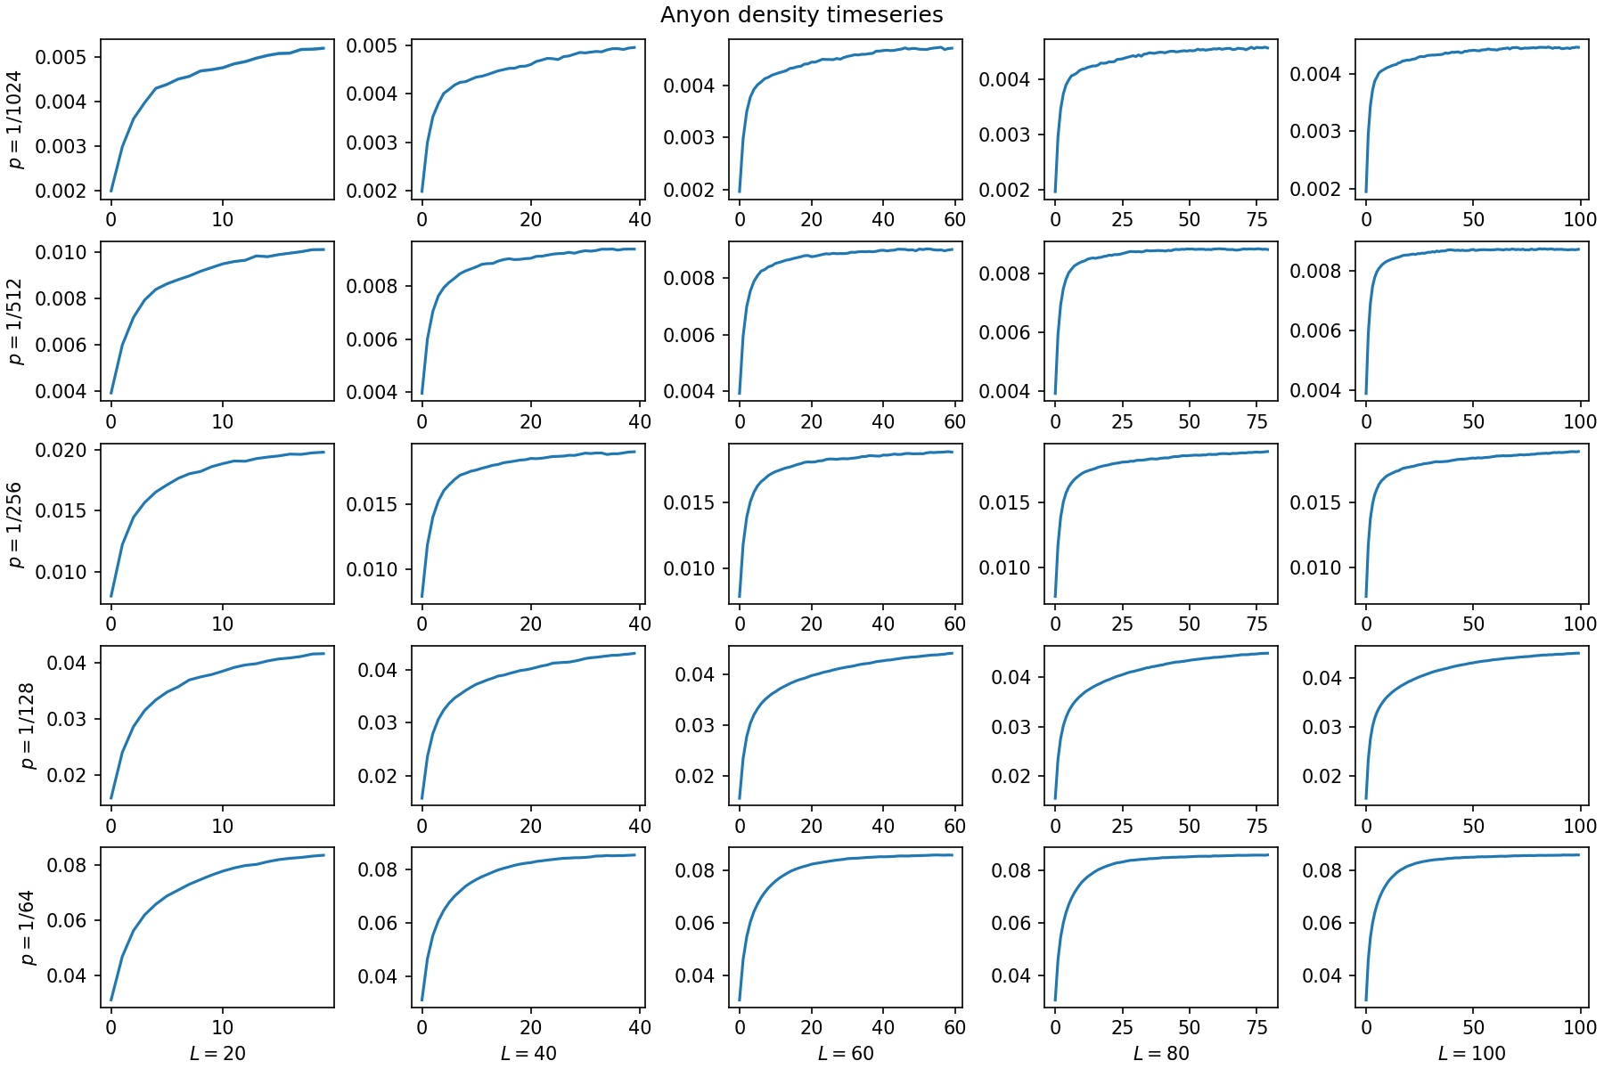
Run 4

Slide 16

Run 5
$L∈\{100,200,300,…,500\}$
$c=16$
$T=L$
$p∈\{2^{−1},2^{−2},2^{−3},…,2^{−10}\}$
$η=0.1$
10000 shots
4 hours, 8 CPUs per task
Record: final anyon density

Slide 17
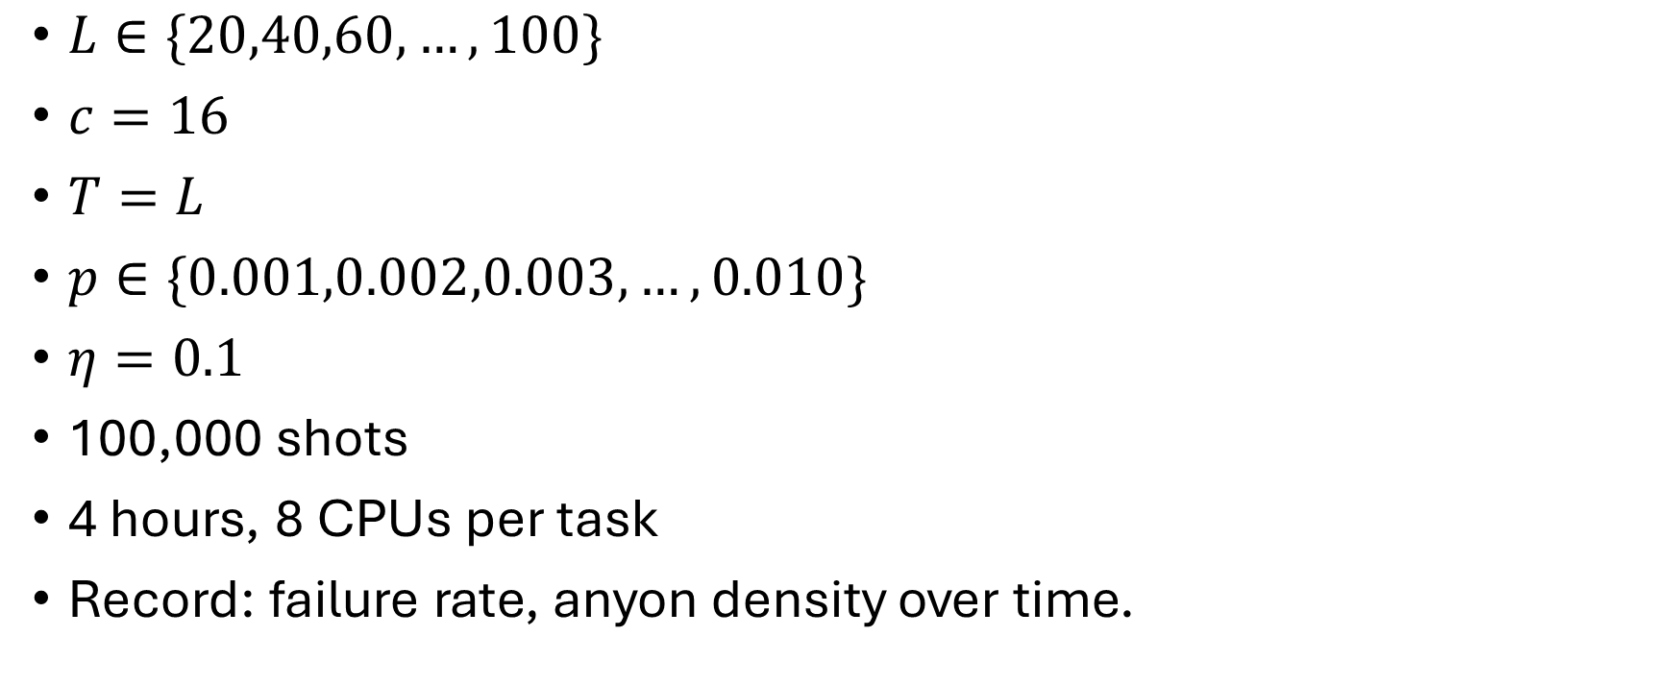
Run 6
$L∈\{20,40,60,…,100\}$
$c=16$
$T=L$
$p∈\{0.001,0.002,0.003,…,0.010\}$
$η=0.1$
100,000 shots
4 hours, 8 CPUs per task
Record: failure rate, anyon density over time.

