Slide 1
Toric Decoder Plots
Daniel Sun

Slide 2

Run 1
$L∈\{20,40,60,80,100\}$
$c∈\{2,4,8,16,32\}$
$T=L$
$p_{\text{initial}}=0.05$
$p_{\text{intermediate}}=0$
$η=0.1$
10000 shots

Slide 3
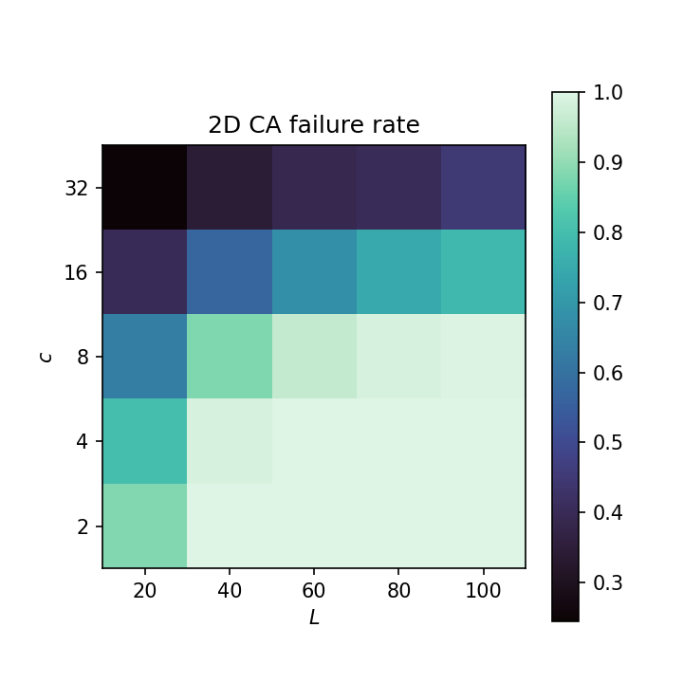
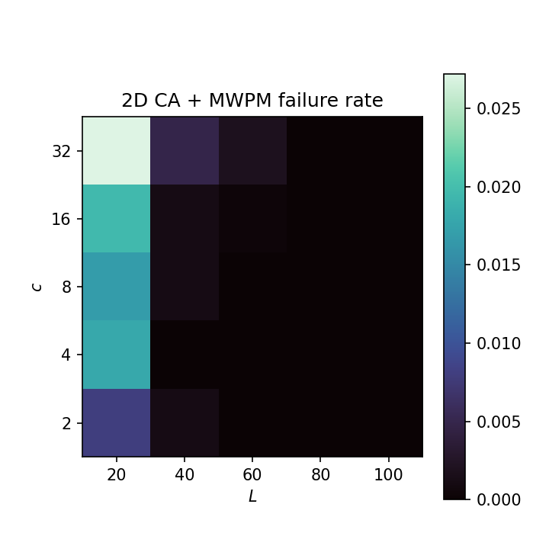
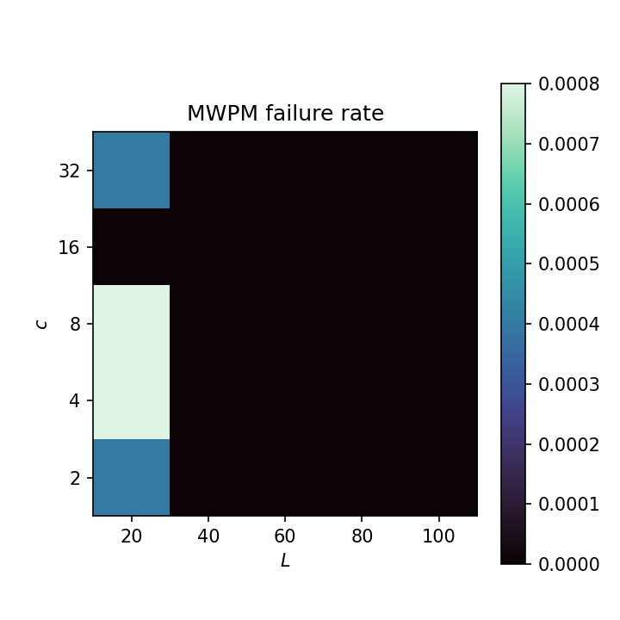
Run 1

Slide 4

Run 2
$L∈\{20,40,60,\backslash dotsc,200\}$
$c∈\{2,4,8,\backslash dotsc,64\}$
$T=L$
$p=0.05$
$η=0.1$
10000 shots
4 hours, 8 CPUs per task

Slide 5
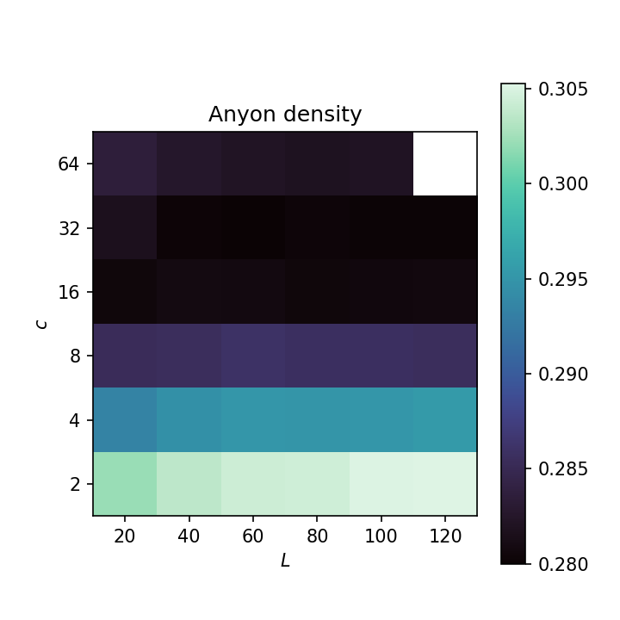
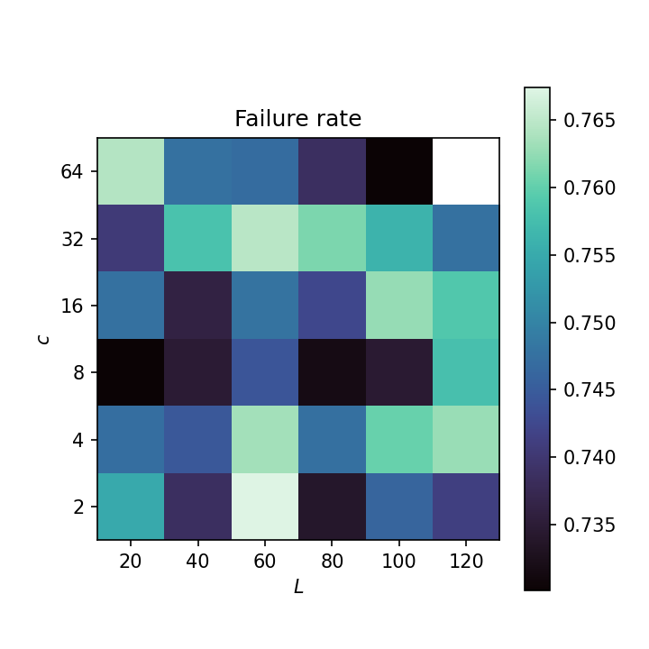
Run 2

Slide 6

Run 3
$L∈\{20,40,60,\backslash dotsc,200\}$
$c=16$
$T=L$
$p∈\{0.01,0.02,0.03,\backslash dotsc,0.05\}$
$η=0.1$
10000 shots
4 hours, 8 CPUs per task

Slide 7
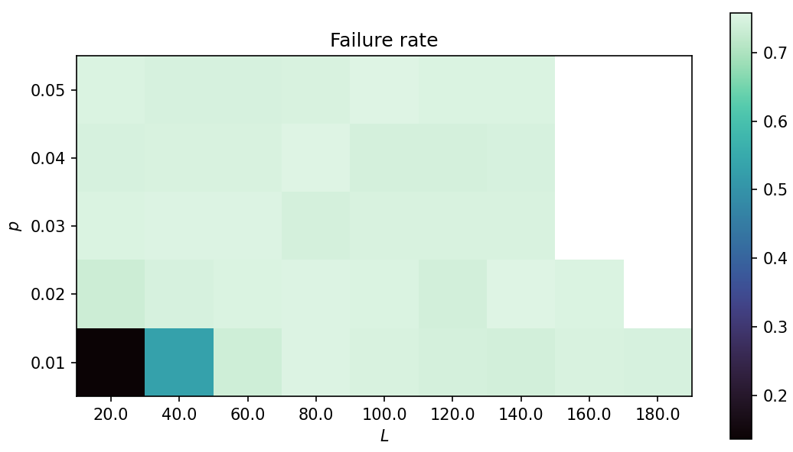
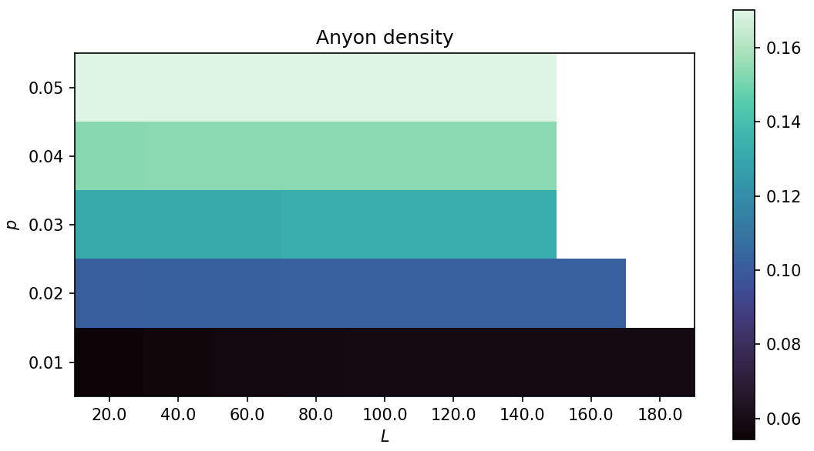
Run 3

Slide 8
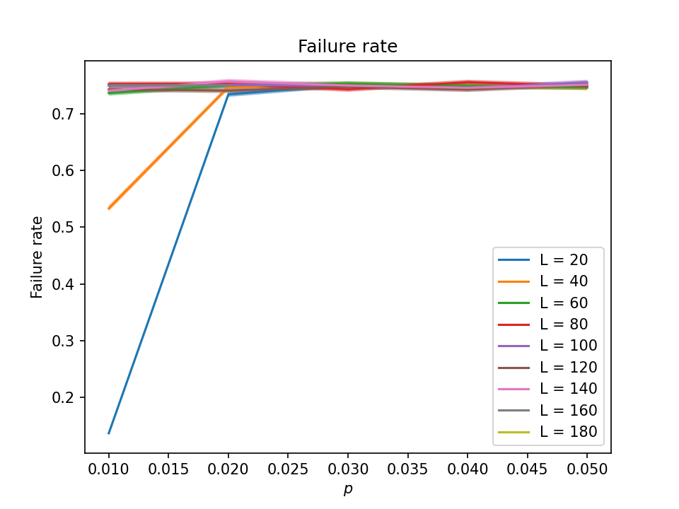
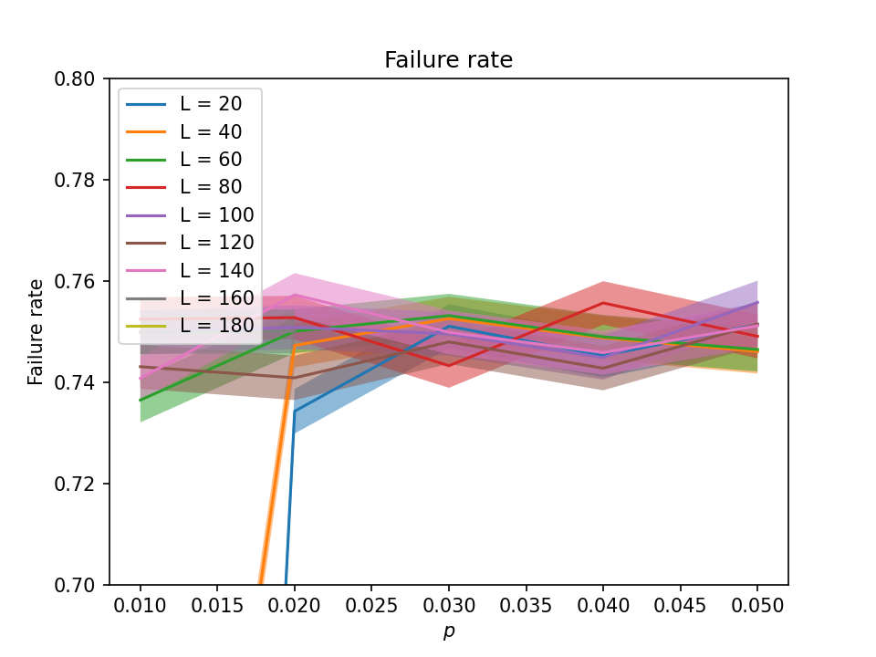
Run 3

Slide 9
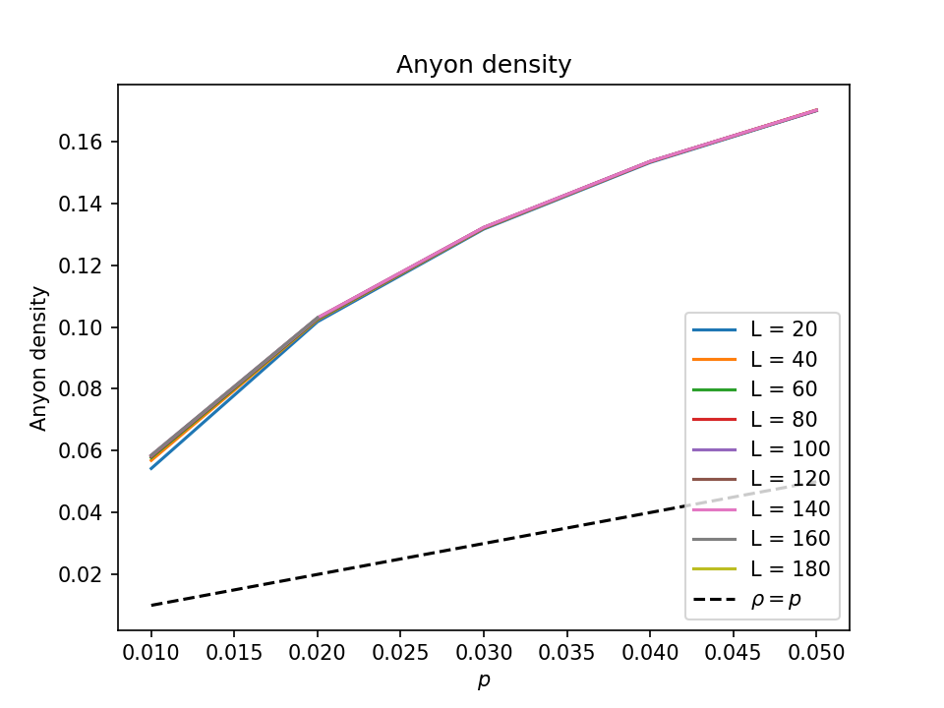
Run 3

