Slide 1
236004: Introduction to Transformers and Attention-based networks
Ablation study for architectures in MDM
Daniel Elgarici, Gil Kizner , Eden Dembinsky
Supervised by Amir Mann
Spring 2025

Slide 2
Project description
Human motion data represents the 3D positions of a person over time, typically formatted as an array of shape (N frames × J joints). Generating and modeling such motions — especially from text prompts — is a key task in computer vision, with applications in gaming, animation, world simulation, robotics, and beyond. A strong baseline for this task is MDM (Motion Diffusion Model), published in late 2022, which uses a diffusion model with a transformer encoder tokenized over frames. However, MDM’s architectural exploration remains preliminary.
This project aims to investigate alternative transformer architectures for motion diffusion, analyzing their impact on generation quality, modeling performance, and robustness

Slide 3
Background
MDM

Slide 4
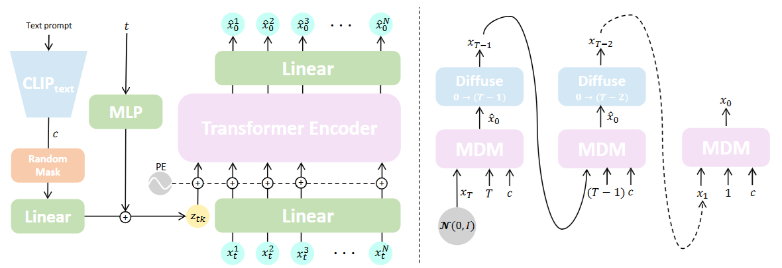
MDM – Motion Diffusion model
MDM, Tevet et al, 2022

Slide 5
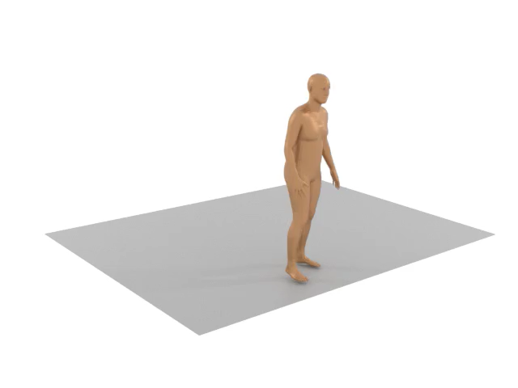
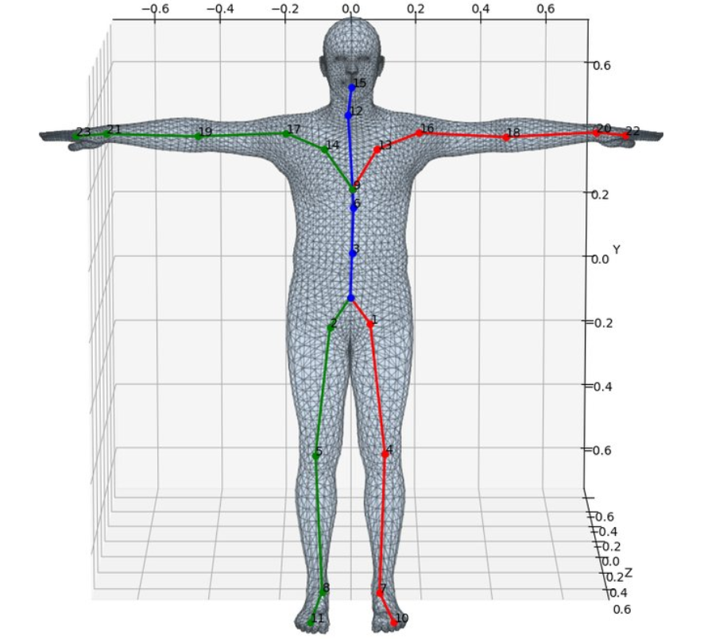
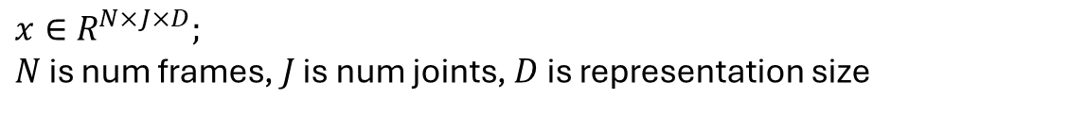
Human Motion

Slide 6
Expected outcome
Training a few variations of MDM with different tokenization, attention mechanisms or transformer architectures showing their results. Can also include mathematical analysis of the tokenization meaning for training and generation (or lack thereof).

Slide 7
Transformer architecture ablation is missing
Cross attention with the text input
Sequence tokenizing for the transformer:
  Over time (in paper)
  Over joints
  Combinations
Encoder vs Decoder vs Encoder Decoder

