Slide 1
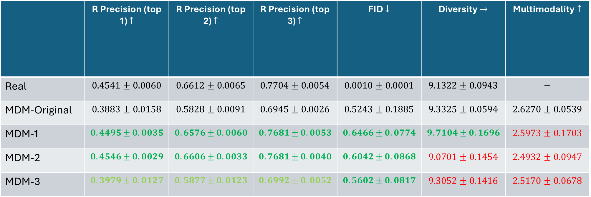
 | R Precision (top 1) $↑$ | R Precision (top 2) $↑$ | R Precision (top 3) $↑$ | FID $↓$ | Diversity $→$ | Multimodality $↑$
Real | $$0.4541±0.0060$$ | $$0.6612±0.0065$$ | $$0.7704±0.0054$$ | $$0.0010±0.0001$$ | $$9.1322±0.0943$$ | $$−$$
MDM-Original | $$0.3883±0.0158$$ | $$0.5828±0.0091$$ | $$0.6945±0.0026$$ | $$0.5243±0.1885$$ | $$9.3325±0.0594$$ | $$2.6270±0.0539$$
MDM-1 | $$0.4495±0.0035$$ | $$0.6576±0.0060$$ | $$0.7681±0.0053$$ | $$0.6466±0.0774$$ | $$9.7104±0.1696$$ | $$2.5973±0.1703$$
MDM-2 | $$0.4546±0.0029$$ | $$0.6606±0.0033$$ | $$0.7681±0.0040$$ | $$0.6042±0.0868$$ | $$9.0701±0.1454$$ | $$2.4932±0.0947$$
MDM-3 | $$0.3979±0.0127$$ | $$0.5877±0.0123$$ | $$0.6992±0.0052$$ | $$0.5602±0.0817$$ | $$9.3052±0.1416$$ | $$2.5170±0.0678$$
1. DiT Block with adaLN-Zero
2. DiT Block with Cross-Attention
3. DiT Block with In-Context Conditioning

Slide 2
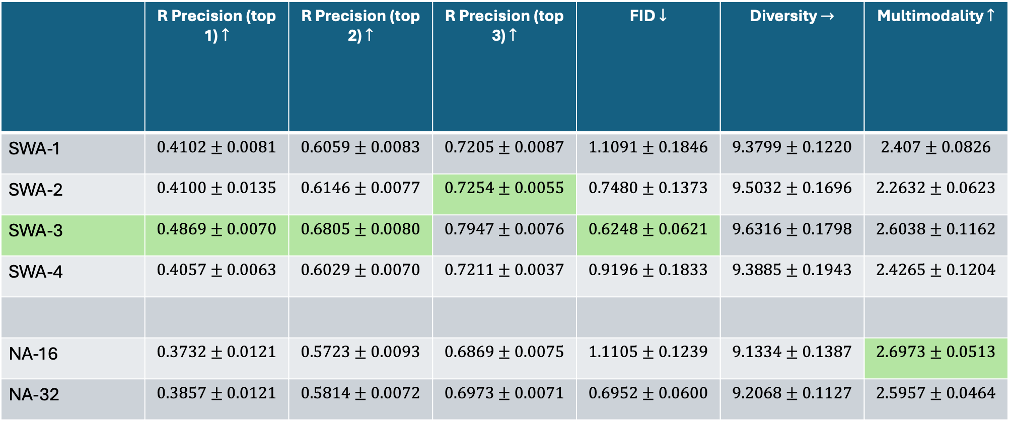
 | R Precision (top 1) $↑$ | R Precision (top 2) $↑$ | R Precision (top 3) $↑$ | FID $↓$ | Diversity $→$ | Multimodality $↑$
SWA-1 | $$0.4102±0.0081$$ | $$0.6059±0.0083$$ | $$0.7205±0.0087$$ | $$1.1091±0.1846$$ | $$9.3799±0.1220$$ | $$2.407±0.0826$$
SWA-2 | $$0.4100±0.0135$$ | $$0.6146±0.0077$$ | $$0.7254±0.0055$$ | $$0.7480±0.1373$$ | $$9.5032±0.1696$$ | $$2.2632±0.0623$$
SWA-3 | $$0.4869±0.0070$$ | $$0.6805±0.0080$$ | $$0.7947±0.0076$$ | $$0.6248±0.0621$$ | $$9.6316±0.1798$$ | $$2.6038±0.1162$$
SWA-4 | $$0.4057±0.0063$$ | $$0.6029±0.0070$$ | $$0.7211±0.0037$$ | $$0.9196±0.1833$$ | $$9.3885±0.1943$$ | $$2.4265±0.1204$$
NA-16 | $$0.3732±0.0121$$ | $$0.5723±0.0093$$ | $$0.6869±0.0075$$ | $$1.1105±0.1239$$ | $$9.1334±0.1387$$ | $$2.6973±0.0513$$
NA-32 | $$0.3857±0.0121$$ | $$0.5814±0.0072$$ | $$0.6973±0.0071$$ | $$0.6952±0.0600$$ | $$9.2068±0.1127$$ | $$2.5957±0.0464$$
SWA = Sliding Window Attention
1. Window size = 4
2. Window size = 8
3. Window size = 12
4. Window size = 16
NA = Neighborhood Attention

Slide 3
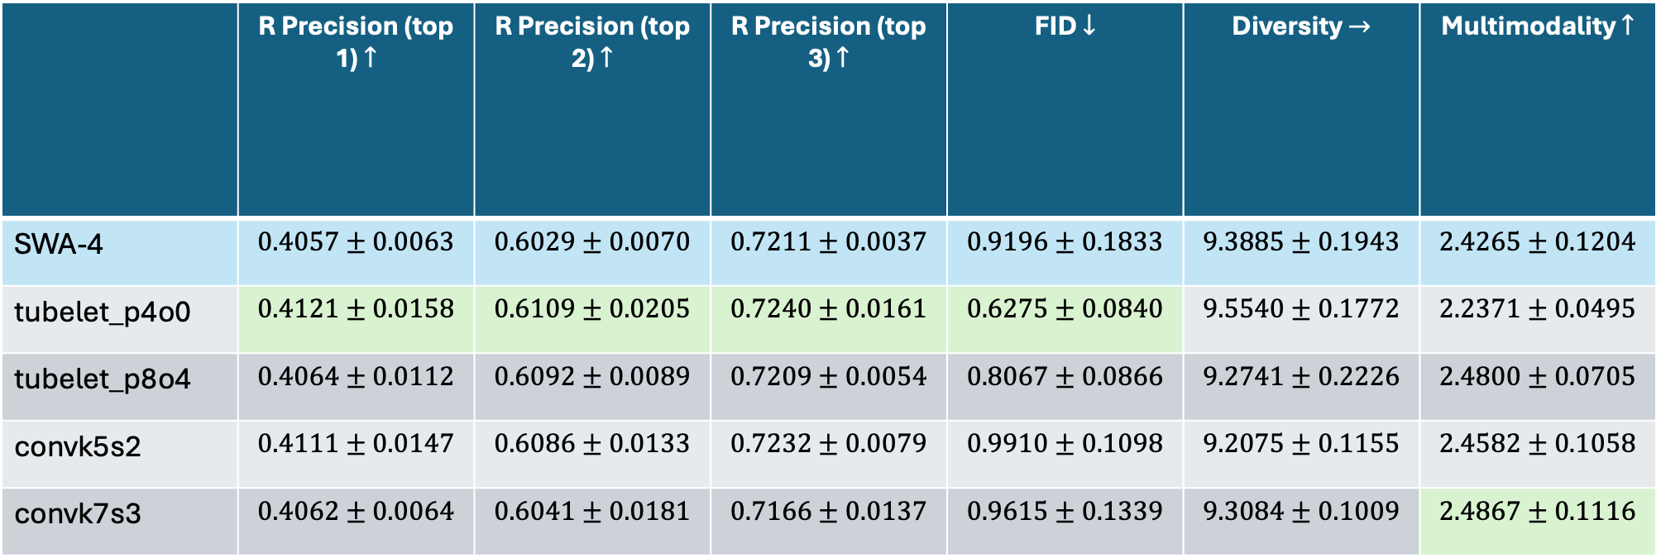
 | R Precision (top 1) $↑$ | R Precision (top 2) $↑$ | R Precision (top 3) $↑$ | FID $↓$ | Diversity $→$ | Multimodality $↑$
SWA-4 | $$0.4057±0.0063$$ | $$0.6029±0.0070$$ | $$0.7211±0.0037$$ | $$0.9196±0.1833$$ | $$9.3885±0.1943$$ | $$2.4265±0.1204$$
tubelet_p4o0 | $$0.4121±0.0158$$ | $$0.6109±0.0205$$ | $$0.7240±0.0161$$ | $$0.6275±0.0840$$ | $$9.5540±0.1772$$ | $$2.2371±0.0495$$
tubelet_p8o4 | $$0.4064±0.0112$$ | $$0.6092±0.0089$$ | $$0.7209±0.0054$$ | $$0.8067±0.0866$$ | $$9.2741±0.2226$$ | $$2.4800±0.0705$$
convk5s2 | $$0.4111±0.0147$$ | $$0.6086±0.0133$$ | $$0.7232±0.0079$$ | $$0.9910±0.1098$$ | $$9.2075±0.1155$$ | $$2.4582±0.1058$$
convk7s3 | $$0.4062±0.0064$$ | $$0.6041±0.0181$$ | $$0.7166±0.0137$$ | $$0.9615±0.1339$$ | $$9.3084±0.1009$$ | $$2.4867±0.1116$$
Window size = 16

