Slide 1
UniSystems Walkthrough
SOFT252

Slide 2
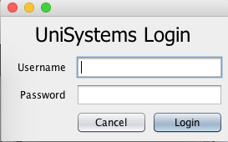
Login Screen
An administrator can login to the system using their username, which is their staff reference number, and their password. Press enter to login. For demonstration purposes, use ‘admin’ and ‘password’ to login.

Slide 3
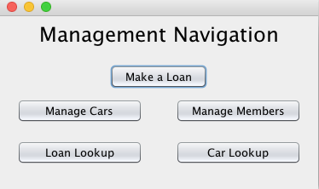
Navigation Screen
As seen above, the navigation screen is simple and easy to use. The user can access all functionality from this screen.

Slide 4
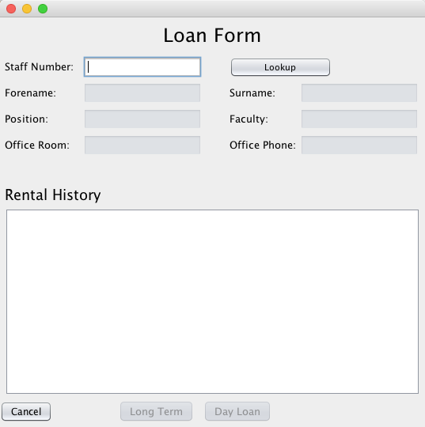
Loan Form
By clicking the ‘Make a Loan’ button from the navigation screen, the user is directed to this form. The user can search for a staff member by entering their staff number and clicking the ‘Lookup’ button.

Slide 5
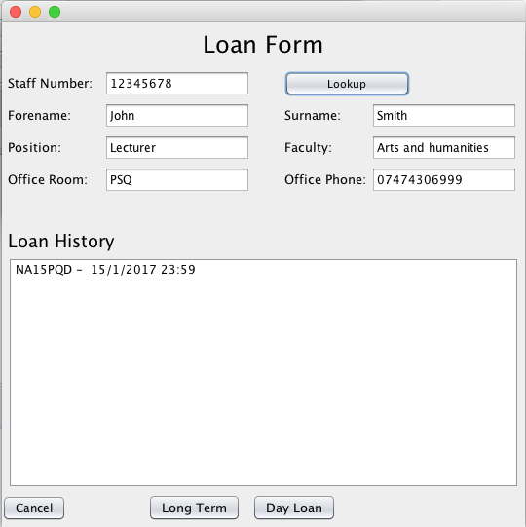
Loan Form
Clicking ‘Lookup’ populates the text fields below showing some information about the staff member selected. A history of all the cars that the staff member has loaned out is shown in a list. The user can then assign a car to the staff member by clicking on either the ‘Long Term’ or ’Day Loan’ button.

Slide 6
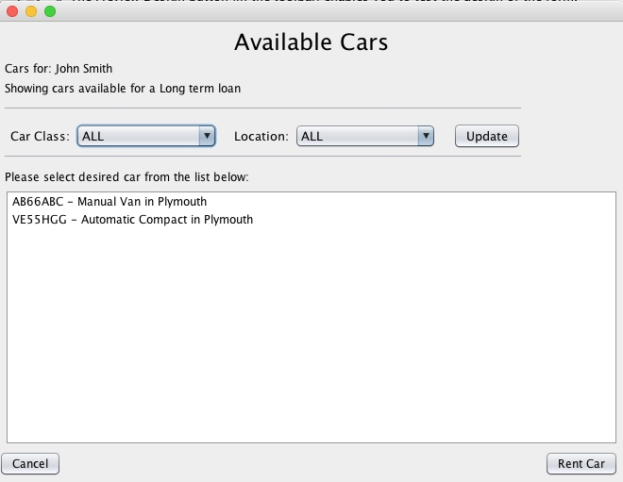
Available Cars
By clicking the ’Long Term’ button in the previous form, the user is taken to the Available Cars form which shows all the available long term cars for the staff member. The user can also filter the list by car class or location using either one of the two or both combo boxes and clicking update.

Slide 7
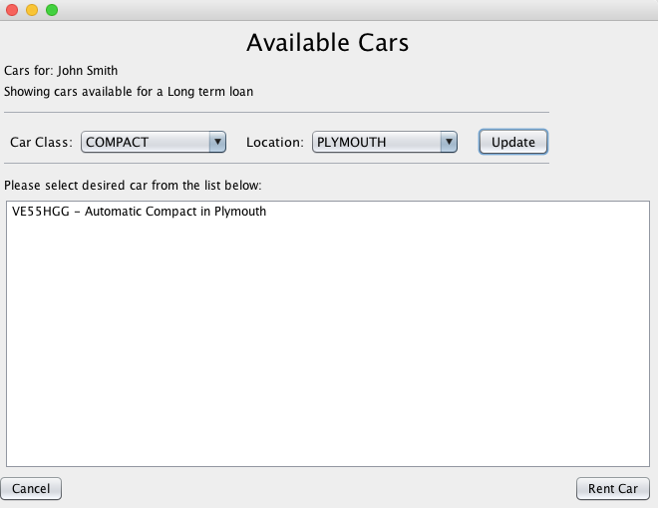
Available Cars – Filtering cars
By selecting compact as the car class and Plymouth as the location of the car using the combo boxes, the user is shows all compact cars that are located in Plymouth. The user can then rent a car for the staff member by selecting a car from the list and clicking the ‘Rent Car’ button.

Slide 8
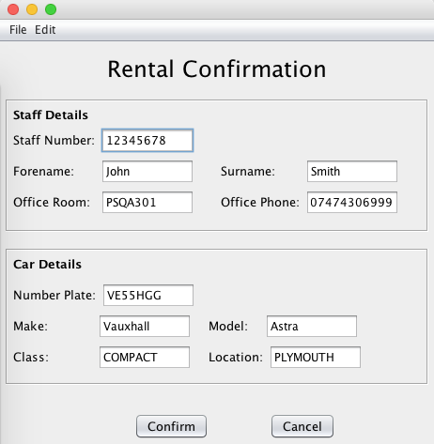
Rental Confirmation
The user is then taken to rental confirmation form where they the details for the staff member and the car that they are loaning out. By clicking the ’Confirm’ button, the user can confirm the assignment of the selected car to the selected staff member. The loan form is then shown with the updated loan history for the staff member showing the car that can just been loaned.

Slide 9
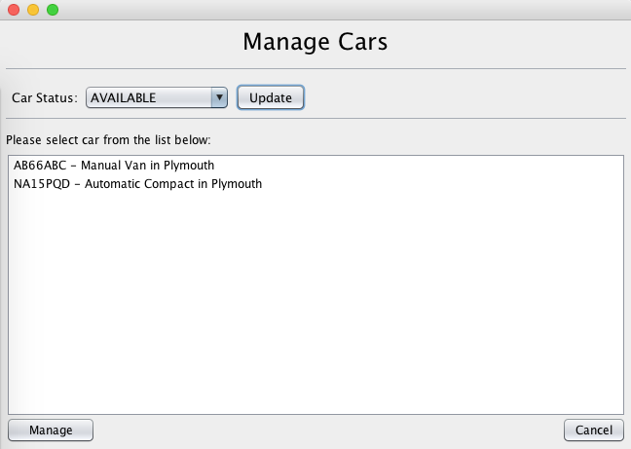
Manage Cars
By selecting the ‘Manage Cars’ option from the management navigation, the Manage Cars form is then shown. The user can filter the cars shown in the list by selecting a status from the combo box and clicking update. Selecting ’Available’ shows all the cars that are available to be hired. The user can then select a desired car from the list and click the Manage button where they will be taken to the Car’s page.

Slide 10
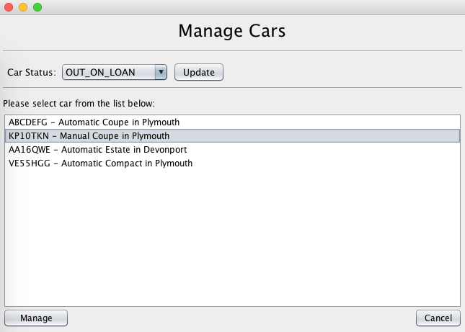
Manage Cars
Selecting ’Out on Loan’ from the combo box shows all the cars that are currently loaned out. The user can then select a desired car from the list and click the Manage button where they will be taken to the Car’s page.

Slide 11
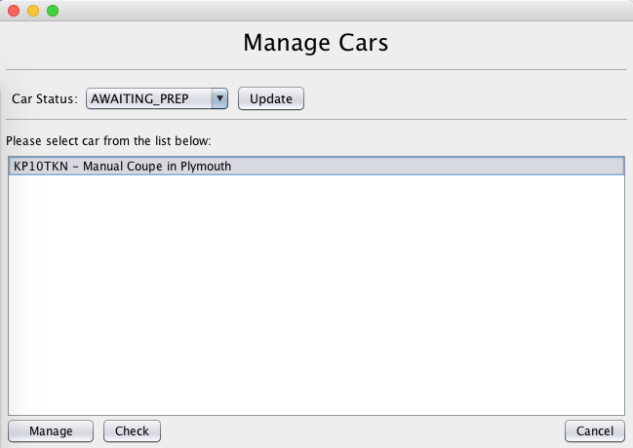
Manage Car
Selecting ‘Awaiting Prep’ from the combo box shows all the cars that have recently been returned and are now awaiting to be checked and prepared for rental. The user can then select a desired car from the list and click the Manage button where they will be taken to the Car’s page. They can also click the Check button in order to check in and prepare the selected car. This will take them to the Car check in page.

Slide 12
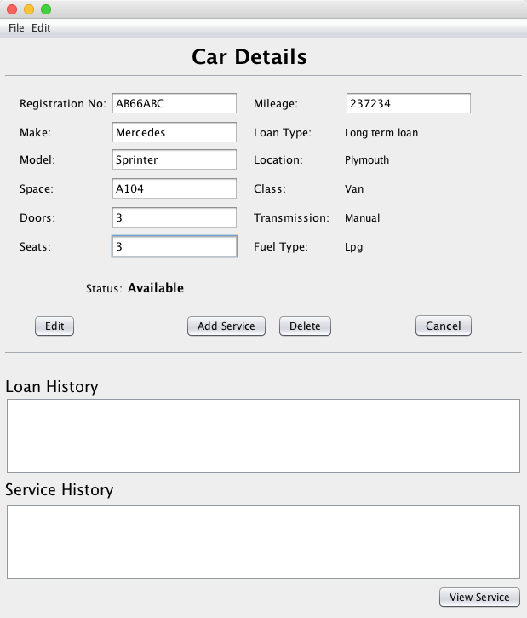
Car Details
The Manage Car button from the previous form will take the user to the Car Details form. On this form the user is able to view, update and delete the car and add a service to the car. The user is also able to view the loan and service history and view a specific service and repairs.

Slide 13
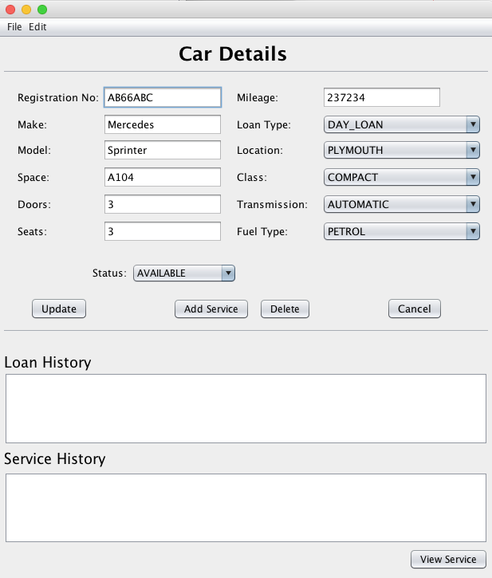
Car Details
When the user clicks the edit button, the fields change to editable text boxes and combo boxes allowing the user to amend any detail of the car. The changes are then saved by clicking the Update button. An action such as deleting a car can be undone or redone by selecting undo or redo from the edit menu.

Slide 14
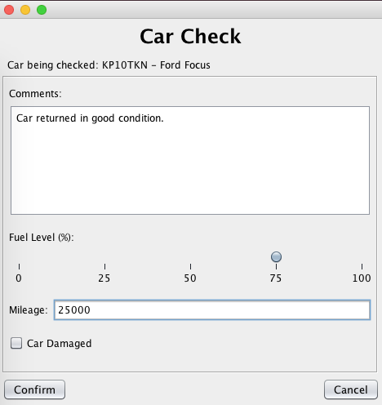
Car Check
For a car awaiting prep, clicking the ‘Check’ button from the Manage Cars form will take the user to the Car Check form where they can approve the car to become available to be loaned out. The user can enter comments, fuel level and mileage about the car after it has been returned. If the car has been damaged, the user can tick the Car Damaged box which will set the car’s status to ‘Damaged’, requiring the car to be repaired.

Slide 15
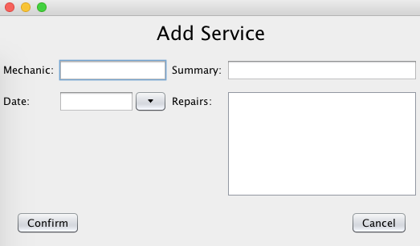
Add Service
By clicking the Add Service button from the previous form, the user is shown a form where they can enter information about a service such as the mechanic, summary, date and repairs.

Slide 16
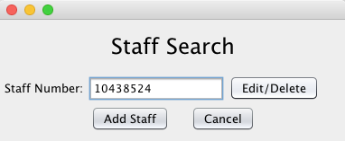
Staff Search
The user can search for staff members using their staff number by selecting the Manage Members option from the management navigation page. The user can either edit, delete or add a staff member by selecting one of the options from this form.

Slide 17
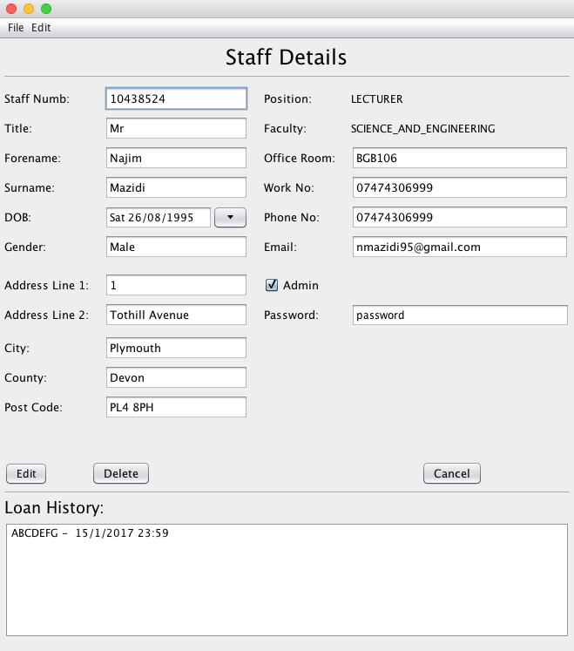
Staff Details
The Edit/Delete button from the previous form will take the user to the Staff Details form. On this form the user is able to view, update and delete the staff member. The user is also able to view the loan history. If the staff member is an administrator of the system, the user can change the password or take away their admin privileges.

Slide 18
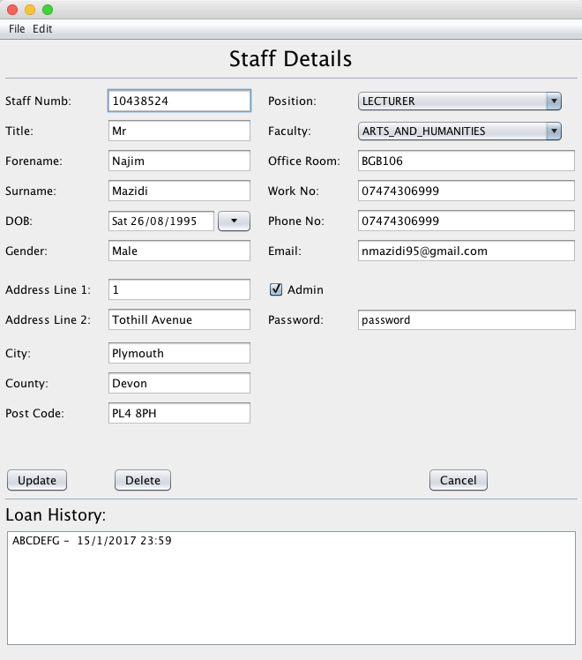
Staff Details
When the user clicks the edit button, the fields change to editable text boxes and combo boxes allowing the user to amend any detail of the staff member. The changes are then saved by clicking the Update button. An action such as deleting a staff member can be undone or redone by selecting undo or redo from the edit menu.

Slide 19
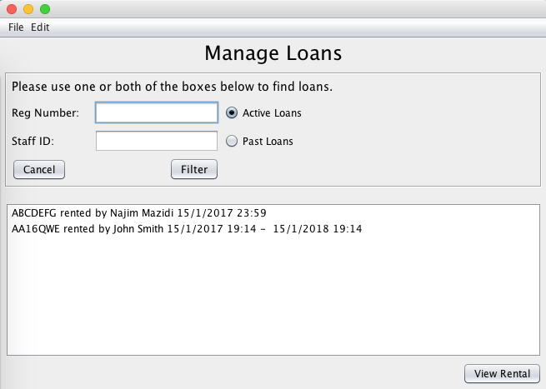
Manage Loans
The user can manage active or past loans by selecting the Loan Lookup option from the management navigation menu. The user can filter the loans shown in the list by either searching by reg number, staff ID or both and clicking Filter. A selected loan on the list can be viewed in detail and returned by clicking View Rental.

Slide 20
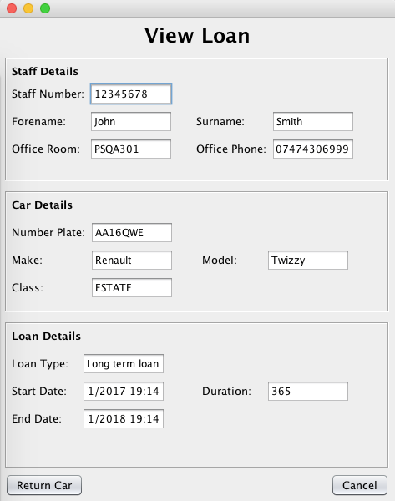
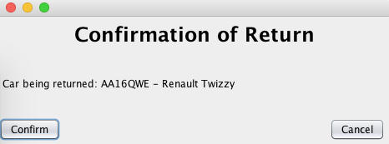
View/Return Loan
By clicking View Rental from the previous form, the View Loan form is shown. The user can view the details of the staff member that has taken out the loan, the details of the car that has been loaned and details of loan such as loan type, start date, etc. The car can be returned by pressing the Return Car button. The user will be asked to confirm the return of the car as shown below.

Slide 21
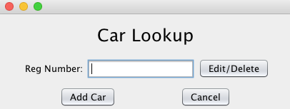
Car Lookup
The user can search for cars using the registration number by selecting the Car Lookup option from the management navigation page. The user can either edit, delete or add a car by selecting one of the options from this form and will be taken to the Car Details form show in previous slides..

