Slide 1
UniSystems Walkthrough
SOFT252

Slide 2
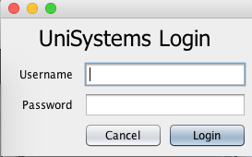
Login Screen
An administrator can login to the system using their username, which is their staff reference number, and their password. Press enter to login. For demonstration purposes, use ‘admin’ and ‘password’ to login.

Slide 3
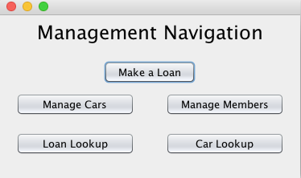
Navigation Screen
As seen above, the navigation screen is simple and easy to use. The user can access all functionality from this screen.

Slide 4
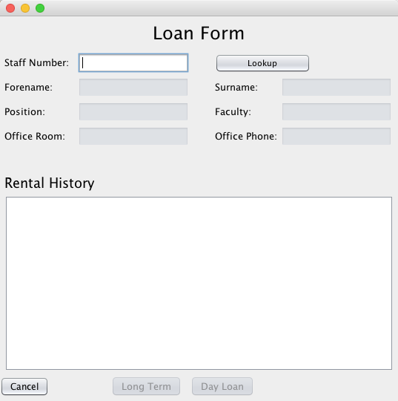
Loan Form
By clicking the ‘Make a Loan’ button from the navigation screen, the user is directed to this form. The user can search for a staff member by entering their staff number and clicking the ‘Lookup’ button.

Slide 5
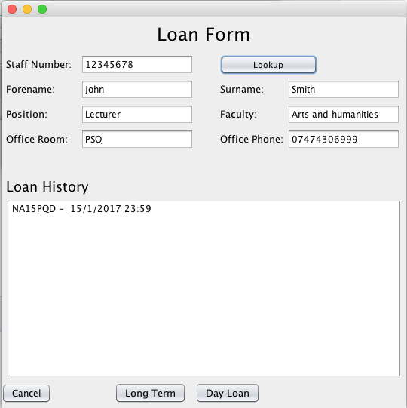
Loan Form
Clicking ‘Lookup’ populates the text fields below showing some information about the staff member selected. A history of all the cars that the staff member has loaned out is shown in a list. The user can then assign a car to the staff member by clicking on either the ‘Long Term’ or ’Day Loan’ button.

Slide 6
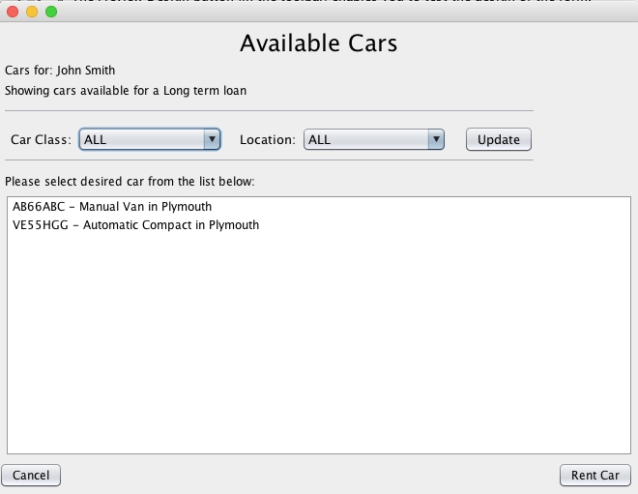
Available Cars
By clicking the ’Long Term’ button in the previous form, the user is taken to the Available Cars form which shows all the available long term cars for the staff member. The user can also filter the list by car class or location using either one of the two or both combo boxes and clicking update.

Slide 7
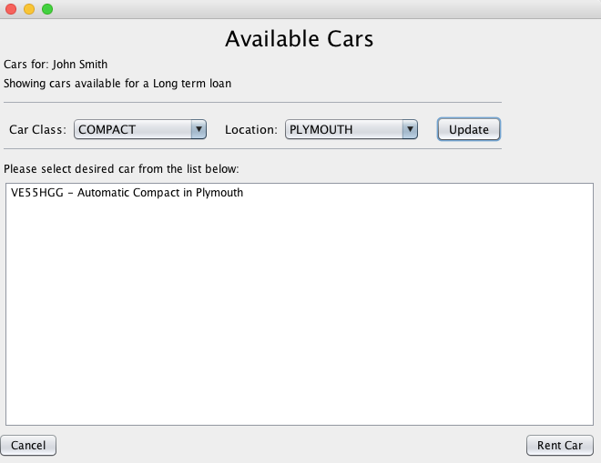
Available Cars – Filtering cars
By selecting compact as the car class and Plymouth as the location of the car using the combo boxes, the user is shows all compact cars that are located in Plymouth. The user can then rent a car for the staff member by selecting a car from the list and clicking the ‘Rent Car’ button.

Slide 8
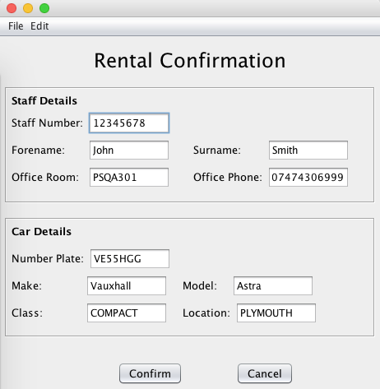
Rental Confirmation
The user is then taken to rental confirmation form where they the details for the staff member and the car that they are loaning out. By clicking the ’Confirm’ button, the user can confirm the assignment of the selected car to the selected staff member. The loan form is then shown with the updated loan history for the staff member showing the car that can just been loaned.

Slide 9
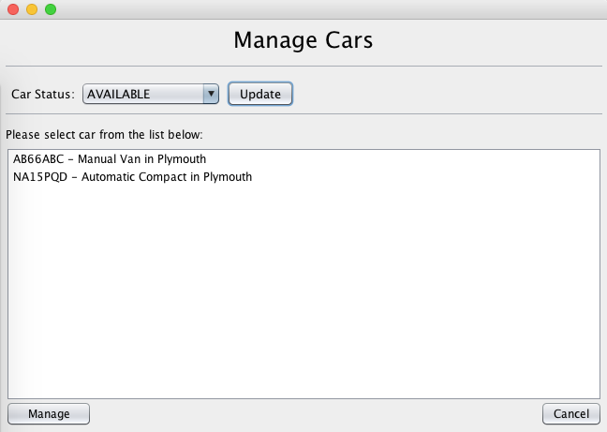
Manage Cars
By selecting the ‘Manage Cars’ option from the management navigation, the Manage Cars form is then shown. The user can filter the cars shown in the list by selecting a status from the combo box and clicking update. Selecting ’Available’ shows all the cars that are available to be hired. The user can then select a desired car from the list and click the Manage button where they will be taken to the Car’s page.

Slide 10
Manage Car
By clicking the ’Long Term’ button in the previous form, the user is taken to the Available Cars form which shows all the available long term cars for the staff member. The user can also filter the list by car class or location using either one of the two or both combo boxes and clicking update.

