Slide 1
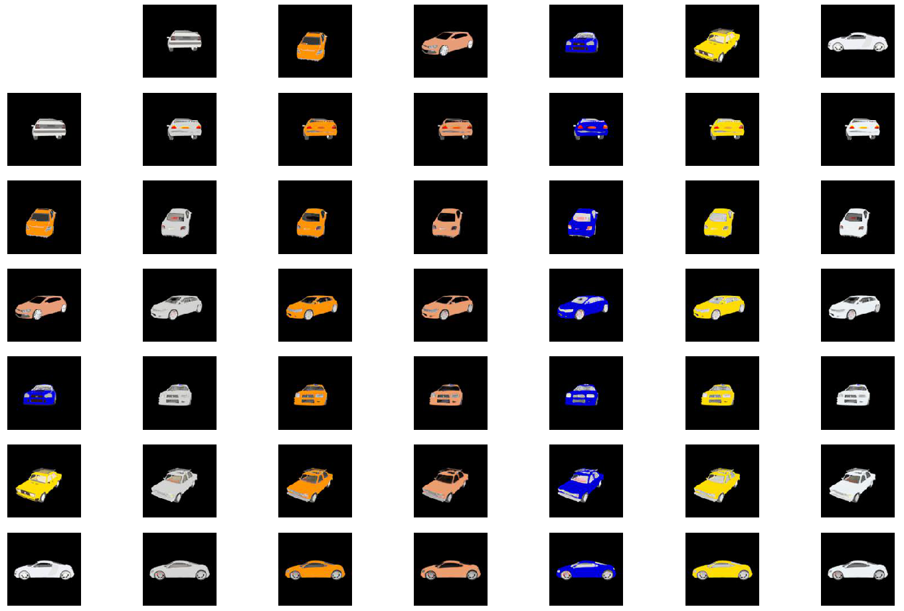
style input
content input

Slide 2
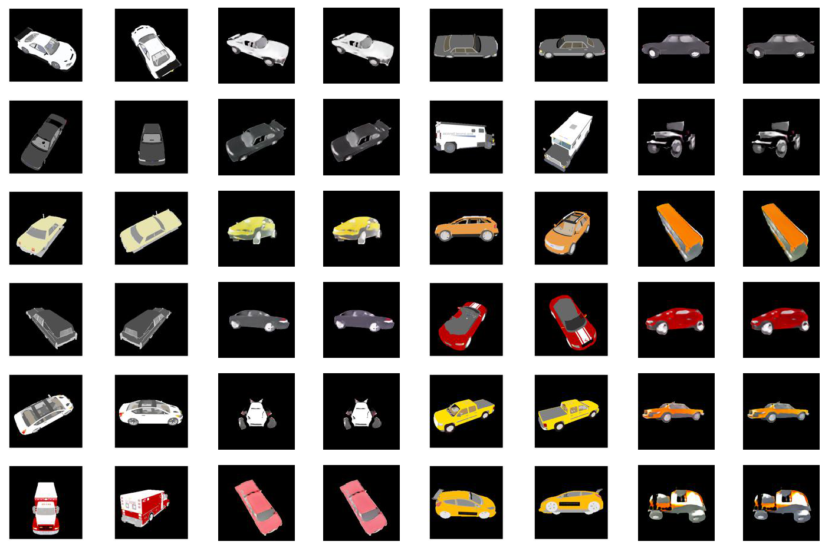
input1 input2 output1 output2
input1 input2 output1 output2

Slide 3
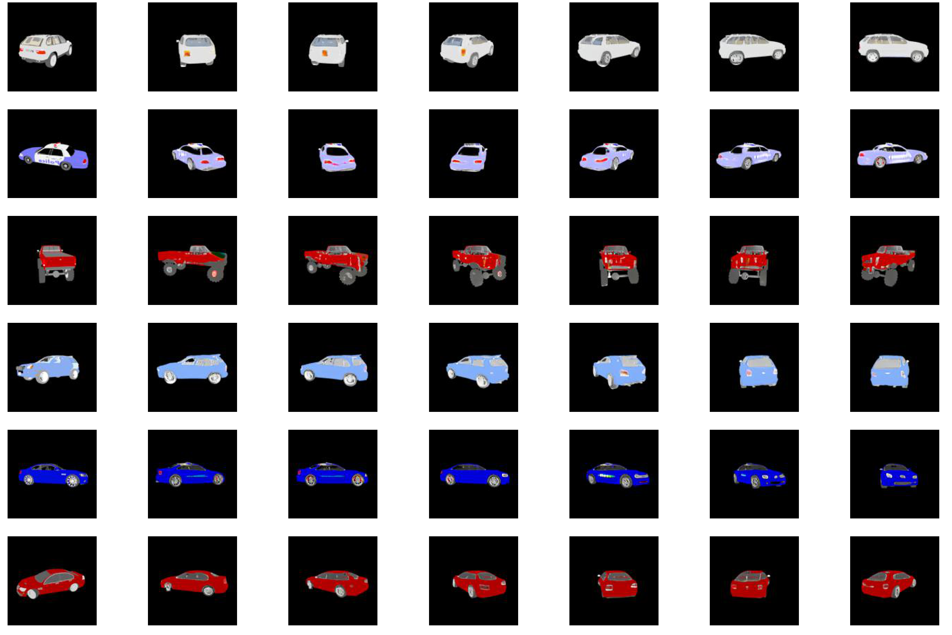
input output

Slide 4
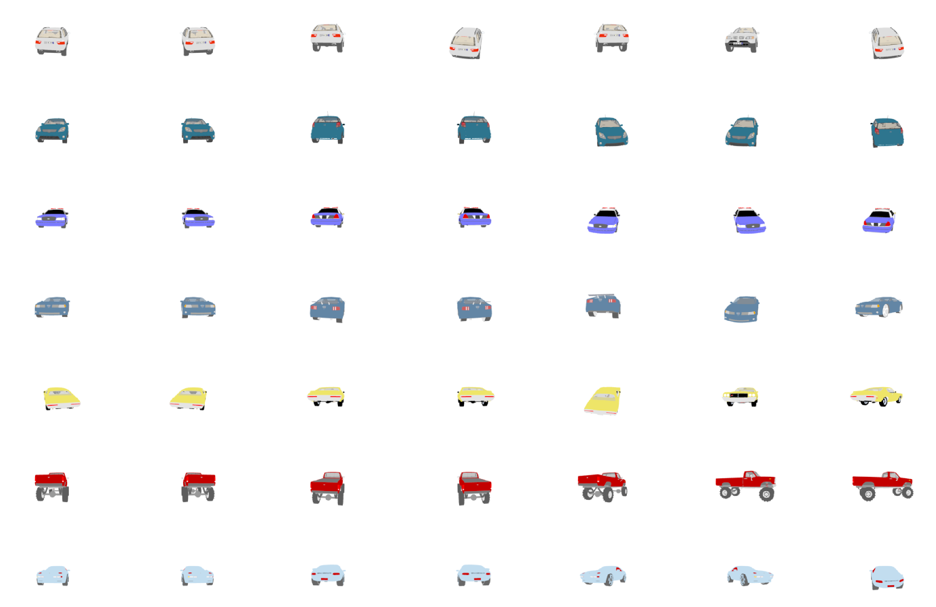
1st 2nd 3rd 4th 5th 6th 7th

Slide 5
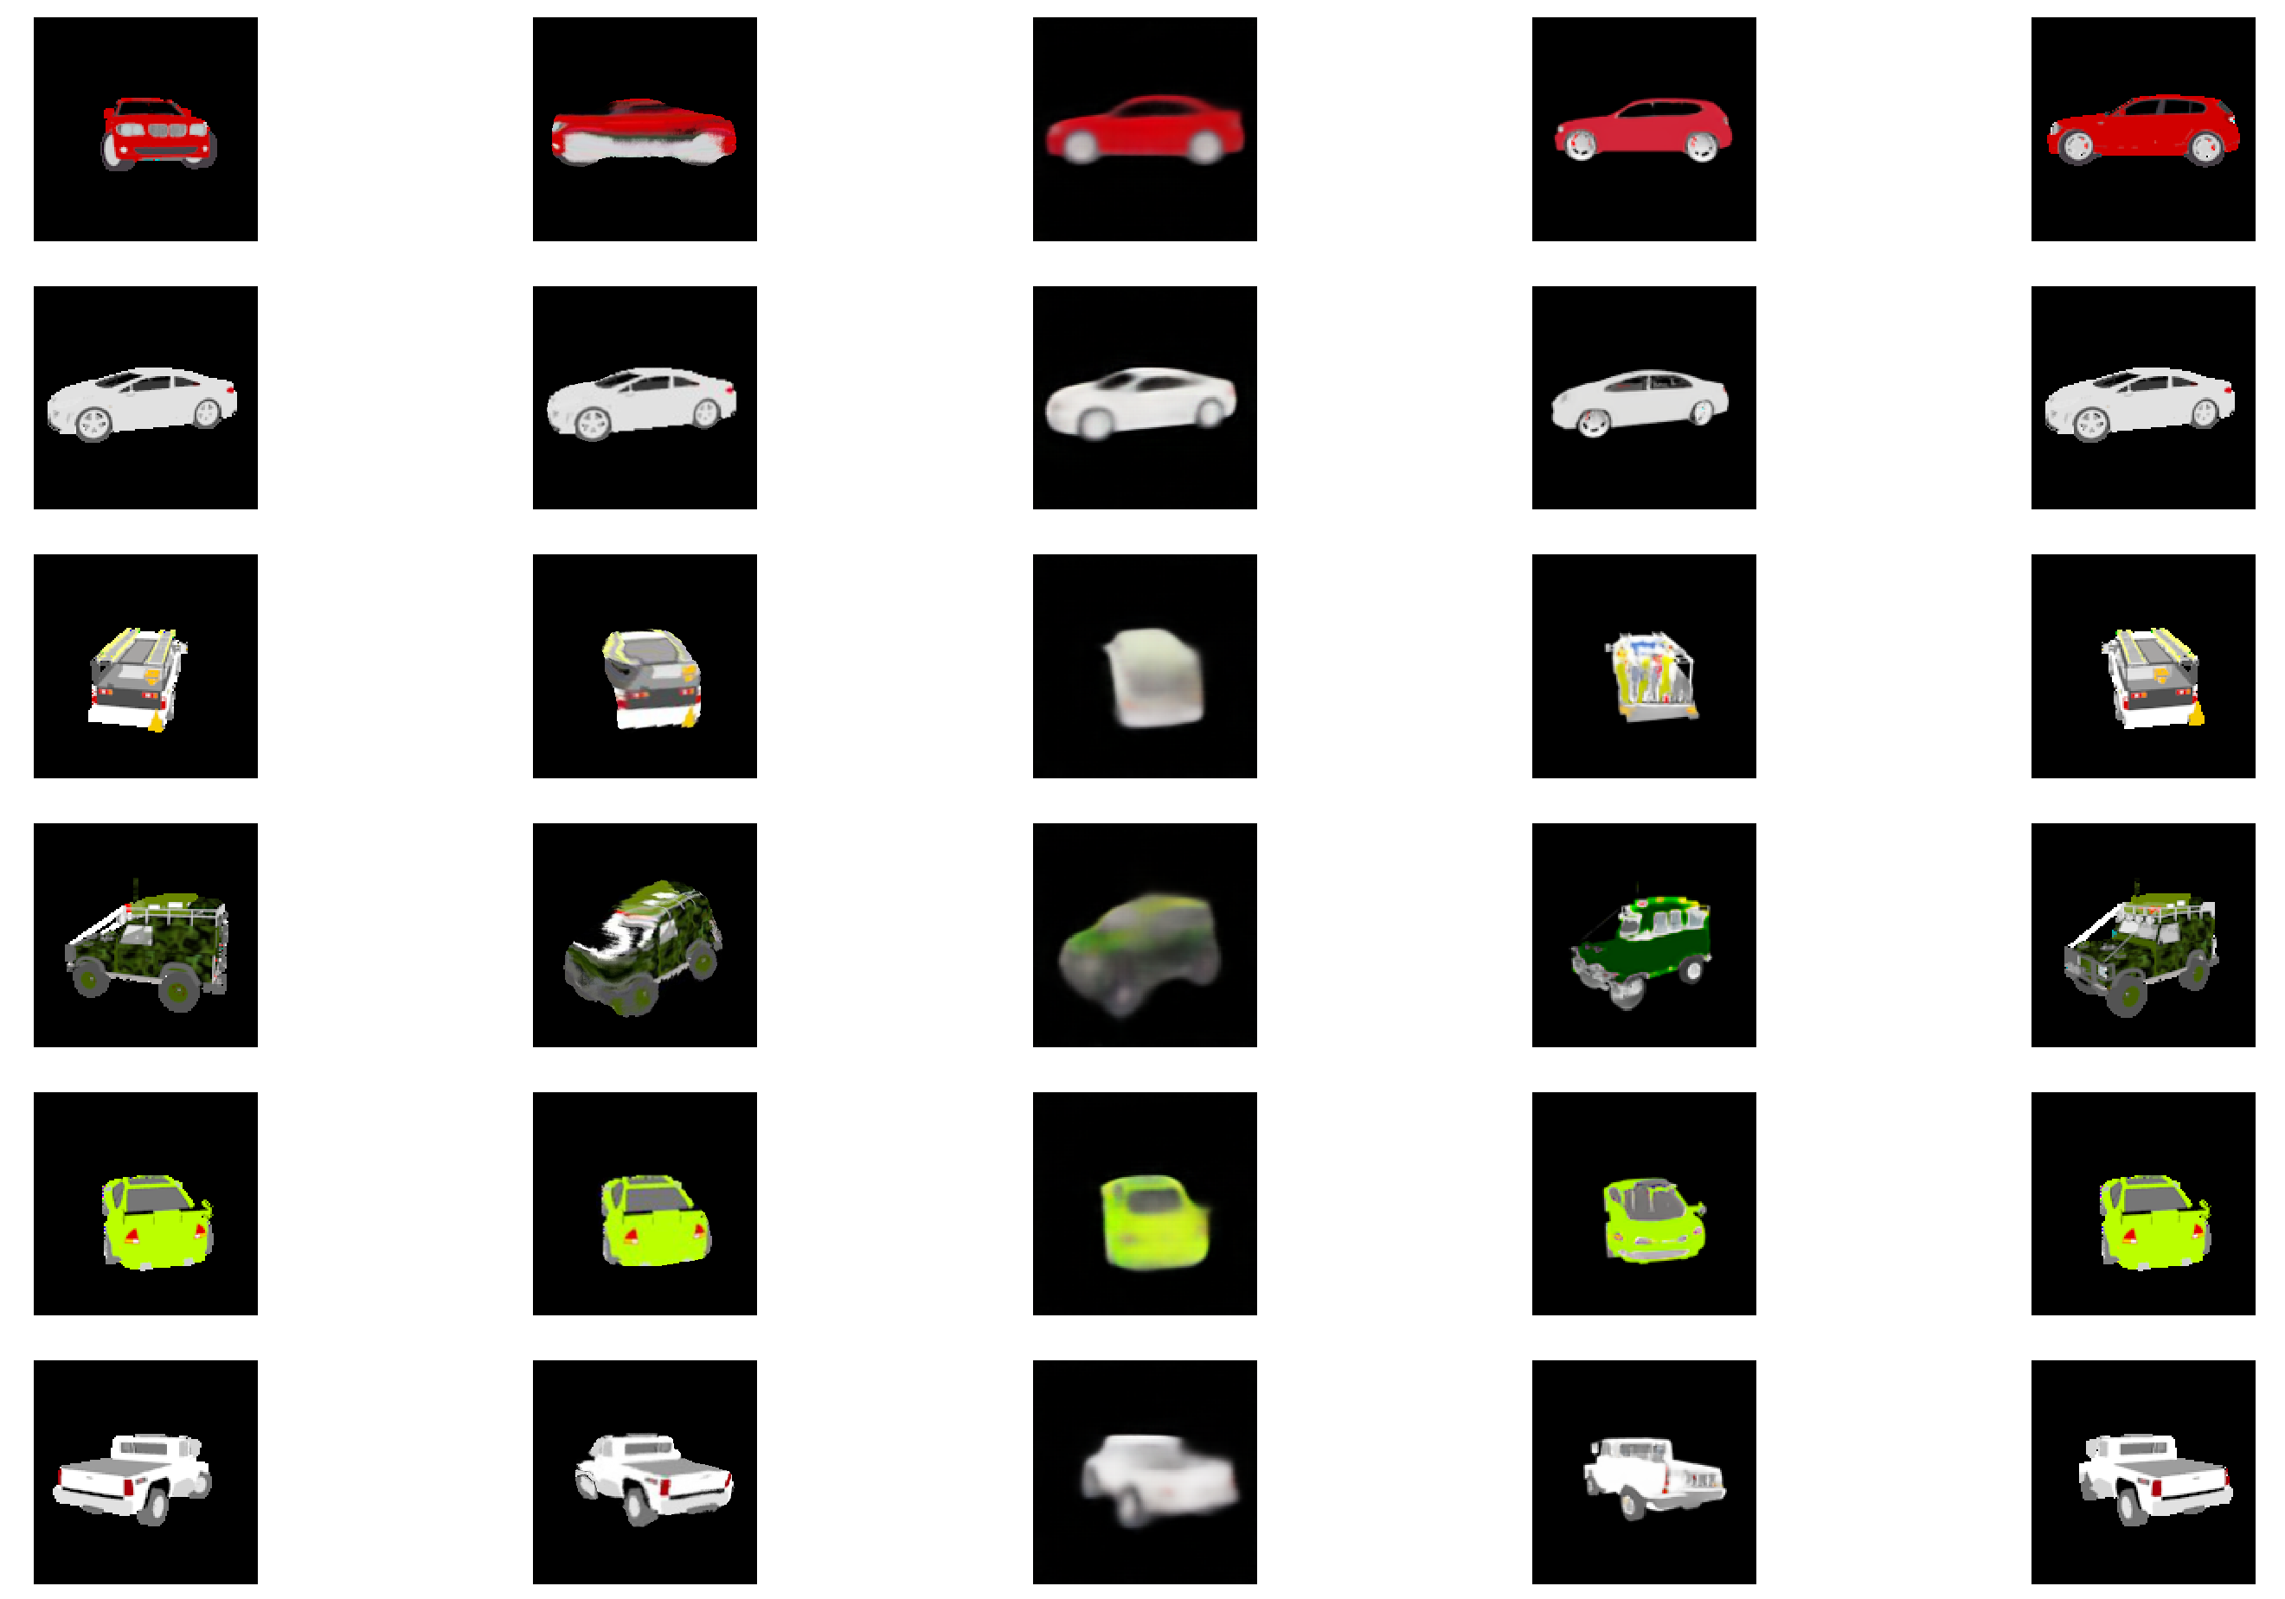
input AF mv3d ours target

Slide 6
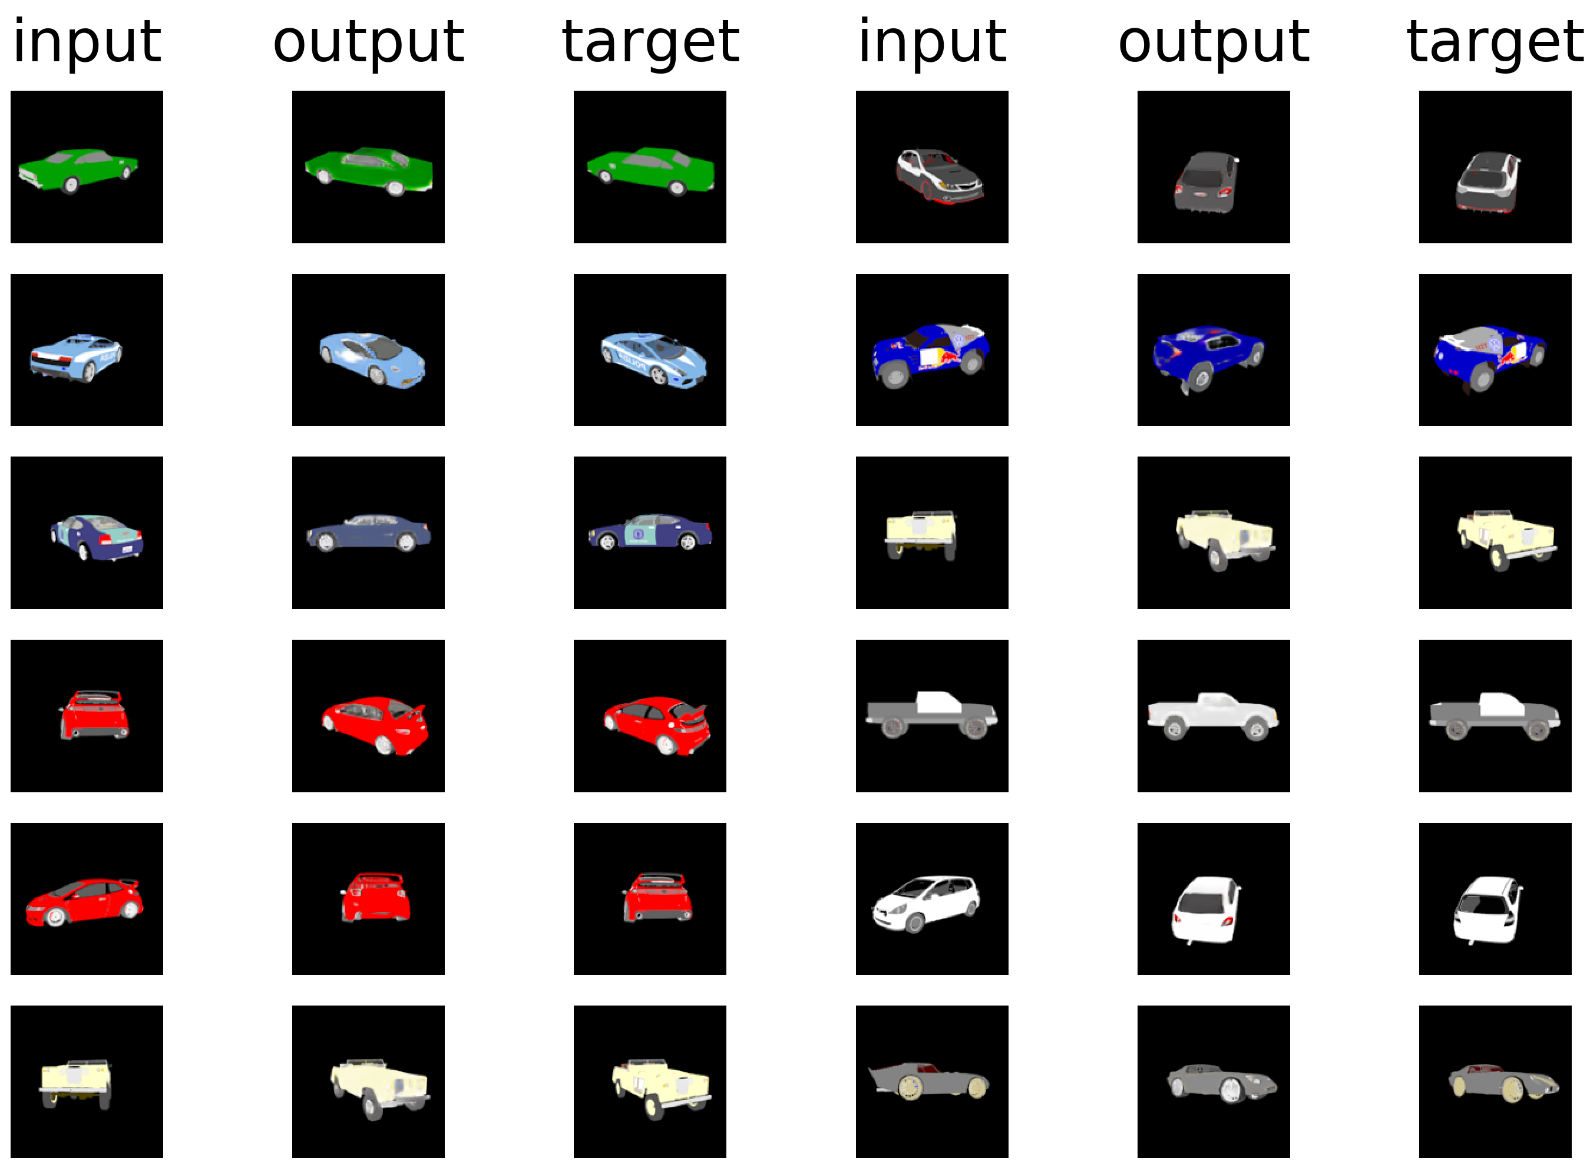
input output target
input output target

Slide 7
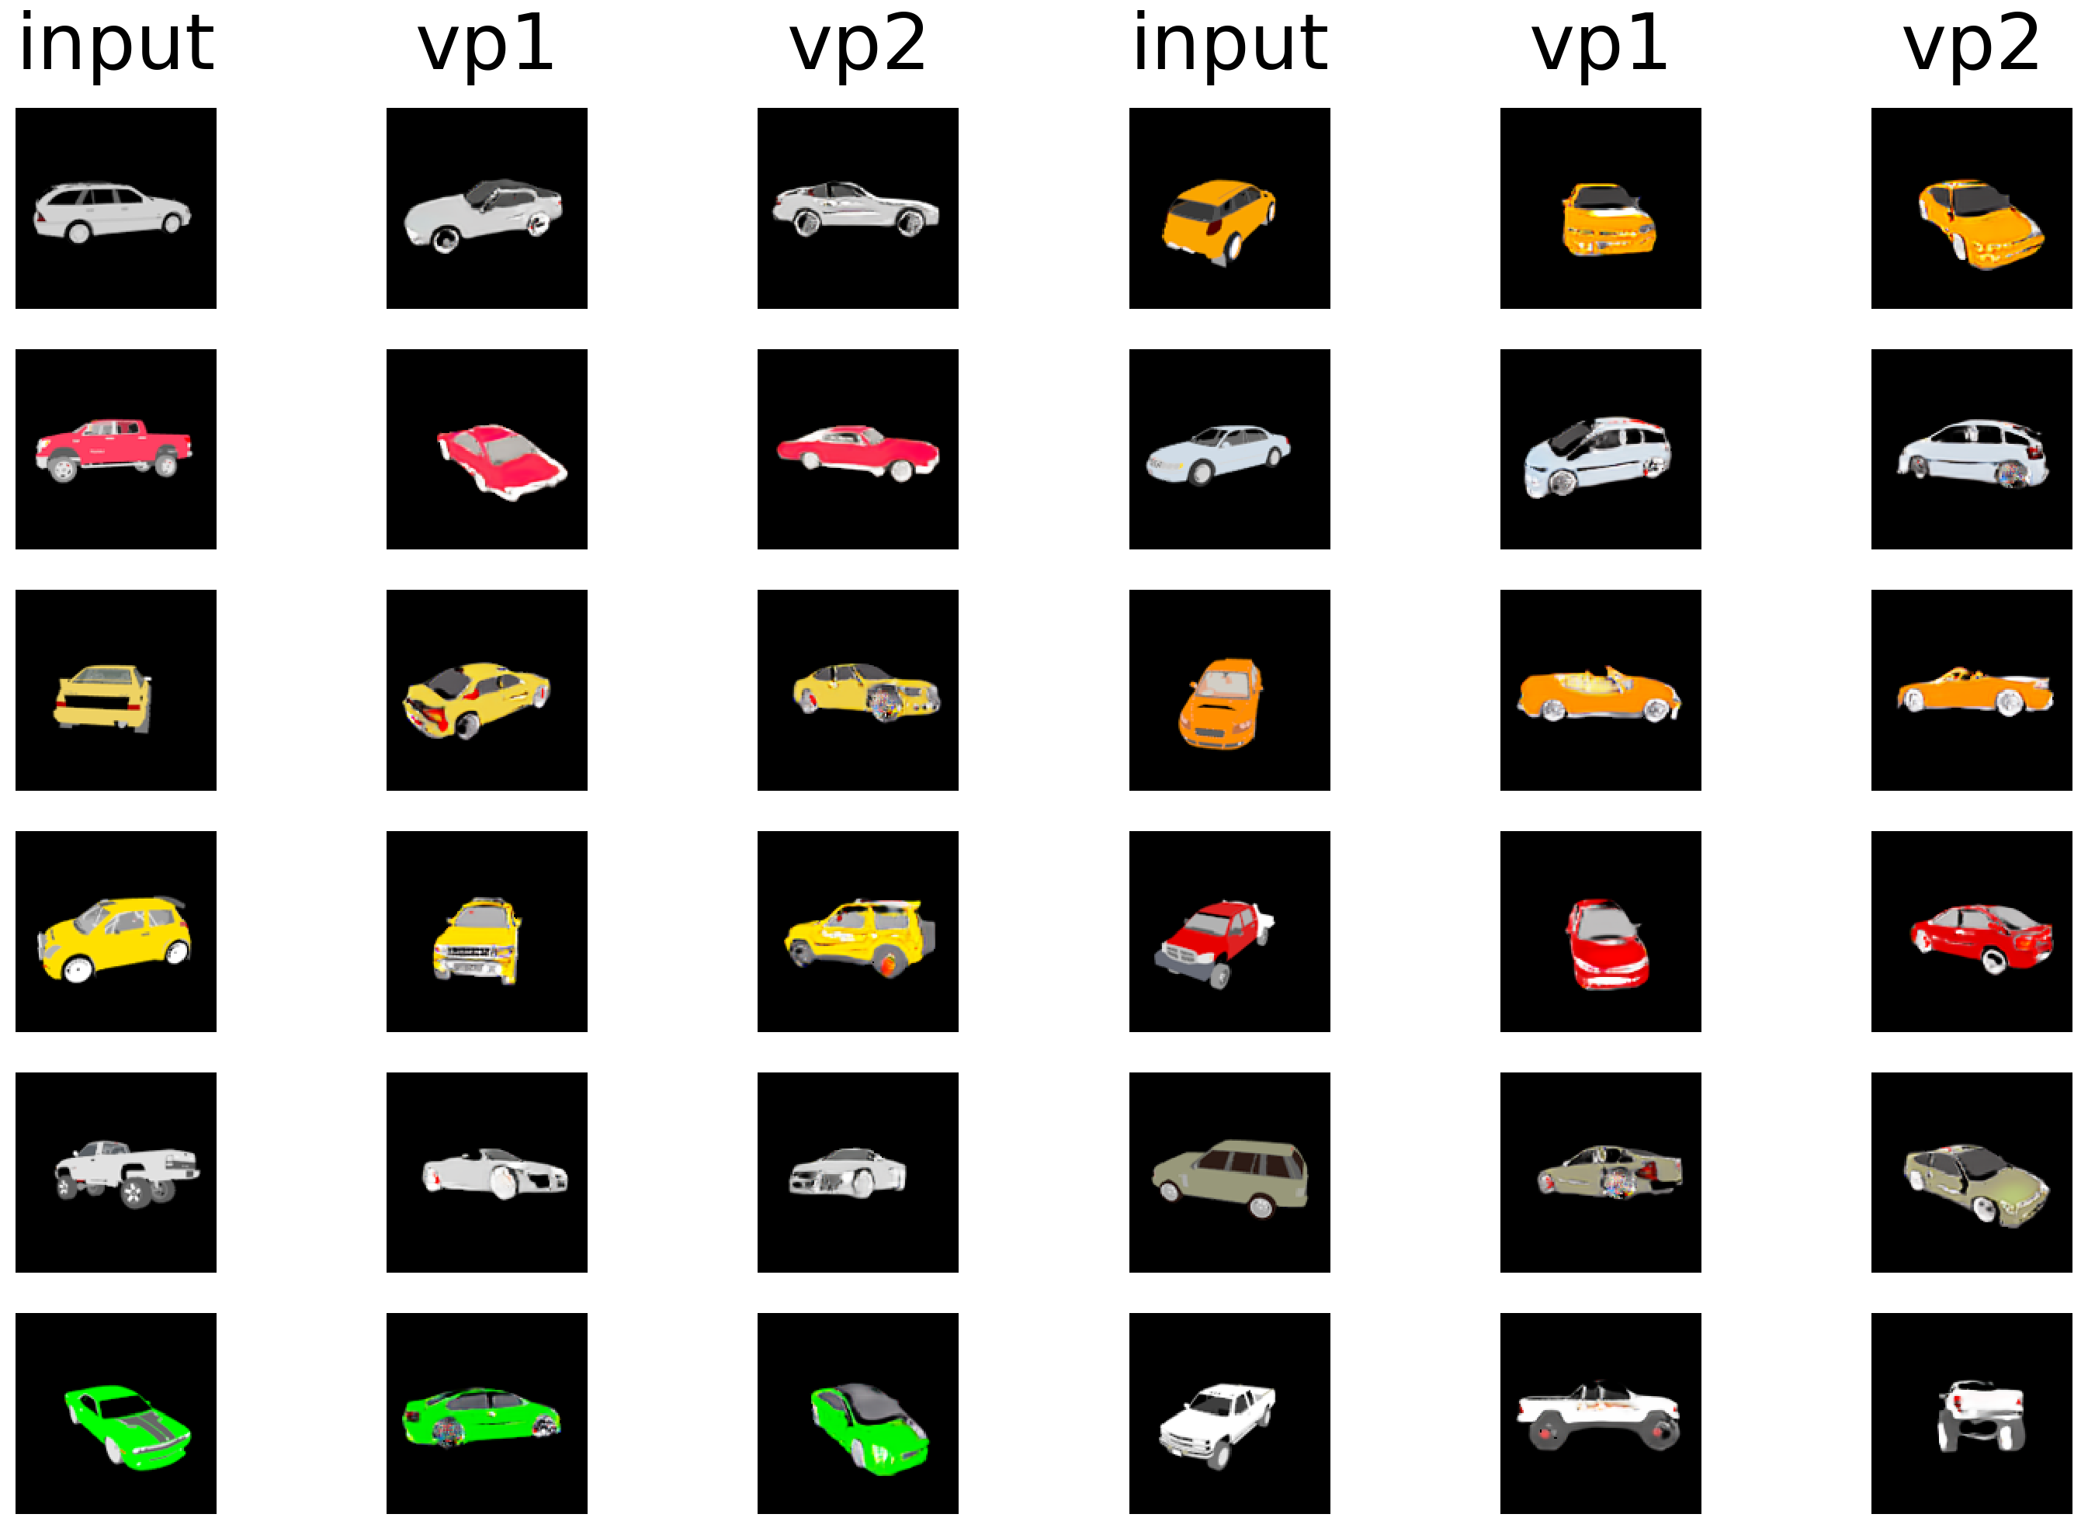
input vp1 vp2
input vp1 vp2

