Slide 1


DEEPlasma
GENE Surrogate Model for Tokamak Pedestal Plasma
This work has been carried out within the framework of the EUROfusion Consortium, funded by the European Union via the Euratom Research and Training Programme (Grant Agreement No 101052200 — EUROfusion). Views and opinions expressed are however those of the author(s) only and do not necessarily reflect those of the European Union or the European Commission. Neither the European Union nor the European Commission can be held responsible for them.

Slide 2
Introduction to GENE and microturbulance

Slide 3
Overview
What is GENE
Why is GENE useful
Micro Instabilities as Perturbations
Flux Tube Geometry
Interpreting a Linear ky spectrum

Slide 4
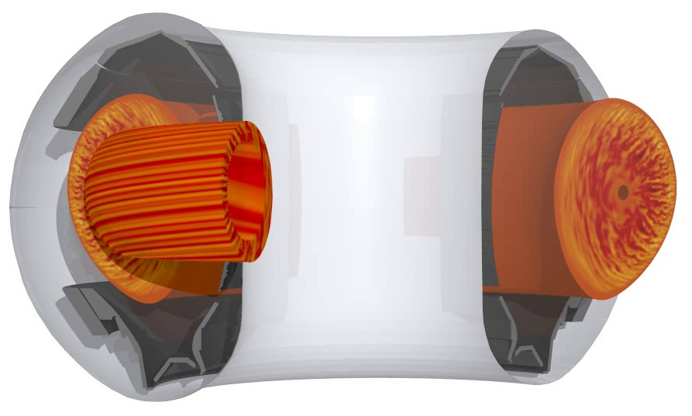
What is GENE I
It is very important to understand particle and heat transport to minimise energy losses for fusion performance, but also for fuelling and impurity purging
The most dominant method for heat and particle transport is micro-turbulence
Non linear GENE can simulate micro-turbulence to compute heat and particle flux
Linear GENE can be used to estimate the heat and particle flux using a saturation rule, called quasilinear (more later)
genecode.org

Slide 5
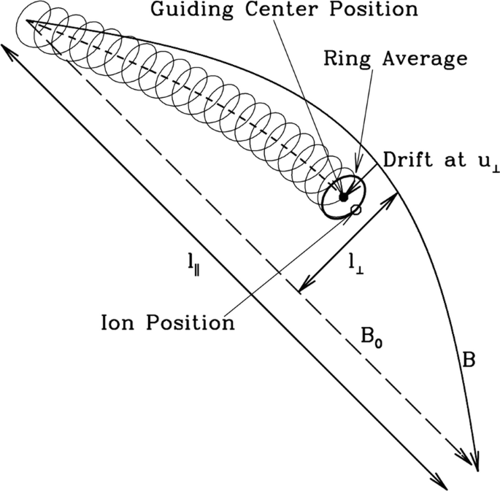
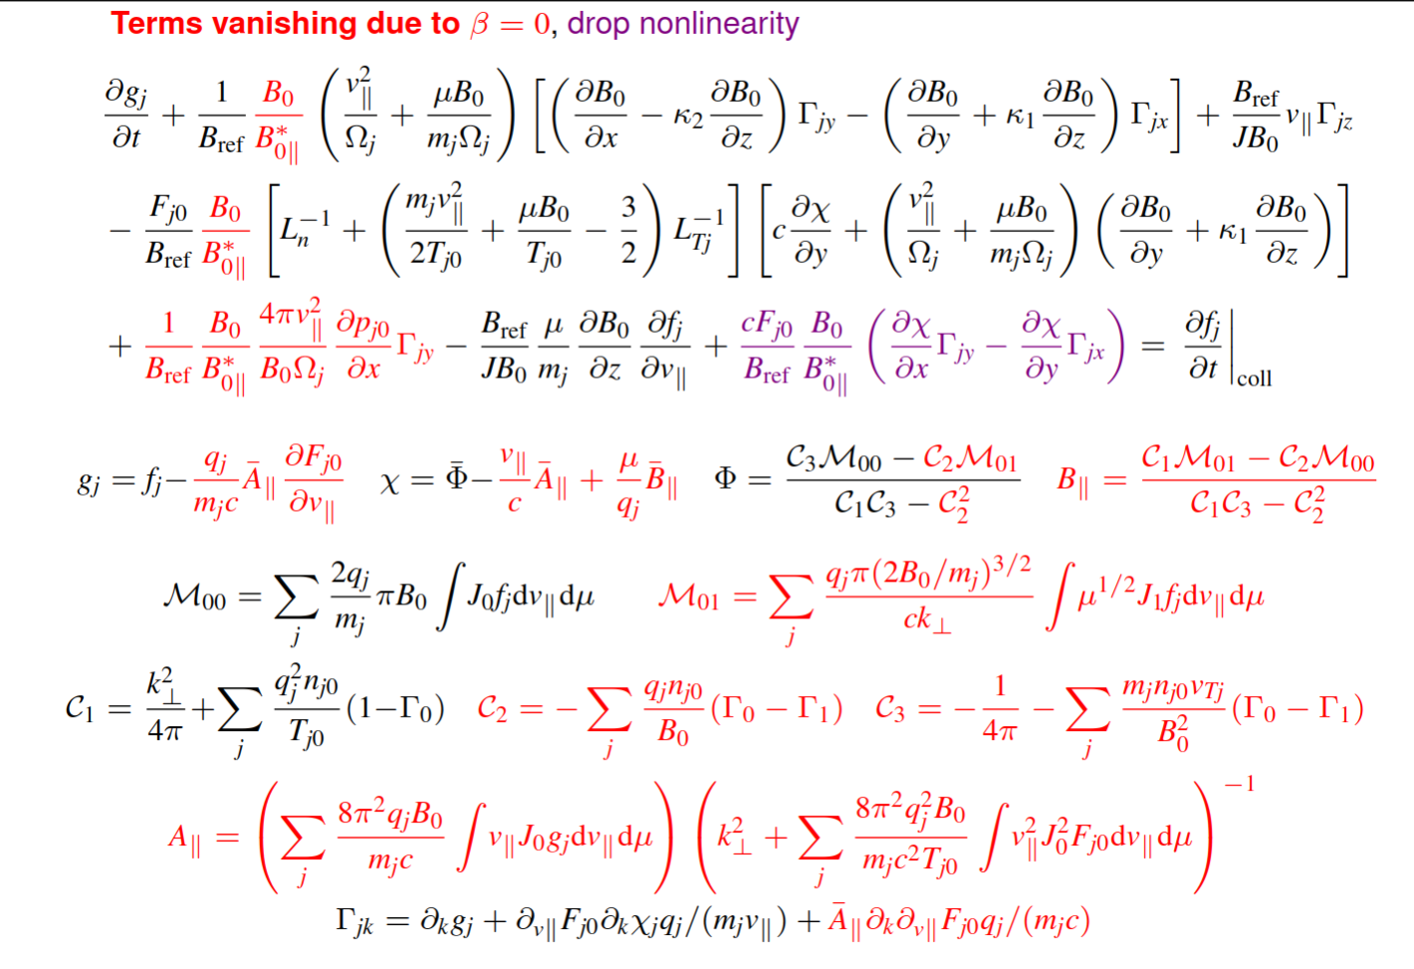

What is GENE II
Gene is a gyrokinetic code that aims to solve the gyrokinetic vlasov maxwell equation

Slide 6
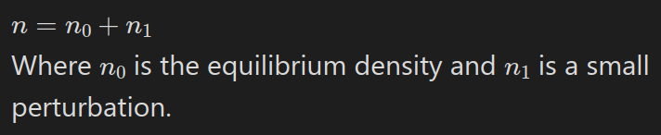
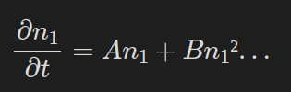



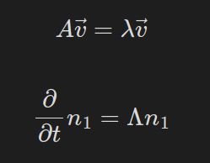
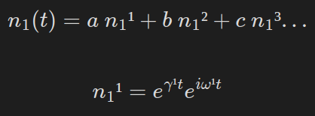
Micro Instabilities as Perturbations
Exploring a toy problem where we have some equilibrium particle density at some point in space
We have some physics derived PDE which describes the evolution of the perturbation over time. This can be Taylor expanded to separate linear and non-linear terms.
We can solve the PDE with a numerical initial value solver which computes the RHS of the PDE and multiplies by a small time step Δt.
By tracking the change in density over time we can compute the growth-rate of any instability and angular frequency.
Alternativly for the Linear part we can use an eigan value solver, this involves using the wave ansatz as a guess for the form of the solution.
Then a set of eigan functions can be identified and perturbation function can be expressed as a linear combination of eigan functions

Slide 7
Micro Instabilities as Perturbations
Some of the eigan functions will have a -ve gamma and thus their amplitude will decay exponentially over time. We don't care about those.
Others have a +ve gamma and will dominate the perturbation function after a long time. These are known as unstable eigan modes.
These are the only ones the GENE linear eigan mode solver GENE will return.
After some time the mode with the largest growth-rate will dominate. Although sub-dominant modes are still returned.
With an initial value solver you only get one growth-rate and frequency which will be determined by the dominant eigen modes.
While there are infinate eigan modes the number of unstable ones are finite. Also since computers can't deal with infinities, the number of modes in the simulation is dependent on the numerical resolution.
You can also get numerical eigan modes, which are not physically present but appear due to the numerical approximation. Great care needs to be taken to ensure there are no unstable numerical eigan modes.

Slide 8
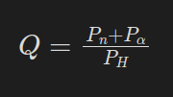
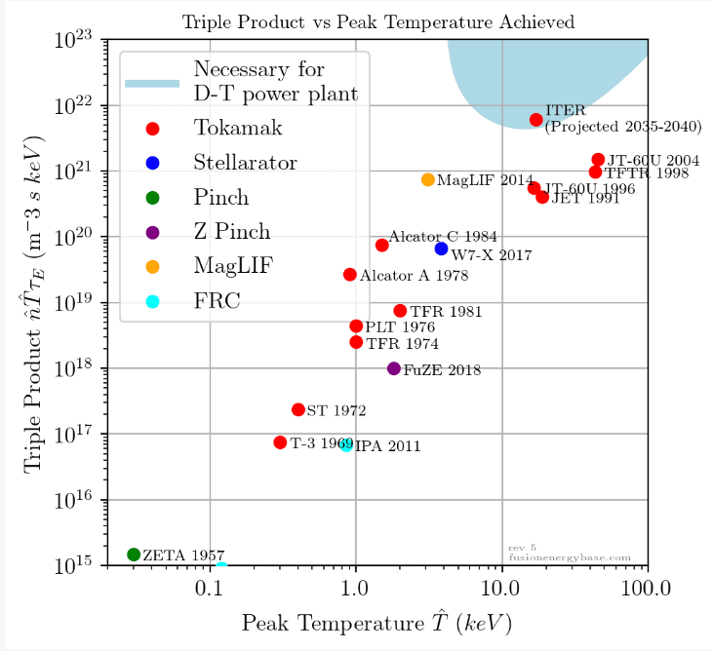


What is the Q factor and Triple Product for Ignition?
Q is the ratio of neutron energy released and heating energy inserted.
Q does not incorporate converting neutron energy into electricity or heating inefficiencies. JET = 0.67, ITER Q=10
Q=5 is said to allow for the energy extracted to match the heating demands
The triple product must be above a threshold to achieve ignition; when fusion alphas sufficiently heat the plasma for further fusion
Both of these metrics are used to measure fusion performance and guide the design of future reactors

Slide 9
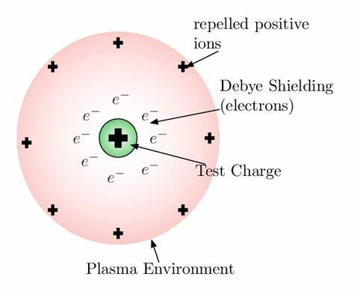


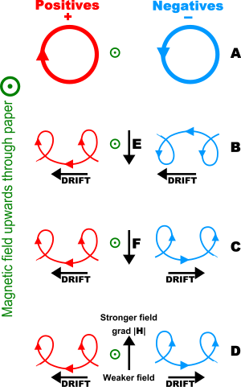

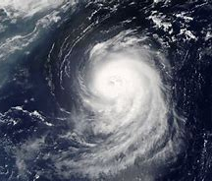
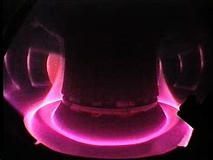


What is a Plasma?
Deby Shielding is the plasmas tennancy to cancel an electric field by rearranging its charged constituents. If the Deby length is larger than the gas then it is not a plasma.
A plasma is an ionised gas that exhibits collective effects:
  Deby Shielding
  Plasma Waves
  Drifts
  Instabilities
  Glowing
If the dominating interaction is collisions then the ionised gas behaves like a normal gas and is thus not a plasma
  Highly Collisional
  Low Ionisation
If the electrons and Ions are seperated, the resulting wave would oscillate at the plasma frequency. It is the natural frequency of the plasma, or resonant frequency.
EM waves faster than the plasma frequency can penetrate the plasma, anything slower is reflected.
Gyrating particles when exposed to an external force will drift perpendicular to both the force and magnetic field.
The force can come from many sources, electric field, variable magnetic field, gravity, centrifugal forces.
Normal gases are also thrown out of equilibrium by external forces but there are many more driving mechanisms and possible features of turbulence and instabilities for plasma.
The thermal radiation of plasma is often in the visible spectrum.

Slide 10
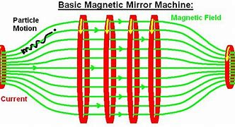

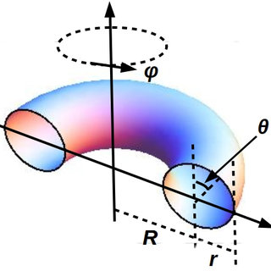
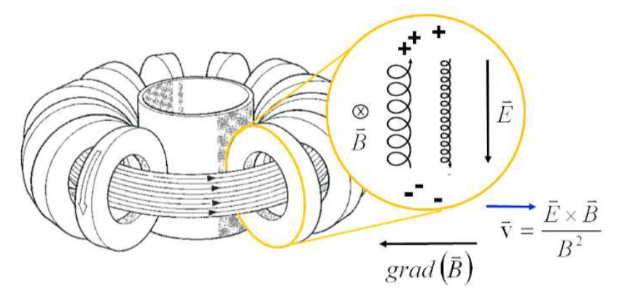
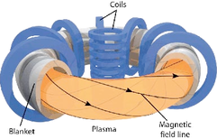
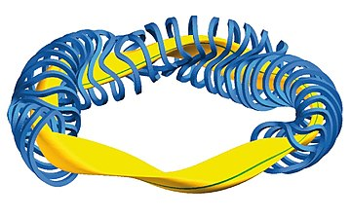
Plasma Confinement
As the particles reach the high field their gyrofrequency increases. This requires energy and the systems mechanics allows this energy to come from the translational motion of the particles until they are stationary and cannot go gurther to the high field region so are reflected.
Particles with enough translational velocity will escape. Since at thermodynamic equilibrium there are always some fast particles, eventually almost all particles escape.
Magnetic Mirror
Torus
Tokamak and Stellerator
Torodial Angle
The obvious solution is to make a torus so there are no ends to plug.
The problem here is that drifts cause all the particles to leave almost instantly.
Polodial Angle
Major
Major
Minor
The tokamak uses a central solenoid to drive a changing magnetic field which induces a current in the plasma which creates a polodial magnetic field. The resulting magnetic field is a helix around the torus. Since the dominating drifts point major radially outwards the particles drift away from the core when outside the torus and towards the core when inside the torus. Effectively the drifts cancel and we have confinement.
To achieve the same effect the stellerator tries to curve the magnetic field lines with a complex torodial field coil design. There is no plasma current. Since there is no central solenoid to charge it can operate in steady state. The coils can also be optimised to reduce turbulence and instabilities. Although due to less symmetry modeling a stellerator is much more difficult.

Slide 11
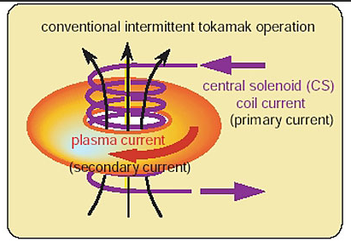
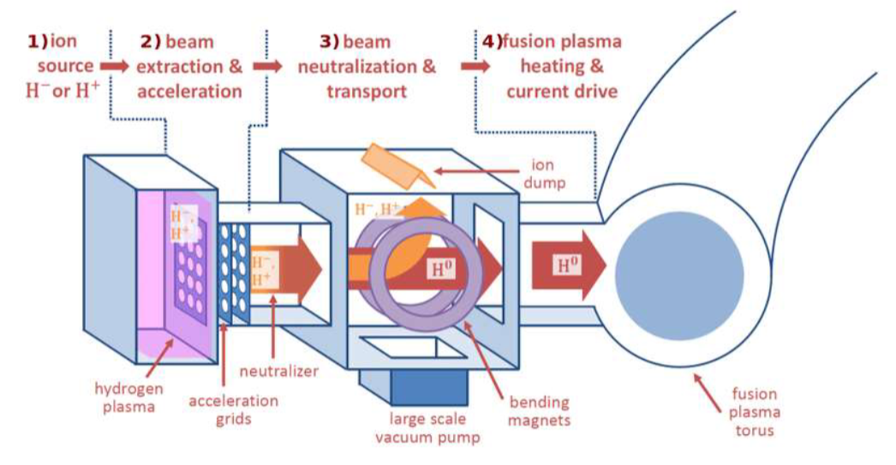
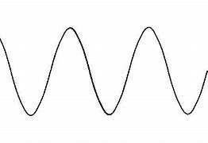
External Heating
Low T
High T
Inducing a current in the plasma can heat the plasma. Although as temperature increases the coulomb collisions become less severe in disrupting trajectories and resistivity decreases. This reduces the effectiveness of ohmic heating at high temperatures required for fusion and other heating methods are needed
First a radio frequency EM wave ionises some fuel
Then charged grids accelerate the ions to high energies
  It is passed through a neutral gas where the beam steals electrons to become neutral
  Any remaining ions are directed away using a magnetic field and the Lorenz force
The high energy neutral beam passes though any magnetic confinement and reaches the plasma; effectively heating it.
Ohmic heating
Neutral Beam Injection
Cyclotron Resonance Heating
ECRH, ICRH
EM waves can be fired into the plasma that have the same frequency as the cyclotron frequency of the electrons or ions. This allows them to resonantly interact and the particles can absorb the energy

Slide 12
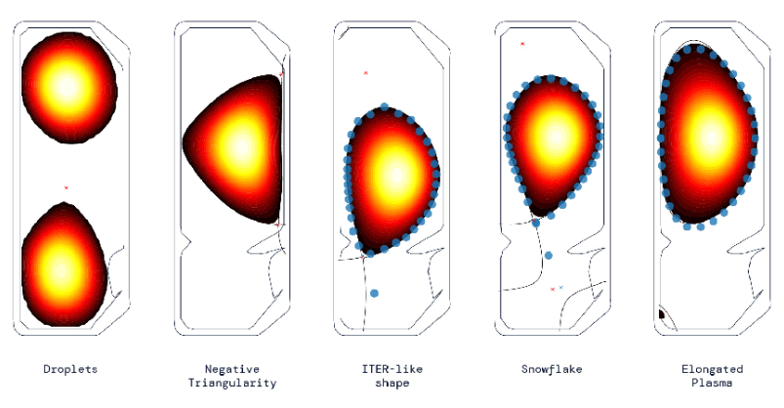
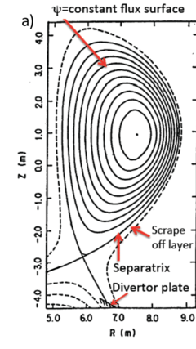
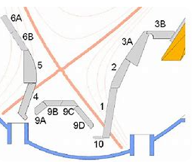
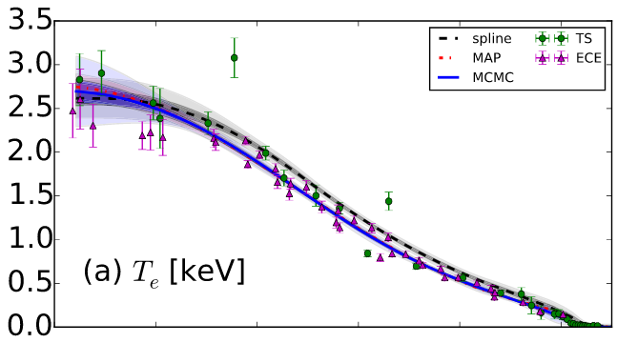
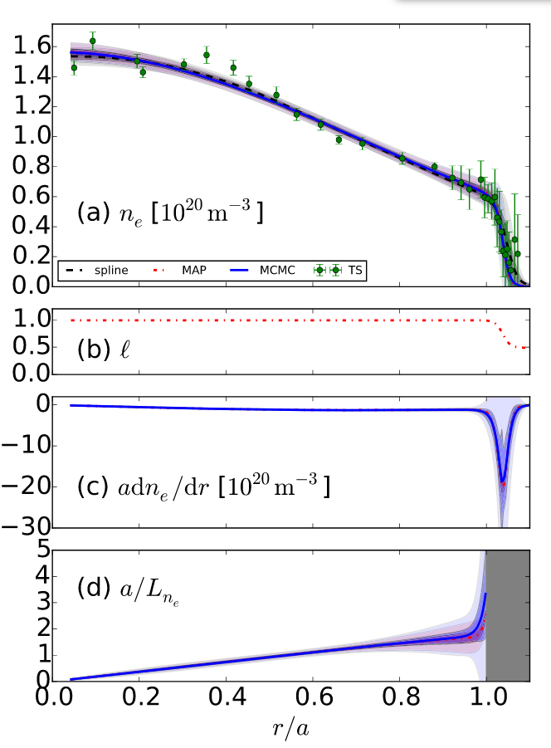
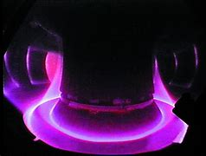

Flux Surfaces and Divertor
Torodial Angle
Polodial Angle
Flux Surfaces represent the equilibrium that is being aimed for, constructing them from magnetic diagnostics is often called equilibrium reconstruction
Assuming particles follow magnetic field lines the flux surfaces are contours of constant density, temperature, pressure, safety factor q, beta thus allow a tokamak plasma to be described by 1D profiles
The flux surface shape mostly affectsβand the D shape maximises beta. There is still debate on left/right D and degree of triangularity.
The diverter is a component close to the X-point of the seperatrix that is designed to receive a high particle flux as majority of particles that leave the plasma or wall will arrive there.
Major
Major
Minor
https://www.newscientist.com/article/2308243-deepmind-uses-ai-to-control-plasma-inside-tokamak-fusion-reactor/
Solving the Grad Shafranov Equation with magnetic diagnostics
Asdex Upgrade Garching Germany
Electron denstiy and temperature profiles fit to Thompson scattering points with Gaussian process regression. Chilenski et al, Nuclear Fusion 55, 2015.
A high impact angle spreads the load and sprinkler motion gives time for plate to cool
Wesson Tokamaks

Slide 13
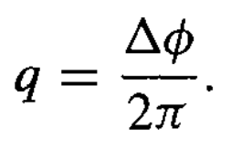
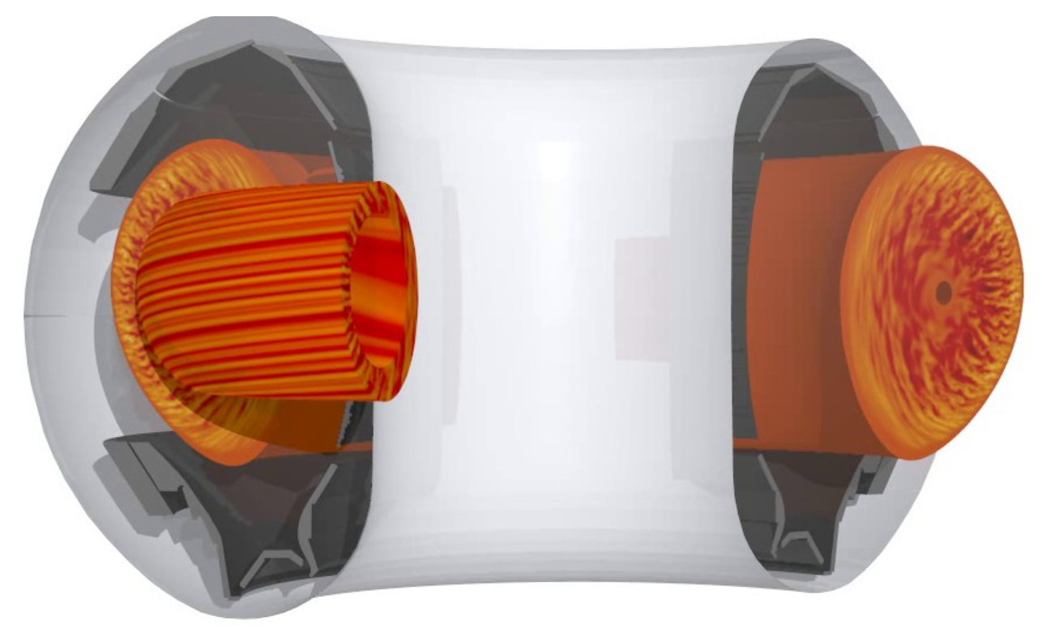
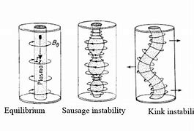
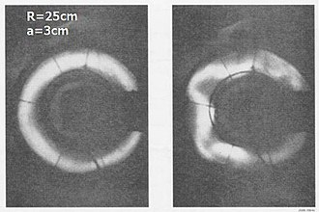
Safety Factor, q
Torodial Angle
Polodial Angle
The safety factor physically represents how coiled the helix of the magnetic field lines are. A high safety factor means the field line is less coiled.
The magnetic field line bites its on tail after m toroidal turns and n polodial turns where m and n are integers.
The safety factor is highly linked to instabilities, hence its name.
Micro turbulence structures have a high length-scale along the magnetic field lines and low perpindicular, if the field lines bites it’s own tail then the turbulence can easily circulate and resonate.
Tuning the safety factor profile is greatly important for avoiding macro instabilities. Example: q=1 at core stabilises kink instability.
Δɸ is the toroidal angle required to return to the same polodial angle, θ.
Major
Major
Minor
gene.org

Slide 14
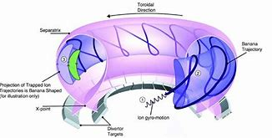
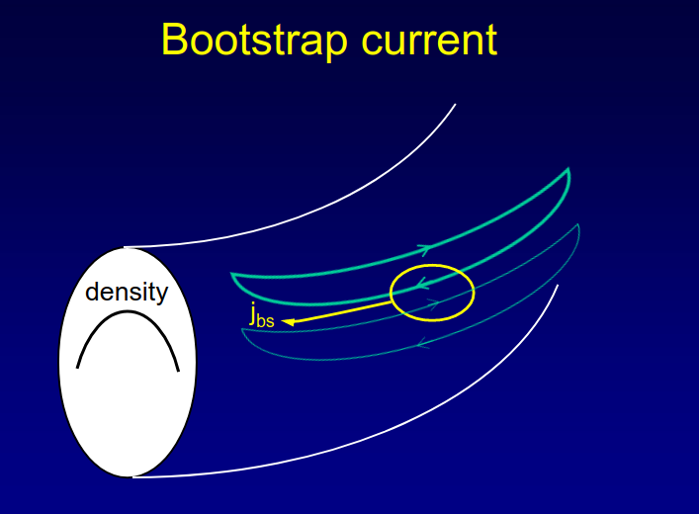
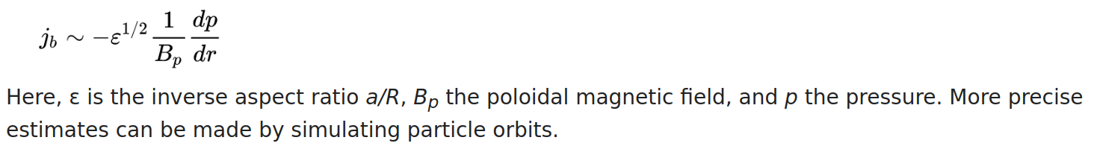
Banana Orbits and Bootstrap Current
Torodial Angle
Polodial Angle
The tokamak has a stronger toroidal magnetic field in the core due to the geometry of the torodial coils.
Particles with low energy are reflected when they get to the high field side, just like in the magnetic mirror.
This leads them to follow banana orbits that are confined closer to the high field side of the tokamak.
This is important for various turbulence and transport processes.
It is also important in the explanation of bootstrap current.
Bootstrap current is a toroidal current that results purely from the geometrical orbits of particles.
It is a sizeable current that lowers the reliance on the central solenoid and thus the cost of a reactor
Major
Major
Minor
Fusion Wiki

Slide 15

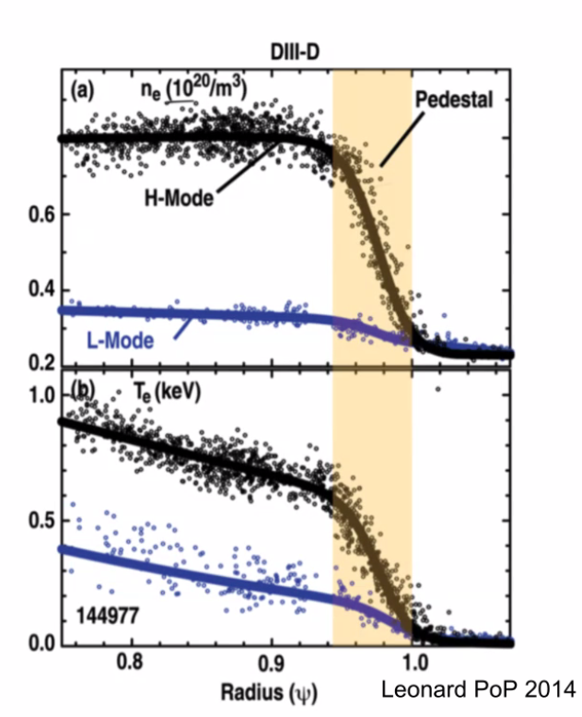
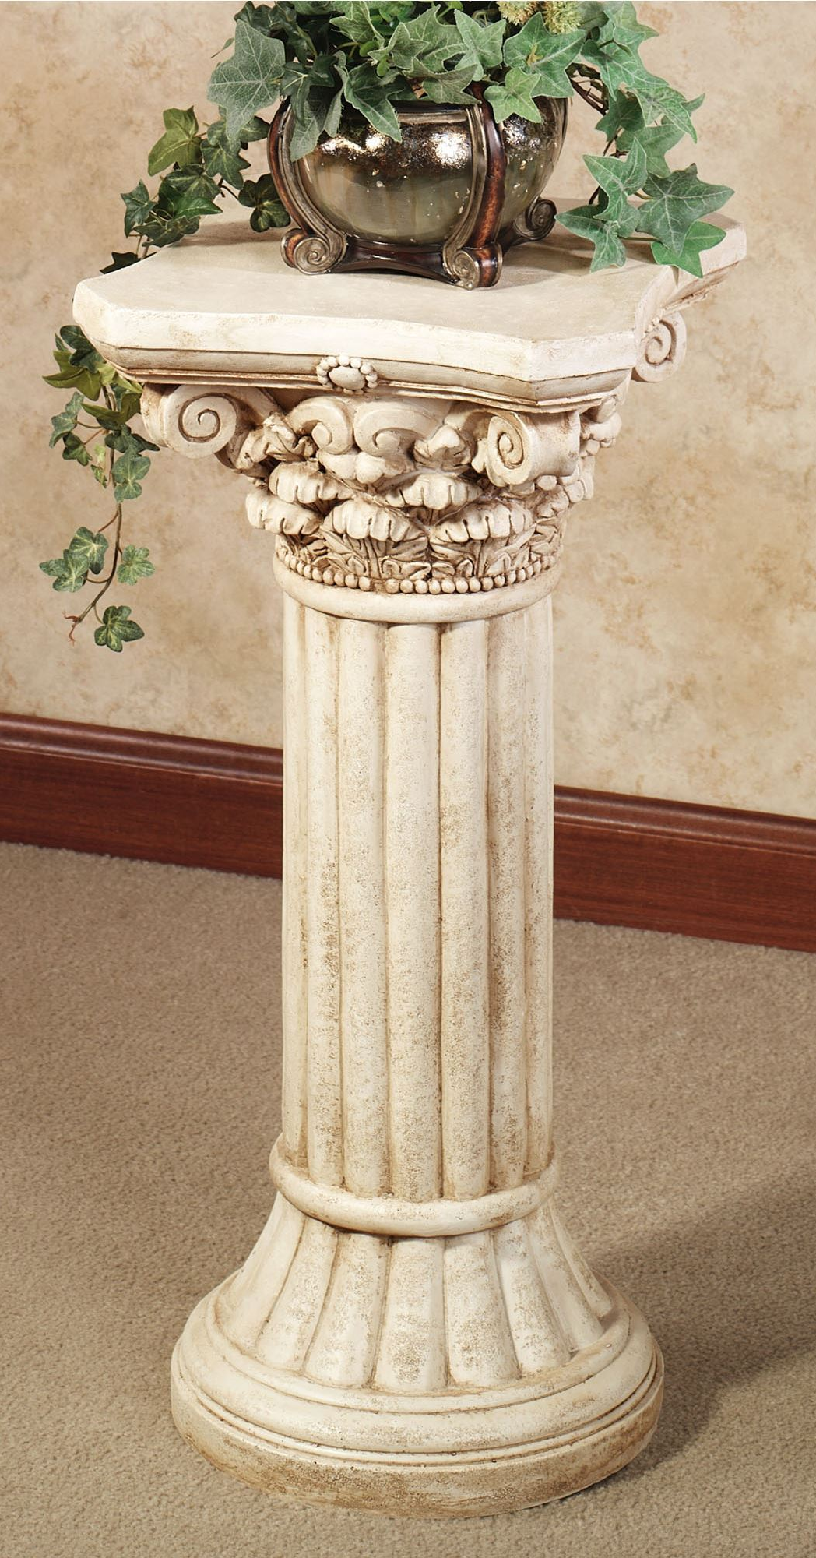
H-mode, Pedestal and ELM’s
Torodial Angle
Polodial Angle
If the external heating is increased and a divertor is used then H-mode appears.
The core profiles appear to be lifted up by a pedestal.
A sharp gradient in the profiles appears at the edge and the plasma is well confined, thus high confinement mode. The time delay part of the triple product largely increases.
A large flow of plasma known as shear flow cuts through instabilities
A new instability is introduced known as Electron Localised Modes, ELM’s.
ELM free scnearios??
There are three types of ELM’s but type I are the destructive ELM’s and thus what most people mean when they say ELM.
ELM’s are short lived sudden bursts of energy with high heat and particle fluxes that immediately damage the plasma facing components and trigger other instabilities which leads to a full disruption; complete loss of confinement, large damage to the tokamak.
Major
Major
Minor
https://www.genecode.org

Slide 16

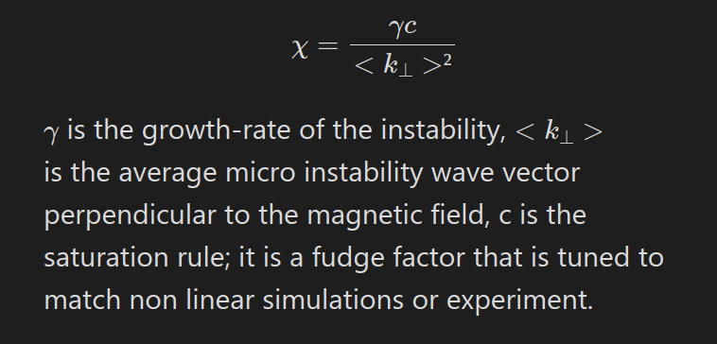
Link to DEEPlasma
Torodial Angle
Polodial Angle
DEEPlasma is trying to surrogate the GENE code for the pedestal region of H-mode tokamak plasmas.
GENE simulates the distribution of plasma particles and can find the growth rate of instabilities.
Micro-instabilities are driven by temperature and density gradients and drifts (among other things).
The pedestal is a region of steep gradients and thus high micro-instability drive (although flow shear should remove some of this).
Micro-instabilities resonate at rational safety factor values
The instabilities cause outward heat and particle flux, which are the engineering parameters of interest
DEEPlasma focuses on linear GENE which cannot output an accurate heat flux but it can provide an input for a quasi-linear analysis.
Major
Major
Minor
https://www.genecode.org
Δɸ is the toroidal angle required to return to the same polodial angle, θ.

