Slide 1
ASCOT AI
GENE vs ASCOT

Slide 2
Why GENE vs ASCOT?
- I am currently working on making an AI GENE surrogate model
- Similarities between the codes make progression of one AI surrogate applicable to the other
- AI methods are very general and a model developed for one task is almost always highly applicable to other tasks
- for example a friend of my is planning on using large language models to categorise proteins

Slide 3
OVERVIEW
- GENE vs ASCOT
- Current Progress with GENE
- GENE Plans for Future
- Similar plan for ASCOT?

Slide 4
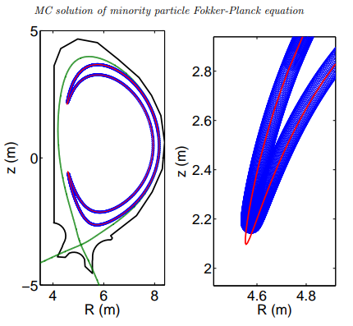
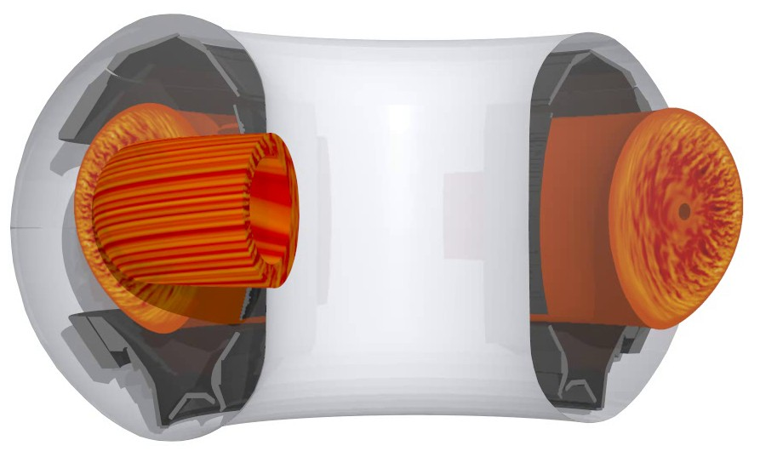
GENE vs ASCOT
GENE focuses on majority species, hydrogen and electrons
GENE aims to resolve micro-turbulence to compute particle and heat fluxes be used to
  predict density, temperature and pressure profiles
  Compute the plasma plasma performance in terms of energy confinement time
  understand the source of turbulence and validate simulated theoretical understanding with experiment
ASCOT focuses on minority species, fast ions (alphas) and impurities
ASCOT aims to follow the particles in their orbit to see
  how many alphas are confined for plasma heating
  how many impurity particles will escape confinement and bombard the wall at what location at what angles
  how many impurity particles will stay in the core and cool it down with radiation emitted from recombination
  Can also work to model NBI and shine through
Fast Surrogate Model –> Integrated Model / Tokamak Digital Twin / Flight Simulator
Real Time Plasma Control & Maintenance Forecasting & Future Device Design

Slide 5
GENE vs ASCOT
Both start with an initial particle distribution in phase space and evolve it according to a partial differential equation
Gyrokinetic Vlasov Equation
Gyrokinetics averages over the gyromotion and reduces the phase space from 6 to 5D, saving compute.
GENE is deterministic
Fokker Planck equation
The gyromotion is averaged over leading to guiding center equations of motion, saving compute.
ASCOT is probabilistic
An AI surrogate designed to progress the particle distribution function in time could be adapted to fit both codes
Physics informed ML methods use the PDE to guide surrogate model training
  Since both codes have a similar PDE with similar goals it is likely and Physics informed methods developed for one code will be portable to the other.
AI surrogate models are probabilistic approximations of the parent model. Since ASCOT is inherently probabilistic this makes is more plausible for a surrogate model to achieve similar performance. Although generating training data could be more costly since for one set of inputs many runs are needed to capture the output distribution that ASCOT would provide.
14/06/24

Slide 6
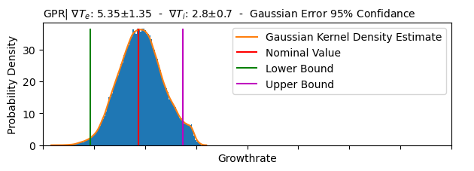
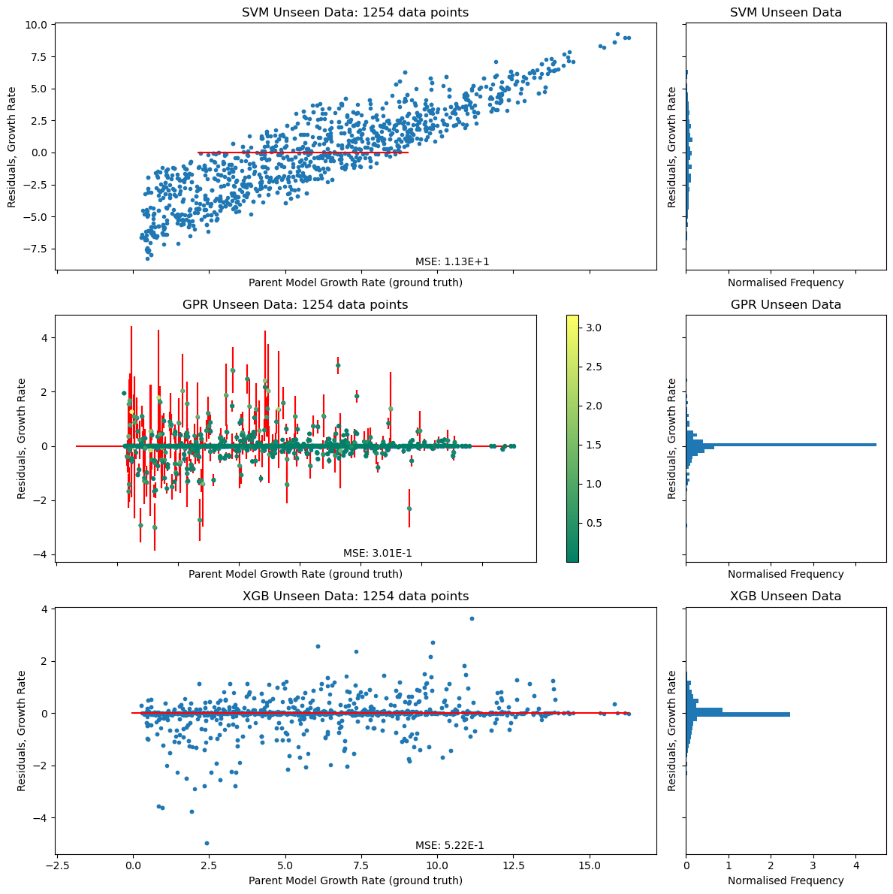
GENE Surrogate Status
ML models have been applied to map GENE input to GENE output.
An Uncertainty Quantification pipeline has been established to use the surrogate models to infer the uncertainty of GENE outputs given an uncertainty of GENE inputs.
Sparse Grid methods are also being deployed with the help of Ionuts Farcas as another Uncertainty Quantification method.

Slide 7
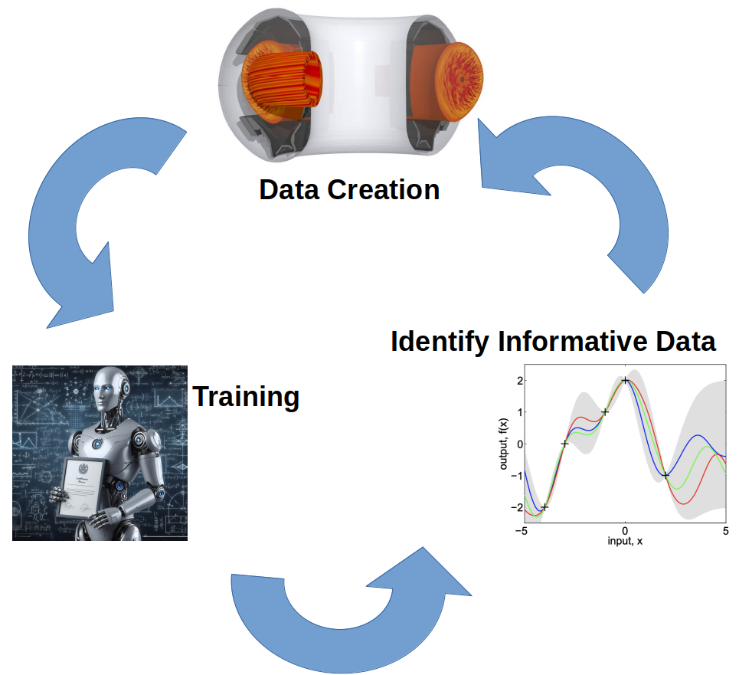
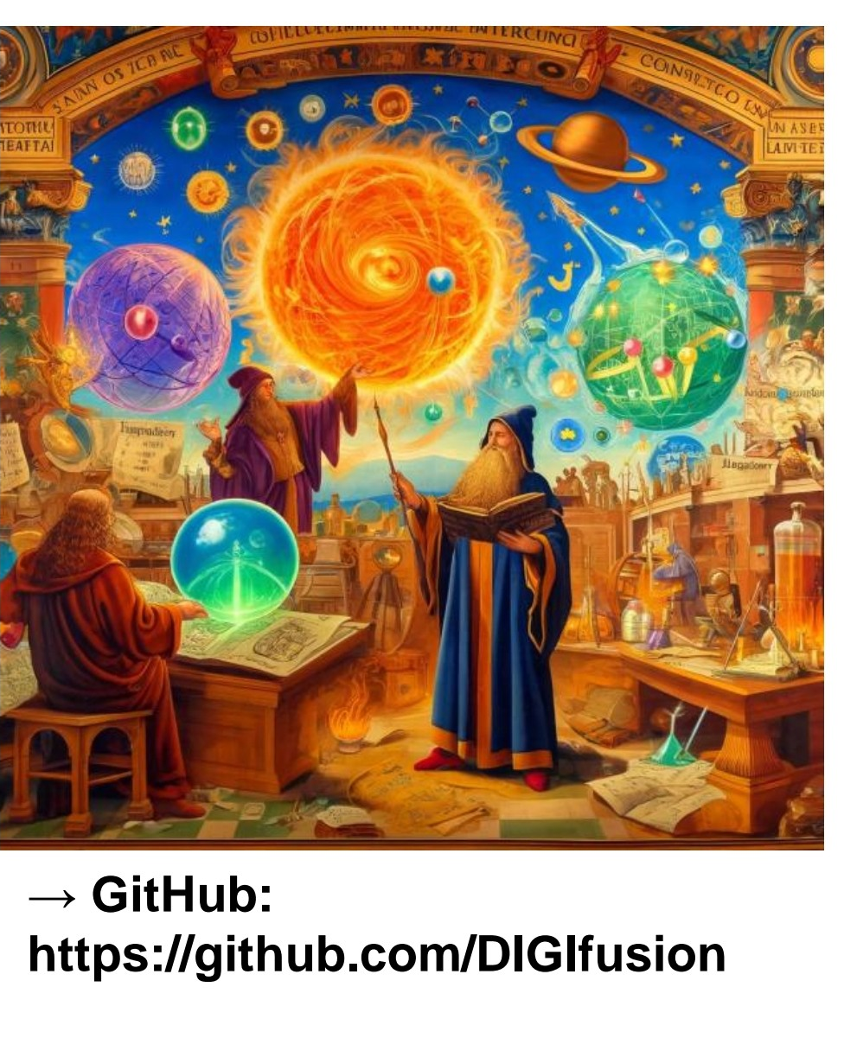
GENE Plans for Future
Take the surrogate models and connect them to experiment by performing turbulence mode identification, for proof of principle paper.
Add GENE to enchanted surrogates. A platform for developing surrogate models of complex physics codes.
    Developed mostly by Adam Kit.
    Enchanted surrogates focuses on active learning
Investigate only learning the correction from a simpler faster model like TGLF.
Investigate methods to progress distribution function in time with AI
Investigating methods for physics informed ML, using the PDE to guide model training.
Compare all the models and their ability to perform the turbulence mode identification pipeline created in task 1
Experimentally validate the models with quasi-linear approach developed by David Hatch, out turbulence expert collaborator.
Active Learning Cycle

Slide 8
Similar Plan for ASCOT??
Generate some input → output data to train ML models to do the mapping
Validate the surrogate model with experimental data using an already existing pipeline for ASCOT validation.
Use enchanted surrogates to deploy active learning and make more accurate surrogates with less data.
Is there a simpler faster model like ASCOT to learn the correction from??
Investigate methods to progress distribution function in time with AI
Investigating methods for physics informed ML, using the PDE to guide model training.
Compare all the models and their ability to be validated against experiment, using the pipeline in task 2.

Slide 9
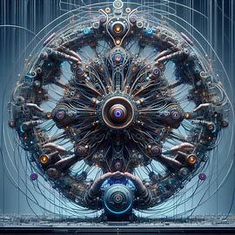
DALL·E 3: generate an image that embodies the ASCOT-AI Nuclear Fusion project

