Slide 1

GENE
Uncertainty Quantification
TSVV1
This work has been carried out within the framework of the EUROfusion Consortium, funded by the European Union via the Euratom Research and Training Programme (Grant Agreement No 101052200 — EUROfusion). Views and opinions expressed are however those of the author(s) only and do not necessarily reflect those of the European Union or the European Commission. Neither the European Union nor the European Commission can be held responsible for them.

Slide 2
Overview
People
What is GENE
Why is it useful
General Approach to Uncertainty Quantification
Sparse Grids, static vs adaptive

Slide 3

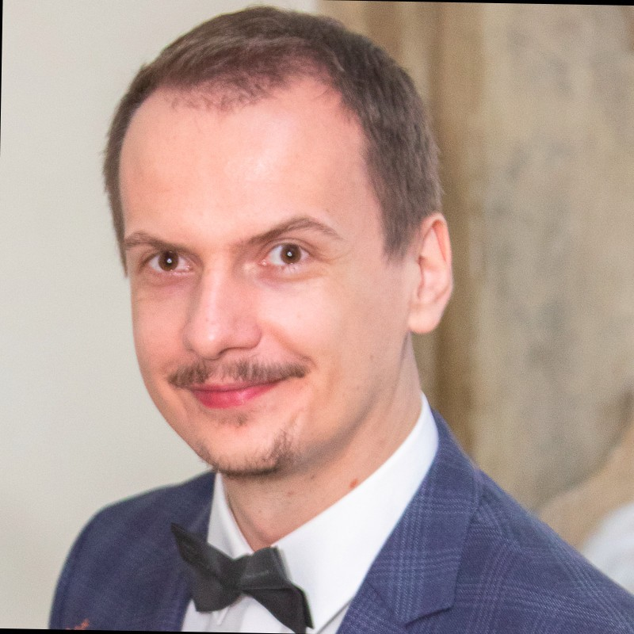
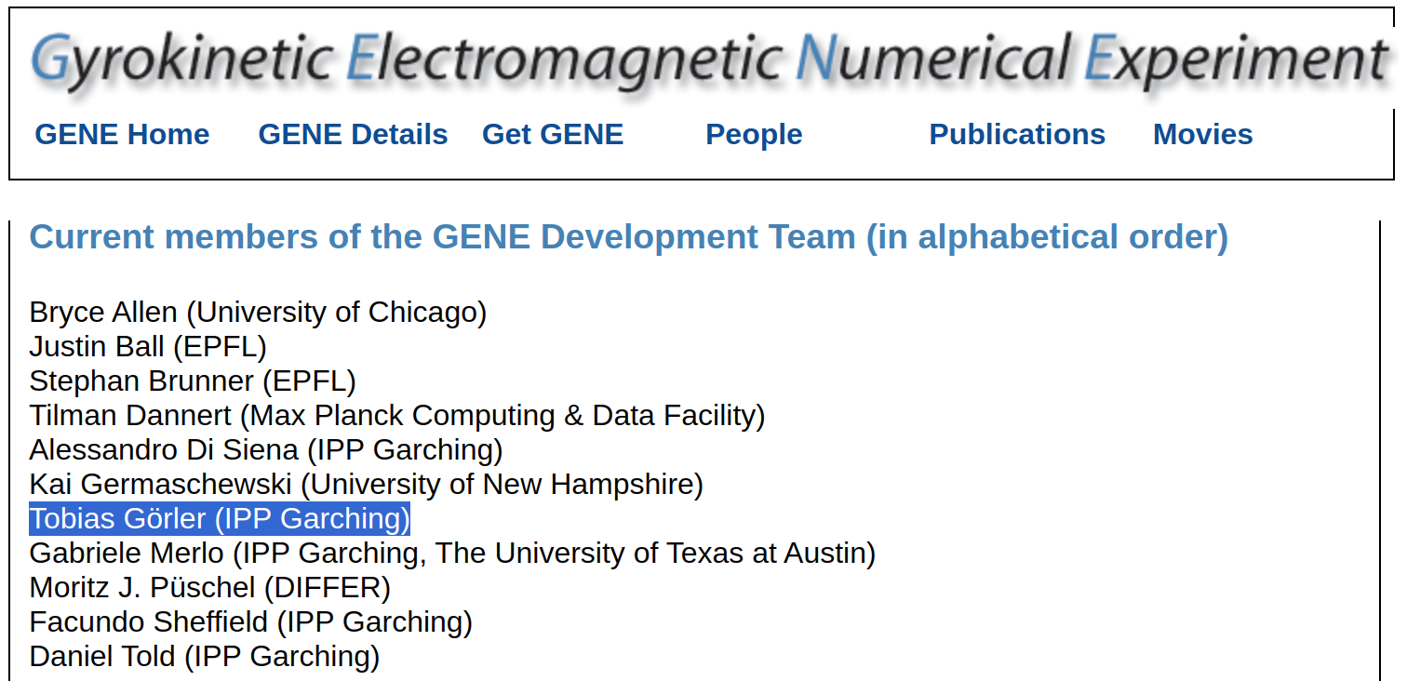
People
Ionut Farcas
A general framework for quantifying uncertainty at scale
Communications Engineer 2022

Slide 4
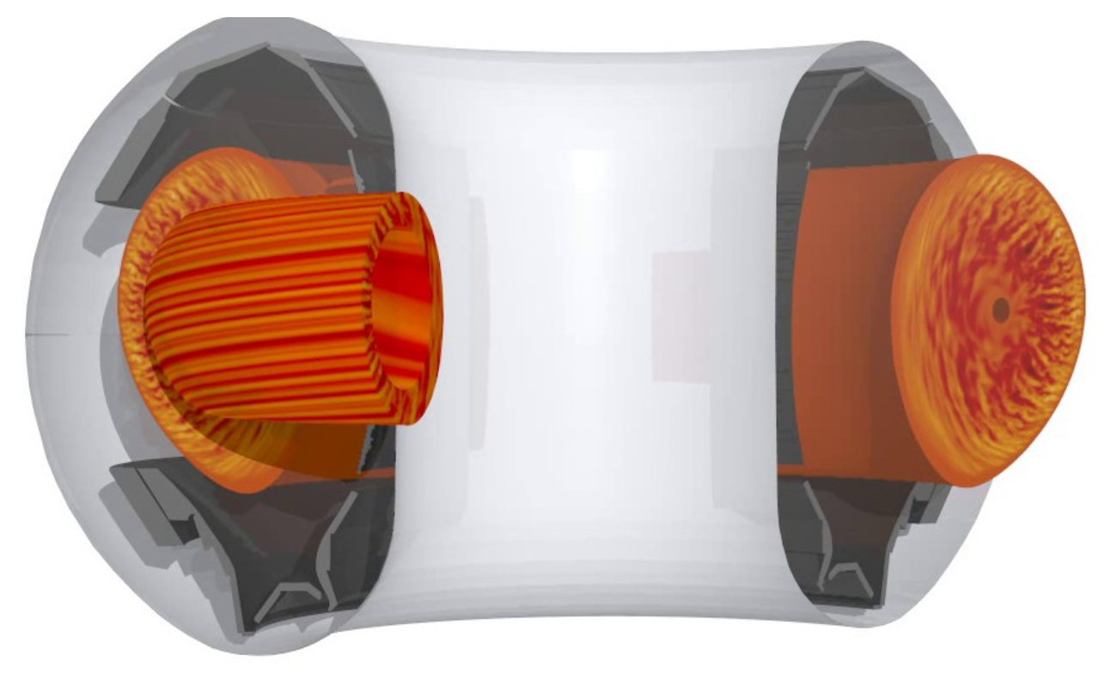
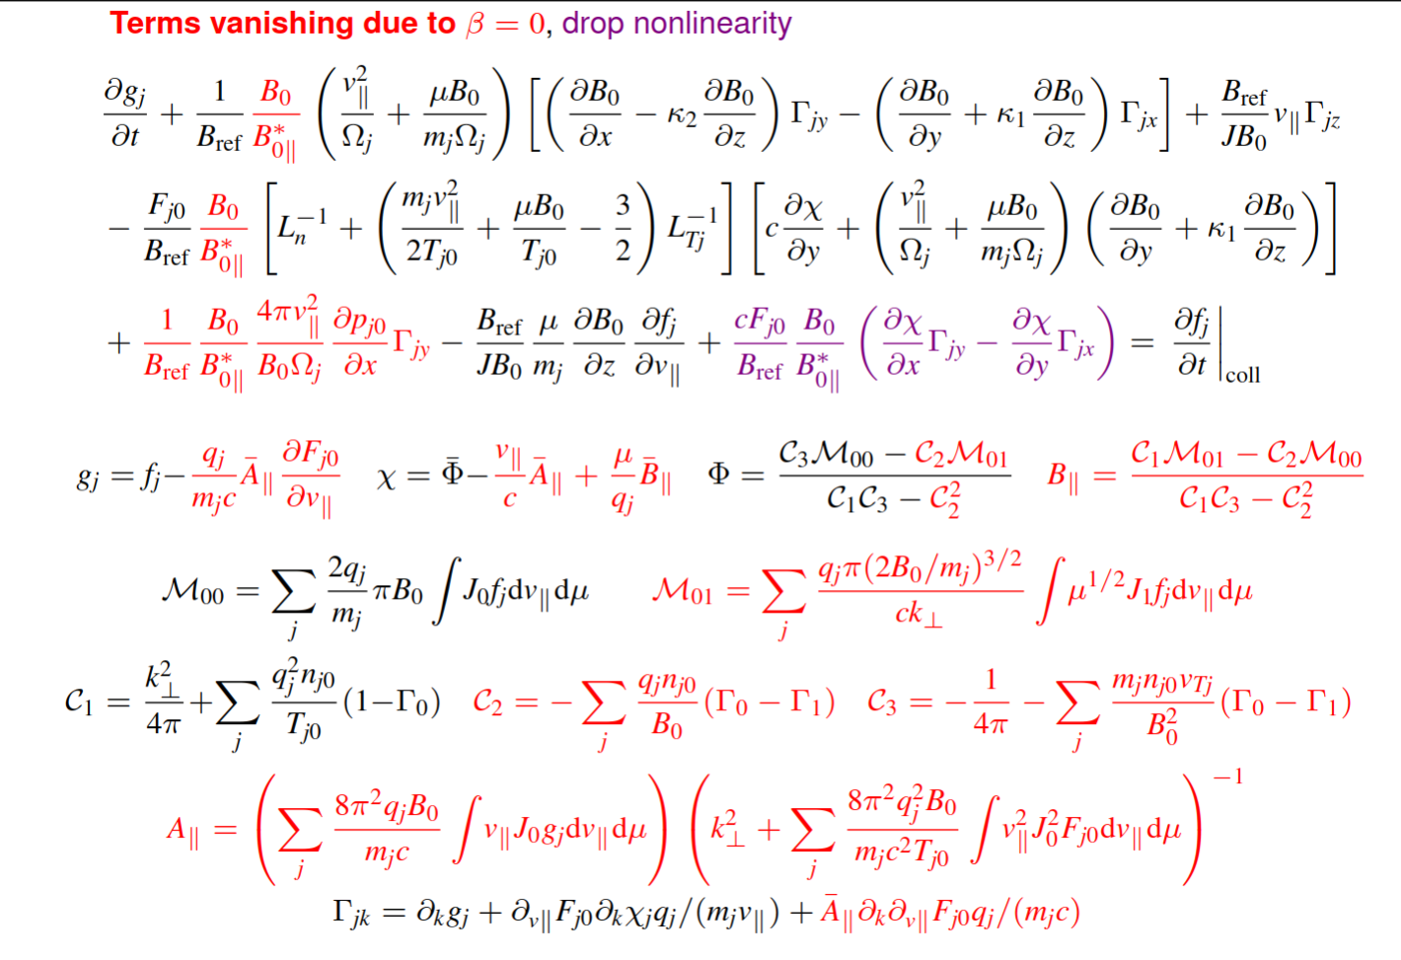
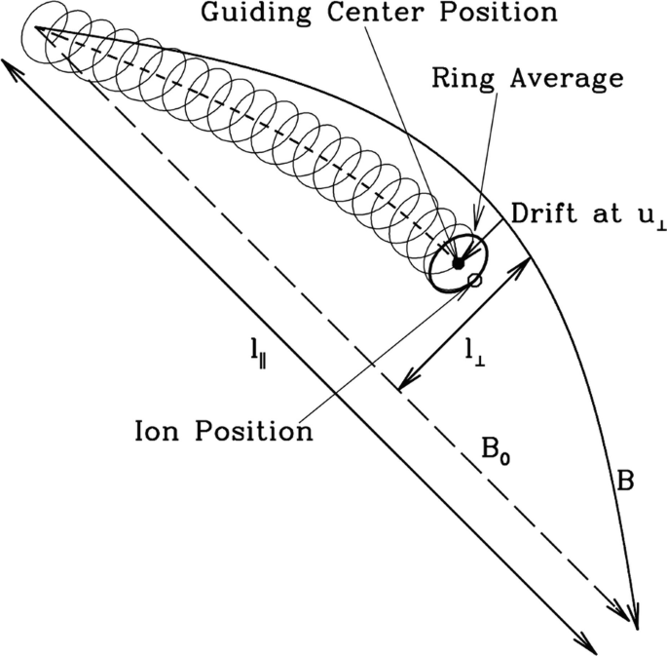

What is GENE
GENE is a gyrokinetic code that tries to solve for the distribution of particles in the plasma
Gyrokinetics uses the assumption that many phenomina we want to observe happen much slower than the gyration frequency
By going into guiding centre co-ordinates and averaging over the gyration angle we reduce the distribution function from 6D to 5D, thus reducing the curse of dimensionality.

Slide 5
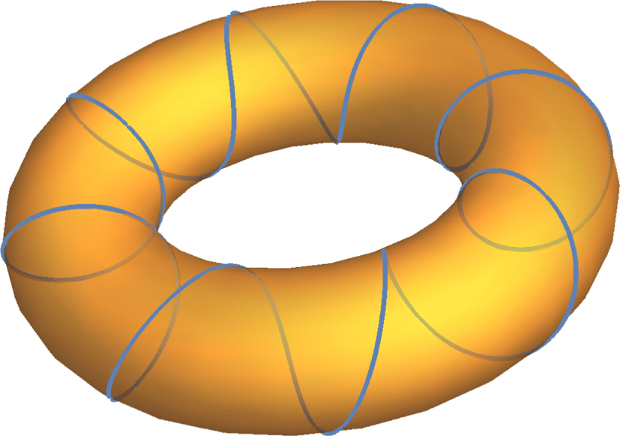
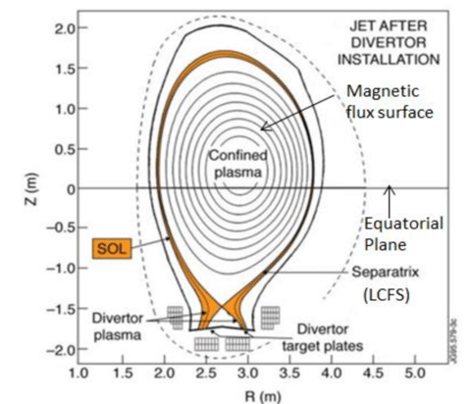
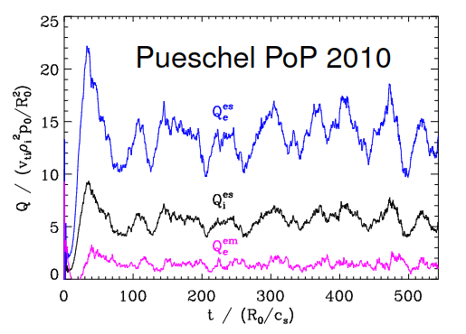
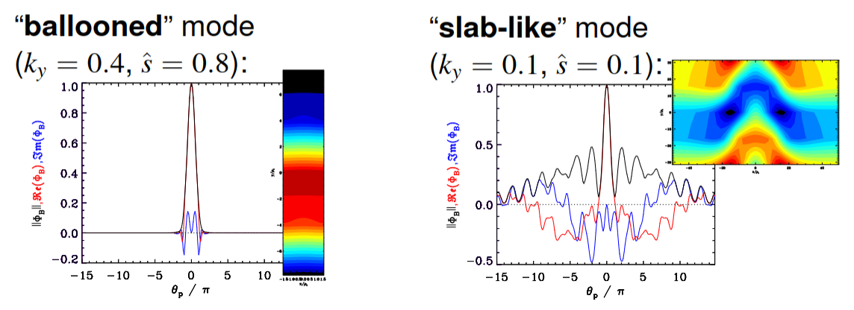
What is GENE
GENE can be ran globally with a specific section of the tokamak geometry
GENE can be ran locally, this means the geometry is a tube centred on a magnetic field line
Symmetry allows the entire flux surface to be represented by a single flux tube.
Heat and particle flux is mostly only accurately captured by non linear simulations
A non-linear flux tube simulation for one minor radius takes a few hundred thousand cpu hours, roughly equivalent to a typical euro-fusion project.
Quasi Linear approach takes linear GENE and a “saturation rule” aka fudge factor, tuned to experiment or a non linear run, allowing for the vicinity to be explored linearly with a good guess for the heat and particle flux.
Inputs:
Tokamak major and minor radius
Magnetic Equilibrium
Density and Temperature Profiles
Initial Distribution
Outputs:
Turbulent Heat and Particle flux
Growthrate of each ky wavenumber
Angular frequency of each ky wavenumber
Balloon Plots
Lots of other stuff

Slide 6
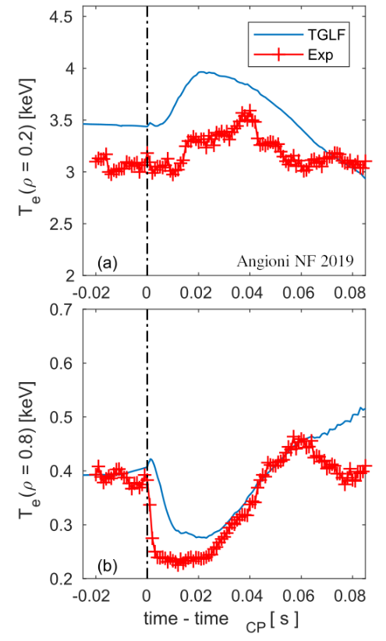

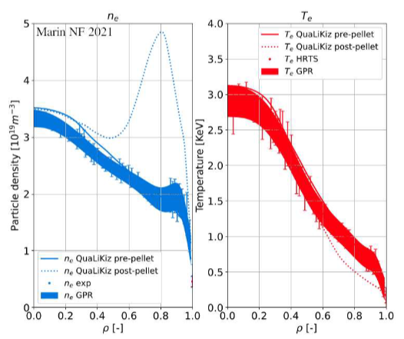
Why is GENE useful?
Impurities are injected to lower edge temperature, the impurities release their electrons which changes electron density gradient which is a drive for certain microturbulance modes.
Then there is a transport mechanism that moved the particles towards the core, which flattens the gradient in the core and you get less TEM, less heat expelled and so the temperature increases.
Turbulence and transport is a complex part of fusion science and it is still largely unknown.
Transport losses ie particles loosing confinement is the major method for heat loss in the tokamak which reduces the temperature and pressure, making ignition more difficult.
Turbulence experts use gene to identify different micro-turbulence modes which have different properties and can be useful or detrimental to fusion performance in different scenarios.
The outputs of GENE are required information for creating reduced models and AI surrogate models that could be included in a larger digital twin or flight simulator that is fast enough to explore a large parameter space for future device planning or real time control.
Fule pellet injection. We get a large bump in the density profile. The density gradients drive micro-turbulence and studies show we get a different turbulance mode appearing on the right than the left of the peak. We get TEM on the left of the peak and ITG on the right.
ITG = Ion Temperature Gradient | TEM = Trapped Electron Mode

Slide 7
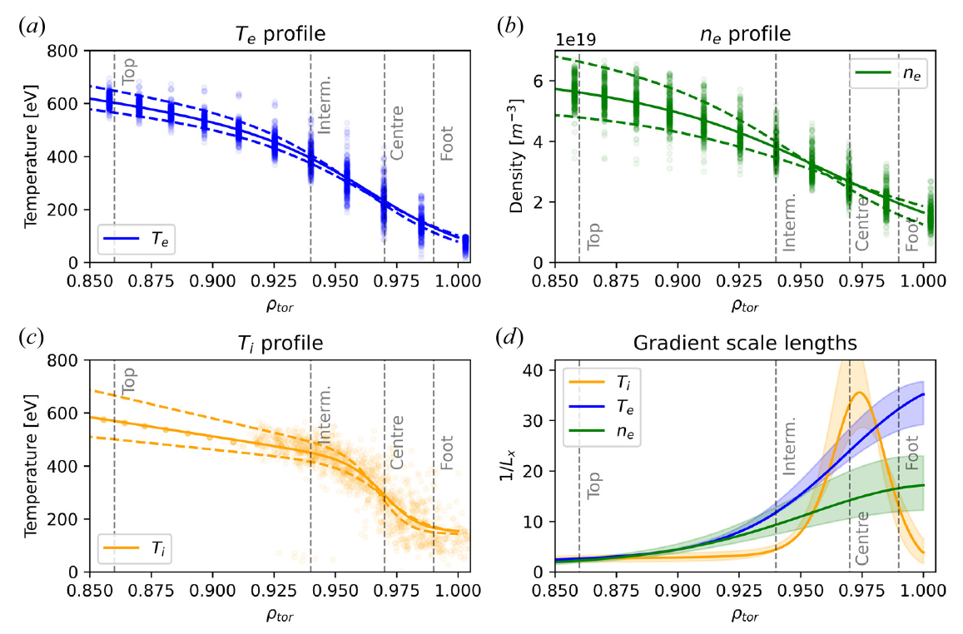
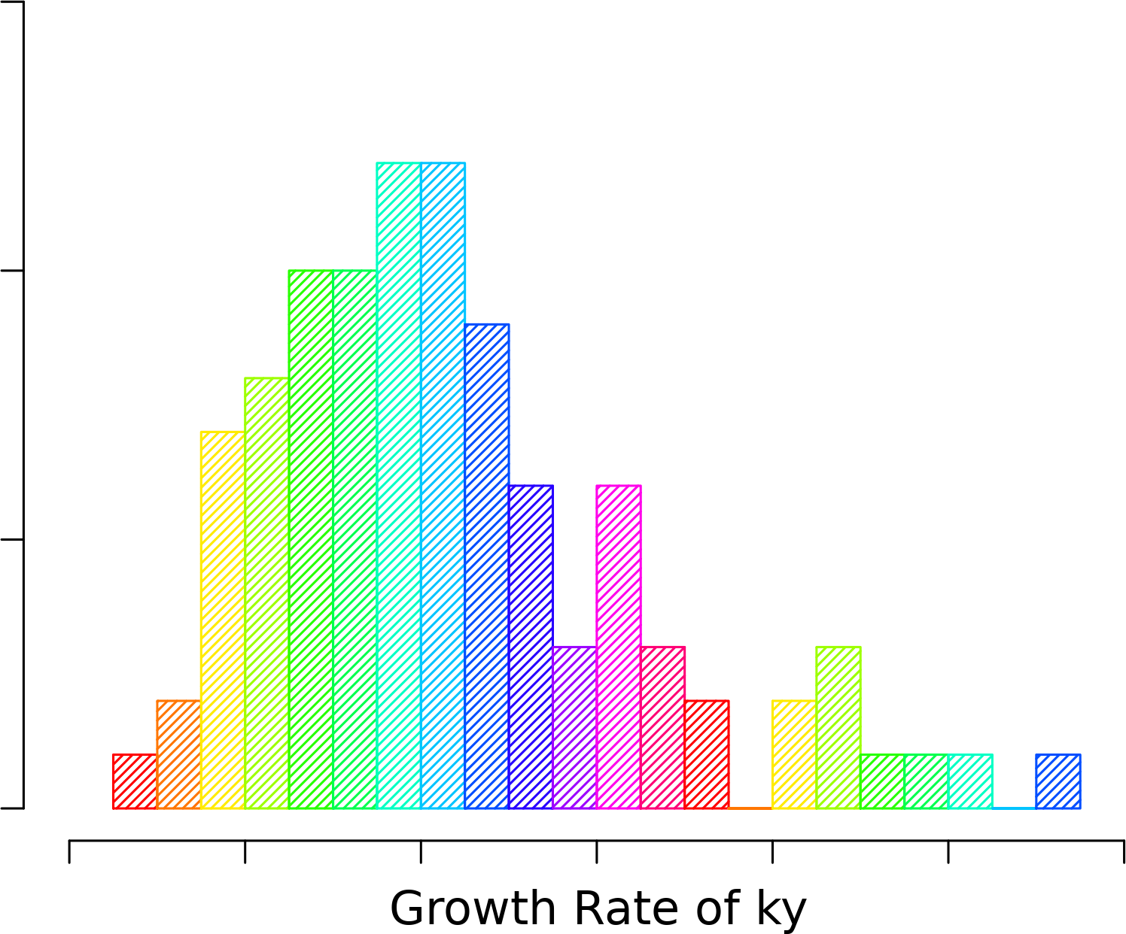
General Approach to UQ
The inputs to GENE often come from experiments, for example temperature gradient and magnetic equilibrium. These have experimental error.
To quantify how much these effect the output of GENE one needs to run GENE multiple times within the bounds of the uncertainty.
Interpolation can be used to approximate the GENE outputs between those points.
This can be used to compute the uncertainty of the output in terms of mean, variance and sensitivity of the inputs.
I plan to fist implement a naive approach where I simply make a histogram of the output given the explored region of inputs.

Slide 8
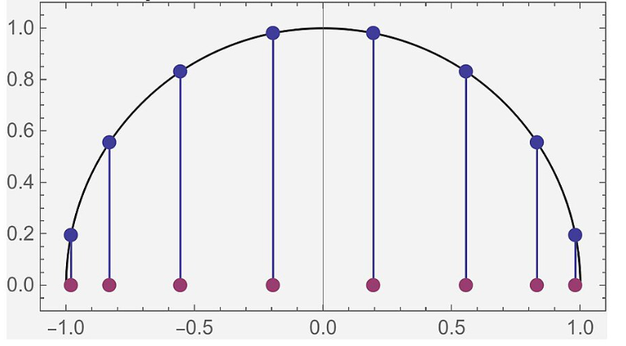
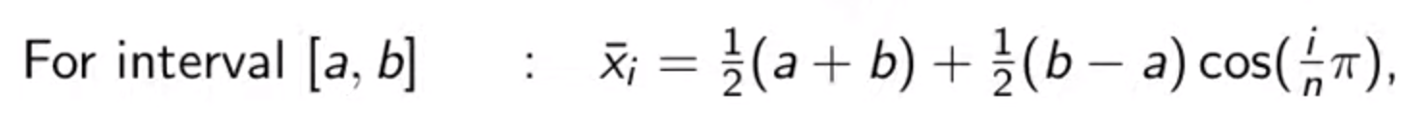
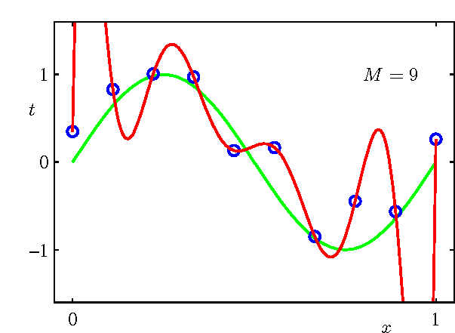

Sparse Grids Static vs Adaptive
Chebyshev Nodes
The goal is to reduce the number of code runs to get a reliable uncertainty quantification, this requires reliance of the interpolation
Static sparse grids selects a grid of code inputs that evenly spreads the interpolation error and provides only enough points required to satisfy the complexity of the interpolation function.
Static SG is highly effective when the number of inputs are small and the output smoothly changes within the uncertainty range of the inputs.
Active sparse grids are made by doing an initial run and then computing sensitivity information and then increasing the density of grid points along the input that greatly affects the output.
This uses the fact that not every input has the same importance on quantifying the uncertainty to reduce the effect of the curse of dimensionality. And can overcome sharp output changes by having more points on the input that cause the sharp change.
More complex interpolation models need more data

Slide 9
Summary
GENE is a gyrokinetic code that tracks the distribution of particles in a tokamak plasma
It can be used to study turbulence and transport to identify ways of purging impurities and transporting fuel to the core or for creating reduced models that can be apart of a flight simulator
The uncertainties can be computed by treating it as a black box and computing the output variance given an input uncertainty range.
Sparse grids can be used to reduce the computational cost from the curse of dimensionality.
Currently static sparse grids with polynomial interpolation has already been implemented with impressive results and my job is to implement adaptive sparse grids to further reduce the curse of dimensionality and deal with sharp changes in the output as the input changes.

