Slide 1
Final Project Classifier & Image Generation
Group 4
108062313 黃允暘 108062311杜方辰
108062122 顏訓哲 108062336陳柏元

Slide 2
Classifier

Slide 3
Methodology
Model: Efficientnet-B6
Data analysis: mean std
Calculate each kind of plane number

Slide 4
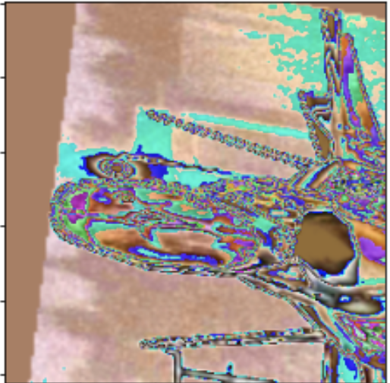
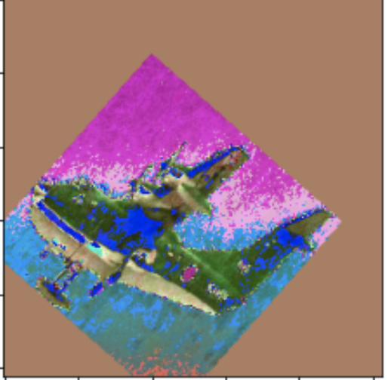
Training method
Optimizer: Adam
Learning rate: 1e-5
Loss function: categorical crossentropy
Matric: Accuracy
Image Augmentations: color jitter, rotation, invert…
Adaptive learning rate

Slide 5
Result
Validation set: 0.95
Test set: 0.93

Slide 6
Generator

Slide 7
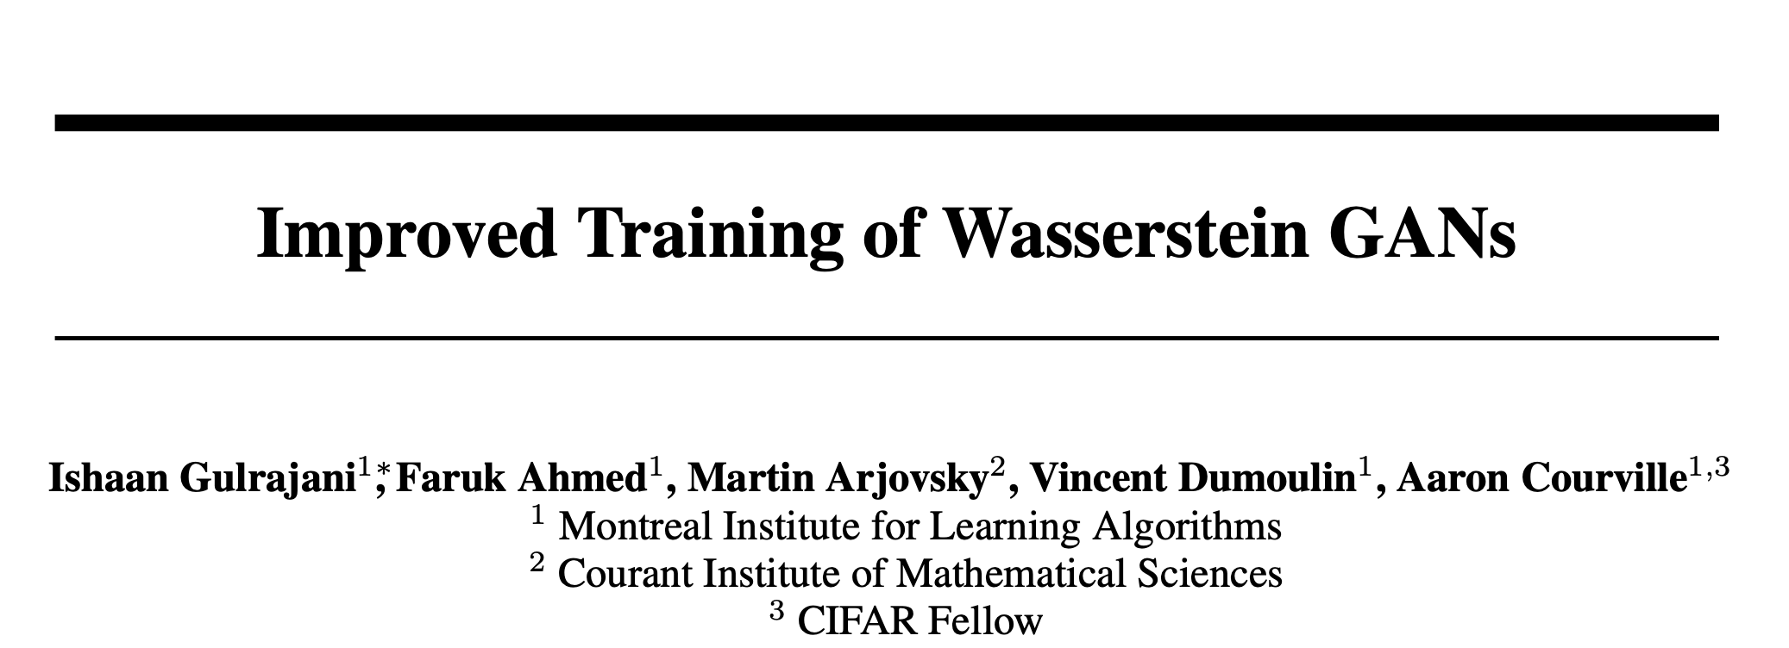
Improved WGAN

Slide 8
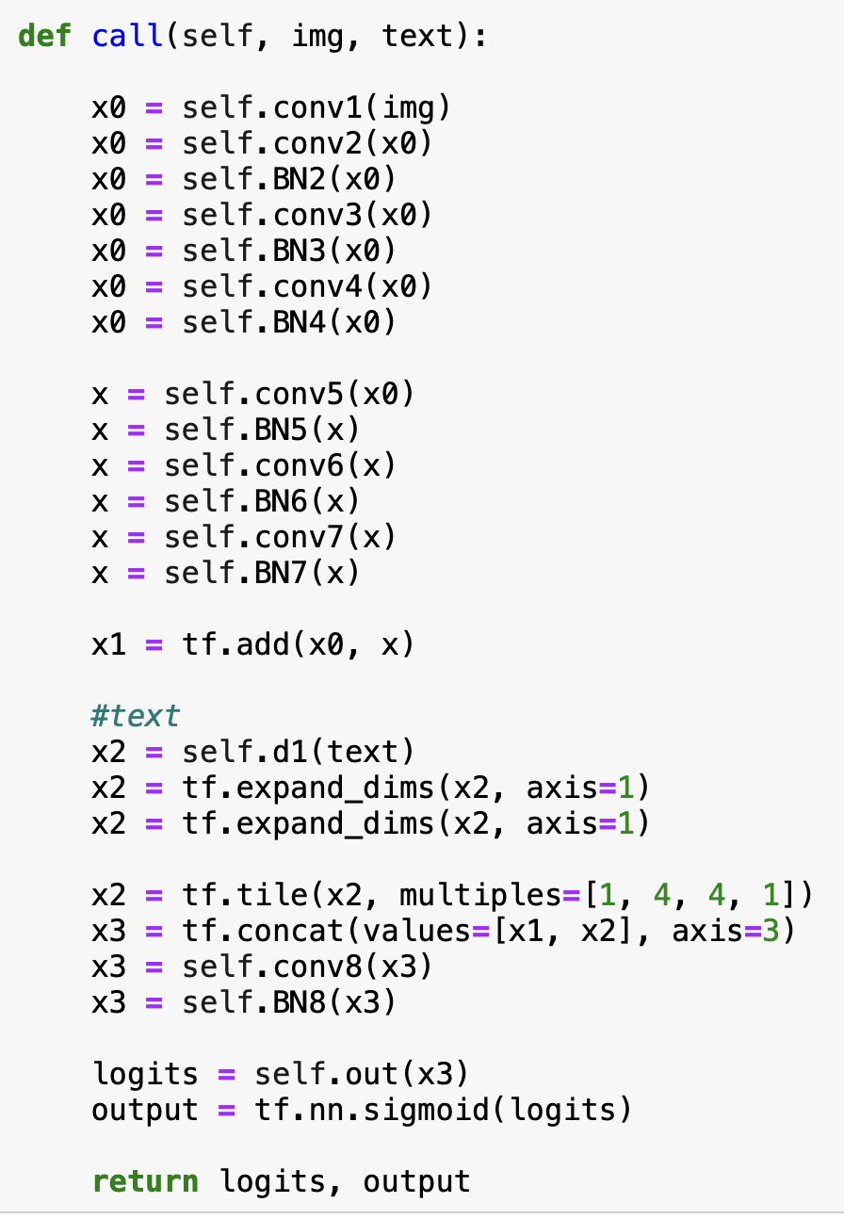
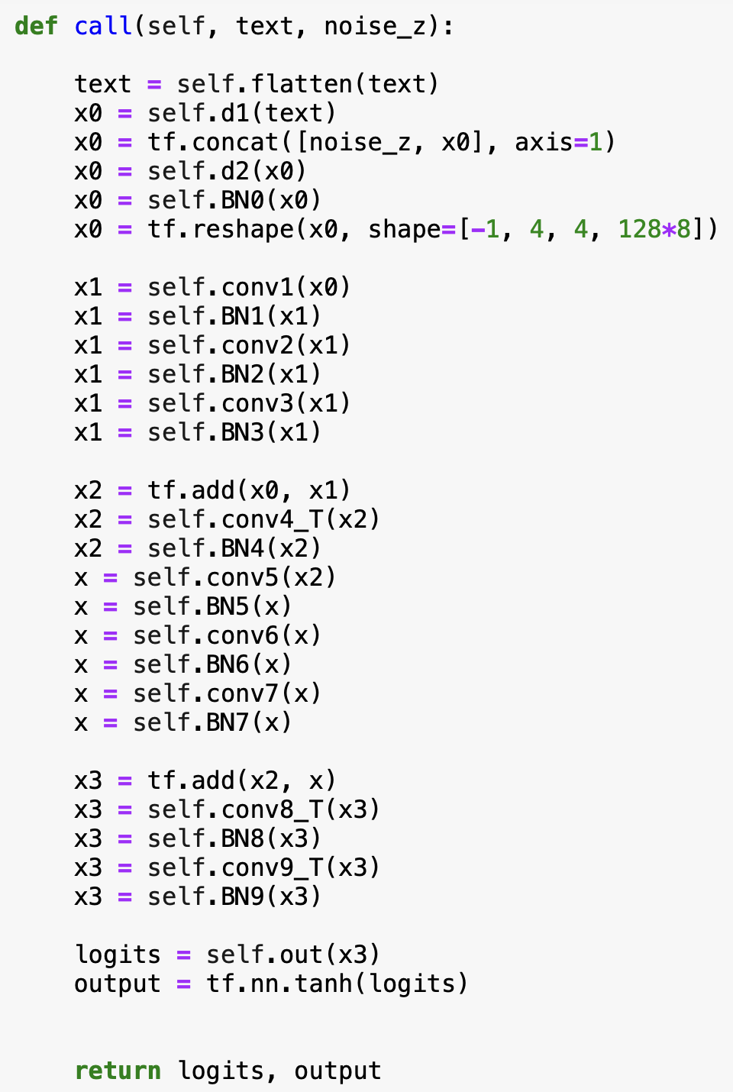
Model architecture
Generator
Discriminator
Text Encoder
Pretrained Bert

Slide 9
Loss function and optimization
Optimizer: Adam
Three pairs:
(real_image, text)
(fake_image, text)
(interpolate, text)
interpolate = a*real_image + b*fake_image, a+b=1
Discriminator

Slide 10
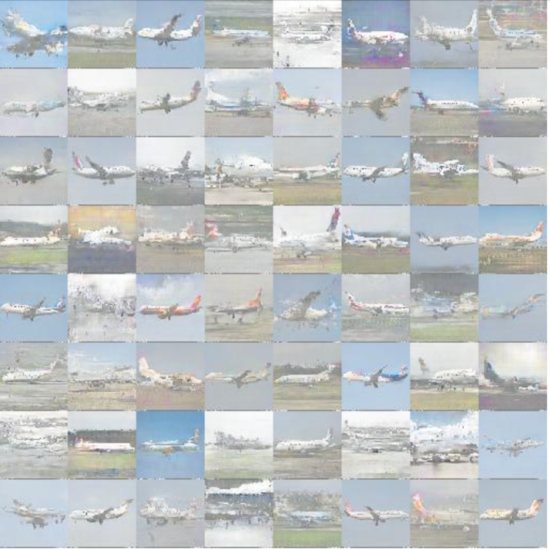
(Bonus) Test result / Demo result

Slide 11
Thank you for your listening

