Slide 1
SNP calling in the founder data

Slide 2
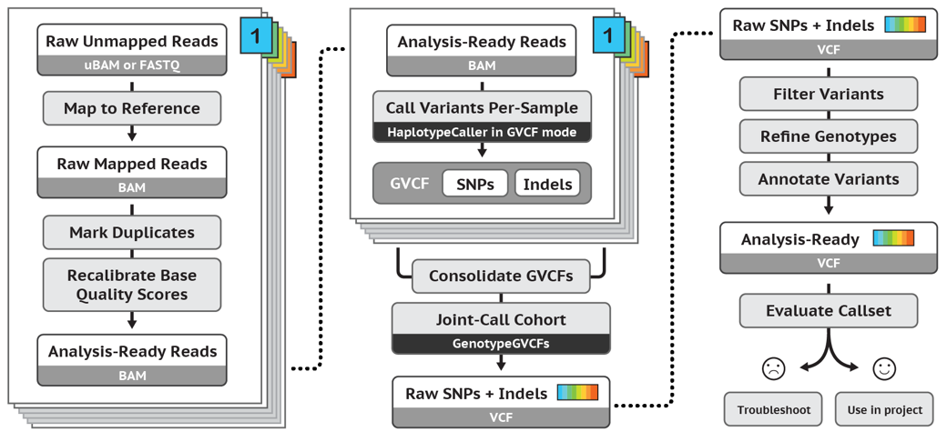
Traditional pipeline (GATK4)

Slide 3
DeepVariant - a deep learning-based variant caller

Slide 4
% Mendelian violation
(27.96%)
DeepVariant.human.GQ0.
DeepVariant.human.GQ20
DeepVariant.trained.GQ0
DeepVariant.trained.GQ20
Gatk.GQ0
Gatk.GQ20
(21.22%)
(7.91%)
(3.12%)
(21.38%)
(8.94%)

