Slide 1
SNP calling in the founders
FITNESS meeting: 30.10.23

Slide 2
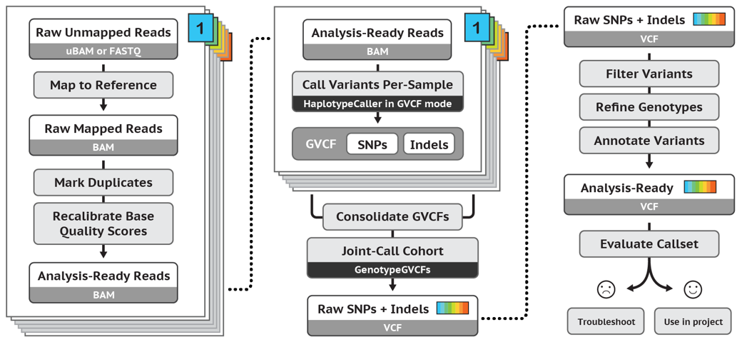
Traditional pipeline (GATK4)

Slide 3
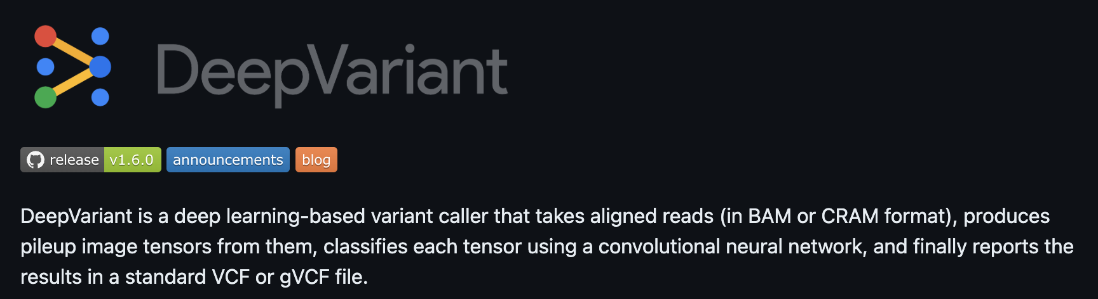
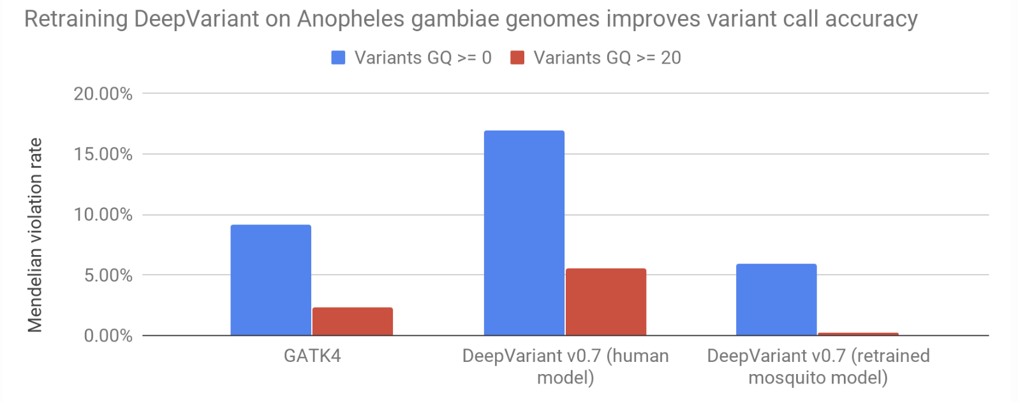
Q: Why use DV?
A: Reduced error rates

Slide 4
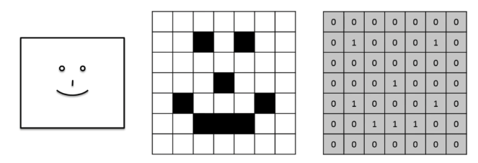
DeepVariant - a deep learning-based variant caller
Uses a Convolutional Neural Network (CNN) designed to classify images
- i.e. it takes and “image" as input, and outputs a probability that it belongs to a certain class.
This “image” . . .
. . . has three “Channels”
. . . a “Tensor” is a
3D array of pixel values)
Red
Green
Blue

Slide 5
DeepVariant – uses 6 channels on a ”pileup” image
Tensor dimensions:
(100, 221, 6)
( H , W , D)
Variant in question is always at the centre
Outputs a liklihood for 0/0, 0/1, or 1/1

Slide 6
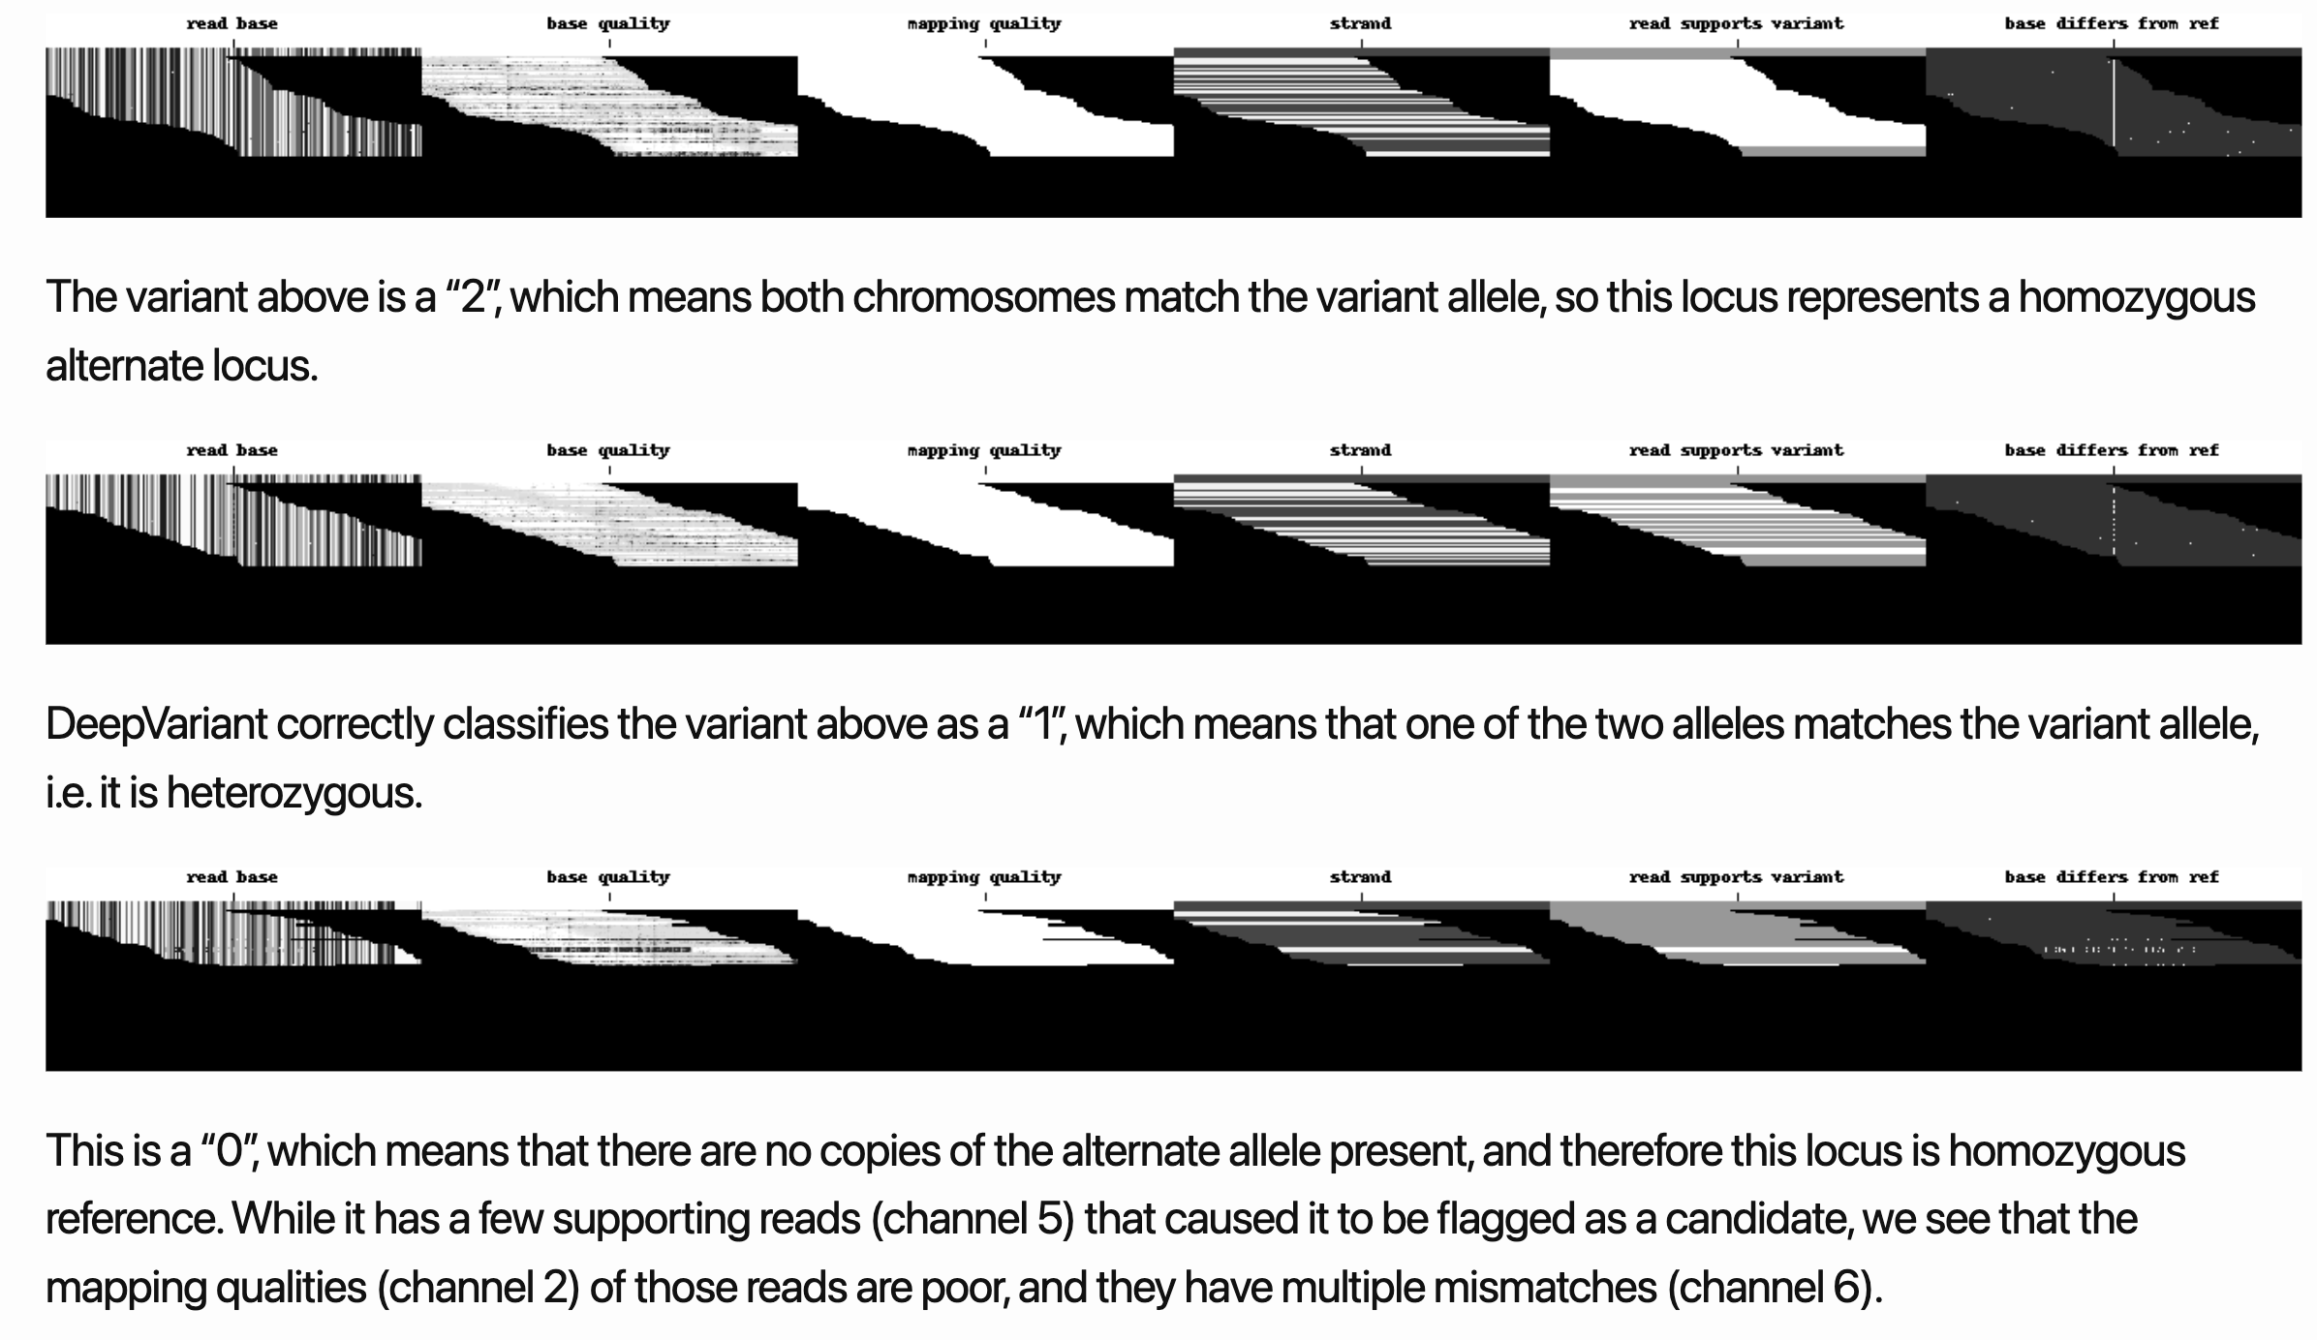
https://google.github.io/deepvariant/posts/2020-02-20-looking-through-deepvariants-eyes/

Slide 7
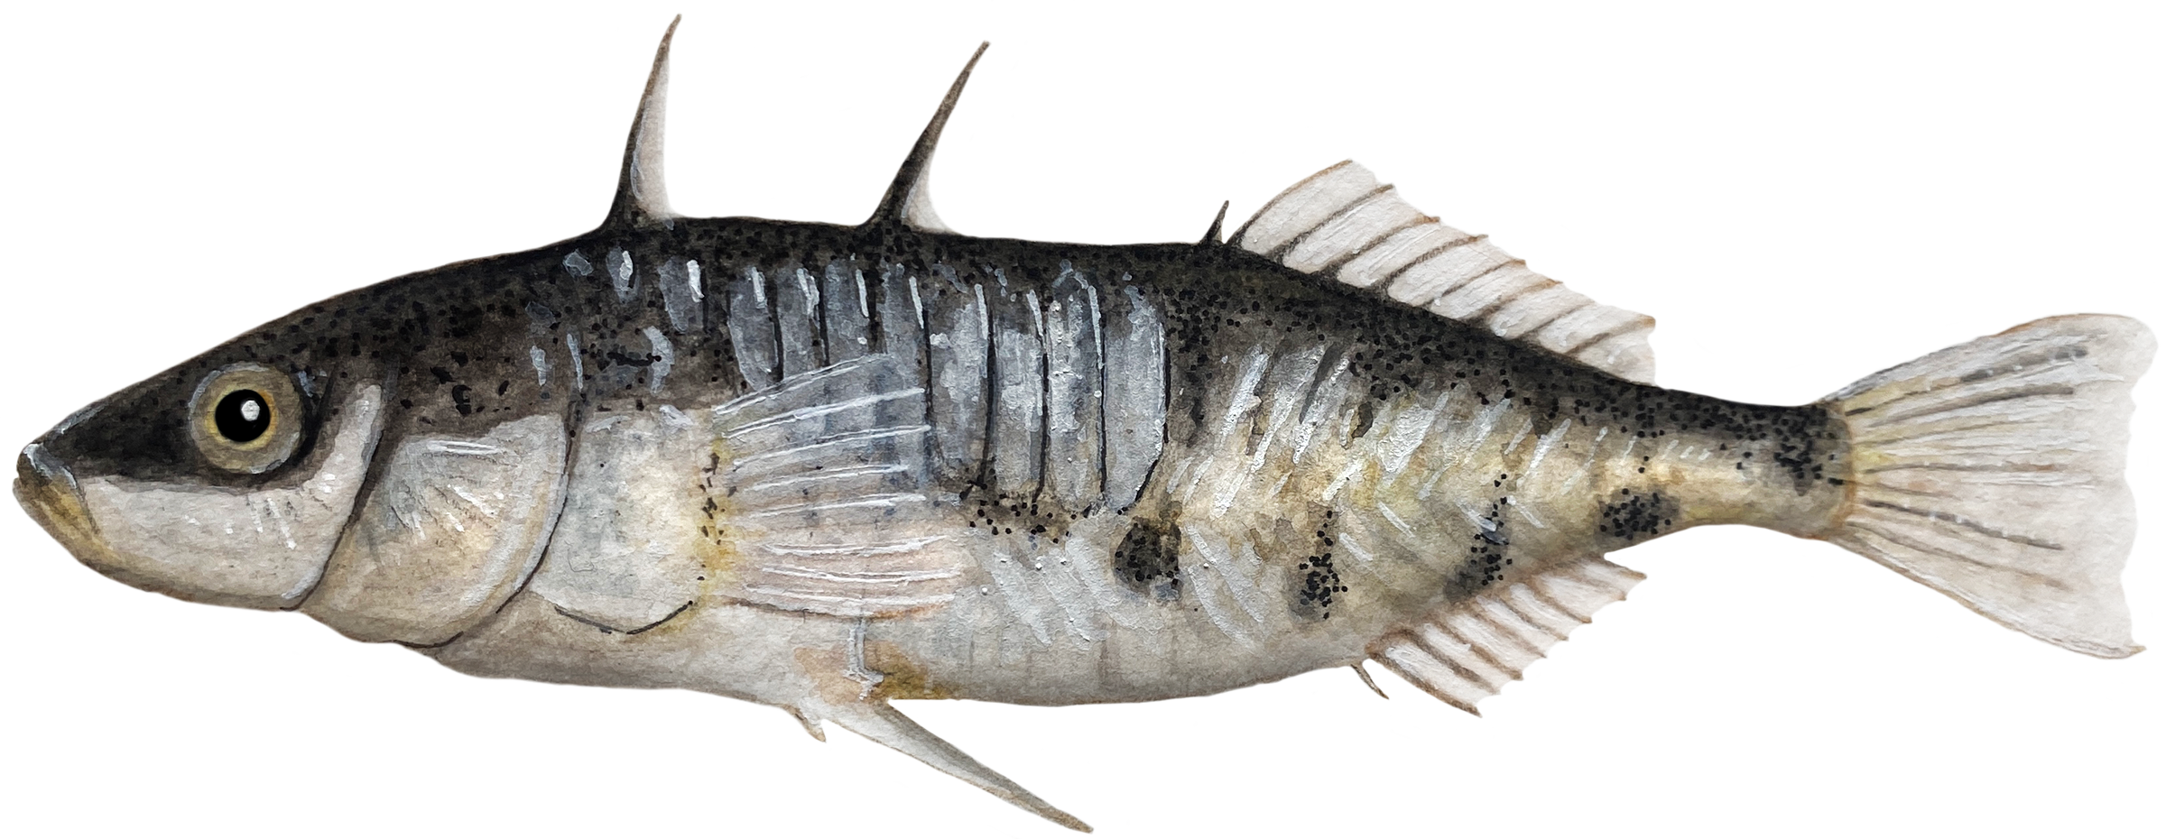
Training the model – using crosses to Train the CNN
0/0
1/1
Truth_set.vcf
Parents
CHROM POS
1 34242
1 35697
1 36989
1 38934
1 39038
…
0/1
F1
Mendelian segregation allows us to be confident of this genotpe
So we can use these to train the CNN on what true variants “look” like

Slide 8
Training the model – using crosses to Validate the CNN
0/0
1/1
Parents
% mendelian violations
0/1
F1

Slide 9
Validating the model
Sardell et al. 2021:
15 crosses (Blackspotted father, Threespine mother, one son, one daughter).
Training dataset
Validation dataset

Slide 10
Prelim training results
% Mendelian
violation
Call set
GATK4 - GQ0
GATK4 - GQ20
DeepVariant - human - GQ0.
DeepVariant - human - GQ20
DeepVariant – trained - GQ0
DeepVariant – trained - GQ20
21.38%
8.94%
27.96%
21.22%
7.91%
3.12%

Slide 11
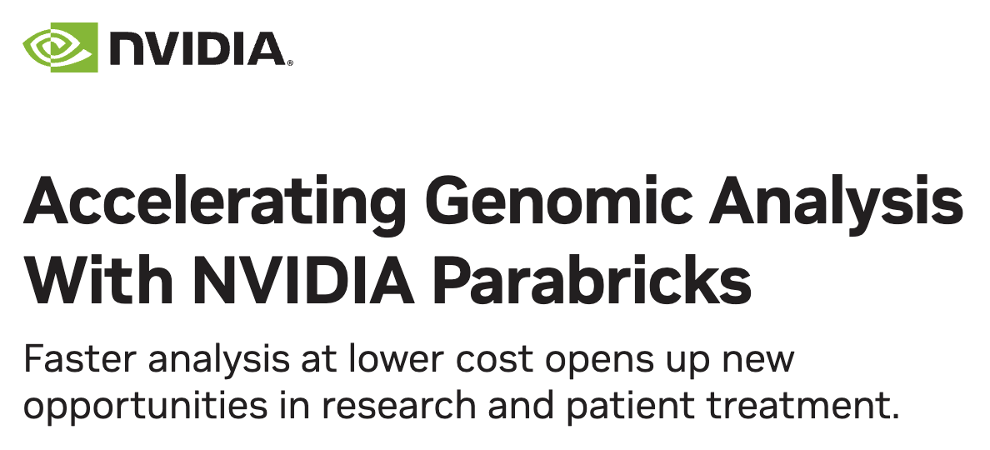
Roughly 10x faster than DV without GPU accelleration

