Slide 1
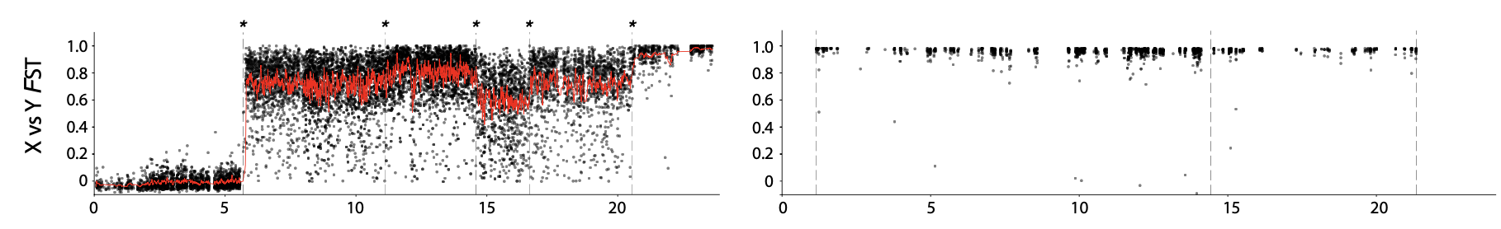
CALCULATE THE MEANS WITHIN THE STRATA,
USE THOSE AS THE RED LINES HERE!
Non-stepwise degeneration based on Fst (from population data)

Slide 2


Slide 3


Slide 4


Slide 5


Slide 6


Slide 7


Slide 8


Slide 9


Slide 10


Slide 12


Slide 13


Slide 16
Non-stepwise degeneration based on Fst (from population data)

