Slide 1

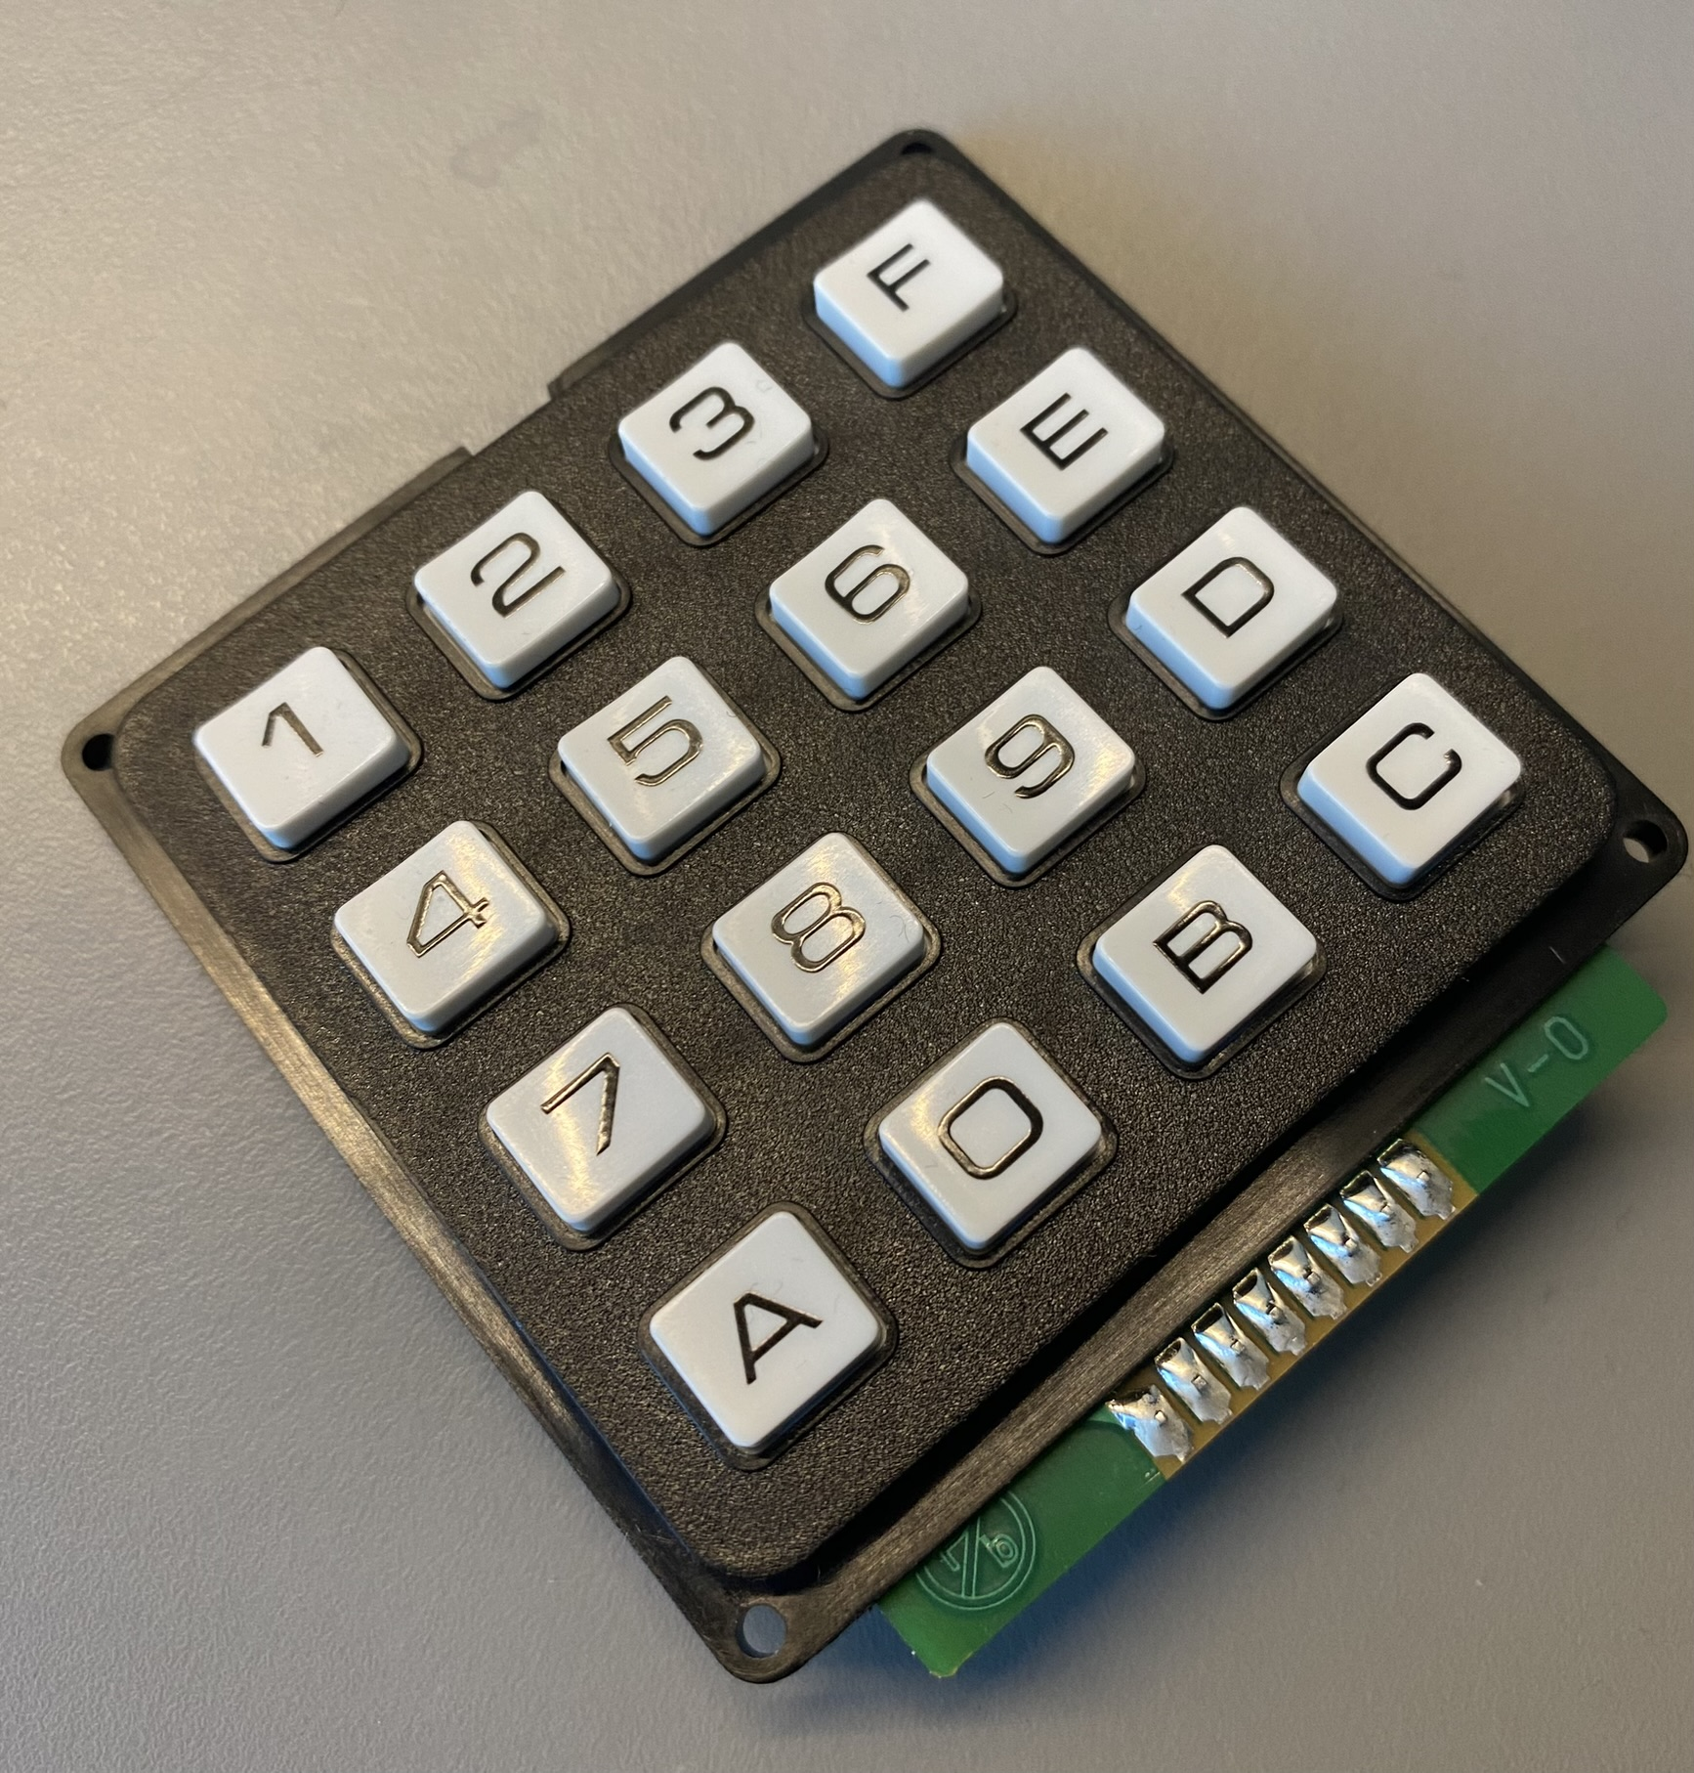
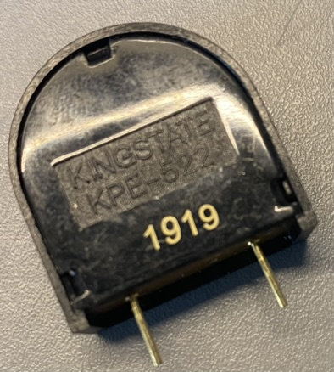
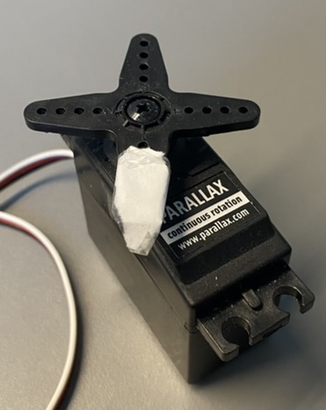
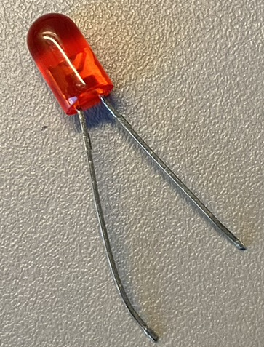
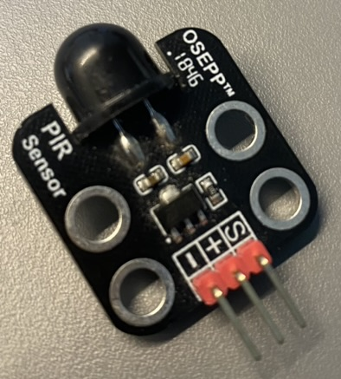
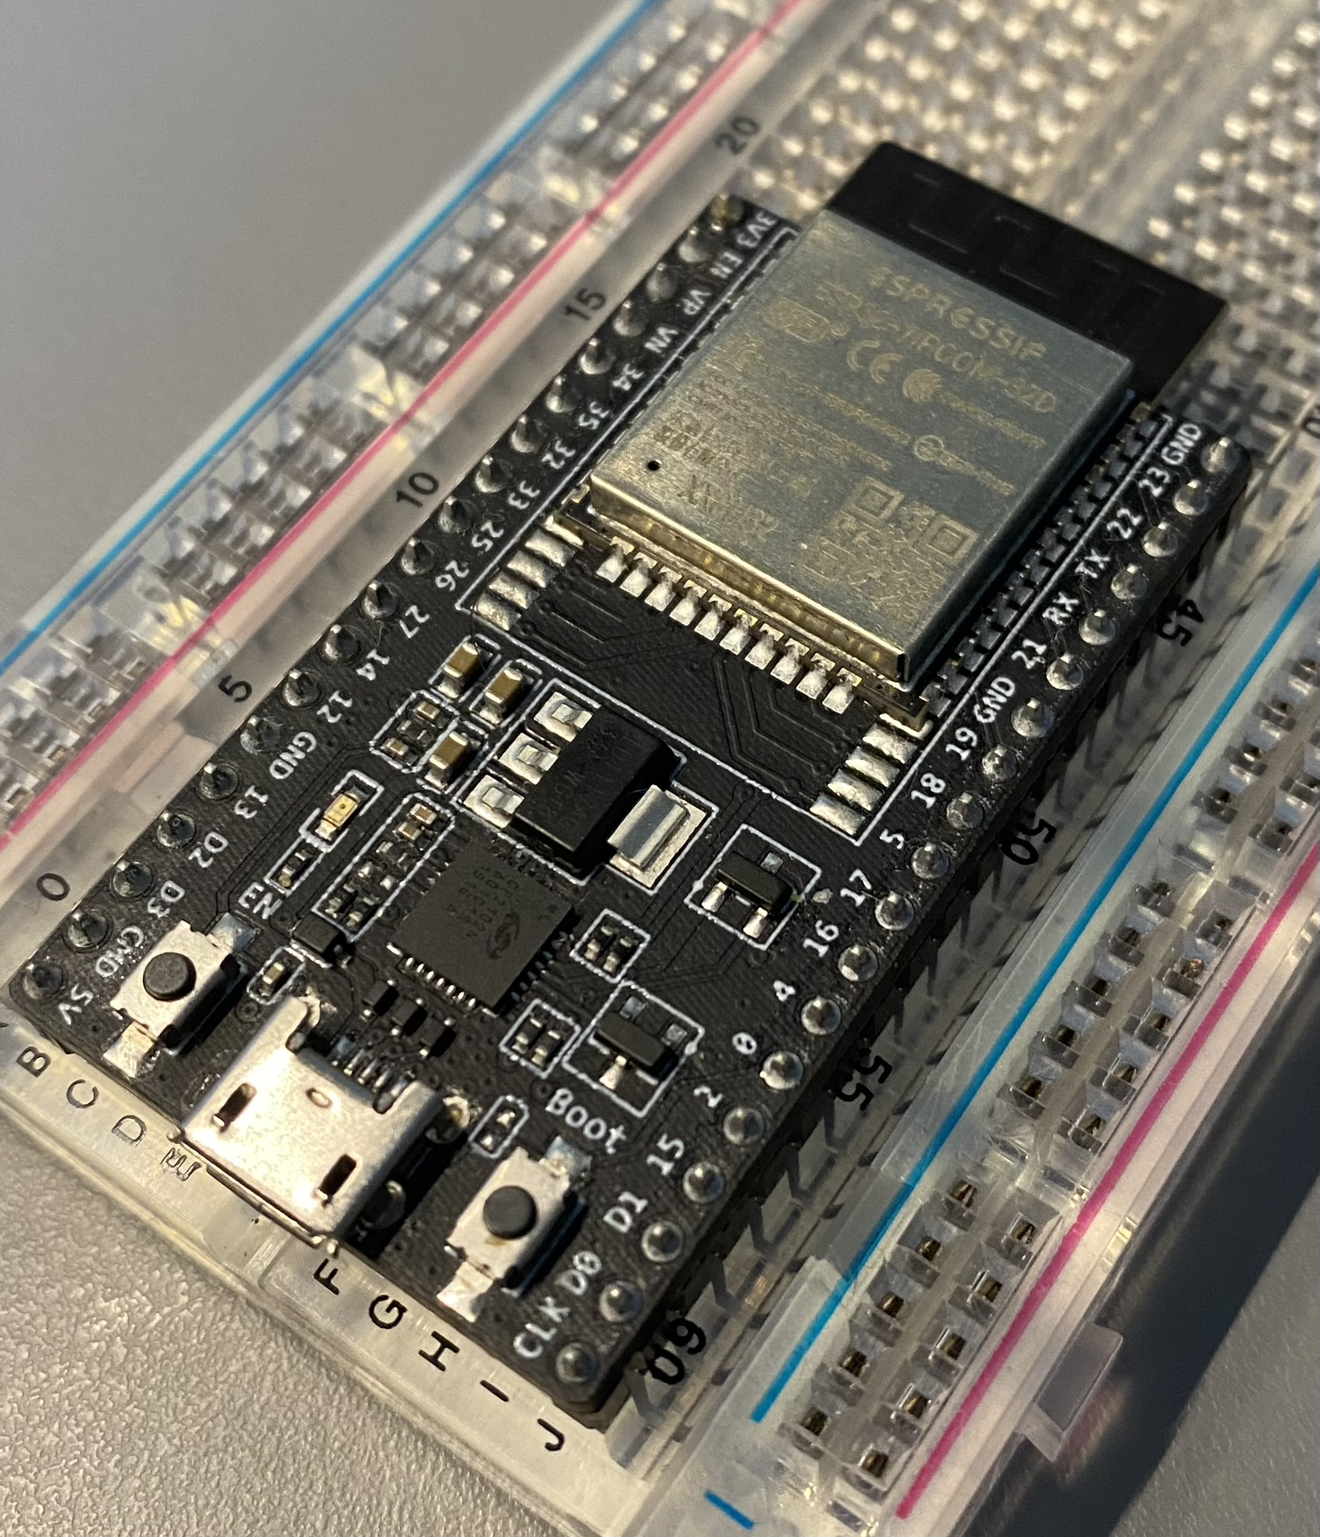
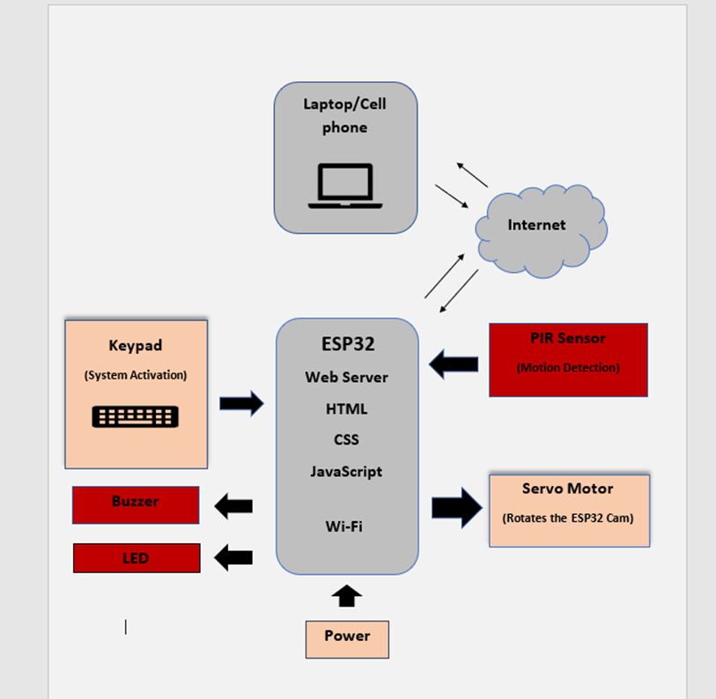
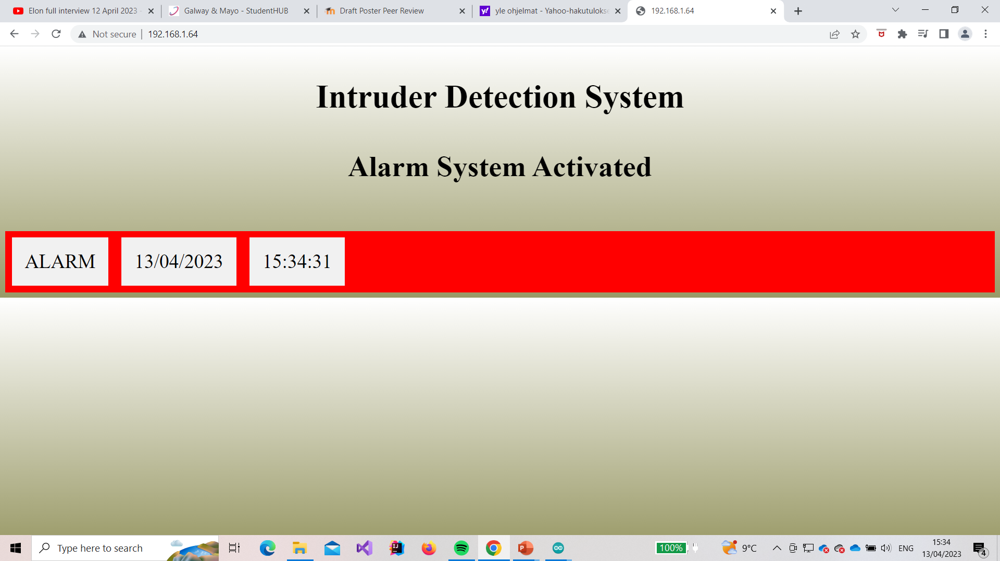
Intruder Detection System
Project by Dan Koskiranta
BENG in Software & Electronic Engineering
Project Description
Features
The Intruder Detection System is designed to increase the security of peoples homes. With the help of this system, anyone can feel a bit safer about their property. You can regularly monitor the status of your home remotely with the help of a web browser. Using a web browser, a request must be sent to the ESP32 web server which will respond with a web page.
The system is activated and deactivated by entering a code from the keypad
The signal will trigger a buzzer for sound alarm.
The ESP32 sends a PWM (Pulse Width Modulation) signal to the servo motor to start rotating between 0 and 180 degrees continuously. Servo motor rotates the ESP32 Cam.
An LED is used for visual alarm indication
A PIR (Passive Infrared) sensor will scan the area to detect any temperature changes from room temperature to body temperature. This change in temperature is sent as a signal to the ESP32 board. The signal will trigger an alarm.
An ESP32 web server is created to display the alarm. With the website the user is able to monitor their house constantly.
Architecture Diagram
Sustainability
Web Page
This project has an impact on UN sustainable development goal 11.1. The project could potentially affect sustainable cities and communities. This project is planned to increase security, so it can make human settlements safer and therefore our communities safer.
Because of the low cost of this project, anyone can use this system to increase the security of their house.

