Slide 1
Aurora-3 Avionics Bracket — PDR
Preliminary design review · February 3, 2026

Slide 2
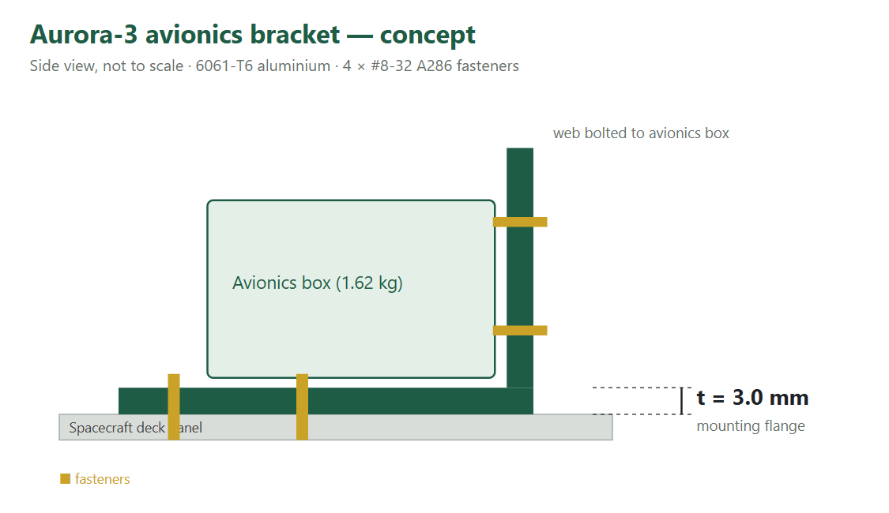
Configuration
6061-T6 aluminium L-bracket
Mounting flange 2.0 mm thick
4 × #8-32 A286 fasteners to deck
Avionics box 1.62 kg

Slide 3
Requirements: factors of safety
Factor | Value | Source
Ultimate design | 1.4 | NASA-STD-5001B Table 1
Yield design | 1.25 | NASA-STD-5001B Table 1
Qualification test | 1.2 | Protoflight approach

Slide 4
Quasi-static loads
Axis | Load factor | Limit force
X | 12 g | 219 N
Y | 12 g | 219 N
Z | 18 g | 328 N

Slide 5
Margins of safety
Part | Mode | MS | Status
Flange | Bending, ultimate | 0.23 | OK
Flange | Bending, yield | 0.15 | Low
Bolt | Tension, ultimate | 1.00 | OK
Flange yield margin is below the 0.15 project threshold → action PDR-1

Slide 6
Open items
PDR-1: increase flange thickness or change material
PDR-2: apply fitting factor to fastener analysis (NASA-STD-5020B)
PDR-3: plan protoflight vibration test

