Slide 1

HEART RATE MONITOR
P2g1 – Engenharia de software – 2018/2019

Slide 2
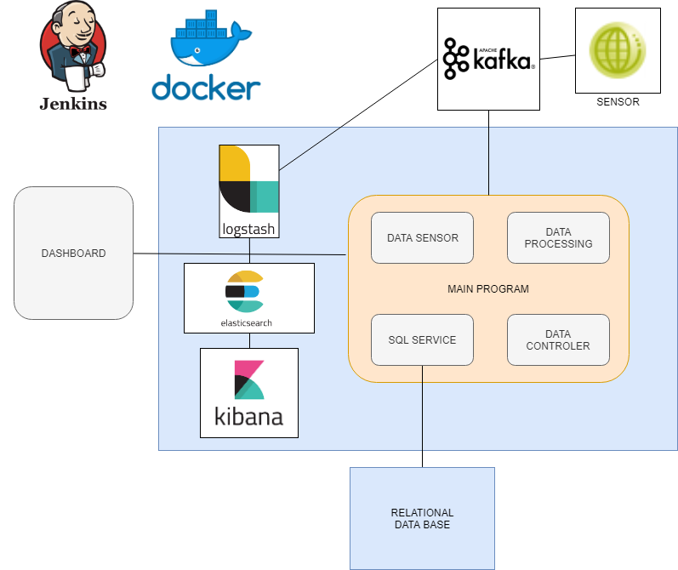

Slide 3
Main problems and solutions

