Slide 1

HEART RATE MONITOR
P2g1 – Engenharia de software – 2018/2019
André Oliveira – 79969
Daniel Martins – 80026
Bruno Mendes – 68411
Silvia Neves - 49938

Slide 2
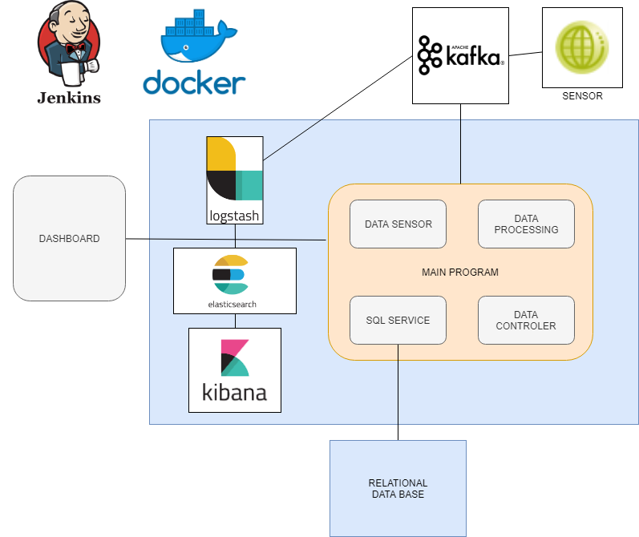

Slide 3
Main problems and solutions

