Slide 1
Zero to Native App in 8 Hours
William Mansfield
wmansfield@socialhaven.com

Slide 2
I don’t PowerPoint

Slide 3
Introduction Who am I? What is Social Haven? Is this..?
Notes:
William – Architect, Developer, Entrepreneur
Social Haven – Engagement Platform designed for private schools, but found a home as white label platform.
Not – App In Box, Parse, Rigid

Slide 4
You will need
A computer
Development Skills
Patience

Slide 5
You will create
Scalable Data-Centric Native App
IOS
Android
Web
Scale Up/Out Flexibility

Slide 6
A Path
Not ‘The’ Path

Slide 7
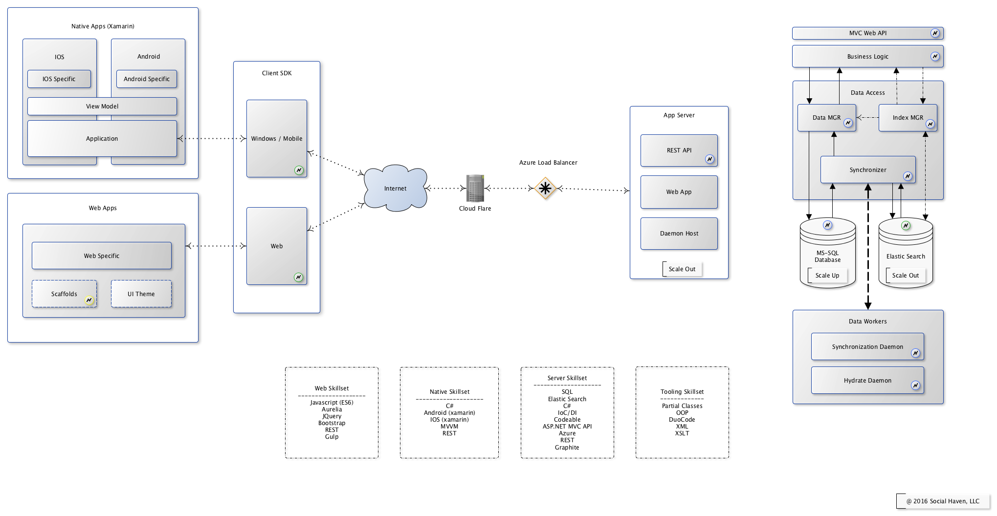
Big Picture

Slide 8
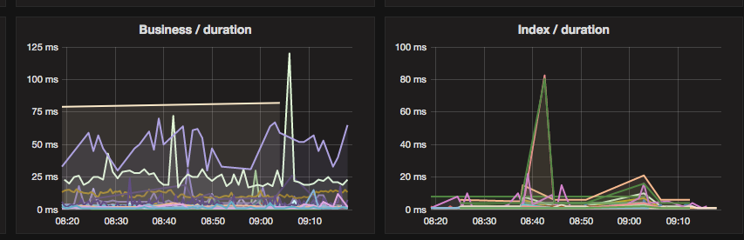
Real Insights

Slide 9
Big Concepts

Slide 10
Data Storage
Database
ACID (atomicity, consistency, isolation, durability)
Scale Up (scale out very limited)
NoSQL
Not ACID
Simple or No Relations
Scalable by design
Caching
Speed, Scale, Invalidation/TTL
Typically Ad-Hoc or Edge based
Notes:
Focus

Slide 11
Caching Inverted
What to cache?
How to cache?
How to expire?
What if everything was cached?
Each item 0.5Kb
2M items = 1GB

Slide 12
Elastic Search
Search Engine
Scales Beautifully
Incredibly fast
Supports Aggregations
Has relationships [not the same as sql!]
Moderate refresh time (1s)
Retrieve guaranteed
Our perfect cache engine

Slide 13
Data Access
API
REST (RESTish)
Resource/Verb Human Readable
IIS (Website)
SDK
Client Library to consume API

Slide 14
Big Picture (again)

Slide 15
Stencil v1.0
Tooling
Gen Tool
XSL/XML
Frameworks
Codeable.Foundation
Core Code Components
Skeleton
Compositions & Patterns
DI/Indexing/Aspect/Plugins/etc

Slide 16
Stencil Walkthrough
Bye bye powerpoint

Slide 17
Homework
Prepare Environment
Install Visual Studio/Xamarin Studio/Visual Studio Code
Acquire SQL Server
Acquire Elastic Search
Acquire Web Host (asp.net website)[azure?]
Set up HostedGraphite (optional health)
Create Project
Clone from Git
Rename files/folders (“Stencil” => “YourWord”) [optional]
Update Assumptions
Find “SocialHaven”, replace as needed.
Create App Store Accounts
DnB if business
Apple Developer, Google Play

Slide 18
Next Session
Getting your app data ready
Creating Database
Create Services
Wire up User Interfaces (ios/android/web)

