Slide 1


TERRAFORM

Slide 2
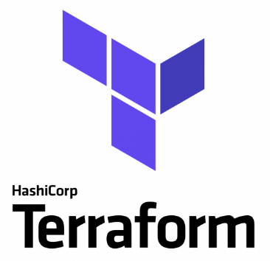
What is Terraform?
Terraform is a tool for building, changing, and versioning infrastructure safely and efficiently
Terraform can manage existing and popular service providers as well as custom in-house solutions.
The infrastructure Terraform can manage includes low-level components such as compute instances, storage, and networking, as well as high-level components such as DNS entries, SaaS features, etc.

Slide 3
key features of Terraform
Infrastructure as Code
Infrastructure is described using a high-level configuration syntax. This allows a blueprint of your datacenter to be versioned and treated as you would any other code.
Execution Plans
Terraform has a "planning" step where it generates an execution plan. The execution plan shows what Terraform will do when you call apply.
Resource Graph
Terraform builds a graph of all your resources, and parallelizes the creation and modification of any non-dependent resources. Because of this, Terraform builds infrastructure as efficiently as possible, and operators get insight into dependencies in their infrastructure
Change Automation
Complex changesets can be applied to your infrastructure with minimal human interaction. With the previously mentioned execution plan and resource graph, you know exactly what Terraform will change and in what order, avoiding many possible human errors.

Slide 4
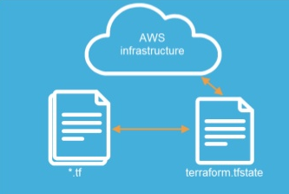
Terraform Components
Terraform Executable An executable written and compiled in GO language. Portable and simple to install. Download from: https://www.terraform.io
Terraform File One or more files that makeup the desired deployment (Repeatable and Consistent). Terraform loads all files ending in .tf in a directory.
Terraform state file
created when you run terraform

Slide 5
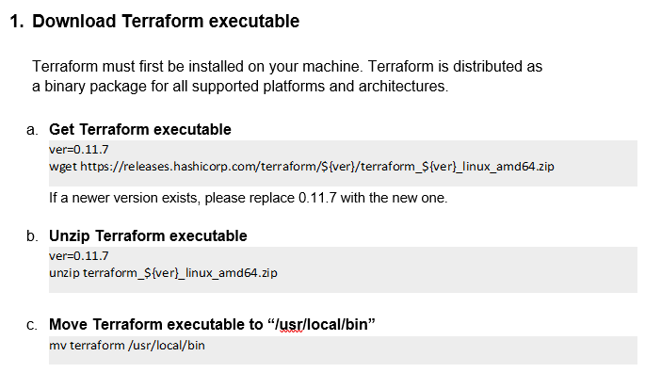
Exersize 1

Slide 6
Terraform File – Input Variables
Input Variables are defined inside “.tf” files, example: variable “access_key” {} variable “secret_key” {} variable “region” { default = “us-east-1” } This defines three variables within your Terraform configuration. The first two have empty blocks {}. The third sets a default. If a default value is set, the variable is optional. Otherwise, the variable is required.

Slide 7
Terraform File – Using Variables
Example: provider "aws" { access_key = "${var.access_key}“ secret_key = "${var.secret_key}“ region = "${var.region}"
} This uses more interpolations, this time prefixed with var.. This tells Terraform that you're accessing variables. This configures the AWS provider with the given variables.

Slide 8
Terraform File – Assigning Variables (1)
1. Command-line flags
You can set variables directly on the command-line with the -var flag: terraform apply -var 'access_key=foo' -var 'secret_key=bar’ 2. From file To persist variable values, create a file and assign variables within this file. Create a file named terraform.tfvars with the following contents: access_key = "foo"
secret_key = "bar“ For all files which match terraform.tfvars or *.auto.tfvars present in the current directory, Terraform automatically loads them to populate variables If the file is named something else, you can use the -var-file flag directly to specify a file: terraform apply -var-file="secret.tfvars"

Slide 9
Terraform File – Assigning Variables (2)
3. From environment variables Terraform will read environment variables in the form of TF_VAR_name to find the value for a variable.
For example, the TF_VAR_access_key variable can be set to set the access_key variable.

Slide 10
Output Variables
When building potentially complex infrastructure, Terraform stores hundreds or thousands of attribute values for all your resources.
As a user of Terraform, you may only be interested in a few values of importance, such as a load balancer IP, VPN address, etc.
Outputs are a way to tell Terraform what data is important. This data is outputted when apply is called, and can be queried using the terraform output command.

Slide 11
Defining Outputs
Let's define an output to show us the public IP address of the elastic IP address that we create. Add this to any of your *.tf files:
output "ip" {
value = "${aws_eip.ip.public_ip}"
}
This defines an output variable named "ip".
The name of the variable must conform to Terraform variable naming conventions if it is to be used as an input to other modules.
In this case, we're outputting the public_ip attribute of the elastic IP address.
Multiple output blocks can be defined to specify multiple output variables.

Slide 12
Resources
Resources are a component of your infrastructure. It might be some low level component such as a physical server, virtual machine, or container. Or it can be a higher level component such as an email provider, DNS record, or database provider.
Example: resource "aws_instance" "web" { ami = "ami-408c7f28“ instance_type = "t1.micro“ }

Slide 13
Data Source Configuration
Data sources allow data to be fetched or computed for use elsewhere in Terraform configuration.
Example: To get AWS (the provider) list of availability zones and store them in a variable (“available” in our case): data “aws_availability_zones” “available” {} Now , for example, we can use it in a resource: resource "aws_subnet" "subnet1“ { cidr_block = "${var.subnet1_address_space}“ vpc_id = "${aws_vpc.vpc.id}“ availability_zone = "${data.aws_availability_zones.available.names[0]}“ }

Slide 14
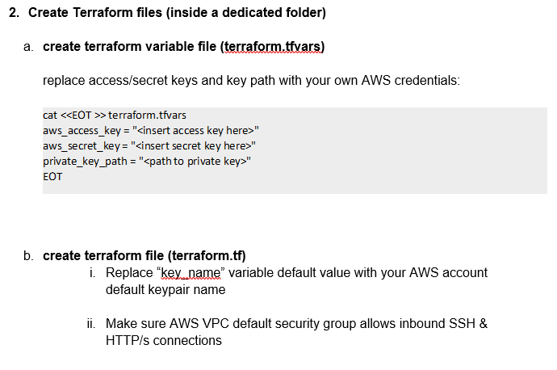
Exersize 2

Slide 15
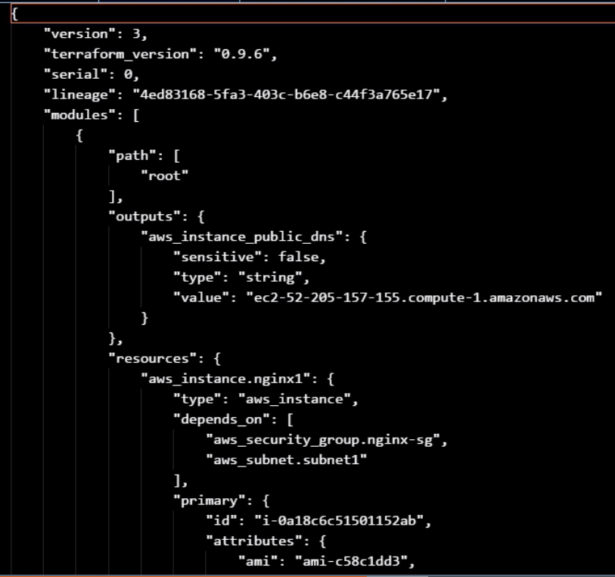
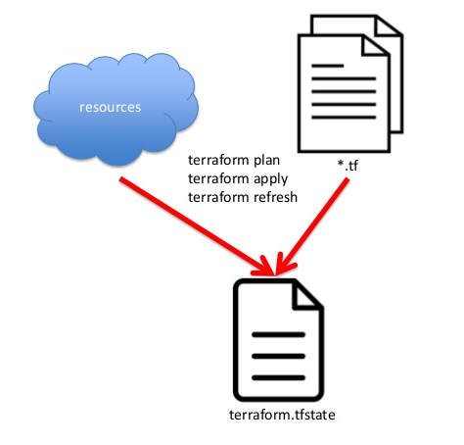
Terraform State
Terraform must store state about your managed infrastructure and configuration.
This state is used by Terraform to map real world resources to your configuration, keep track of metadata, and to improve performance for large infrastructures.

Slide 16
Terraform State and lock File
JSON format (DO NOT TOUCH!)
Resources mapping and metadata
Locking (Local or Remote) - lock file is stored by default in a local file named “terraform.tfstate.lock.info”
State allows to create multiple environments (dev/prod)
State is stored by default in a local file named "terraform.tfstate"

Slide 17
Terraform Planning
Inspect state
Dependency graph
Additions and deletions

Slide 18
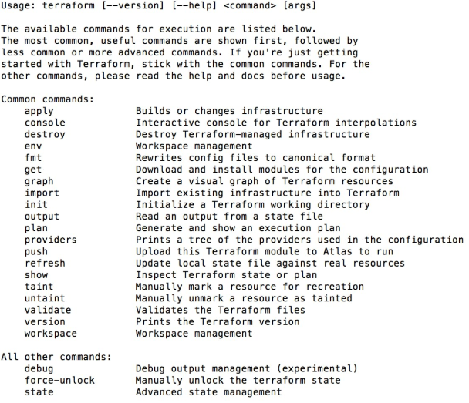
Terraform Common Commands

Slide 19
Terraform init command
The terraform init command is used to initialize a working directory containing Terraform configuration files. This is the first command that should be run after writing a new Terraform configuration or cloning an existing one from version control. Usage: terraform init [options] [dir]

Slide 20
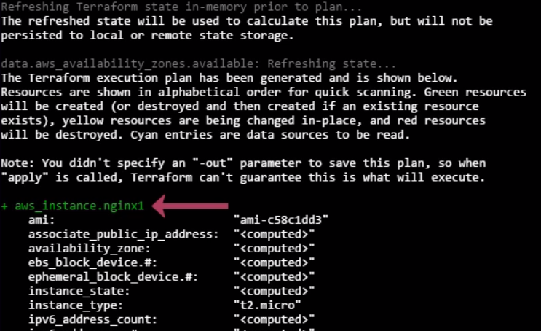
Terraform plan command
determines what actions are necessary to achieve the desired state specified in the configuration files
Usage: terraform plan [options] [dir-or-plan]

Slide 21
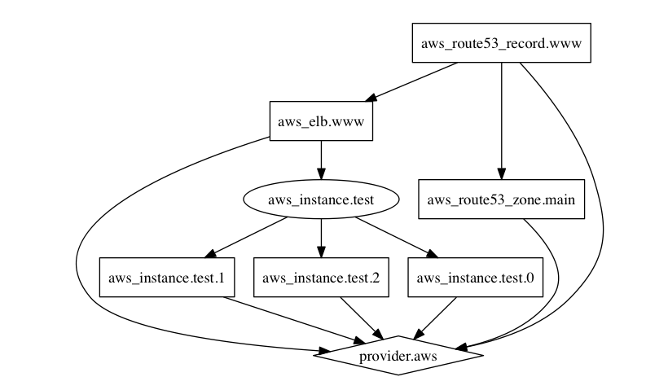
Terraform graph command
The terraform graph command is used to generate a visual representation of either a configuration or execution plan
Usage: terraform graph [options] [DIR]

Slide 22
Terraform apply command
The terraform apply command is used to apply the changes required to reach the desired state of the configuration, or the pre-determined set of actions generated by a terraform plan execution plan.
Usage: terraform apply [options] [dir-or-plan]

Slide 23
Terraform destroy command
The terraform destroy command is used to destroy the Terraform-managed infrastructure. Usage: terraform destroy [options] [DIR]

Slide 24
Terraform Provisioners
Provisioners are used to execute scripts on a local or remote machine as part of resource creation or destruction. Provisioners can be used to bootstrap a resource, cleanup before destroy, run configuration management, etc. Provisioners are added directly to any resource: resource “aws_instance” “web” { # … provisioner “local-exec” { command = “echo ${self.private_ip} > file.txt” } }

Slide 25
Terraform Providers
Terraform is used to create, manage, and update infrastructure resources such as physical machines, VMs, network switches, containers, and more. Almost any infrastructure type can be represented as a resource in Terraform.
A provider is responsible for understanding API interactions and exposing resources. Providers generally are an IaaS (e.g. AWS, GCP, Microsoft Azure, OpenStack), PaaS (e.g. Heroku), or SaaS services (e.g. Terraform Enterprise, DNSimple, CloudFlare).

Slide 26
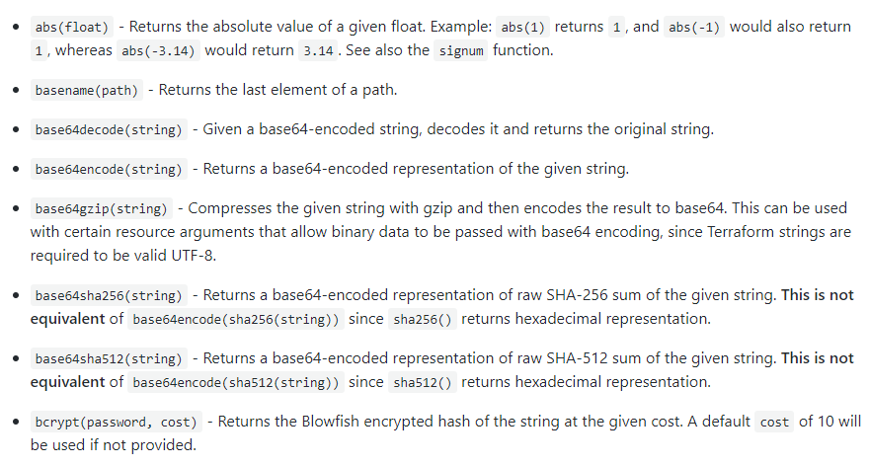
Terraform Functions
Terraform ships with built-in functions. Functions are called with the syntax name(arg, arg2, ...). For example, to read a file: ${file("path.txt")} Some more supported build-in functions:

Slide 27
Terraform Modules
Modules in Terraform are self-contained packages of Terraform configurations that are managed as a group.
Modules are used to create reusable components in Terraform as well as for basic code organization.
In modules we only specify a name, rather than a name and a type as for resources. This name is used elsewhere in the configuration to reference the module and its outputs. The source tells Terraform what to create.
In this example, we instantiate the Consul module for AWS from the Terraform Registry.
Example: module “consul” { source = “hashicorp/consul/aws” servers = 5 }

Slide 28
Terraform Module Components
Variables – supply values to the module
Resources – what is been created by the module
Outputs – outputs to give back to the main terraform configuration that is running

Slide 29
Terraform – AWS VPC Example

Slide 30
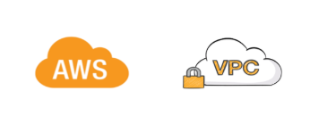

PARTS OF A VPC
VPC definition (CIDR block)
Subnets
Internet gateway to allow our subnet to riute to the internet
Routing table to define how traffic is routed
Main route table associated to tell the vpc what route table to use by default

Slide 31
Terraform – VPC
# VPC
Resource “aws_vpc” “vpc_demo” { cidr_block = “10.20.0.0/16” enable_dns_hostname = true
tags { Name = “vpc_demo” Env = “Prod” TF = “yes” }
}

Slide 32
Terraform – SUBNET
# create a subnet for our instance
Resource “aws_subnet” “vpc_demp_1a” { vpc_id = ${aws_vpc.vpc_demo.id} availability_zone = “us-east-1a” map_public_ip_on_launch = true
tags {
Name = “VPC Demo Subnet AZ 1a” Env = “Prod” TF = “yes” }
}

Slide 33
Terraform – INTERNET GW
# create an internet gw so we can talk to the world
Resource “aws_internet_gateway” “main” { vpc_id = ${aws_vpc.vpc_demo.id}
tags {
Name = “VPC Demo IGW” Env = “Prod” TF = “yes” }
}

Slide 34
Terraform – ROUTE TABLE
Resource “aws_route_table” “vpc_demo” { vpc_id = ${aws_vpc.vpc_demo.id} route { cidr_block = “0.0.0.0/0” gateway_id = “${aws_internet_gateway.main.id}” }
tags {
Name = “VPC Main RTB” Env = “Prod” TF = “yes” }
}

Slide 35
Terraform – ROUTE TABLE ASSOCIATION
Resource “aws_main_route_table_association” “main” { vpc_id = ${aws_vpc.vpc_demo.id} route_table_id = “${aws_route_table.vpc_demo.id}” }

Slide 36
Exersize 3 - 6
Terraform init
Terraform plan
Terraform apply

Slide 37

Thank You!

