Slide 1

Git for Programmers
Primož Gabrijelčič
http://primoz.gabrijelcic.org

Slide 2
Kudos

Slide 3
Pro Git
Scott Chacon and Ben Straub
Pro Git
https://git-scm.com/book/en/v2
Creative Commons Attribution Non Commercial Share Alike 3.0

Slide 4
A little bit of history

Slide 5
Version Control Systems
File backups
  __history
Local VCS
  database of changes
  RCS, SCCS
Centralised VCS
  developer checks out project
  CVS, Subversion, Perforce, Visual SourceSafe
Distributed VCS
  Developer mirrors the repository
  BitKeeper, Git, Mercurial, Darcs

Slide 6
Git

Slide 7
Git
Mini filesystem
Stream of snapshots
  Only changed files are stored
Almost all operations are local
  Repository is mirrored locally
Checksums
  SHA-1
  File name = data hash

Slide 8
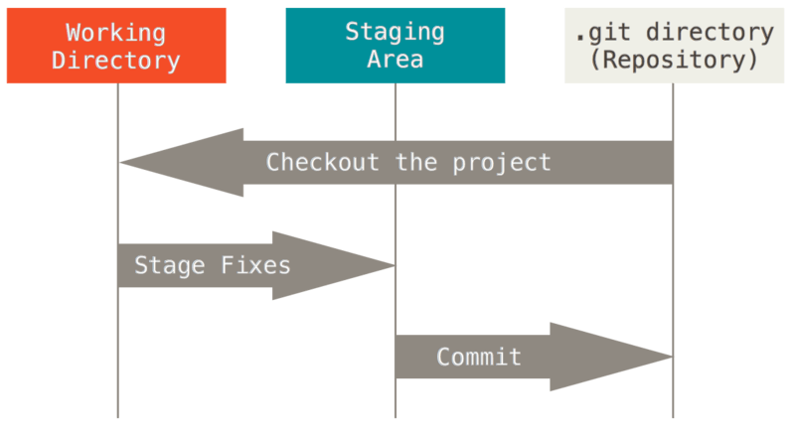
File states
Committed
Modified
Staged
  Can be skipped
Source: https://git-scm.com/book/en/v2/Getting-Started-Git-Basics

Slide 9
Local configuration
git config --list
git config --global core.editor “'C:\Program Files (x86)\PSPad editor\PSPad.exe'“
git config --edit --global
git help config
c:\Users\gabr\.gitconfig

Slide 10
Whitespace and newlines
git config --global core.autocrlf true
  commit: CRLF -> LF
  checkout: LF -> CRLF
for Windows-only projects
  git config --global core.autocrlf false
  CRLF stays CRLF
core.whitespace
  LF-delimited

Slide 11
Repositories

Slide 12
Getting a repository
Initializing new repository
  cd project_folder
  git init
  git add files
  git commit –m “initial commit”
Clone existing repository
  git clone <url>
    http://, https://, ssh://, git://
Notes:
https://github.com/gabr42/ITDevCon2016

Slide 13
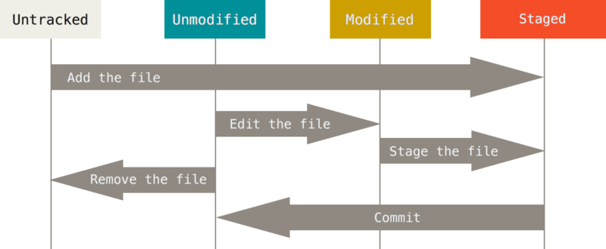
Files
git status
git add <mask>
git diff [--staged]
git commit [-a] [-m “message”]
git rm [--cached]
git mv <from> <to>
  git rm + git add
git commit
Source: https://git-scm.com/book/en/v2/Getting-Started-Git-Basics
Notes:
Create new file
Git status
Git add
Modify checked in file
Git status
Git add
Modify checked in file
Git status
Git status –s
Git add
Git status –s
Git diff
Git diff –staged
Git commit

Slide 14
.gitignore
https://github.com/github/gitignore/blob/master/Delphi.gitignore

Slide 15
Changelog
git log [-p] [--stat] [--graph]
Notes:
Alias glog

Slide 16
Ooops!
git commit --amend
  AKA Ooops, I forgot that file!
git reset HEAD <file>
  AKA ‘unstage’
  git config --global alias.unstage “reset HEAD –”
Notes:
Git commit --amend
Zadnji entry je popravljen
Git status pokaže ‚git reset HEAD‘

Slide 17
Remotes
No programmer is an island

Slide 18
Remotes
git clone
git remote [-v]
  origin = name for the default remote repository
perfectly valid: more than one remote
  git remote add <remote_name> <url>

Slide 19
Pull & Push
git fetch [<remote_name>]
  Retrieves the data you don’t yet have
  New data goes to the repository, not to your working area
git pull
  fetch + merge
git push [<remote_name>]

Slide 20
Branching

Slide 21
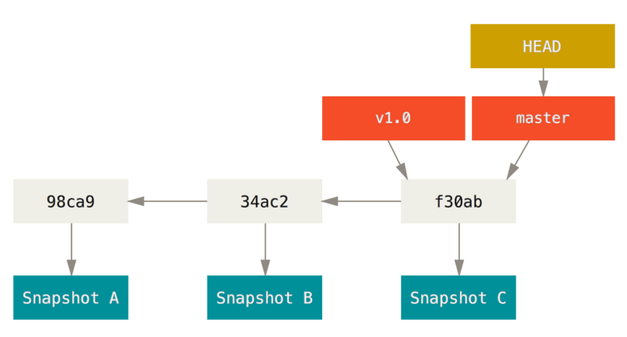
Branches
A branch is a pointer into commit tree
‘git init’ creates ‘master’ branch
git branch <branch_name>
git log --oneline --decorate
git checkout <branch_name>
git checkout --b <new_branch>
git branch [--merged]
git branch --d <branch_name>
branch = lightweight
  A single file containing 40-char SHA-1 checksum of the commit
Source: https://git-scm.com/book/en/v2/Getting-Started-Git-Basics
Notes:
Create a branch
Switch to branch
Make a change, commit
Switch to master
Make a change, commit
Git log –oneline –decorate –graph –all
Git glog

Slide 22
Merging
You always work on a branch that is checked out
git merge <branch_name>
Resolving merge conflicts
  <<<<<<< HEAD
  Changed in the master.
  =======
  This is a branch.
  >>>>>>> branch1
  git mergetool
  git commit
Notes:
Fast-forward: just the pointer is incremented

Slide 23
Types of branches
Long-Running branches
  master/develop
  feature
  git-flow
Topic branches
  Short-lived
  A fix for an issue = a branch

Slide 24
Remote branches
origin/master
git fetch <remote>
git push <remote> <branch>
git config push.default current
git checkout --b <new_branch>
git push --origin <new_branch>
git push

Slide 25
Tracking branch
git checkout --b <new_branch> <remote>/<remote_branch>
git checkout --track <remote>/<remote_branch>
git checkout <remote_branch>
git branch –u <remote>/<remote_branch>
git pull

Slide 26
Rebase
Take changes committed on one branch …
  … and reply them on another one.
git checkout experimental
git rebase master
Do not rebase commits that exist outside your repository.

Slide 27
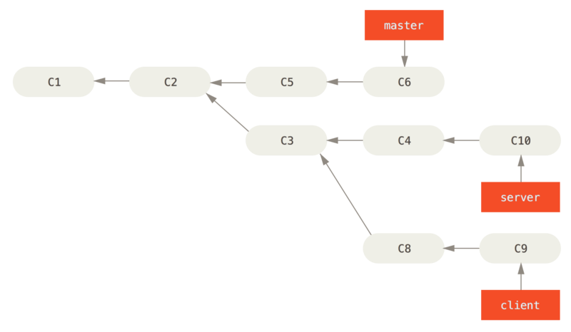
3-branch rebase
git rebase [--onto <branch>] <basebr> <topicbr>
git rebase --onto master server client
Source: https://git-scm.com/book/en/v2/Getting-Started-Git-Basics

Slide 28
Workflows

Slide 29
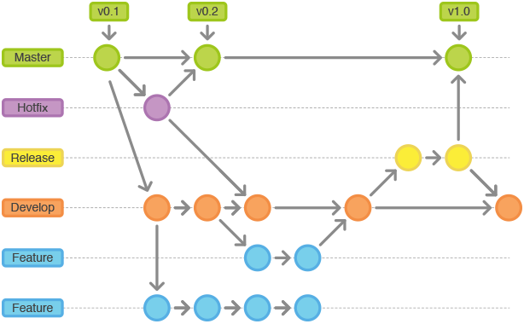
GitFlow
Source: https://raw.githubusercontent.com/Voronenko/gitflow-release/master/images/git-workflow-release-cycle-4maintenance.png

Slide 30

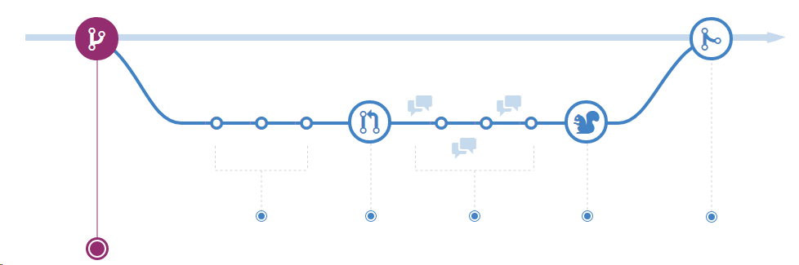
GitHub Flow
Source: https://guides.github.com/introduction/flow/

Slide 31
Tools

Slide 32
Tools
Git for Windows
TortoiseGit
GitHub Desktop
GitKraken

Slide 33
Resources

Slide 34
Resources
https://en.wikipedia.org/wiki/Version_control
https://git-scm.com
https://github.com
https://bitbucket.org
https://git-for-windows.github.io
https://git-scm.com/downloads/guis
https://desktop.github.com
https://www.gitkraken.com
https://tortoisegit.org
https://git-scm.com/book/en/v2
https://wiert.me/2016/07/14/git-cheat-sheet/

Slide 35
Workflows
http://jeffkreeftmeijer.com/2010/why-arent-you-using-git-flow/
https://yakiloo.com/getting-started-git-flow/
https://github.com/nvie/gitflow
https://www.git-tower.com/learn/git/ebook/en/command-line/advanced-topics/git-flow
http://danielkummer.github.io/git-flow-cheatsheet/
http://endoflineblog.com/gitflow-considered-harmful
https://guides.github.com/introduction/flow/

Slide 36
Questions?

