Slide 1



ANSIBLE

Slide 2

What is Ansible?
It's a simple automation language that can perfectly describe an IT application infrastructure in Ansible Playbooks.
It's an automation engine that runs Ansible Playbooks.
Ansible Tower is an enterprise framework for controlling, securing and managing your Ansible automation with a UI and RESTful API.

Slide 3




Ansible’s neighbors
In the anon DevOps kit we have several tools for the software provisioning, configuration management and application deployment:

Slide 4
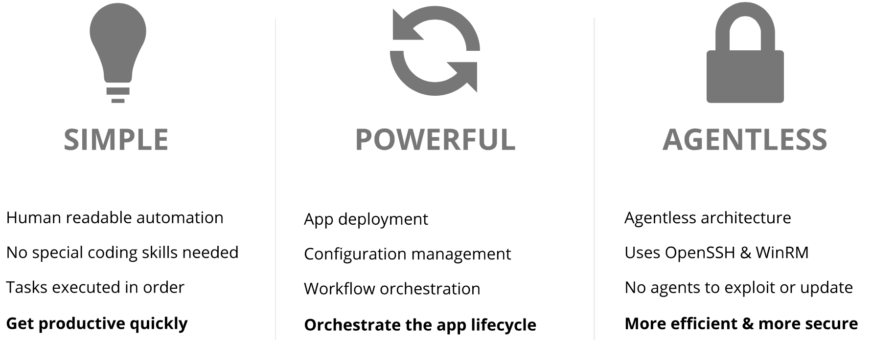
What is Ansible?

Slide 5
The Ansible Way
CROSS PLATFORM – Linux, Windows, UNIX
Agentless support for all major OS variants, physical, virtual, cloud and network
HUMAN READABLE – YAML
Perfectly describe and document every aspect of your application environment
PERFECT DESCRIPTION OF APPLICATION
Every change can be made by playbooks, ensuring everyone is on the same page
VERSION CONTROLLED
Playbooks are plain-text. Treat them like code in your existing version control.
DYNAMIC INVENTORIES
Capture all the servers 100% of the time, regardless of infrastructure, location, etc.
ORCHESTRATION THAT PLAYS WELL WITH OTHERS – HP SA, Puppet, Jenkins, RHNSS, etc. Homogenize existing environments by leveraging current toolsets and update mechanisms.

Slide 6
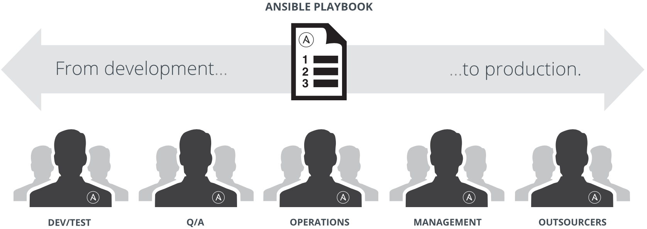
Ansible: The Language of DevOps
COMMUNICATION IS THE KEY TO DEVOPS.
Ansible is the first automation language that can be read and written across IT. Ansible is the only automation engine
that can automate the entire application lifecycle and continuous delivery pipeline.

Slide 7
Ansible included
Ansible comes bundled with hundreds of modules for a wide variety of automation tasks
Ansible Modules control the things that you’re automating. They can do everything from acting on system files, installing packages, or making API calls to a service framework. Ansible ships with over 1300 today -- and this number is always expanding with every release.
cloud
containers
database
files
messaging
monitoring
network
notifications
packaging
source control
system
testing
utilities
web infrastructure

Slide 8
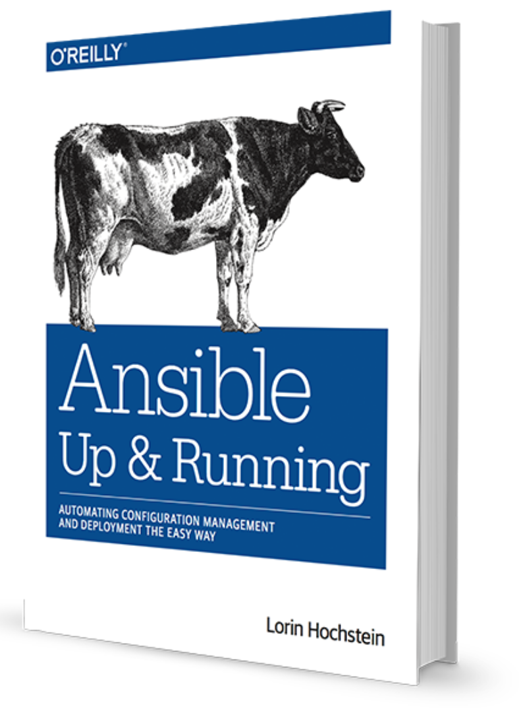
Community
THE MOST POPULAR OPEN-SOURCE AUTOMATION COMMUNITY ON GITHUB
28,000+ stars & 10,000+ forks on GitHub
3200+ GitHub Contributors
Over 1300 modules shipped with Ansible
New contributors added every day
1200+ users on IRC channel
Top 10 open source projects in 2017
World-wide meetups taking place every week
Ansible Galaxy: over 18,000 subscribers
250,000+ downloads a month
AnsibleFest and Ansible Automates events across the globe
http://ansible.com/community

Slide 9
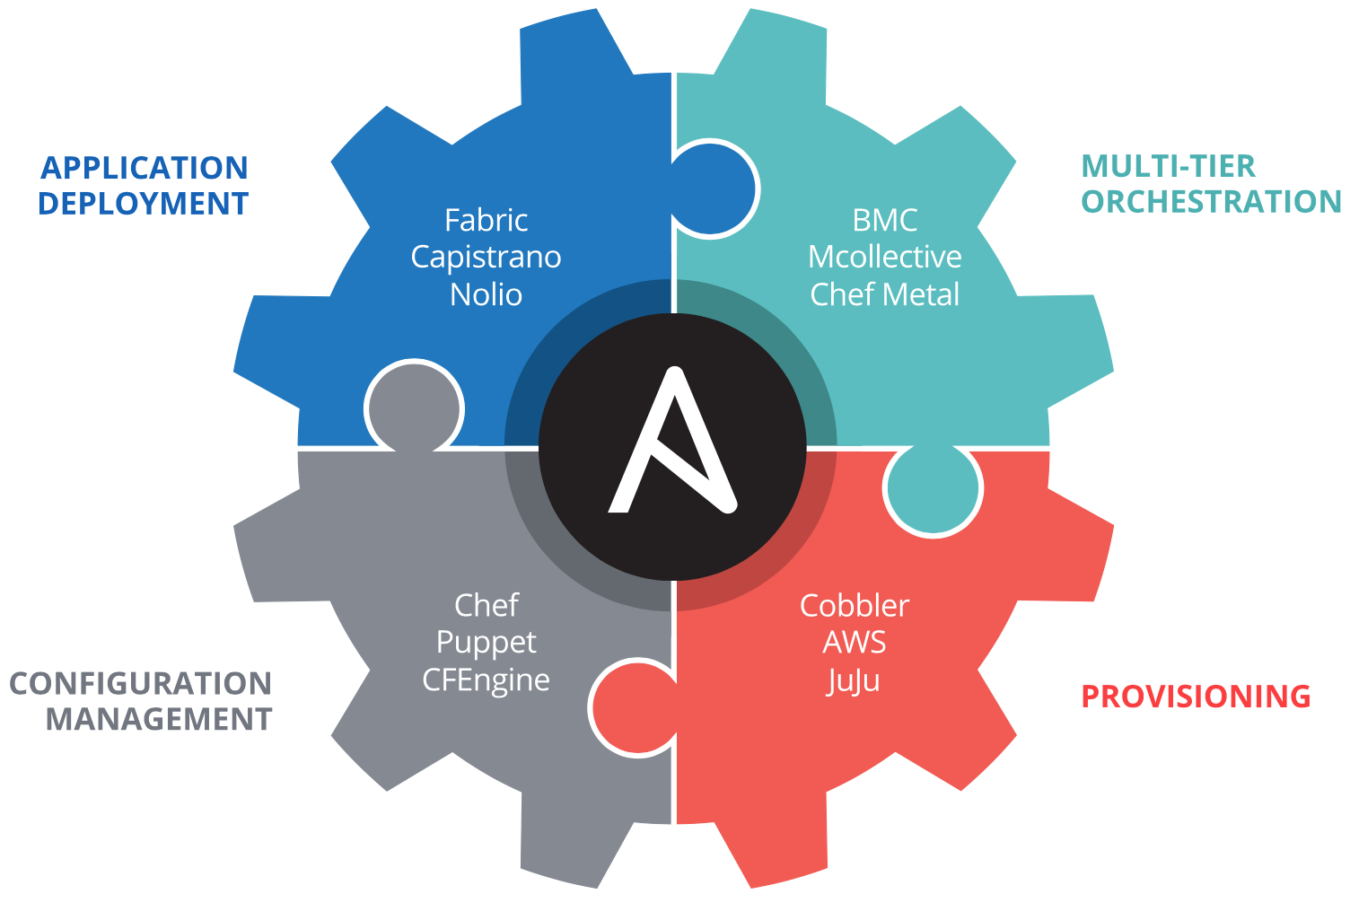
Complete Automation

Slide 10
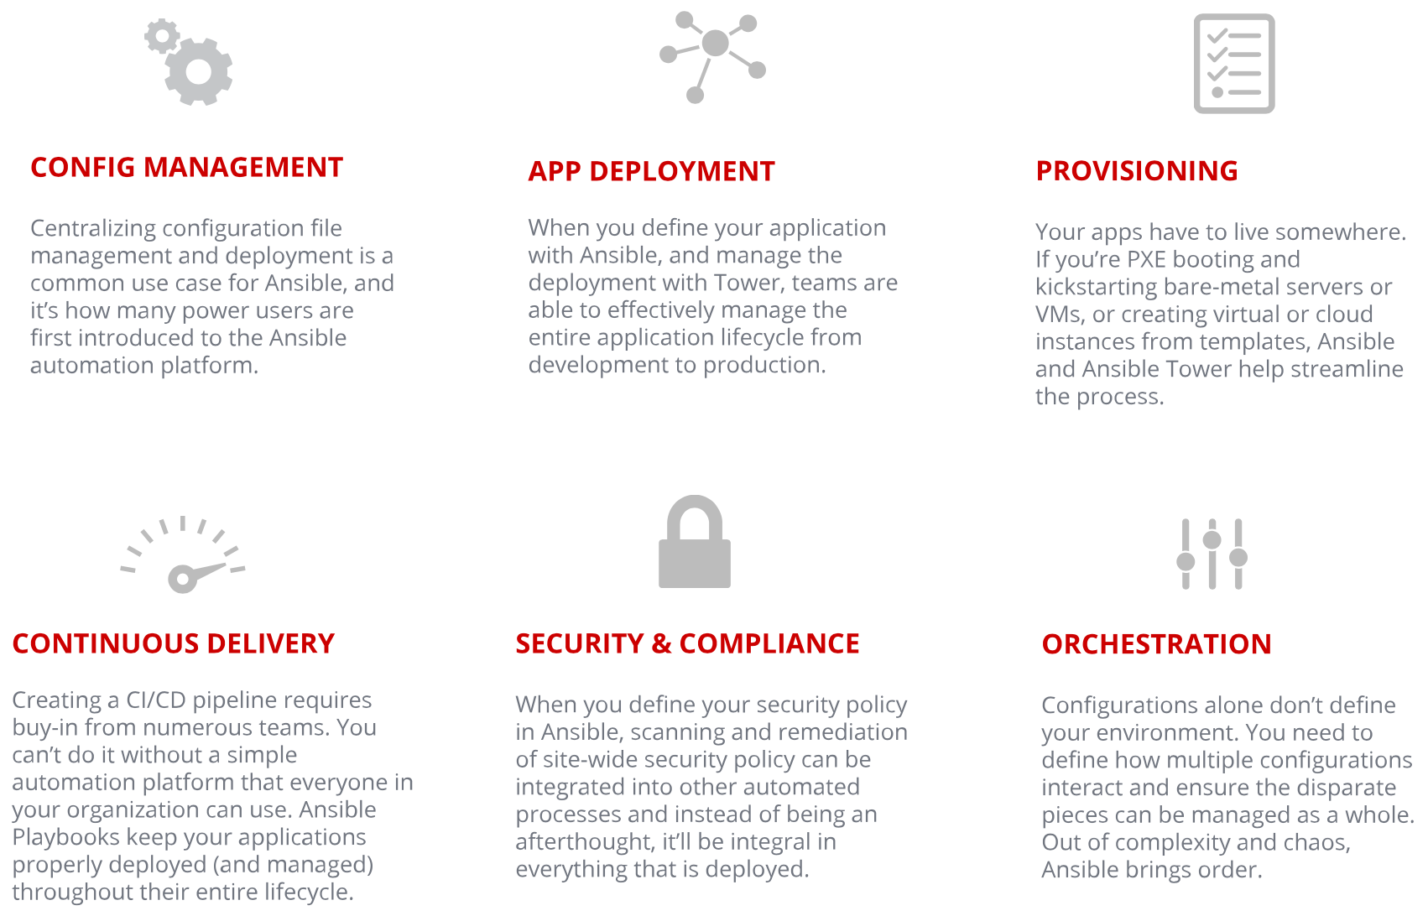
Use Cases

Slide 11
Installing Ansible
The best way to install Ansible on CentOS, RHEL, or Scientific Linux is to configure the EPEL repository and install Ansible directly:
$ sudo yum install ansible
# on Debian or Ubuntu you will need the PPA repo configured $ sudo apt-get install ansible
# on all other platforms it can be installed via pip
$ sudo pip install ansible

Slide 12

Installing Ansible
For this current course we have already created the Ansible environment on Ubuntu for you, please ask mentor to provide the credentials.
- by this sign we would mark the practice part
  Get to the course Ansible environment using SSH CLI (command line interface):
Type the following command to get the current ansible version:
  >ansible --version
The output should say like this:
  ansible 2.6.1
  config file = /etc/ansible/ansible.cfg
  configured module search path = [u'/home/ubuntu/.ansible/plugins/modules', u'/usr/share/ansible/plugins/modules’]
  ansible python module location = /usr/lib/python2.7/dist-packages/ansible
  executable location = /usr/bin/ansible python version = 2.7.12 (default, Dec 4 2017, 14:50:18) [GCC 5.4.0 20160609]

Slide 13
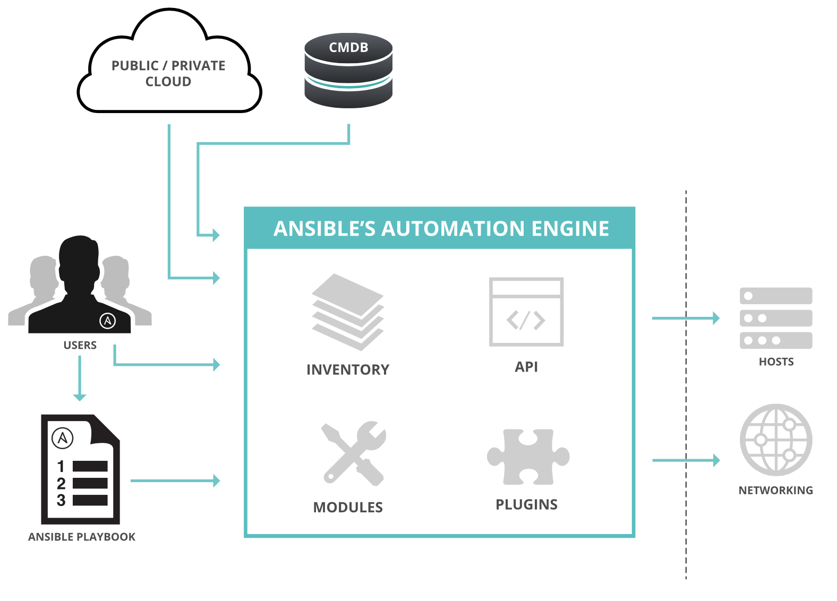
How Ansible Works

Slide 14
How Ansible Works
PLAYBOOKS are written in YAML. Tasks are executed sequentially and invokes Ansible modules.
MODULES are “tools in the toolkit” Python, Powershell or any language Extended Ansible simplicity to entire stack.
PLUGINS are ”gears in the engine”. Code that plugs the core engine. Adaptability for various uses & platforms.
INVENTORY gets acquainted your Ansible core within the structured set of infrastructure to work on.

Slide 15
Modules
Modules are bits of code transferred to the target system and executed to satisfy the task declaration.
apt/yum
copy
file
get_url
git
ping
debug
service
synchronize
template
uri
user
wait_for
assert

Slide 16
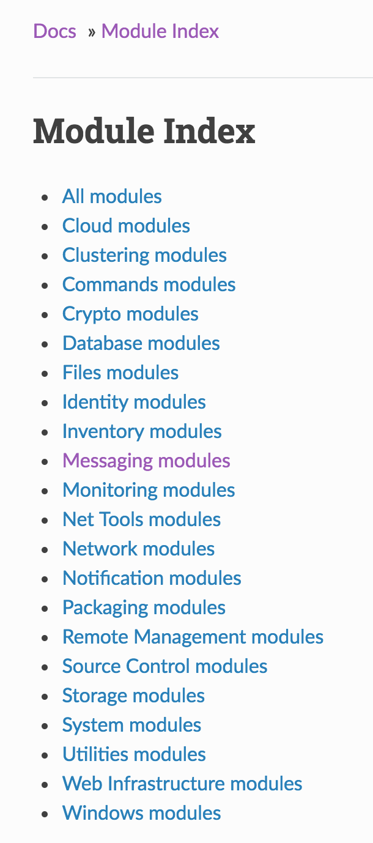
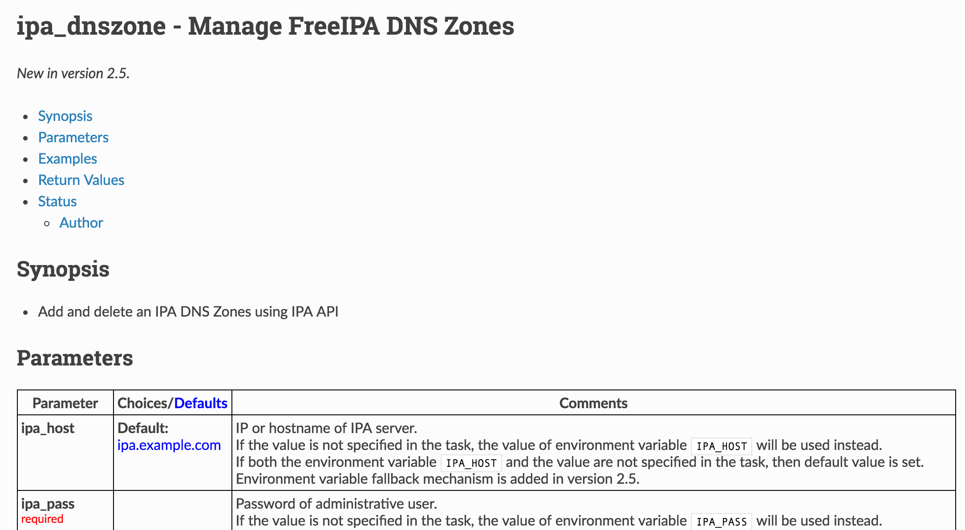
Modules Documentation
http://docs.ansible.com/

Slide 17
Modules
To retrieve all the ansible modules that are currently installed on the environment please run:
  >ansible-doc -l
The output should say like this:
a10_server Manage A10 Networks AX/SoftAX/Thunder/vThunder devices' server object. a10_server_axapi3 Manage A10 Networks AX/SoftAX/Thunder/vThunder devices a10_service_group Manage A10 Networks AX/SoftAX/Thunder/vThunder devices' service
…
* It takes a while to get the list

Slide 18
Modules: Run Commands
If Ansible doesn't have a module that suits your needs there are the “run command” modules:
command: Takes the command and executes it on the host. The most secure and predictable.
shell: Executes through a shell like /bin/sh so you can use pipes etc. Be careful.
script: Runs a local script on a remote node after transferring it.
raw: Executes a command without going through the Ansible module subsystem.
NOTE: Unlike standard modules, run commands have no concept of desired state and should only be used as a last resort.

Slide 19
Inventory
Inventory is a collection of hosts (nodes) with associated data and groupings that Ansible can connect and manage.
  Hosts (nodes)
  Groups
  Inventory-specific data (variables)
  Static or dynamic sources

Slide 20
Inventory
  [control]
  control ansible_host=10.42.0.2
  [web]
  node-[1:3] ansible_host=10.42.0.[6:8]
  [haproxy]
  haproxy ansible_host=10.42.0.100
  [all:vars]
  ansible_user=vagrant
  ansible_ssh_private_key_file=~/.vagrant.d/insecure_private_key

Slide 21
Inventory
To play ansible on the same host we configured the inventory in a following way:
  >cat /home/ubuntu/hosts
The output should say like this:
  [local]
  localhost ansible_connection=local

Slide 22
Ad-Hoc Commands
An ad-hoc command is a single Ansible task to perform quickly, but don’t want to save for later:
  # check all my inventory hosts are ready to be managed by Ansible
  >ansible all -m ping
  WARNING]: provided hosts list is empty, only localhost is available. Note that the implicit localhost does not match 'all’
  # collect and display the discovered facts for the localhost
  >ansible localhost -m setup
  # run the uptime command on all hosts on the localhost
  >ansible localhost -m command -a "uptime”
  localhost | SUCCESS | rc=0 >> 10:22:28 up 46 min, 1 user, load average: 0.01, 0.02, 0.03

Slide 23
Sidebar: Discovered Facts
Facts are bits of information derived from examining a host systems that are stored as variables for later use in a play:
  >ansible localhost -m setup
  localhost | SUCCESS => {
  "ansible_facts": {
  "ansible_all_ipv4_addresses": [
  "172.17.0.1",
  "172.31.44.83",
  "172.24.0.1"
  ],
  "ansible_all_ipv6_addresses": [
  "fe80::47a:67ff:fed7:c9ec"
  ],
  "ansible_apparmor": {
  "status": "enabled"
  },

Slide 24
Variables
Ansible can work with metadata from various sources and manage their context in the form of variables.
Command line parameters
Plays and tasks
Files
Inventory
Discovered facts
Roles

Slide 25
Variable Precedence
The order in which the same variable from different sources will override each other.
extra vars
task vars (only for the task)
block vars (only for tasks in block)
role and include vars
play vars_files
play vars_prompt
play vars
set_facts
registered vars
host facts
playbook host_vars
playbook group_vars
inventory host_vars
inventory group_vars
inventory vars
role defaults

Slide 26
Tasks
Tasks are the application of a module to perform a specific unit of work.
file: A directory should exist
yum: A package should be installed
service: A service should be running
template: Render a configuration file from a template
get_url: Fetch an archive file from a URL
git: Clone a source code repository

Slide 27
Example Tasks in a Play
  tasks:
  - name: Ensure httpd package is present
  yum:
  name: httpd
  state: latest
  - name: Ensure latest index.html file is present
  copy:
  src: files/index.html
  dest: /var/www/html/
  - name: Restart httpd
  service:
  name: httpd
  state: restarted

Slide 28
Handler Tasks
Handlers are special tasks that run at the end of a play if notified by another task when a change occurs:
  tasks:
  - name: Ensure httpd package is present
  yum:
  name: httpd
  state: latest
  notify: restart httpd
  - name: Ensure latest index.html file is present
  copy:
  src: files/index.html
  dest: /var/www/html/
  handlers:
  - name: restart-httpd
  service:
  name: httpd

Slide 29
Plays & Playbooks
Plays are ordered sets of tasks to execute against host selections from your inventory. A playbook is a file containing one or more plays:
  ---
  - name: Ensure apache is installed and started
  hosts: web
  become: yes
  vars:
  http_port: 80
  tasks:
  - name: Ensure httpd package is present
  yum:
  name: httpd
  state: latest
  - name: Ensure latest index.html file is present
  copy:
  src: files/index.html

Slide 30
Doing More with Playbooks
Templates
Ansible embeds the Jinja2 templating engine that can be used to dynamically:
Set and modify play variables
Conditional logic
Generate files such as configurations from variables

Slide 31
Doing More with Playbooks
Loops
Loops can do one task on multiple things, such as create a lot of users, install a lot of packages, or repeat a polling step until a certain result is reached.
  - yum:
  name: "{{ item }}"
  state: latest
  with_items:
  - httpd
  - mod_wsgi

Slide 32
Doing More with Playbooks
Conditionals
Ansible supports the conditional execution of a task based on the run-time evaluation of variable, fact, or previous task result.
  - yum:
  name: httpd
  state: latest
  when: ansible_os_family == "RedHat"

Slide 33
Doing More with Playbooks
Tags
Tags are useful to be able to run a subset of a playbook on-demand.
  - yum:
  name: "{{ item }}"
  state: latest
  with_items:
  - httpd
  - mod_wsgi
  tags:
  - packages

Slide 34
Doing More with Playbooks
Blocks
Blocks cut down on repetitive task directives, allow for logical grouping of tasks and even in play error handling.
  - block:
  - yum:
  name: "{{ item }}"
  state: latest
  with_items:
  - httpd
  - mod_wsgi
  - template:
  src: templates/httpd.conf.j2
  dest: /etc/httpd/conf/httpd.conf
  when: ansible_os_family == "RedHat"

Slide 35
Roles
Roles are packages of closely related Ansible content that can be shared more easily than plays alone.
  Improves readability and maintainability of complex plays
  Eases sharing, reuse and standardization of automation processes
  Enables Ansible content to exist independently of playbooks, projects -- even organizations
  Provides functional conveniences such as file path resolution and default values

Slide 36
Ansible Galaxy
Ansible Galaxy is a hub for finding, reusing and sharing Ansible content including roles.
Jump-start your automation project with content contributed and reviewed by the Ansible community.
http://galaxy.ansible.com

Slide 37
Ansible Galaxy
To install your first ansible role, please run:
  >ansible-galaxy install jdauphant.nginx
    *- This role installs and configures the nginx web server
The output should say like this:
  downloading role 'nginx', owned by jdauphant
  downloading role from https://github.com/jdauphant/ansible-role-nginx/archive/v2.18.1.tar.gz
  extracting jdauphant.nginx to /home/ubuntu/.ansible/roles/jdauphant.nginx
  jdauphant.nginx (v2.18.1) was installed successfully
See the role there: /home/ubuntu/.ansible/roles

Slide 38
Ansible Galaxy
To use the just installed role, please create the following playbook:
  >vi /home/ubuntu/my_first_playbook.yml
  - hosts: localhost
  roles:
  - role: jdauphant.nginx
  nginx_http_params:
  - sendfile "on"
  - access_log "/var/log/nginx/access.log"
  nginx_sites:
  default:
  - listen 8089
  >cd /home/ubuntu
  > sudo ansible-playbook my_first_playbook.yml -i ./hosts
It installs the nginx web server to listen to the 8089 port

Slide 39
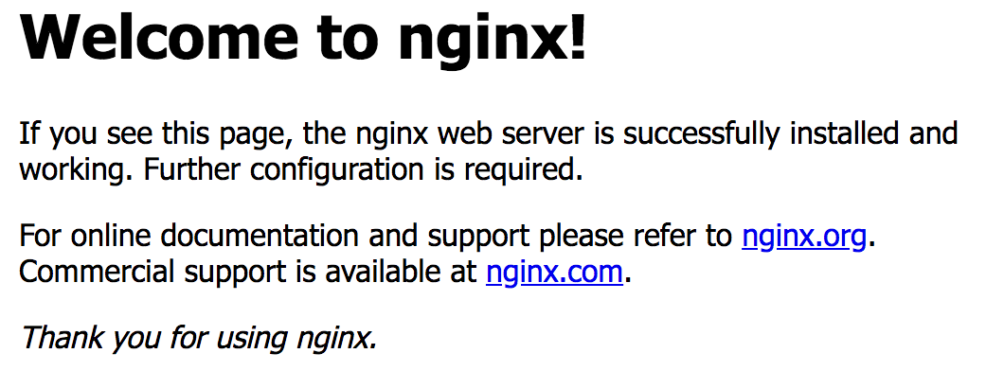
Ansible Galaxy
Please check the installation by drilling down the link:
http://<your server IP>:8089/
Stop and remove the nginx by:
>sudo service nginx stop
>sudo apt-get remove -y nginx

Slide 40
Next Steps
  It's easy to get started
  ansible.com/get-started
  Join the Ansible community
  ansible.com/community
  Would you like to learn a lot more?
  redhat.com/en/services/training/do407-automation-ansible

Slide 41

Thanks!!!

