Slide 1
THE 5 MOST
SPECTACULAR
PHOTOS IN 2003

Slide 2
5th

Slide 3
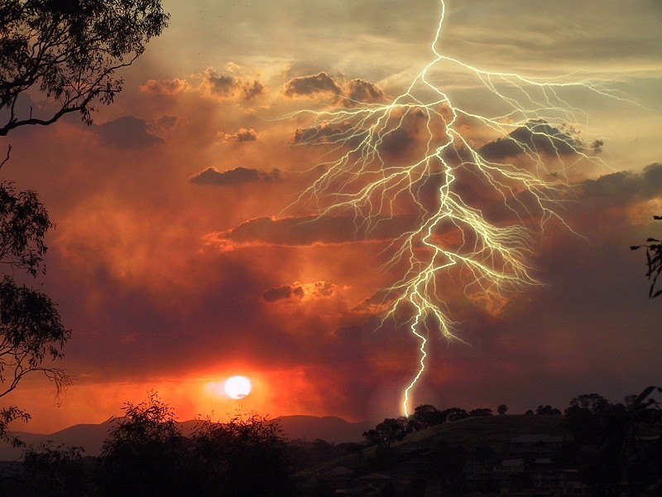

Slide 4
4th

Slide 5
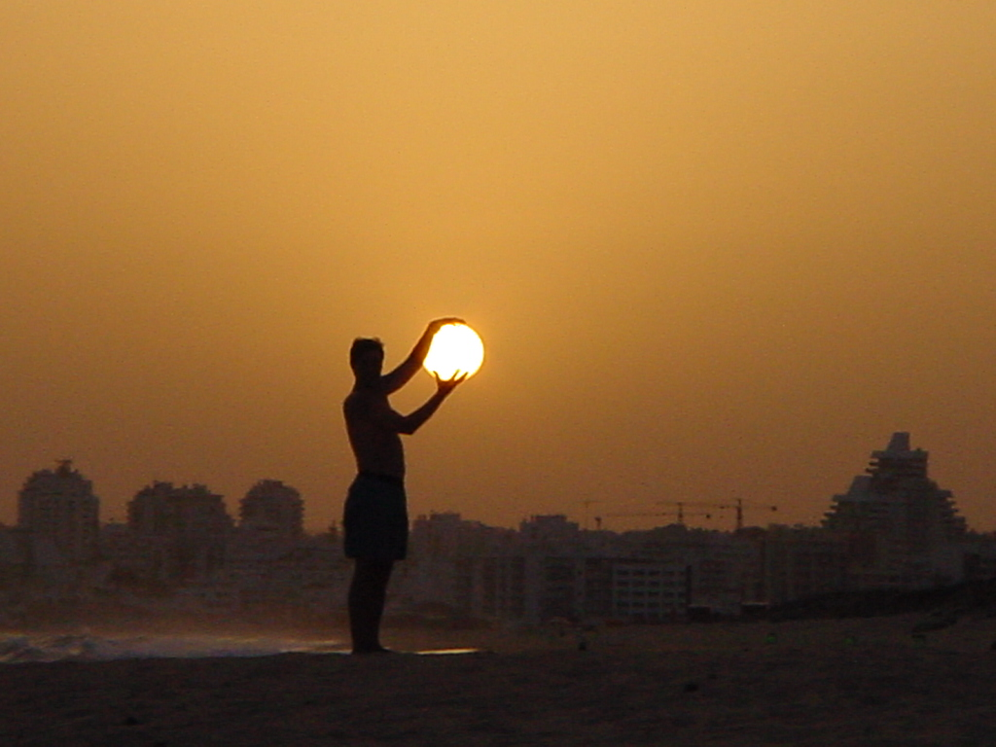

Slide 6
3rd

Slide 7
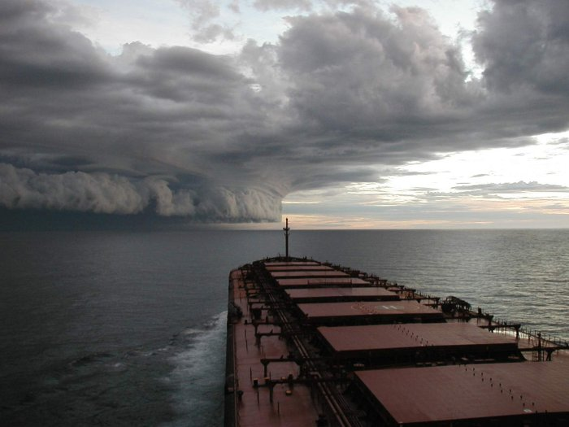

Slide 8
2nd

Slide 9
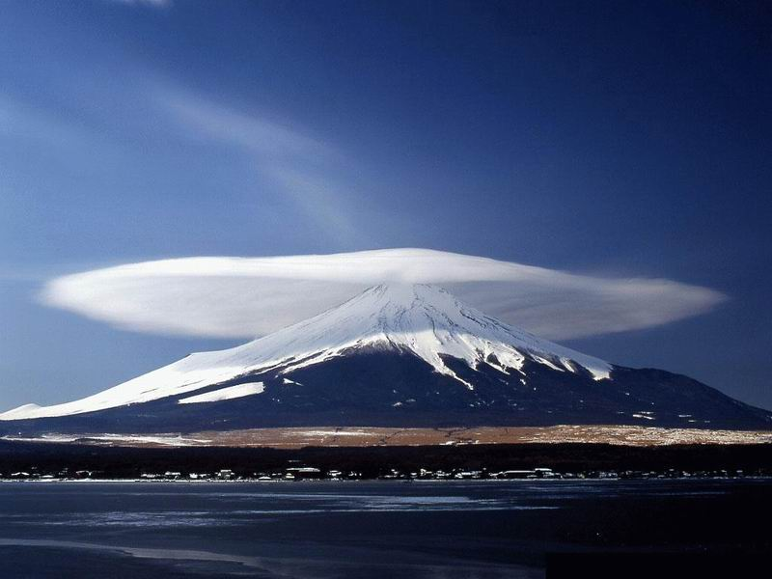

Slide 10
1st

Slide 11
