Slide 1
Things you will see ONLY in…

Slide 2

Japan

Slide 3
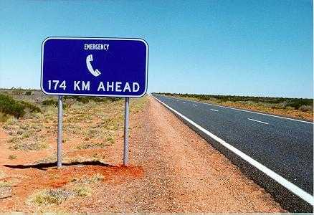
Australia

Slide 4

France

Slide 5
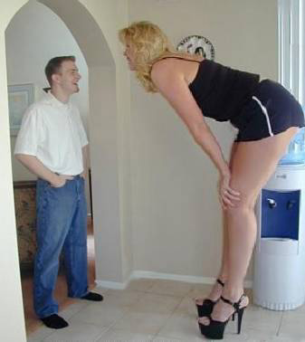
Amsterdam

Slide 6

Spain

Slide 7
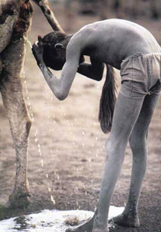
Africa

Slide 8
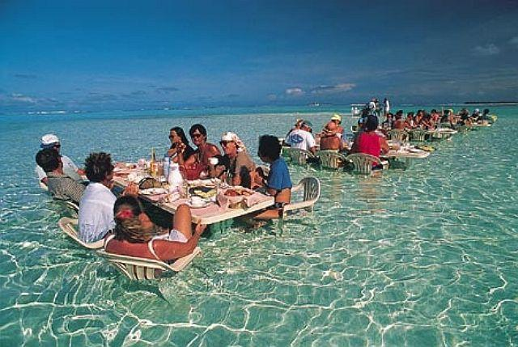
Hawaï

Slide 9
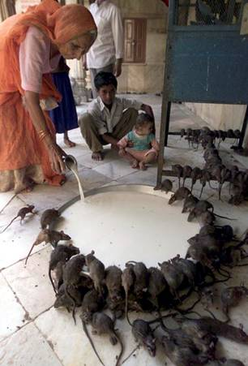
India

Slide 10

Mexico

Slide 11
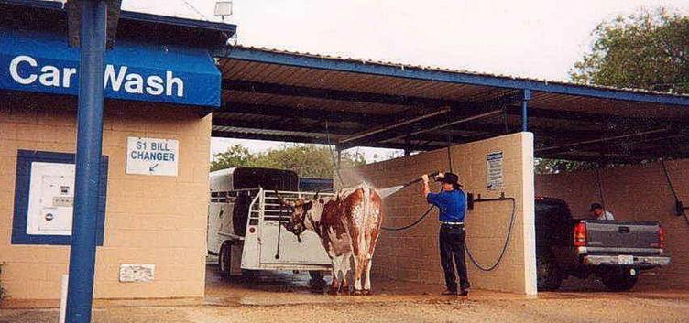
Texas

Slide 12

Thaïlande

Slide 13

Colombia

Slide 14
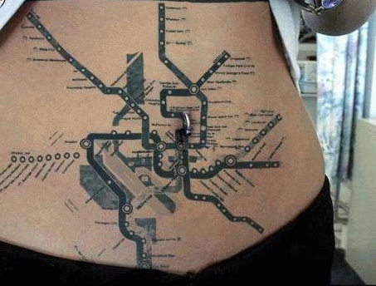
London

Slide 15
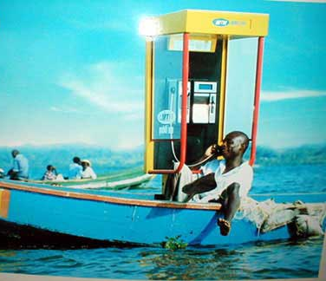
Cariebian

Slide 16
And Finally
……..

Slide 17

US

