Slide 1
Insurance Models
Kuei

Slide 2
Social Demographics
Social Demographics | Frequency (%)¹
Gender
Female | 27 (40%)
Male | 41 (60%)
Age
Below 30 years | 25 (37%)
30 - 39 years | 27 (40%)
40 - 49 years | 11 (16%)
Over 50 years | 5 (7.4%)
Level of Education
Secondary | 9 (13%)
Diploma | 22 (32%)
Bachelor's | 34 (50%)
Postgraduate | 3 (4.4%)
Occupation
CEO | 31 (46%)
Financial officer | 27 (40%)
Internal Auditor | 10 (15%)
Working Period
Less than 1 year | 6 (8.8%)
1 - 5 years | 30 (44%)
6 - 10 years | 21 (31%)
over 10 years | 11 (16%)
¹ n (%)
Demographics summary

Slide 3
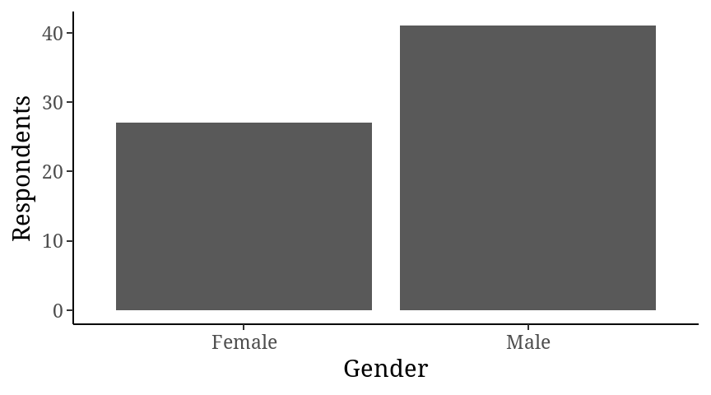
Gender

Slide 4
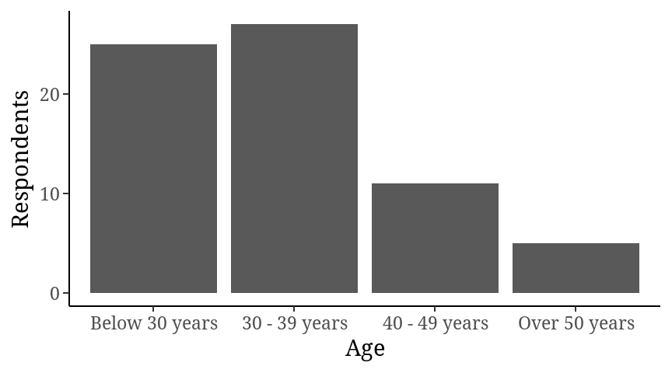
Age

Slide 5
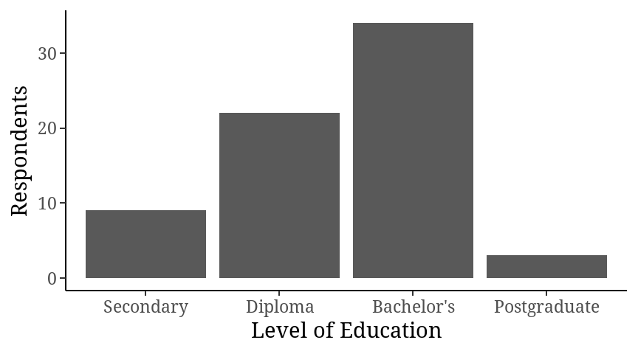
Level of education

Slide 6
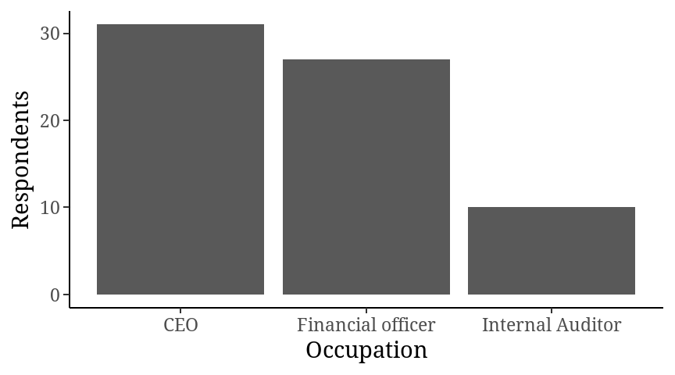
Occupation

Slide 7
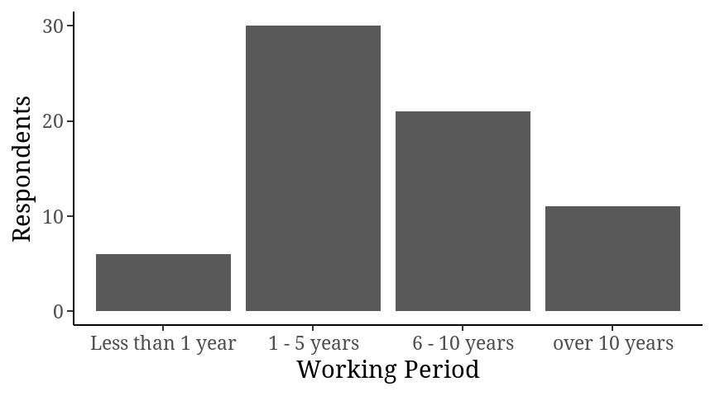
Working Period

Slide 8
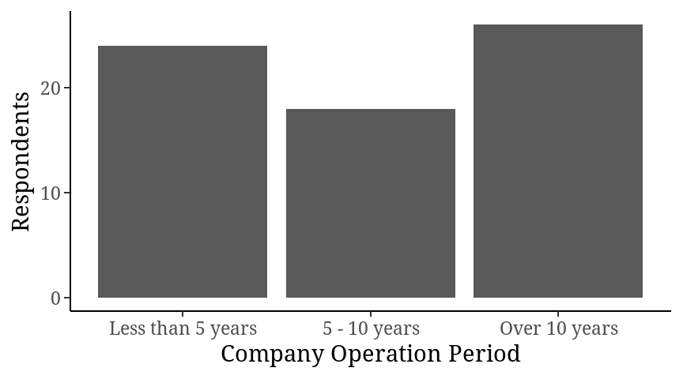
Company Operation Period

Slide 9
Characteristic | Beta | 95% CI¹ | p-value
Financial innovation | 0.15 | -0.11, 0.41 | 0.2
Longterm Investment | 0.02 | -0.74, 0.78 | >0.9
Equity Investment | -0.31 | -0.75, 0.13 | 0.2
Asset Base | -0.05 | -0.60, 0.51 | 0.9
Gender
Female | — | —
Male | 0.21 | -0.41, 0.83 | 0.5
Age
Below 30 years | — | —
30 - 39 years | 0.51 | -0.34, 1.3 | 0.2
40 - 49 years | -0.27 | -1.1, 0.57 | 0.5
Over 50 years | -0.13 | -1.3, 1.0 | 0.8
Working Period
Less than 1 year | — | —
1 - 5 years | -1.2 | -2.2, -0.11 | 0.032
6 - 10 years | -0.73 | -2.0, 0.49 | 0.2
over 10 years | -0.22 | -1.7, 1.3 | 0.8
Company Operation Period
Less than 5 years | — | —
5 - 10 years | 0.72 | -0.08, 1.5 | 0.075
Over 10 years | 0.08 | -0.73, 0.89 | 0.8
Level of Education
Secondary | — | —
Diploma | 0.21 | -0.65, 1.1 | 0.6
Bachelor's | 0.23 | -0.61, 1.1 | 0.6
Postgraduate | -0.10 | -1.5, 1.3 | 0.9
Occupation
CEO | — | —
Financial officer | 0.01 | -0.63, 0.65 | >0.9
Internal Auditor | -1.3 | -2.2, -0.38 | 0.006
¹ CI = Confidence Interval
Overall Model
Call: lm(formula = `Financial Performance` ~ `Financial innovation` + `Longterm Investment` + `Equity Investment` + `Asset Base` + Gender + Age + `Working Period` + `Company Operation Period` + `Level of Education` + Occupation, data = Data) Residuals: Min 1Q Median 3Q Max -1.9113 -0.4418 0.1667 0.3825 4.1000 Coefficients: Estimate Std. Error t value Pr(>|t|) (Intercept) 6.05343 1.60166 3.779 0.000427 `Financial innovation` 0.15213 0.13064 1.164 0.249889 `Longterm Investment` 0.01906 0.37991 0.050 0.960199 `Equity Investment` -0.31012 0.21957 -1.412 0.164151 `Asset Base` -0.04665 0.27693 -0.168 0.866935 GenderMale 0.21129 0.30857 0.685 0.496735 Age30 - 39 years 0.50508 0.41828 1.207 0.233040 Age40 - 49 years -0.26938 0.41640 -0.647 0.520704 AgeOver 50 years -0.12894 0.58550 -0.220 0.826616 `Working Period`1 - 5 years -1.17535 0.53131 -2.212 0.031647 `Working Period`6 - 10 years -0.73372 0.60839 -1.206 0.233606 `Working Period`over 10 years -0.21532 0.75456 -0.285 0.776568 `Company Operation Period`5 - 10 years 0.71610 0.39385 1.818 0.075150 `Company Operation Period`Over 10 years 0.07802 0.40405 0.193 0.847682 `Level of Education`Diploma 0.21070 0.42992 0.490 0.626260 `Level of Education`Bachelor's 0.22703 0.41514 0.547 0.586946 `Level of Education`Postgraduate -0.09787 0.70343 -0.139 0.889912 OccupationFinancial officer 0.01029 0.31974 0.032 0.974448 OccupationInternal Auditor -1.27868 0.44539 -2.871 0.006029 (Intercept) *** `Financial innovation` `Longterm Investment` `Equity Investment` `Asset Base` GenderMale Age30 - 39 years Age40 - 49 years AgeOver 50 years `Working Period`1 - 5 years * `Working Period`6 - 10 years `Working Period`over 10 years `Company Operation Period`5 - 10 years . `Company Operation Period`Over 10 years `Level of Education`Diploma `Level of Education`Bachelor's `Level of Education`Postgraduate OccupationFinancial officer OccupationInternal Auditor ** --- Signif. codes: 0 '***' 0.001 '**' 0.01 '*' 0.05 '.' 0.1 ' ' 1 Residual standard error: 0.9993 on 49 degrees of freedom Multiple R-squared: 0.3781, Adjusted R-squared: 0.1496 F-statistic: 1.655 on 18 and 49 DF, p-value: 0.08263

Slide 10
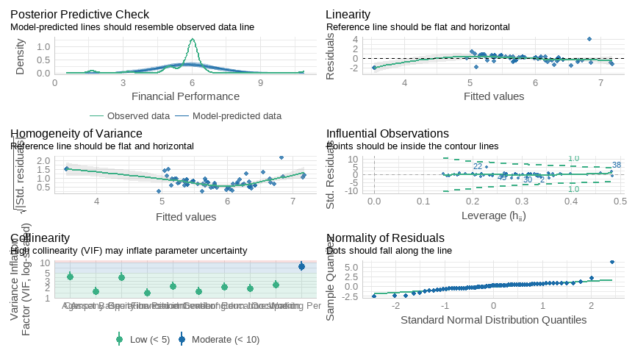

Slide 11
AIC | AICc | BIC | R2 | R2_adjusted | RMSE | Sigma
210.5984 | 228.4707 | 254.9885 | 0.3780775 | 0.1496162 | 0.8482848 | 0.9993051

Slide 12
Objective 1: The effect of financial innovations on financial performance
Characteristic | Beta | 95% CI¹ | p-value
Financial innovation | 0.24 | 0.05, 0.42 | 0.012
¹ CI = Confidence Interval
Call: lm(formula = `Financial Performance` ~ `Financial innovation`, data = Data) Residuals: Min 1Q Median 3Q Max -3.2178 -0.1449 0.1405 0.2832 5.0375 Coefficients: Estimate Std. Error t value Pr(>|t|) (Intercept) 4.50399 0.51504 8.745 1.24e-12 *** `Financial innovation` 0.23779 0.09256 2.569 0.0125 * --- Signif. codes: 0 '***' 0.001 '**' 0.01 '*' 0.05 '.' 0.1 ' ' 1 Residual standard error: 1.041 on 66 degrees of freedom Multiple R-squared: 0.09091, Adjusted R-squared: 0.07713 F-statistic: 6.6 on 1 and 66 DF, p-value: 0.01247

Slide 13
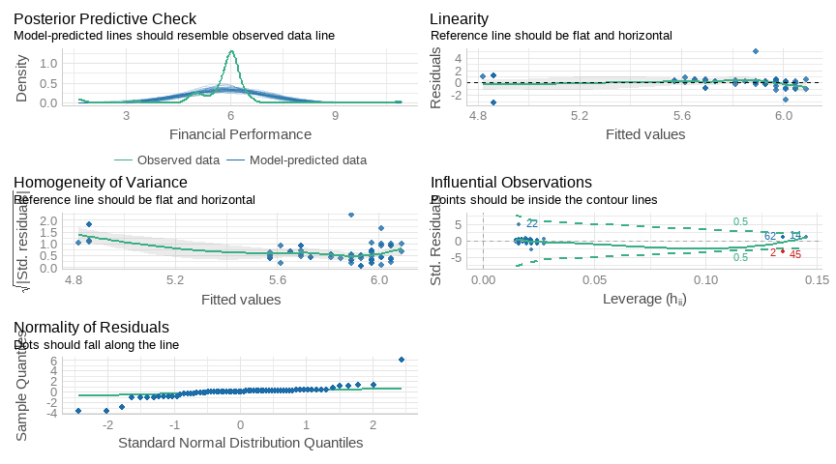

Slide 14
AIC | AICc | BIC | R2 | R2_adjusted | RMSE | Sigma
202.4133 | 202.7883 | 209.0719 | 0.09090697 | 0.07713283 | 1.025599 | 1.041023

Slide 15
Objective 2: The effect of long- term investment on financial performance
Characteristic | Beta | 95% CI¹ | p-value
Longterm Investment | -0.71 | -1.3, -0.13 | 0.018
¹ CI = Confidence Interval
Call: lm(formula = `Financial Performance` ~ `Longterm Investment`, data = Data) Residuals: Min 1Q Median 3Q Max -3.5254 -0.1639 0.0860 0.3544 5.1920 Coefficients: Estimate Std. Error t value Pr(>|t|) (Intercept) 7.1576 0.5786 12.369 <2e-16 *** `Longterm Investment` -0.7105 0.2926 -2.428 0.0179 * --- Signif. codes: 0 '***' 0.001 '**' 0.01 '*' 0.05 '.' 0.1 ' ' 1 Residual standard error: 1.046 on 66 degrees of freedom Multiple R-squared: 0.082, Adjusted R-squared: 0.06809 F-statistic: 5.895 on 1 and 66 DF, p-value: 0.01791

Slide 16
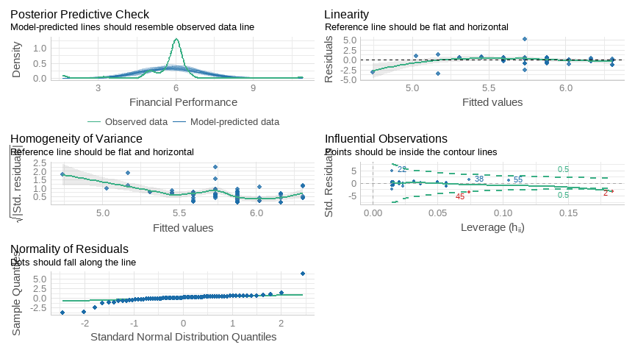

Slide 17
AIC | AICc | BIC | R2 | R2_adjusted | RMSE | Sigma
203.0764 | 203.4514 | 209.7349 | 0.08199911 | 0.06809 | 1.030612 | 1.046111

Slide 18
Characteristic | Beta | 95% CI¹ | p-value
Equity Investment | -0.30 | -0.70, 0.10 | 0.14
¹ CI = Confidence Interval
#Objective 3: The relationship between equity investment and financial performance
Call: lm(formula = `Financial Performance` ~ `Equity Investment`, data = Data) Residuals: Min 1Q Median 3Q Max -3.9620 -0.1353 0.1422 0.3442 5.2742 Coefficients: Estimate Std. Error t value Pr(>|t|) (Intercept) 6.4954 0.4938 13.153 <2e-16 *** `Equity Investment` -0.2968 0.1995 -1.488 0.142 --- Signif. codes: 0 '***' 0.001 '**' 0.01 '*' 0.05 '.' 0.1 ' ' 1 Residual standard error: 1.074 on 66 degrees of freedom Multiple R-squared: 0.03244, Adjusted R-squared: 0.01778 F-statistic: 2.213 on 1 and 66 DF, p-value: 0.1416

Slide 19
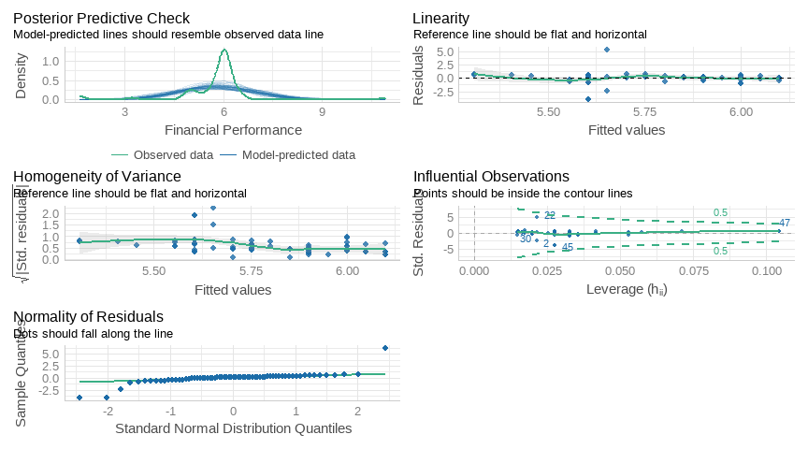

Slide 20
AIC | AICc | BIC | R2 | R2_adjusted | RMSE | Sigma
206.6516 | 207.0266 | 213.3101 | 0.03244263 | 0.01778267 | 1.058064 | 1.073976

Slide 21
Objective 4 :The moderating effect of asset base relationship between financial management determinants and performance
Characteristic | Beta | 95% CI¹ | p-value
Financial innovation | -0.33 | -1.0, 0.35 | 0.3
Asset Base | 1.3 | -1.6, 4.3 | 0.4
Longterm Investment | 0.95 | -1.2, 3.1 | 0.4
Equity Investment | 1.0 | -0.35, 2.3 | 0.14
Financial innovation * Asset Base | 0.18 | -0.13, 0.50 | 0.2
Asset Base * Longterm Investment | -0.51 | -1.6, 0.54 | 0.3
Asset Base * Equity Investment | -0.65 | -1.3, 0.03 | 0.062
¹ CI = Confidence Interval
Call: lm(formula = `Financial Performance` ~ `Financial innovation` * `Asset Base` + `Longterm Investment` * `Asset Base` + `Equity Investment` * `Asset Base`, data = Data) Residuals: Min 1Q Median 3Q Max -2.8312 -0.3625 0.0450 0.2195 5.0610 Coefficients: Estimate Std. Error t value Pr(>|t|) (Intercept) 3.8342 2.9590 1.296 0.2000 `Financial innovation` -0.3278 0.3373 -0.972 0.3351 `Asset Base` 1.3254 1.4786 0.896 0.3736 `Longterm Investment` 0.9478 1.0801 0.877 0.3837 `Equity Investment` 0.9992 0.6728 1.485 0.1428 `Financial innovation`:`Asset Base` 0.1842 0.1561 1.180 0.2428 `Asset Base`:`Longterm Investment` -0.5071 0.5228 -0.970 0.3359 `Asset Base`:`Equity Investment` -0.6544 0.3446 -1.899 0.0624 . --- Signif. codes: 0 '***' 0.001 '**' 0.01 '*' 0.05 '.' 0.1 ' ' 1 Residual standard error: 0.9593 on 60 degrees of freedom Multiple R-squared: 0.2983, Adjusted R-squared: 0.2164 F-statistic: 3.643 on 7 and 60 DF, p-value: 0.00244

Slide 22
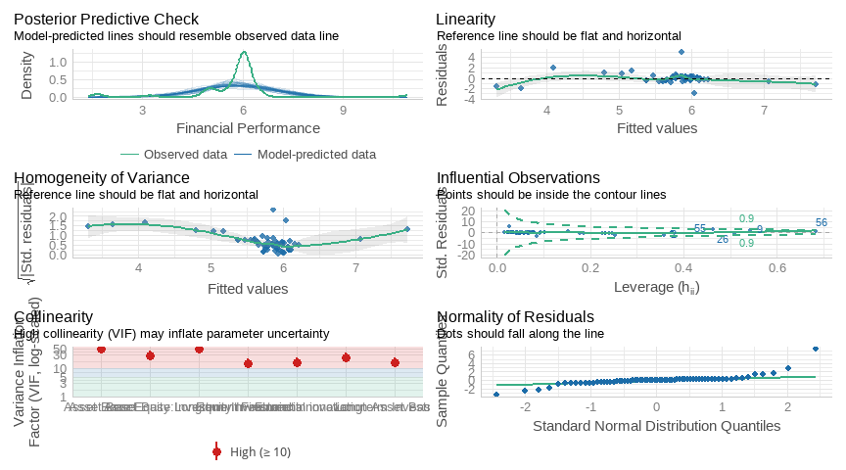

Slide 23
Df | Sum Sq | Mean Sq | F value | Pr(>F)
1 | 7.1524238 | 7.1524238 | 7.772808 | 0.007094229
1 | 0.4172093 | 0.4172093 | 0.453397 | 0.503311686
1 | 3.1139114 | 3.1139114 | 3.384005 | 0.070780552
1 | 1.8387229 | 1.8387229 | 1.998209 | 0.162652658
1 | 4.1376391 | 4.1376391 | 4.496528 | 0.038106868
1 | 3.4894517 | 3.4894517 | 3.792118 | 0.056178815
1 | 3.3180170 | 3.3180170 | 3.605814 | 0.062389276
60 | 55.2111211 | 0.9201854 | NA | NA

Slide 24
AIC | AICc | BIC | R2 | R2_adjusted | RMSE | Sigma
196.8083 | 199.9117 | 216.7839 | 0.2982692 | 0.2164007 | 0.9010706 | 0.9592629

