Slide 1
Operational Amplifiers
Mandy Hardono, Section 306

Slide 2
Agenda
Analyze the internal circuitry of an op amp and learn the designs and functions of several op amp circuits
Design and simulate a few op amp circuits using CAPTURE and PSPICE A/D
Difference amplifier, Differentiator, Integrator, Wien-Bridge oscillator
Build and test the designed circuits and assess whether they align with the simulation results
Use the gain equations to confirm accuracy of results

Slide 3
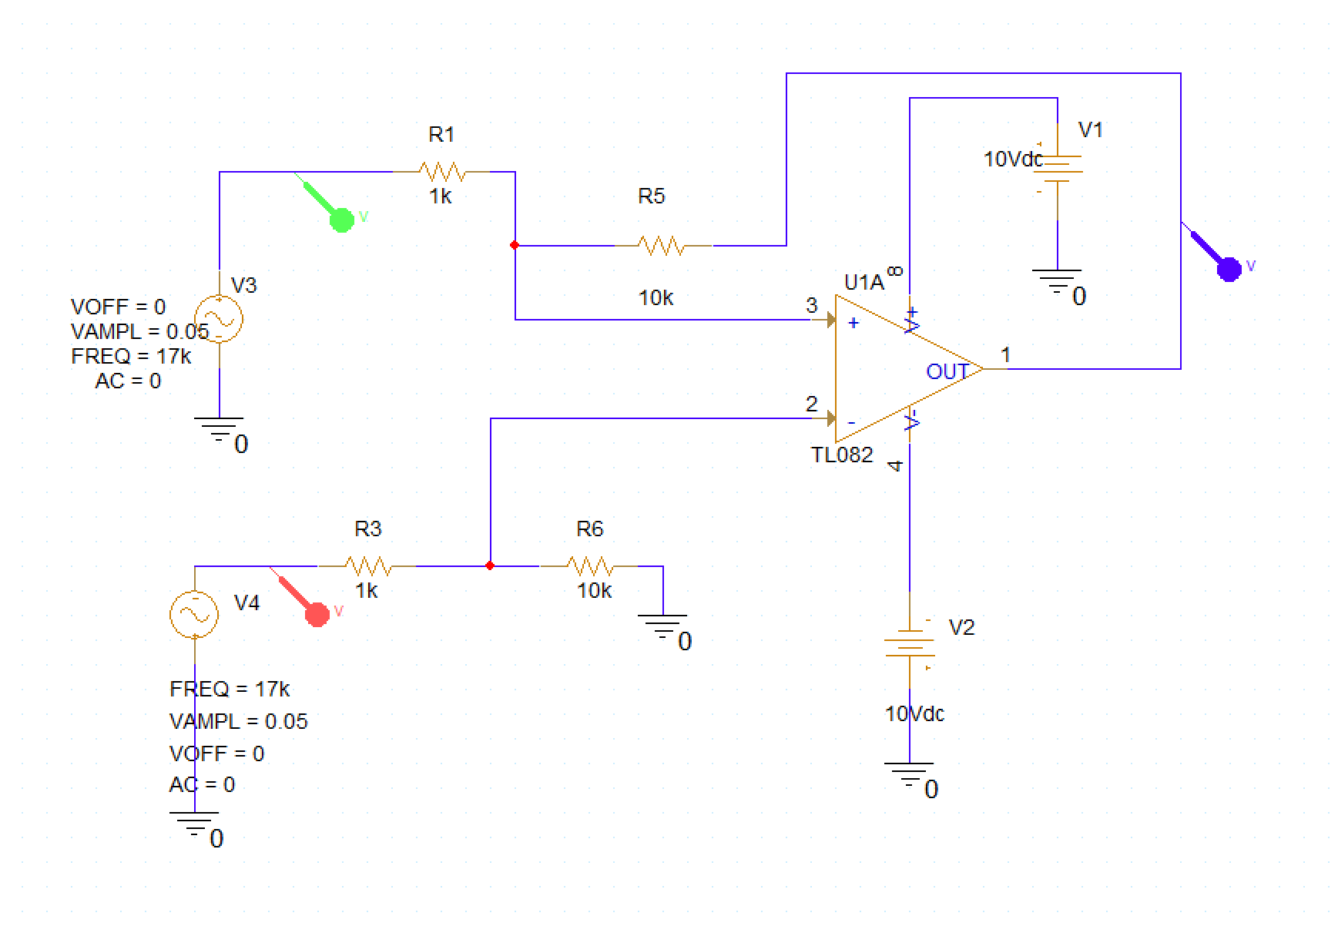
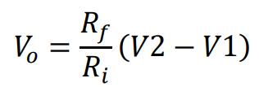
Setup: Difference Amplifier

Slide 4
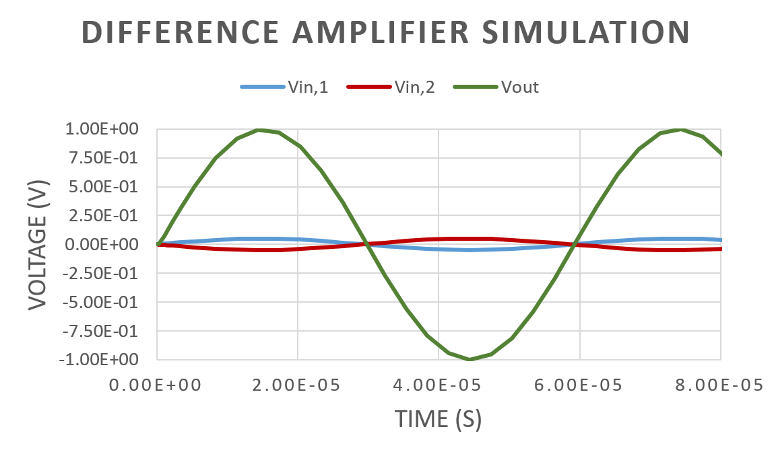
Expectations: Difference Amplifier
Voltage gain = G = -10 V/V
Vout = G(V2 - V1) = -10(-.1 - .1) = 2 Vpp.

Slide 5
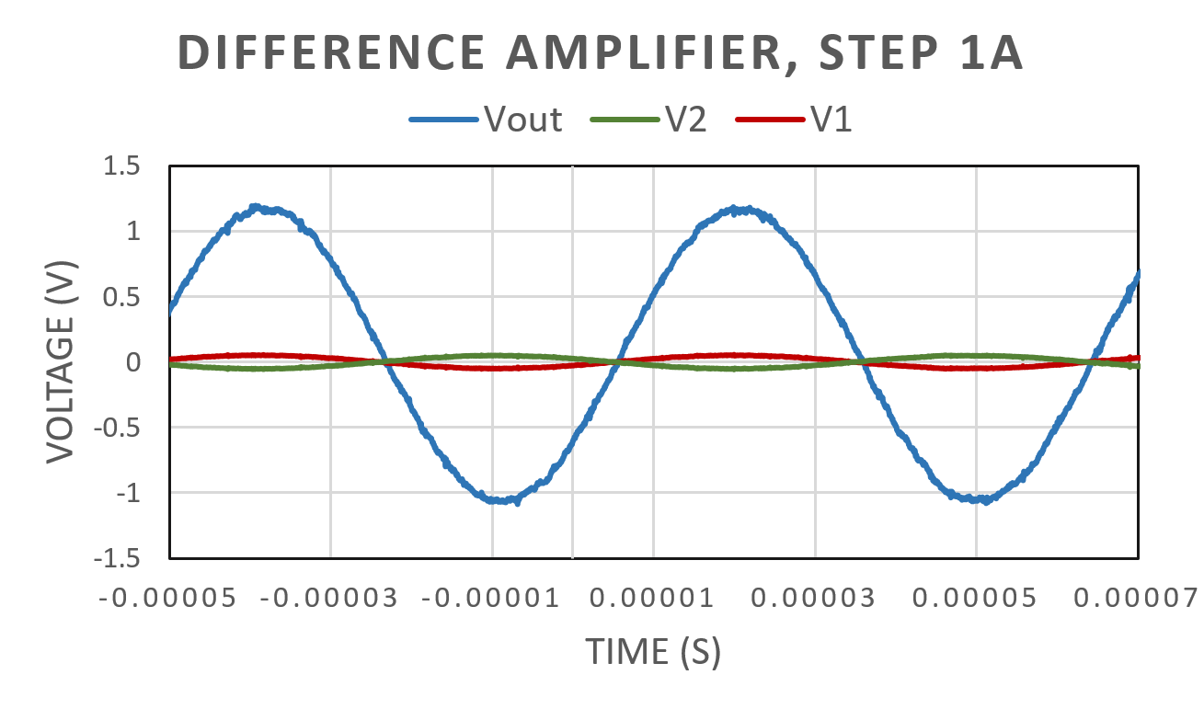
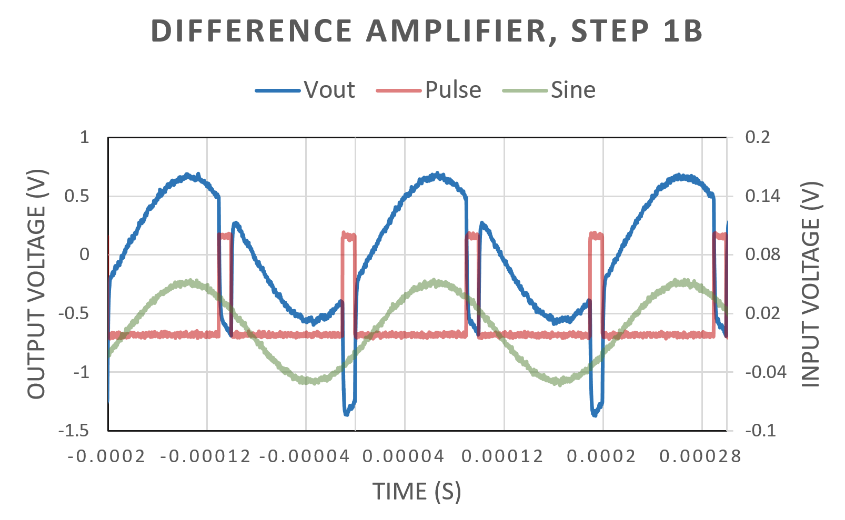
Results (1 out of 2):
Difference Amplifier
Step 1A : Pre-Lab Circuit
Vout ~ 2 Vpp
Step 1B : Sine - Pulse
Theoretical output: 10(.2-.1) = 1 Vpp.
Real output ~ 1 Vpp, with pulses subtracted.

Slide 6
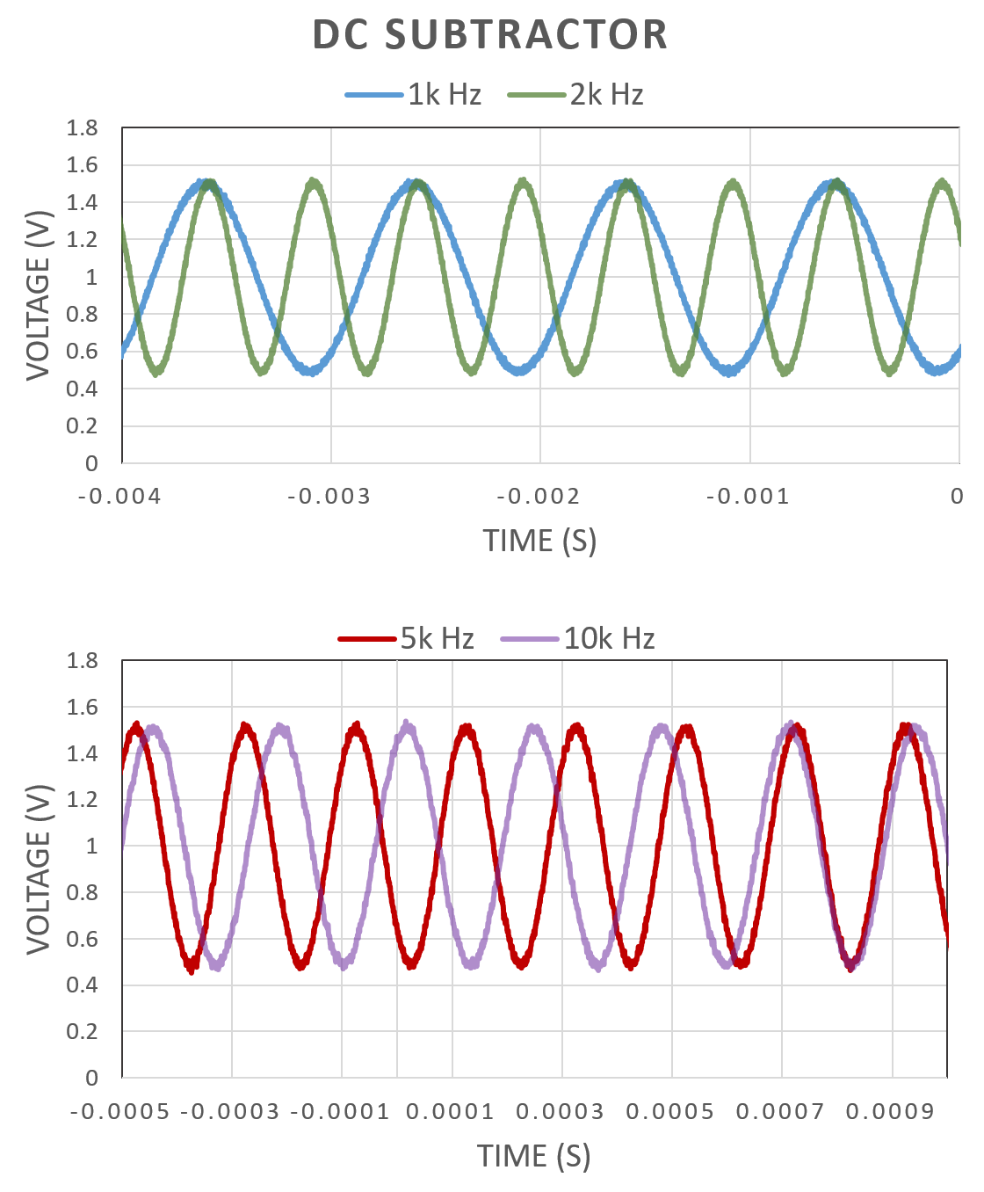
Results (2 out of 2):
Difference Amplifier
Step 1 Addition: DC Subtractor
At all frequencies, the amplifier subtracted the DC input from the AC input. At higher frequencies, this difference is clearer.

Slide 7
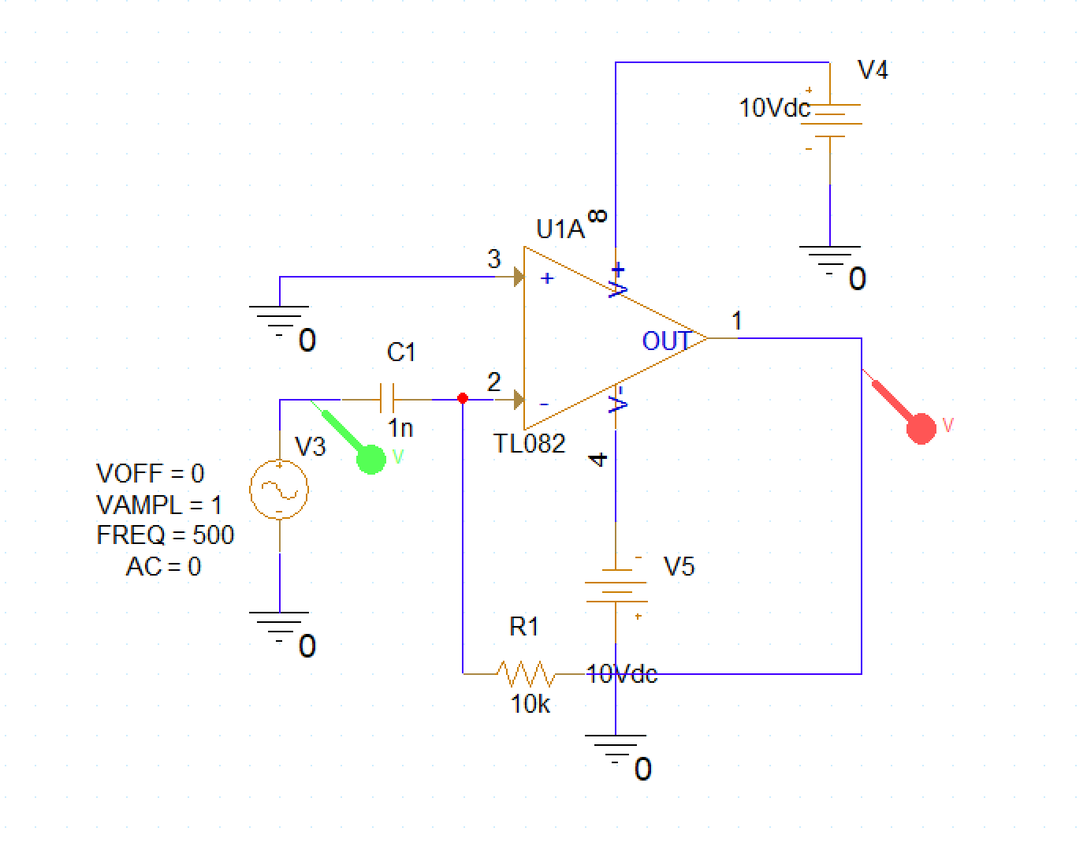

Setup: Differentiator

Slide 8
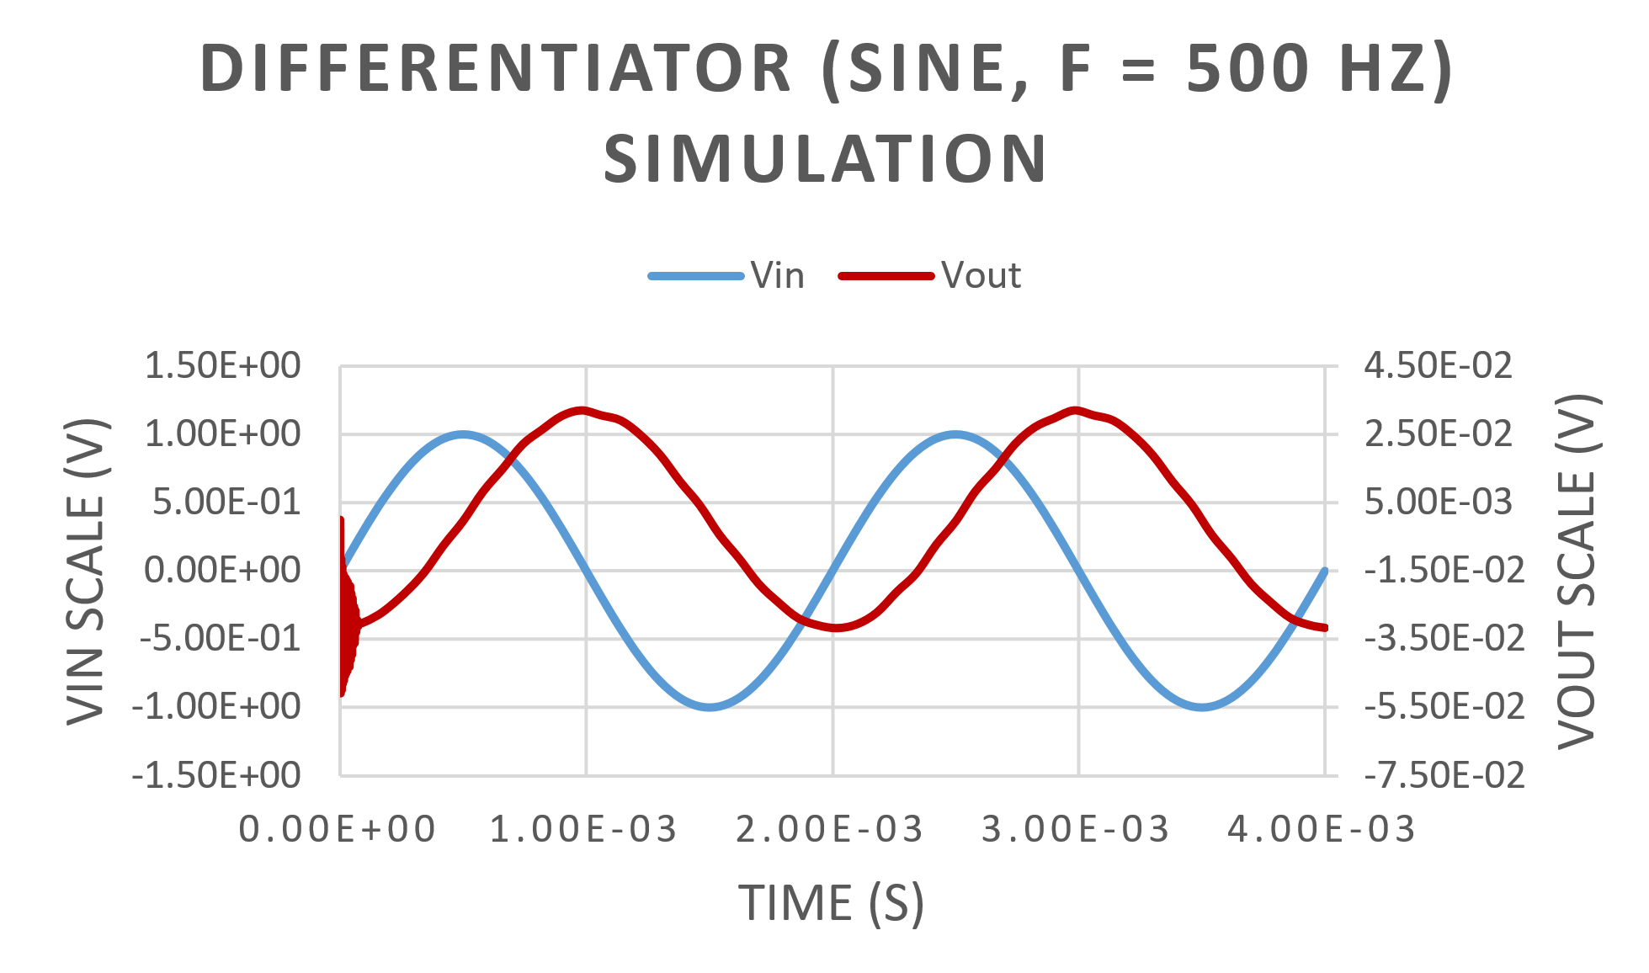
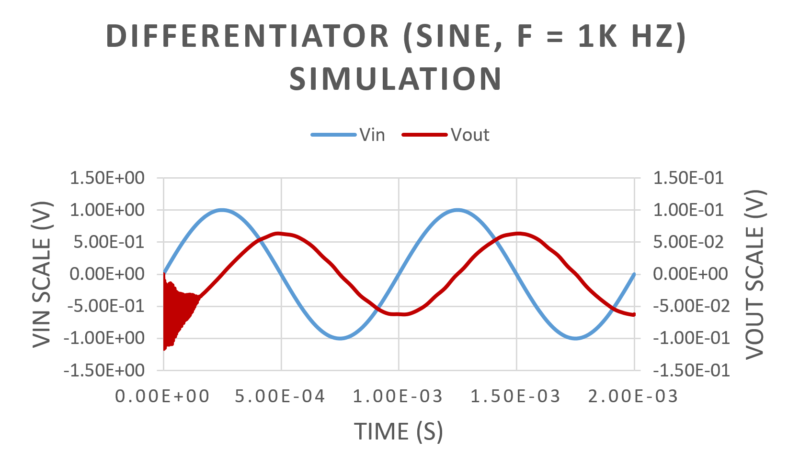
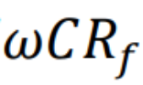
Expectations (1 out of 2): Differentiator (Sine)
At 500 Hz and 1 kHz, the simulation output magnitudes are very small, due to the scale factor
The outputs are cosine waveforms as (d/dx)(sin(x)) = cos(x)

Slide 9
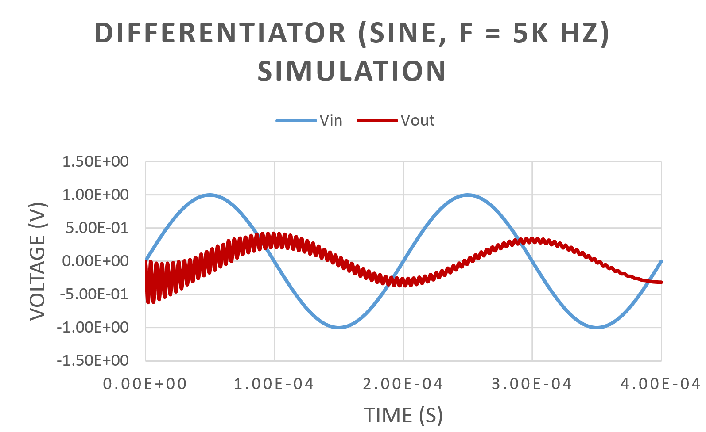
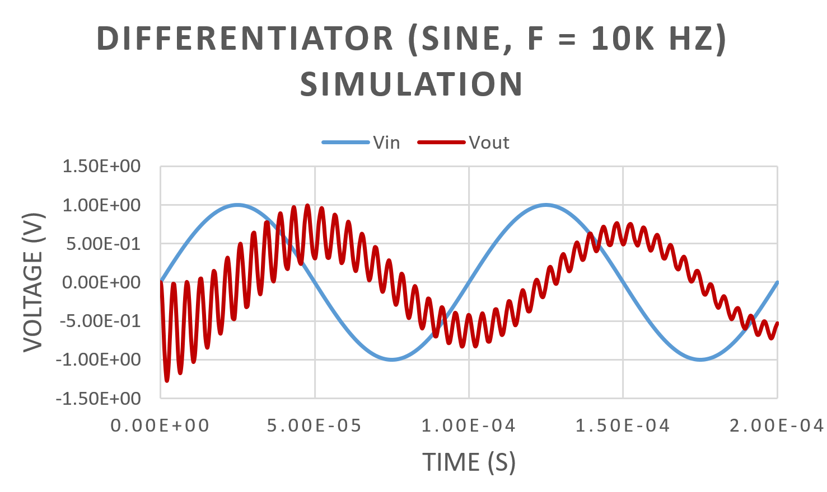
Expectations (2 out of 2): Differentiator (Sine)
At 5 kHz and 10 kHz, the simulation output magnitudes are much larger, due to the scale factor
The outputs are cosine waveforms as (d/dx)(sin(x)) = cos(x)

Slide 10
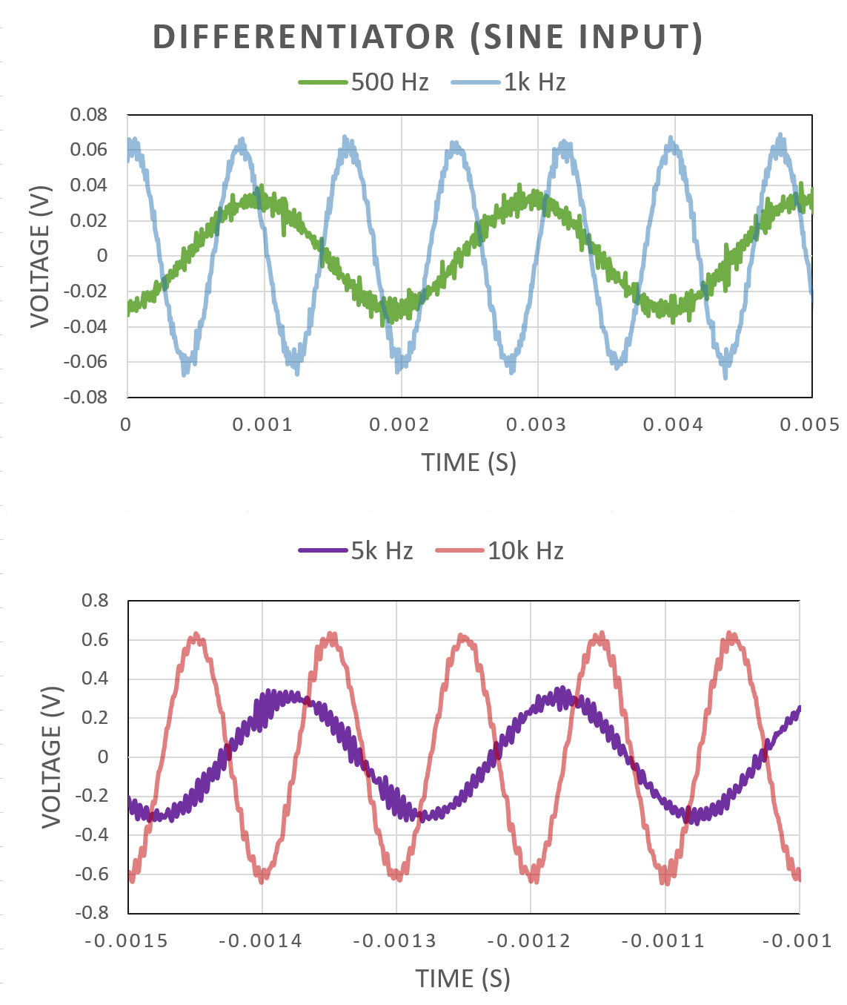
Results:
Differentiator (Sine)
At each frequency, the outputs align with the simulation results and calculations.
E.G. at 500 Hz, Vout = (2π500)(1✕10-9)(10000)(2 Vpp) ~ 0.062 Vpp.

Slide 11
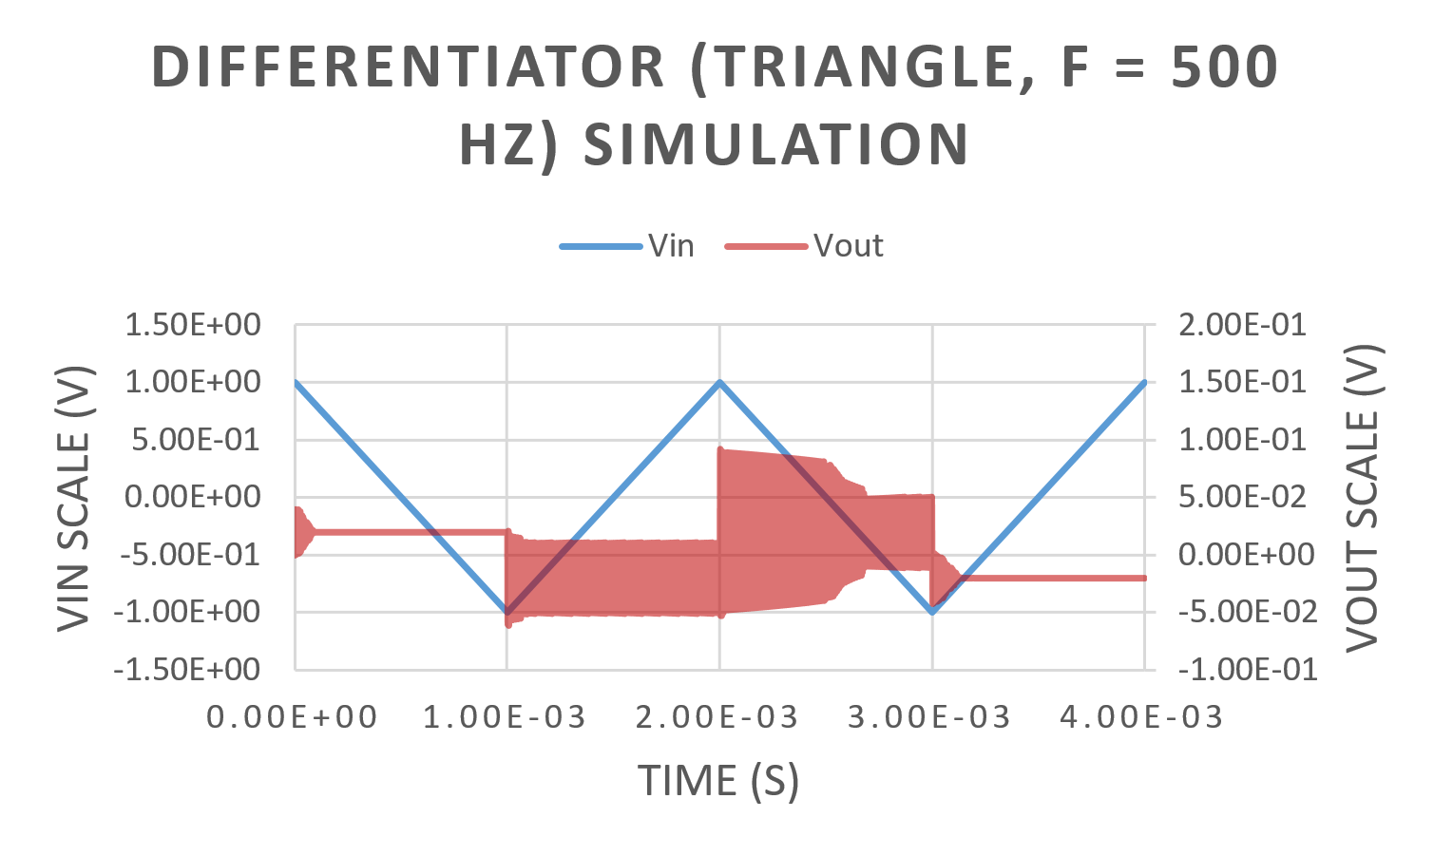
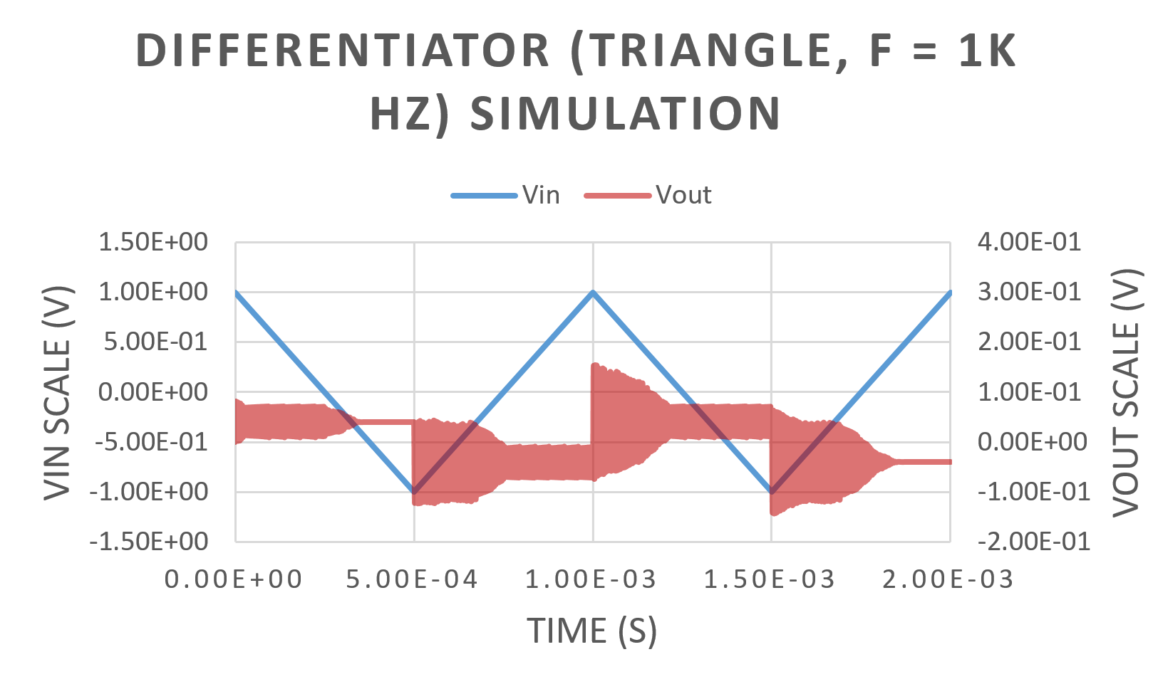
Expectations (1 out of 2): Differentiator (Triangle)
At 500 Hz and 1 kHz, the simulation output magnitudes are very small, due to the scale factor
The outputs are SQUARE waveforms (derivative of sloping line = straight line)

Slide 12
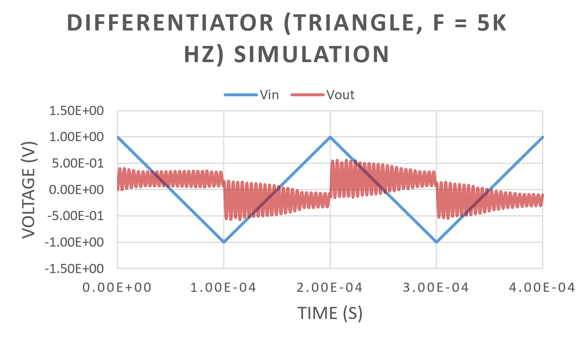
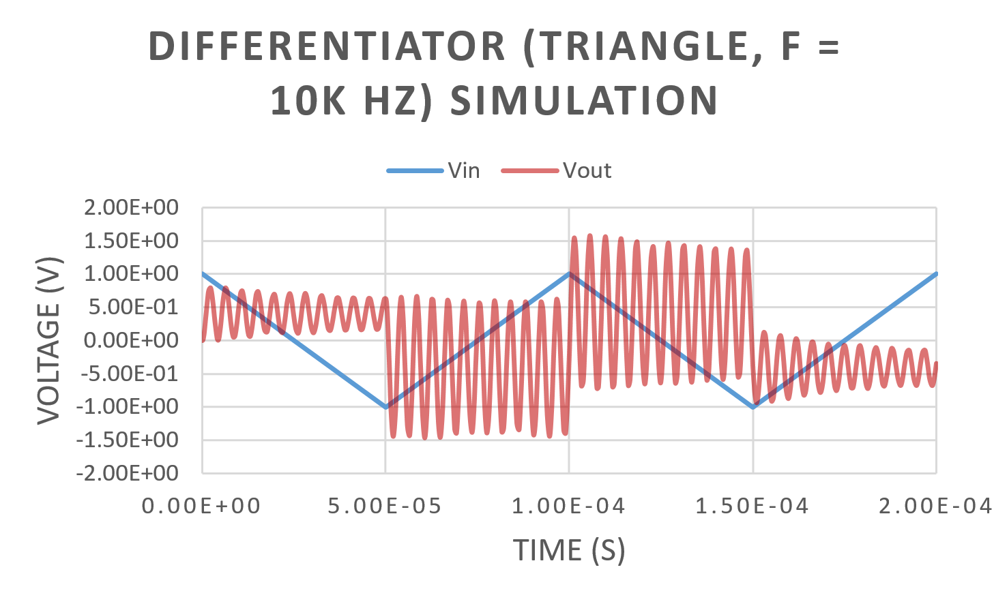
Expectations (2 out of 2): Differentiator (Triangle)
At 5 kHz and 10 kHz, the simulation output magnitudes are much larger, due to the scale factor
The outputs are SQUARE waveforms (derivative of sloping line = straight line)

Slide 13
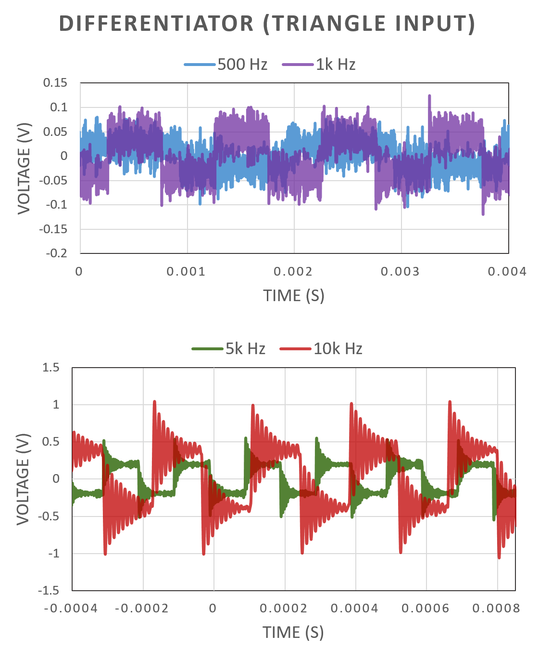
Results:
Differentiator (Triangle)
At each frequency, the outputs align with the simulation results and calculations.
E.G. at 5k Hz, Vout = (2π5000)(1✕10-9)(10000)(2 Vpp) ~ 0.62 Vpp.

Slide 14
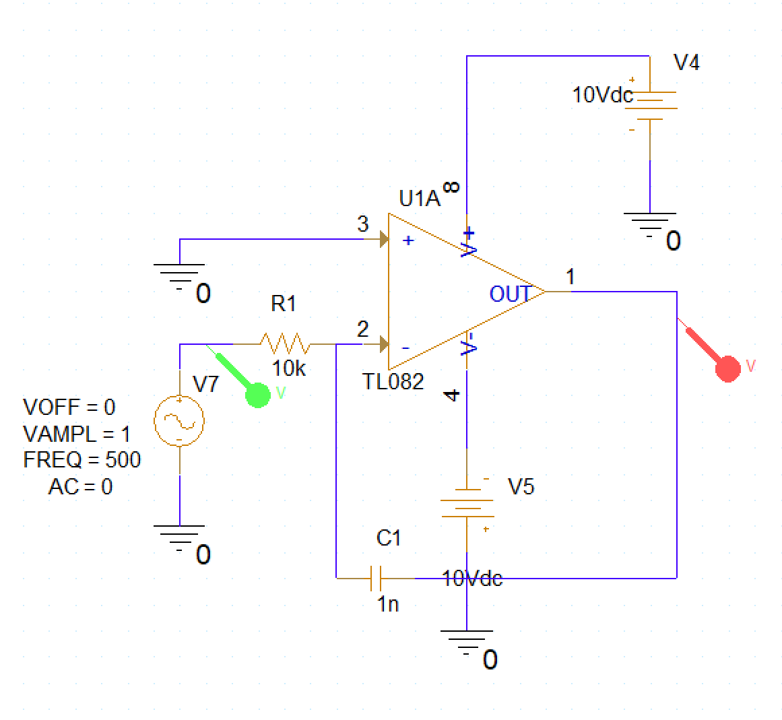
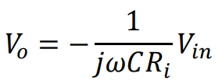
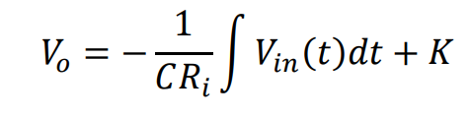
Setup: Integrator

Slide 15
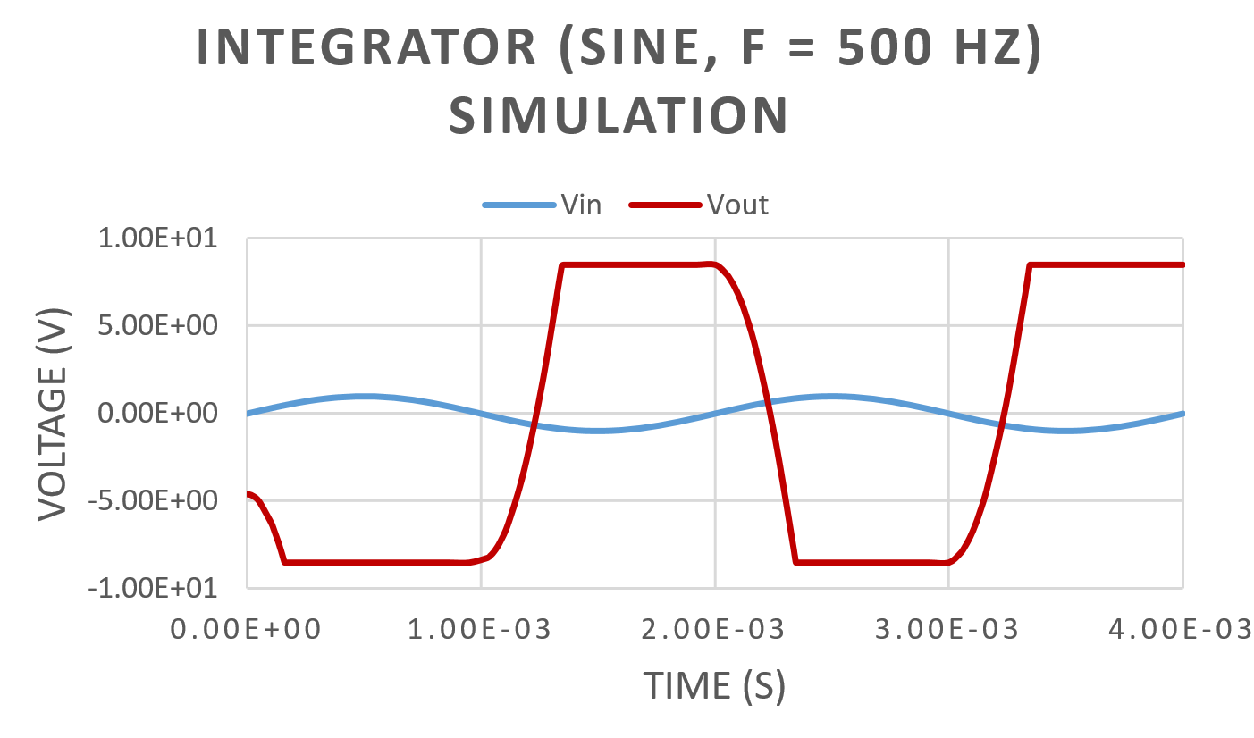
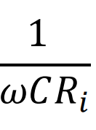
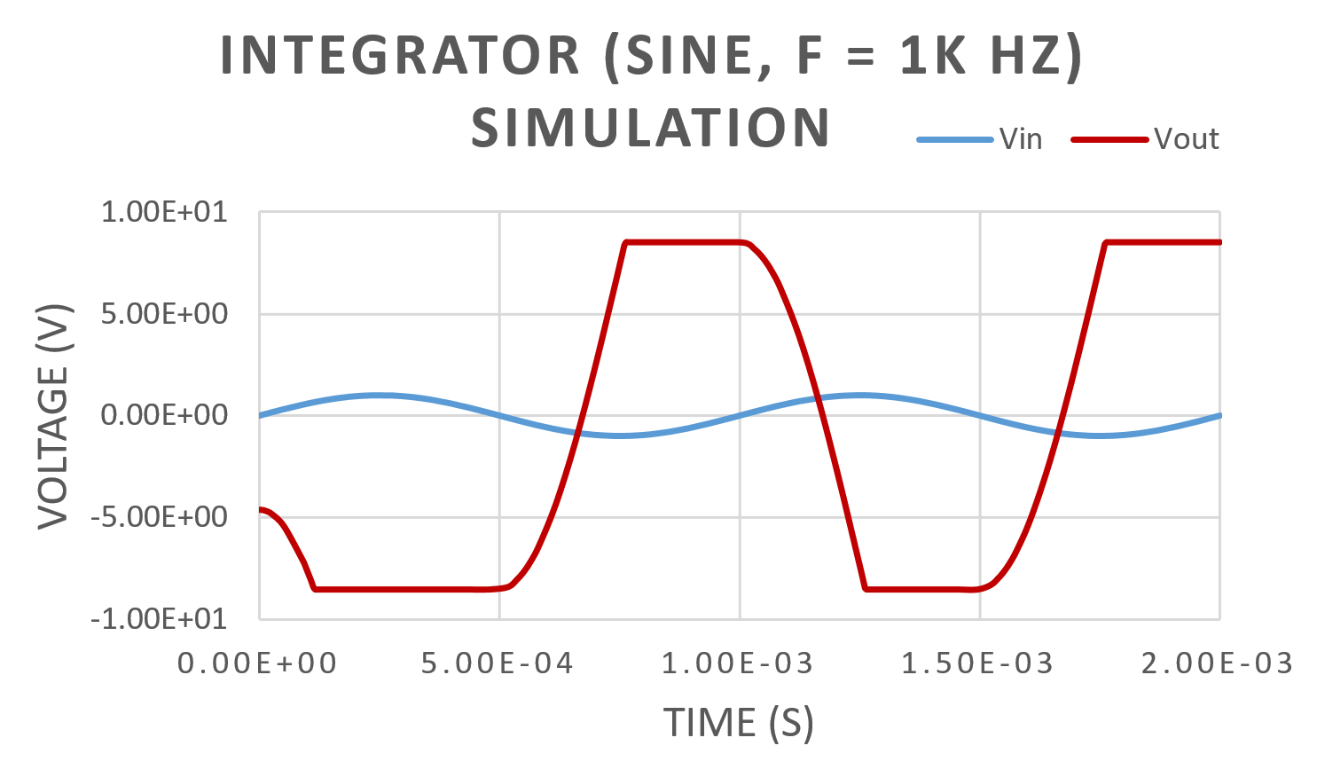
Expectations (1 out of 2): Integrator (Sine)
At 500 Hz, the simulation magnitude is largest, due to scale factor
The outputs are cosine waveforms (integral of sin(x) = -cos(x))

Slide 16
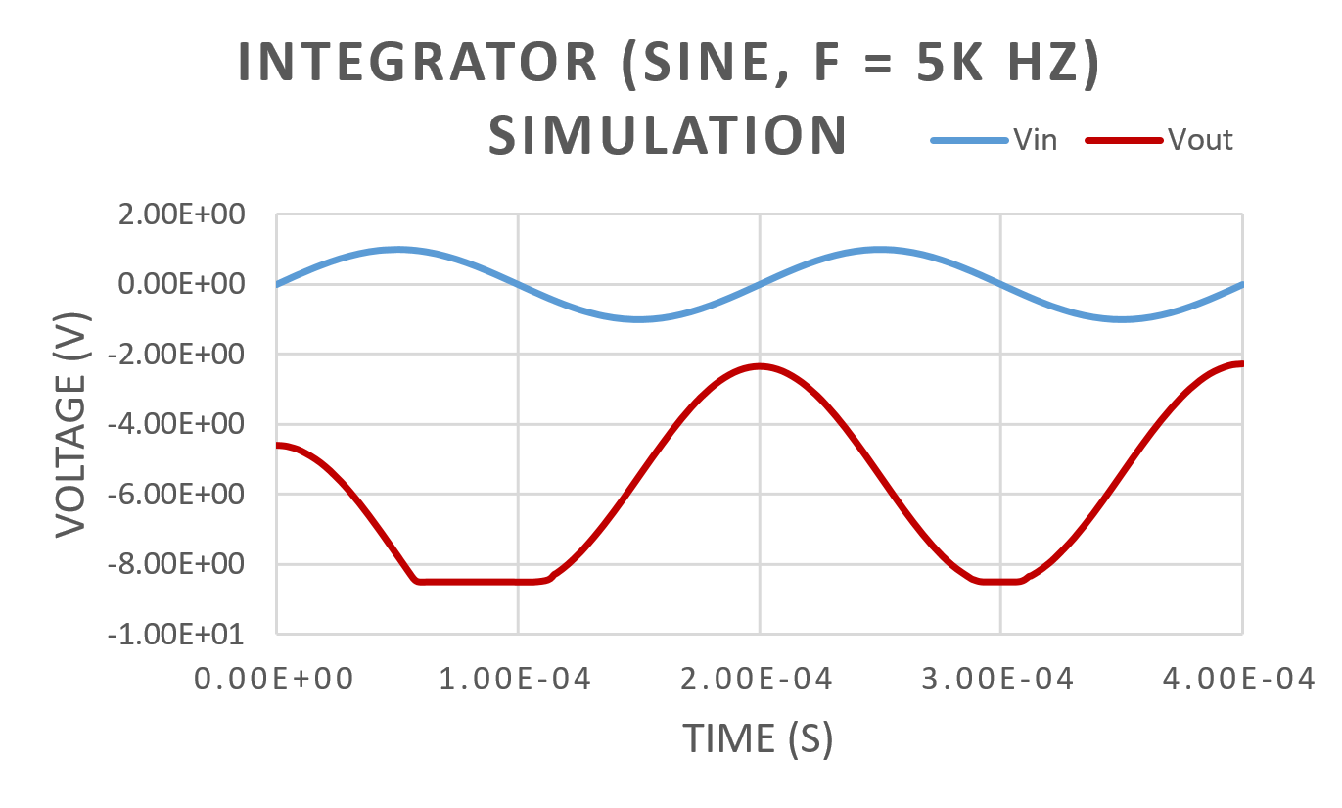
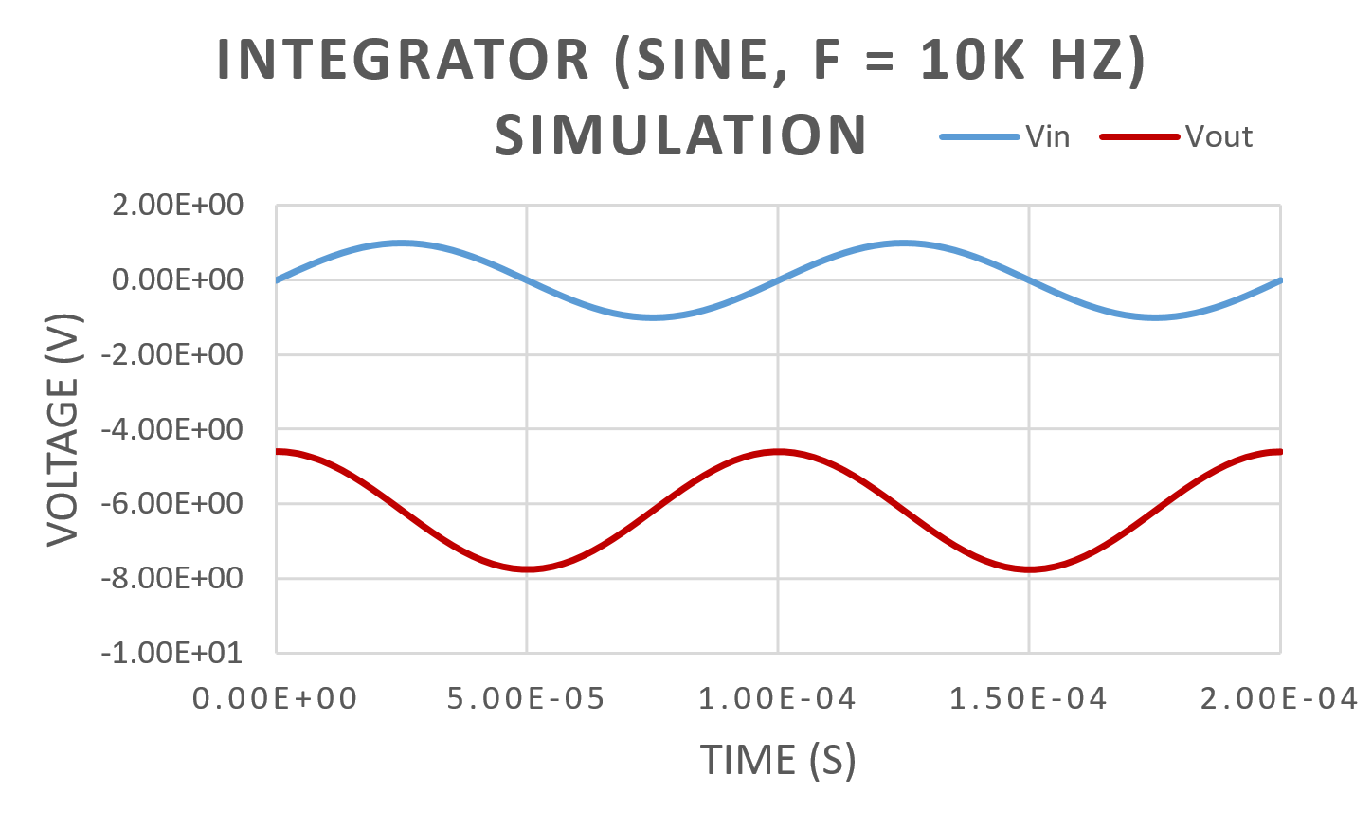
Expectations (2 out of 2): Integrator (Sine)
At 10 kHz, the simulation magnitude is smallest, due to scale factor
The outputs are cosine waveforms (integral of sin(x) = -cos(x))

Slide 17
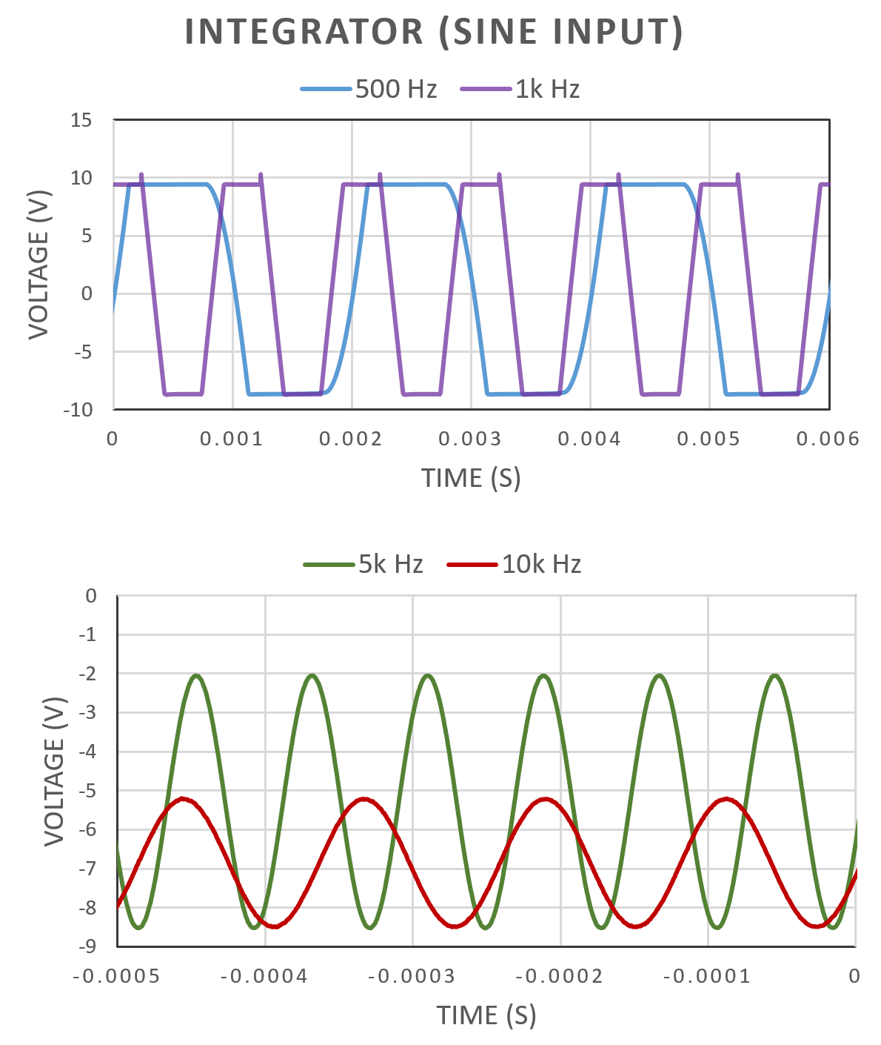
Results:
Integrator (Sine)
At each frequency, the outputs align with the simulation results and calculations.
Vertical shifts due to constant of integration K.

Slide 18
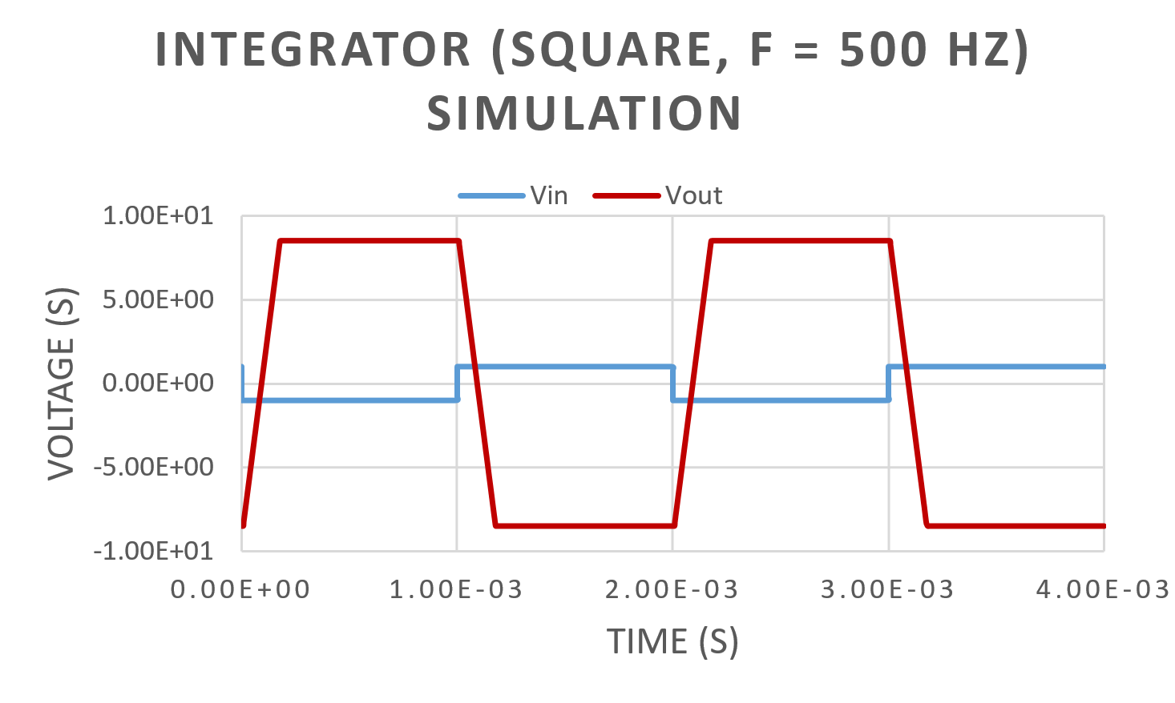
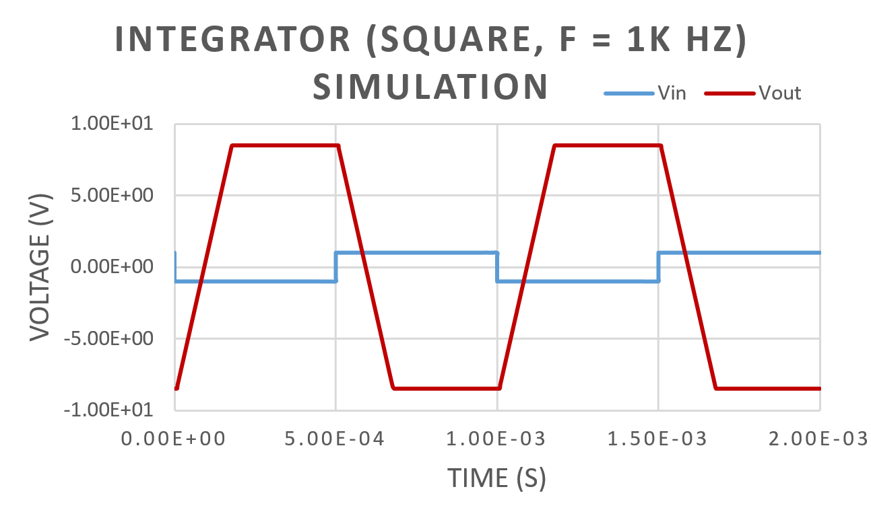
Expectations (1 out of 2): Integrator (Square)
At 500 Hz, the simulation magnitude is largest, due to scale factor
The outputs are triangle waveforms (integral of straight horizontal line = sloping line)

Slide 19
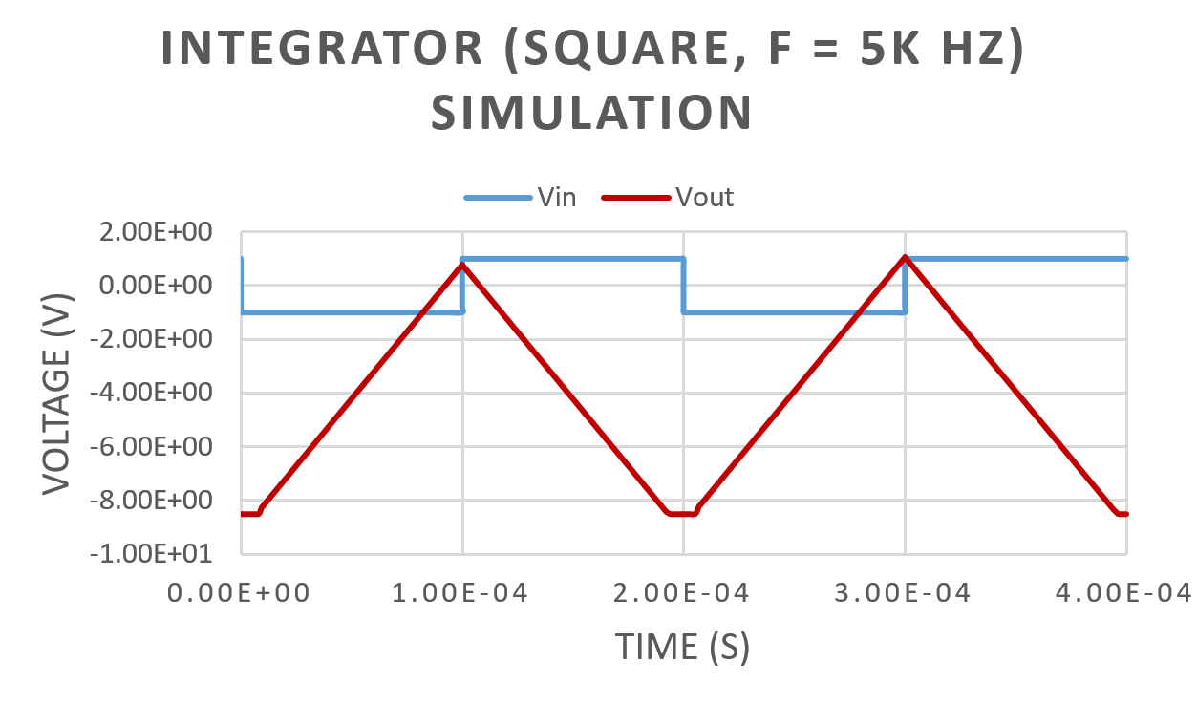
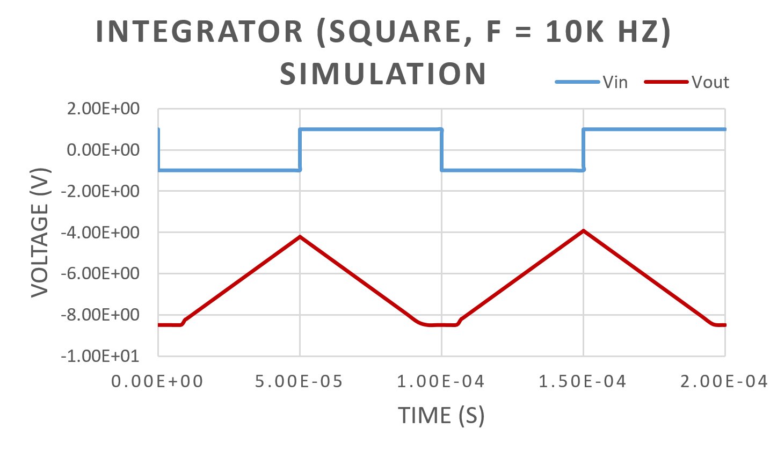
Expectations (2 out of 2): Integrator (Square)
At 10 kHz, the simulation magnitude is smallest, due to scale factor
The outputs are triangle waveforms (integral of straight horizontal line = sloping line)

Slide 20
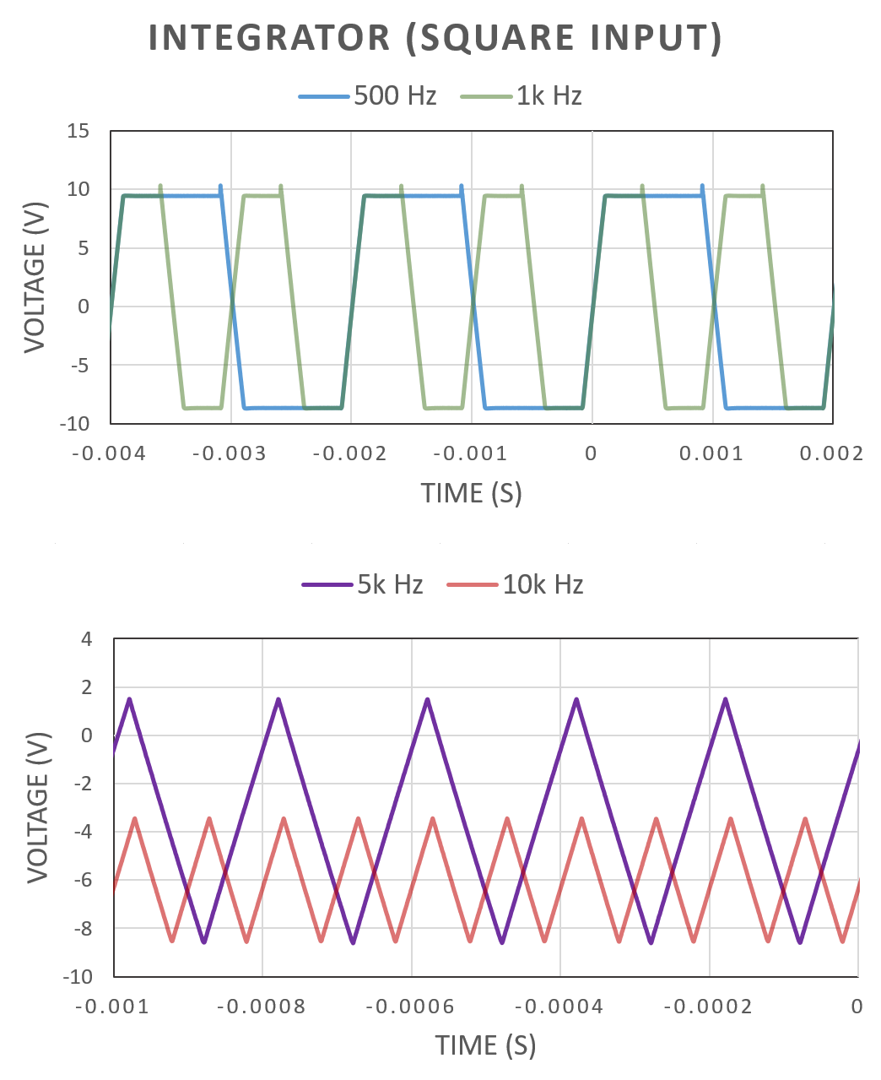
Results:
Integrator (Square)
At each frequency, the outputs align with the simulation results and calculations.
Vertical shifts due to constant of integration K.

Slide 21
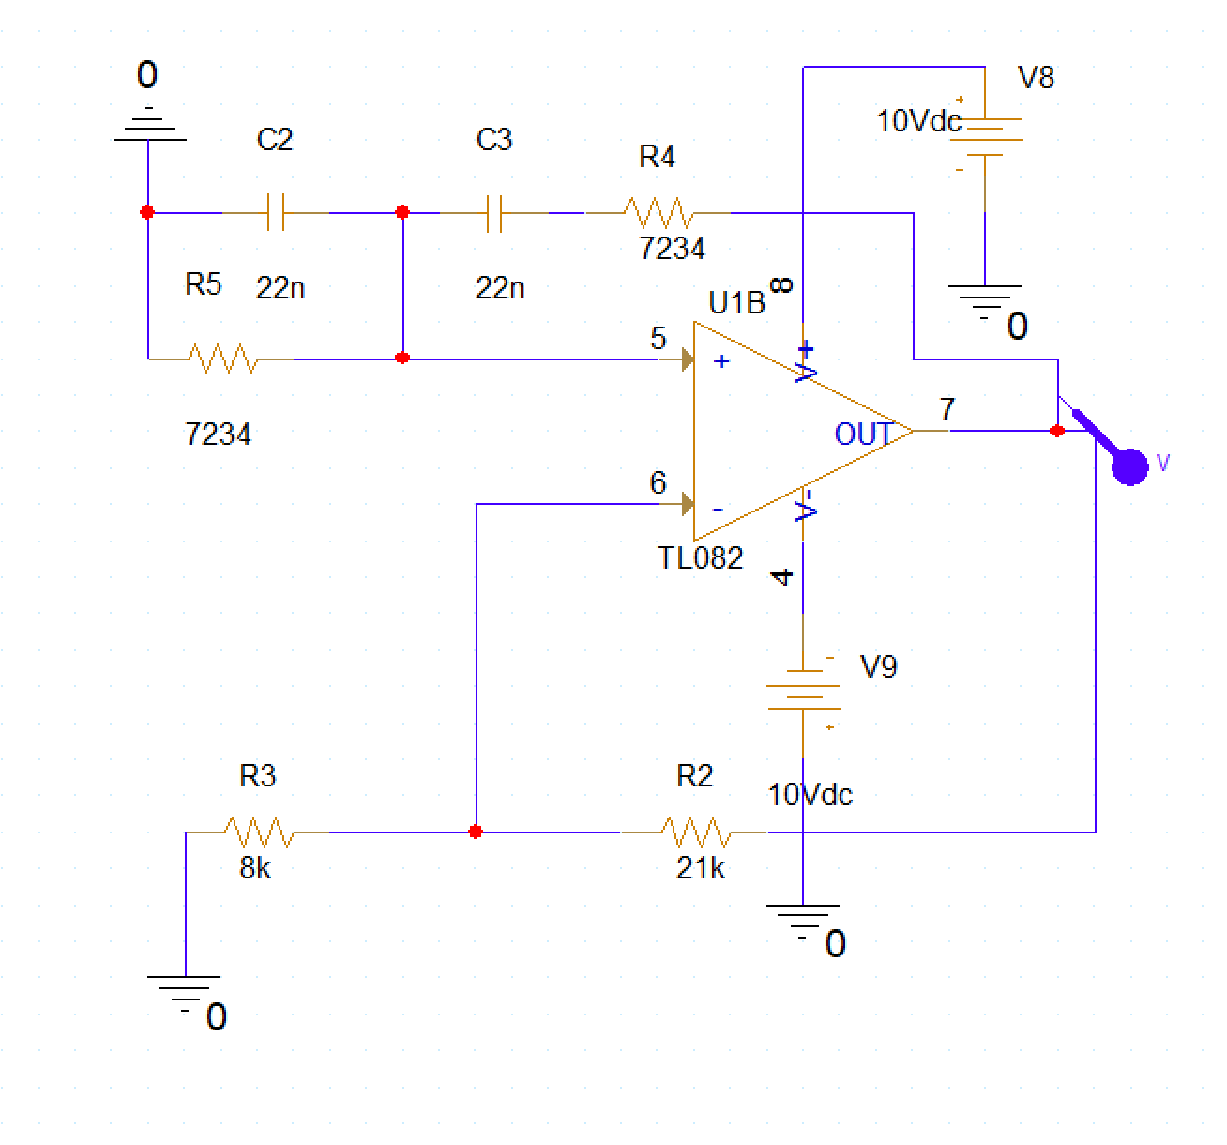
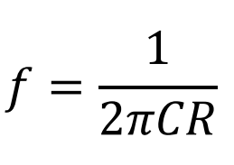
Setup: Wien-Bridge Oscillator

Slide 22
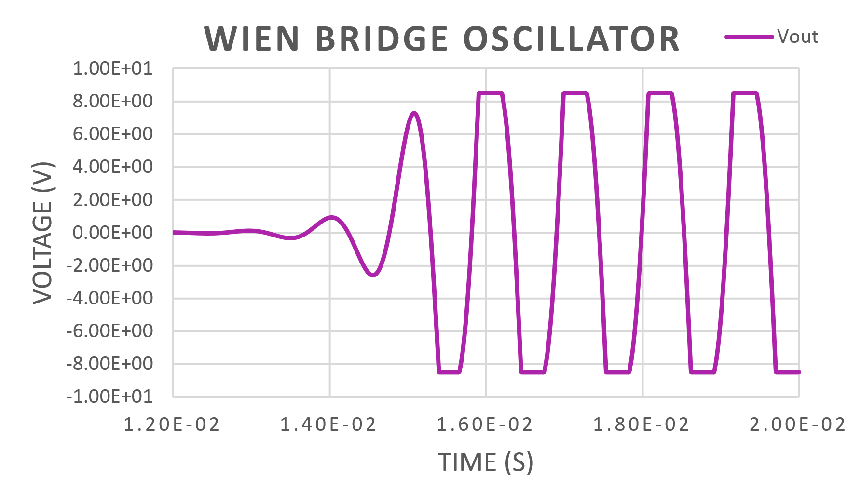
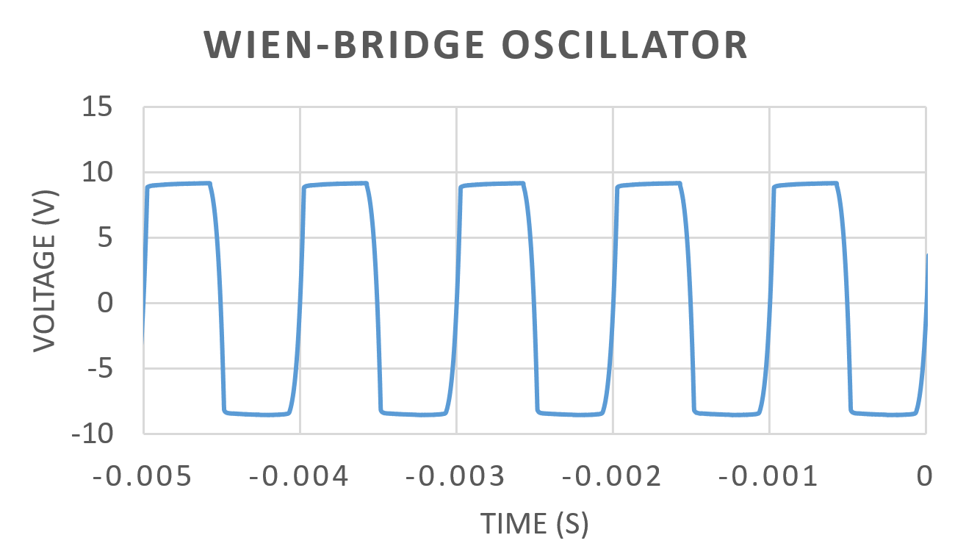
Wien-Bridge Oscillator
Expectation: f = 1 kHz
Result: f ~ 1 kHz

Slide 23
Conclusion
Learned how to design different op amp circuits using their gain equations
Difference amplifier, Differentiator, Integrator, Wien-Bridge oscillator
Obtained results in the lab congruent to the theoretical calculations and simulations, with little discrepancies

