Slide 1
Conditional Statements

Slide 2
This presentation will go over the following topics:
“ If ”, “ else ” and “ else if “ statements
comparison operators
logical operators
truthy vs falsy values
ternary operators
switch statement

Slide 3
What is a conditional statement? A conditional statement in JavaScript is a way to make decisions in your code based on certain conditions. It allows your program to choose different actions depending on whether a condition is true or false. Think of it like making decisions in real life:
If it is raining → take an umbrella
otherwise → do not take an umbrella
If it is sunny → take sunglasses
otherwise → do not take sunglasses
* Everyone come up with one more, real life example!
Notes:
This presentation will go over the following topics:
if, else if, and else statements
comparison operators
logical operators
truthy vs falsy values
ternary operators
switch statement

Slide 4
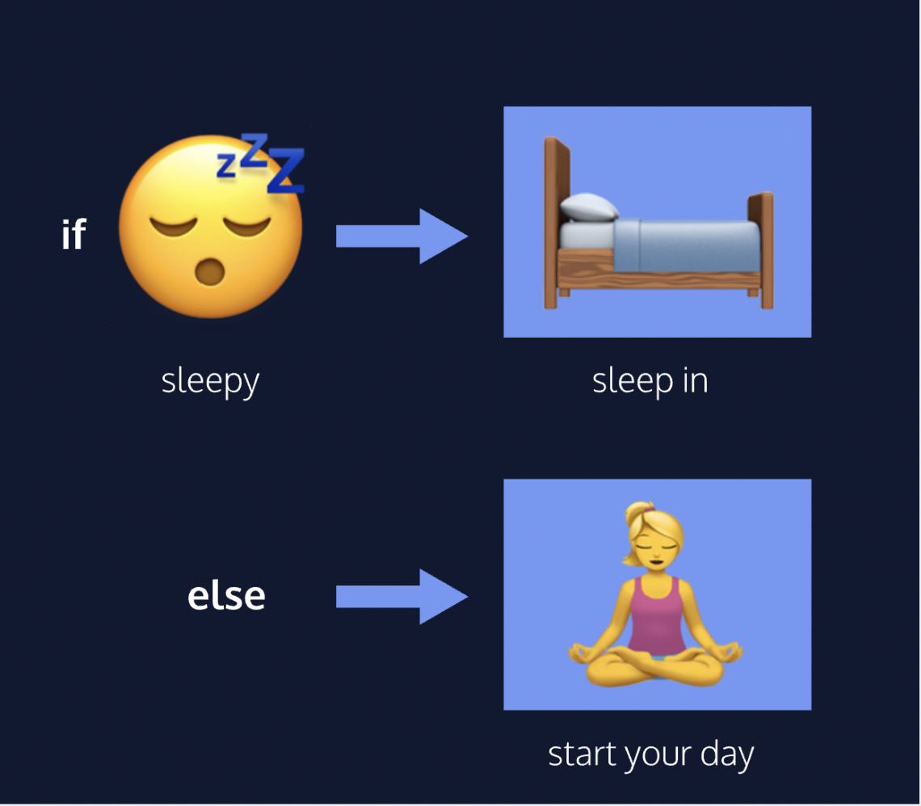

Slide 5
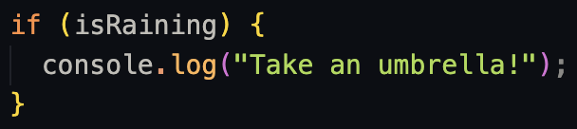
“ if “ Statement
The if statement is the most basic form of a conditional statement. It checks if a condition is
true, and if it is, it runs a block of code. This means if something is true, it does something specific.
basic syntax:
If
(condition)
{code block}
The condition goes inside the ( ). It is either true or false. If the condition is true, the code inside the curly braces {} runs, or ‘executes’. If the condition evaluates to false, the block won’t execute.

Slide 6
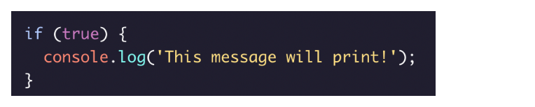
If statement example

Slide 7
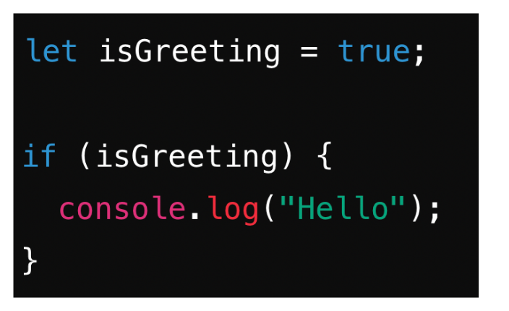
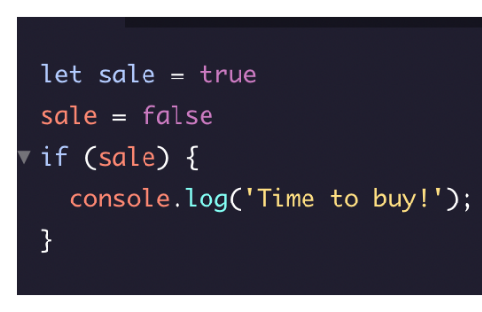
More examples:
explain what will happen in each case

Slide 8
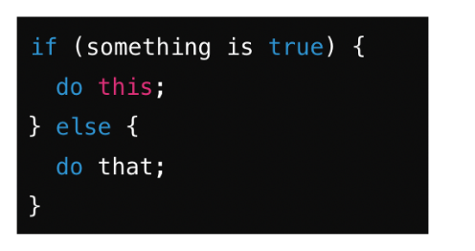
If...Else Statements
An if else statement lets your code choose between two things:
If something is true, do one thing. Else (otherwise), do something different.
Basic syntax:
If
(condition)
{code block}
else
{second code block}
The condition goes inside the ( ). It is either true or false.
If the condition is true, the code inside the first curly braces {} runs, or ‘executes’. If the condition evaluates to false, the second code block will execute.

Slide 9
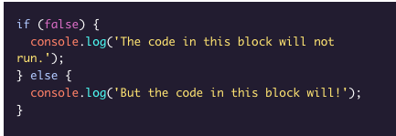
If...Else Statement example:

Slide 10
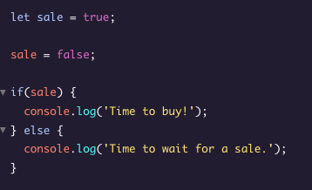
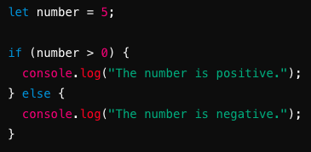
More example:
explain what will happen in each case

Slide 11
Comparison operators
A comparison operator is a special symbol in programming that compares two values. It tells the computer how to compare them and what the result of the comparison should be.
Think of it like asking a question about the values, such as "Are these two numbers the same?" or "Is this number bigger than that number?"

Slide 12
Here is a list of some comparison operators and their syntax:
Less than: <
Greater than: >
Less than or equal to: <=
Greater than or equal to: >=
Is equal to: ===
Is not equal to: !==

Slide 13
Evaluate these statements to true or false
10 < 12 5 > 9 10 !== 10 5 === 5 3 >= 2 + 1
It can be helpful to think of comparison statements as questions. When the answer is “yes”, the statement evaluates to true, and when the answer is “no”, the statement evaluates to false.

Slide 14
We can also use comparison operators on different data types like strings:
Are these true or false?
‘apples’ !== ‘oranges’ ‘up’ === down

Slide 15
Basic principles
All comparison statements evaluate to either true or false and are made up of:
Two values that will be compared.
An operator that separates the values and compares them accordingly (>, <, <=,>=,===,!==).

Slide 16
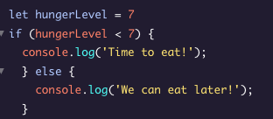
How we can use them in conditional statements:
Conditional statements let the computer make decisions based on these comparisons. Let's look at a simple example.

Slide 17
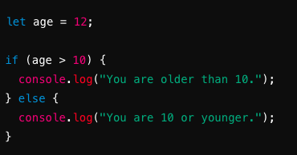
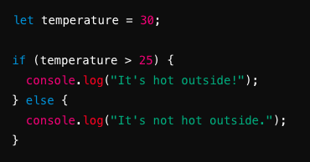
More examples:

Slide 18
== (equality operator) vs === (strict equality operator)
The == operator performs type coercion, meaning it converts the values being compared to the same type before making the comparison. This means when using == it doesn’t matter if one variable is a string and the other is a number they are viewed by the computer as the same.
Examples:
5 == '5' is true because the string '5' is converted to the number 5 before comparison.
null == undefined is true because they are considered the same

Slide 19
=== (strict equality operator)
The === operator does not perform type coercion. It compares both the values and their types.
Examples:
5 === '5' is false because the types are different (number and string).
null === undefined is false because they are different types.

Slide 20
Logical operators
Logical operators are symbols that help you combine multiple conditions or invert them. They are used in conditional statements to make more complex decisions. The Three Main Logical Operators are:
&& (AND)
|| (OR)
! (NOT)

Slide 21
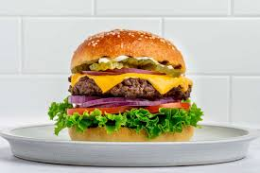


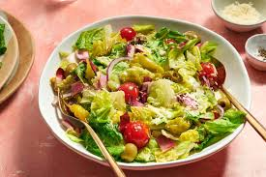

What do they want for dinner?
&&
||
!

Slide 22
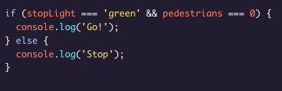
&&
When we use the && operator we are checking if two things are true:

Slide 23
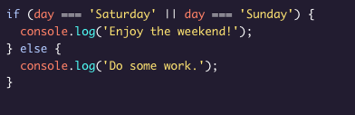
||
When we use the || operator we are checking if either one of the conditions are true:

Slide 24
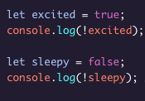
!
When we use the ! operator we are reversing the condition:

Slide 25
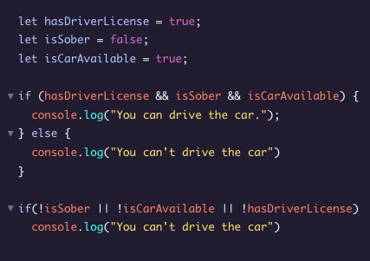
Example:

Slide 26
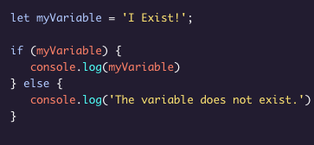
Truthy
Let’s see how Javascript handles a situation without a boolean type (true or false). Sometimes, you’ll want to check if a variable exists and you won’t necessarily want it to equal a specific value — you’ll only check to see if the variable has been assigned a value.
In this case myVariable is truthy. It has a truthy value; even though the value of myVariable is not explicitly the value true, when used in a boolean or conditional context, it evaluates to true because it has been assigned a non-falsy value -because it exists.
Notes:
What will be logged to the console here?

Slide 27
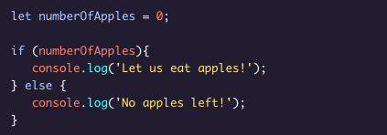
Falsey
What is considered a falsey value?
0
Empty strings like " " or ' '
null which represent when there is no value at all
undefined which represent when a declared variable lacks a value
NaN, or Not a Number
Notes:
What will be logged to the console?

Slide 28
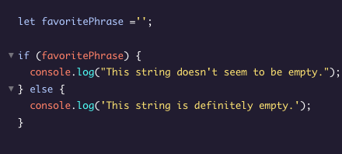
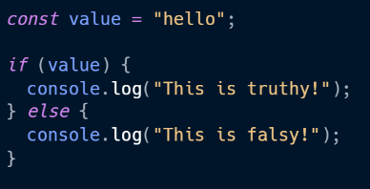
More examples:
What will be logged to the console?

Slide 29
Truthy/falsey assignment

Slide 30
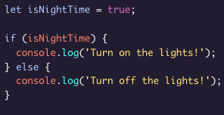

Ternary Operator
We can use a ternary operator to simplify an if...else statement

Slide 31
Ternary operator syntax
The condition is provided before the ?
Two expressions follow the ? and are separated by a colon :
If the condition evaluates to true, the first expression executes.
If the condition evaluates to false, the second expression executes.

Slide 32


Examples:

Slide 33
Make your own ternary operator for:
Variable: let age = 65 Condition: canRetire
Variable: let profession = doctor Condition: canPresribeMedicine
Variable: let time = 21:00 Condition: timeForBreakfast
Your idea

Slide 34
Else if statements
We can add more conditions to our if...else with an else if statement The else if statement allows for more than two possible outcomes. You can add as many else if statements as you’d like, to make more complex conditionals

Slide 35
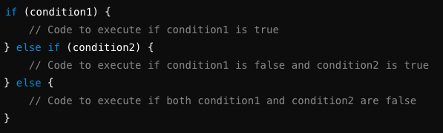
Else if syntax
if: This checks the first condition (condition1). If it's true, the code inside its block runs.
else if: This checks another condition (condition2) only if the first condition was false. If it's true, that block of code runs.
else: This runs if neither of the previous conditions were true.

Slide 36
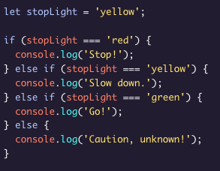
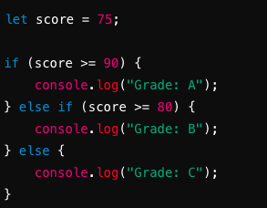
Example:
Notes:
What will log to the console? What if i change it to green

Slide 37
Make your own if else statements
Set the value of your variable and then make an else if statement
Temperature
Age
Time
Your own idea

Slide 38
Example else if statement
Ex. rating let rating = 4
If (rating >= 4) {
console.log(“Excellent movie”)
}else if (rating === 3) {
console.log("Good movie!"); } else {
console.log(“Bad movie”) }

Slide 39
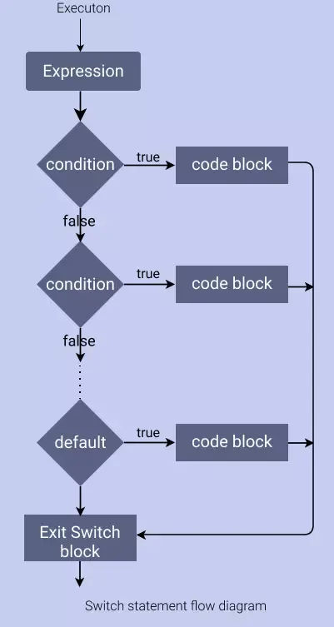
Switch Statements
A switch statement in JavaScript is a decision-making tool that helps your code choose what to do based on different cases. It tells your code, “If you see this value, do this; if you see that value, do something else.”

Slide 40
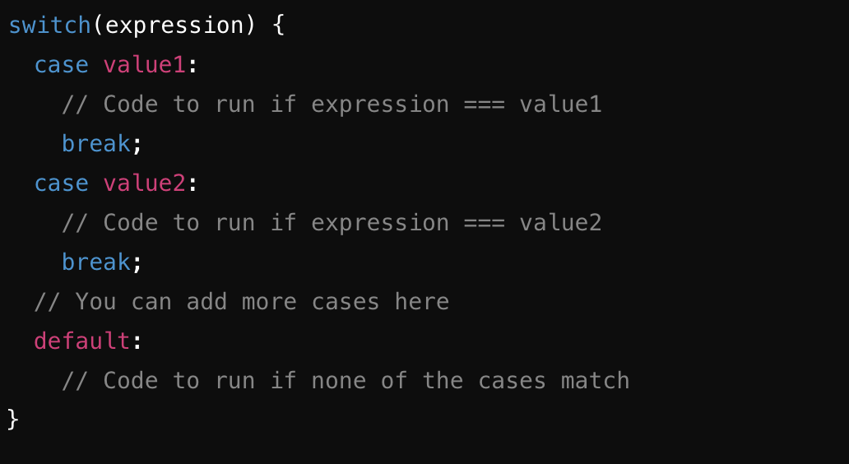
Switch Statement syntax
switch(expression): The expression is what you want to evaluate or check. It could be a variable, a function call, or any value.
case value: Each case represents a possible value that expression might equal. If expression matches value, the code following that case will run.
Break; The break statement stops the switch from checking any more cases. Without break, the code would continue to run into the next case, which is usually not what you want.
default: (optional): The default case runs if none of the above cases match. It's like the "else" in an if-else statement.

Slide 41
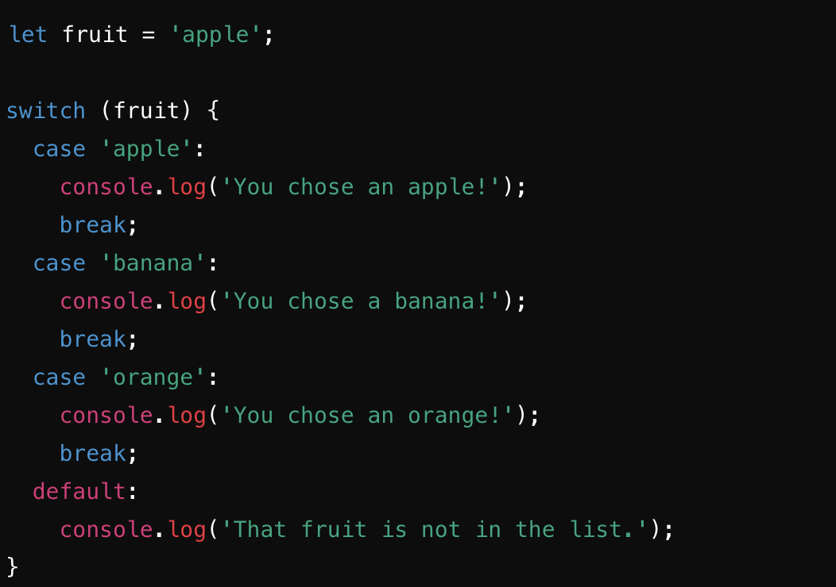
Example of a switch statement
Steps: 1. switch (fruit): The switch statement checks the value of fruit.
2. case 'apple':: If fruit is 'apple', the code following this line will run.
3. break;: This tells the switch to stop checking other cases once it finds a match.
4. default:: If none of the case values match, the code in default runs.
What do you think will log to the console?

Slide 42
Switch Statement practice
Create a switch statement that logs to the console what you will eat at different times of the day: morning, afternoon, and night. let timeOfDay =
Syntax:

Slide 43
Larger combined conditional assignment

