Slide 1
Scope

Slide 2
What will be covered?
Global scope
Local scope
Block scope

Slide 3
What is scope?
The formal definition of scope is:
“Scope in JavaScript refers to the context or environment in which variables are declared and can be accessed.”
Basically, it’s the area of your code in which the variable or value was created. Scope comes in three varieties: global, local, and block.

Slide 4
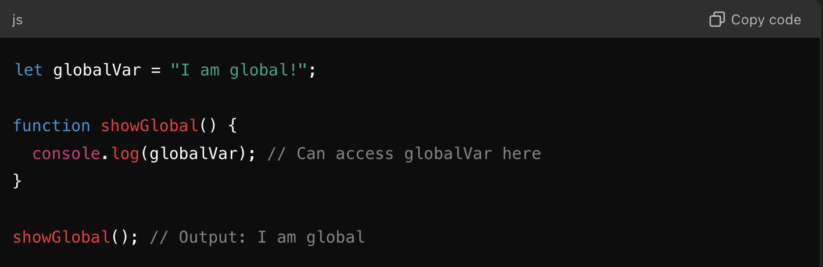
Global Scope
If you declare a variable outside of any function or block, it's in the global scope.
This means it's accessible everywhere in your code.

Slide 5
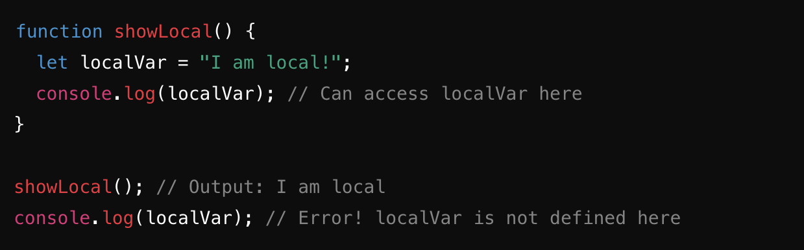
Local Scope
Variables declared inside a function are in local scope.
These variables are only accessible inside that function.

Slide 6
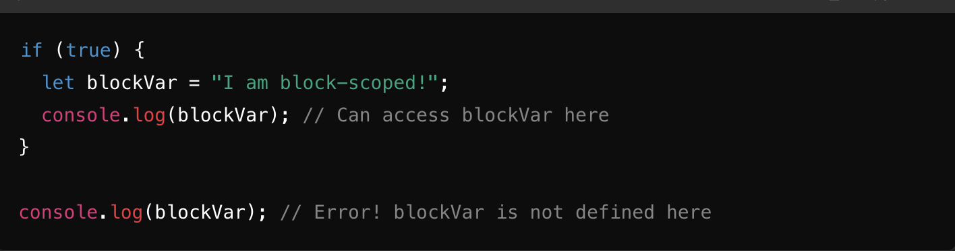
Block Scope
Variables declared with let or const inside a block (e.g., in { } like in loops or if statements) have block scope.
These variables are only accessible inside that block.

Slide 7
Summary
Global scope: Variables are accessible everywhere.
Local scope: Variables are only accessible within a function.
Block scope: let and const variables are limited to blocks like { }. Helpful resources:
Article about scope w3schools scope explanation Free code camp scope explanation

Slide 8
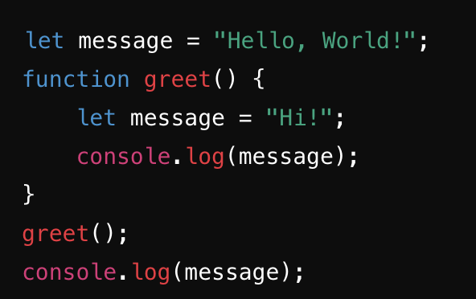
1. Global vs Function Scope:
What is the scope of each message variable?
What will be the output of the two console.log() statements?

Slide 9
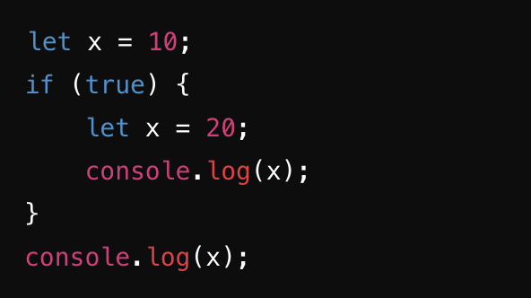
2. Block Scope with let:
What is the scope of the x variable inside the if block compared to the one outside?
What will be logged to the console?

