Slide 1
BubbleCopter
Arduino powered location aware quadcopter
Raspberry Pi powered 360º video recording
Original goals:
  <£200 build cost
  >30 minutes flight time
  >500m control range
  GPS based autopilot
  >15 FPS video captured at >1000x1000px

Slide 2
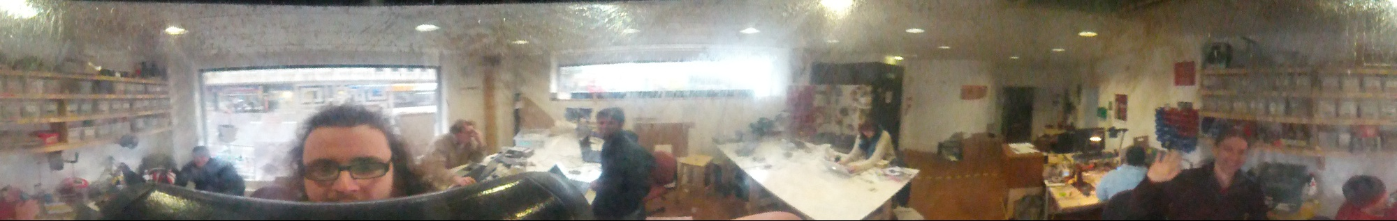
360º Photography
Using BubbleScope mobile phone attachment
Ideal capture resolution is an image in 1:1 aspect ratio
Majority of capture is what is around the BubbleScope rather than what is above or below it

Slide 3
360º Photography
Using Raspberry Pi and camera board
Other options considered:
  BeagleBone Black with USB webcam (limited V4L2 driver)
  ODROID with USB webcam (limited by camera capture modes)
BubbleScopeCL tool
  Allows capturing still images, videos and timelapses from a V4L2 source in either original or unwrapped format
  Can unwrap pre recorded video, stills and timelapse frames
  Can be used with MJPEG-Streamer to stream video from a capture source
Current method of capture on BubbleCopter
  Record H264 video, JPEG images or timelapse frames using raspicam tools controlled through GPIO via the flight controller
  Get recorded data from Raspberry Pi SD card
  Convert recordings on PC

Slide 4
Multirotor Design
Typically range from 3-8 rotors
More rotors
  Greater stability
  More lifting capability
  Expensive
  Tolerant of in flight motor/propellor failures
  Typically used for stable aerial imaging and carrying significant payloads
Less rotors
  More maneuverability
  Lower power consumption
  Cheaper
  Typical off the shelf or self built multirotor

Slide 5
Frame and Drive Electronics
Custom designed frame
  6mm laser cut MDF
  3mm MDF panels to hold some electronics, Pi and BubbleScope
  Various 3D printed and laser cut parts to hold individual components
Off the shelf drive electronics
  Trunigy 4 cell 5Ah Lithium Polymer battery
  Trunigy 1000KV brushless DC motors
  Turnigy 40A ESC motor drivers

Slide 6
Flight Control
Multiple modes of operation:
  Navigation
  Aware of geographic position
  Restorative Stabilisation
  Revert to target flight attitude
  Balancing
  Attempt to maintain current flight attitude
Can be broken into three main components:
  Sensing the current state (“Knowing where you are”)
  Knowing how to react to the state to achieve a desired outcome (“Knowing what to do”)
  Being able to react to the state (“Knowing how to do it”)

Slide 7
Knowing where you are
Gyroscope
  Measures angular velocity (rad.s⁻¹)
  Used for vehicle balancing
Accelerometer
  Measures proper acceleration (g)
  Used to restore vehicle attitude after being moved by an external force
Magnetometer
  Measures magnetic flux density (G)
  Used to determine compass heading
Barometric Altimeter
  Measures altitude above sea level (ft)
Ultrasonic Altimeter
  Measures altitude relative to terrain up to 6m
  Used for terrain referenced altitude hold and automatic landing
GPS
  Useful measurements: latitude, longitude and altitude
  Used for autopilot (position hold, route follow, etc.)

Slide 8
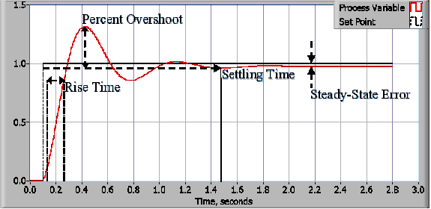
Knowing how to do it
http://www.ni.com/white-paper/3782/en/

Slide 9
Knowing how to do it
PID Control
  Proportional Response
    Calculate difference between target value and process value (the error term)
    Used to compensate for the majority of the error
  Integral Response
    Sums error term of each iteration
    Used to reduce steady state error to zero
  Derivative Response
    Measures rate of change of process value
    Used to compensate output value for rapid changes in process value, hence reduces overshoot

Slide 10
Knowing how to do it
PID in BubbleCopter
  P calculated from difference between target pitch/bank angle and current pitch/bank angle (calculated from accelerometer and gyroscope)
  I is ignored as target pitch/bank has no long term stable state
  D is calculated using the values form the gyroscope
Motor control
  BubbleCopter uses the X4 multirotor configuration
  Pitch and bank angles modified by adjusting throttle on pairs of motors
  Yaw angle modified by adjusting throttle on pairs of motors running is same direction
    Causing an overall rotational inertia on the vehicle about the Z axis

Slide 11
Knowing what to do
Ground Transmitter
  Radio link between operator and quadcopter
  Requirements:
    Range
    Low latency
    Durability
  Current control method for BubbleCopter
Autopilot
  Usually GPS based
    Can use a range of sensors to determine next action
  Predefined flight plan programmed into flight controller before takeoff
  Can include auto takeoff and landing with supporting sensors

Slide 12


More Information
github.com/DanNixon/BubbleCopter
github.com/DanNixon/BubbleScopeCL
@TechnoDucky
dan-nixon.com

