Slide 1
Announcing the EMF schedule like its the 80s

Slide 2
Me
Software engineer by trade
Long term maker (hardware hacking, electronics, software, etc.)
Recent radio amateur

Slide 3
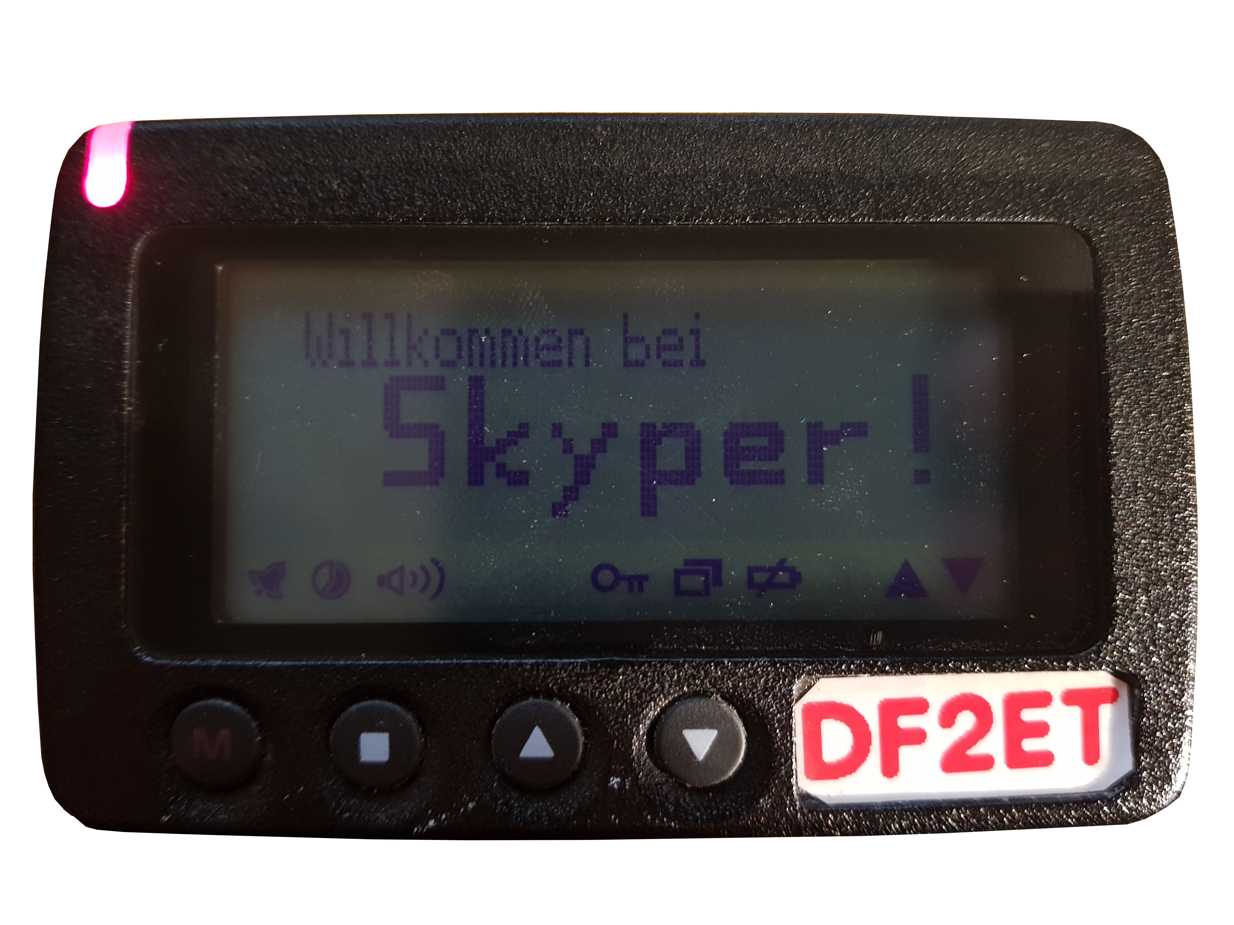
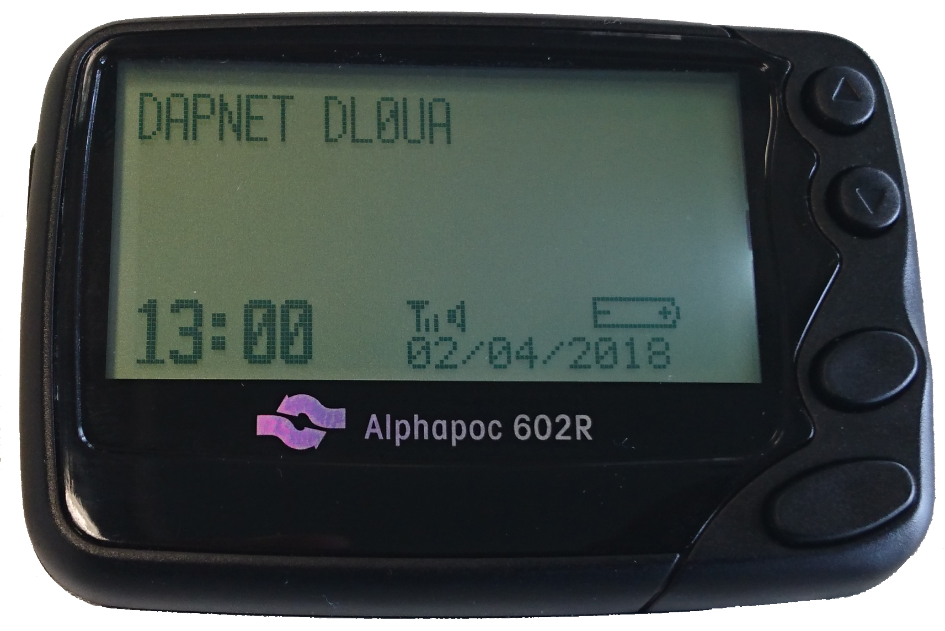
Pagers
Push notifications before push notifications were a thing

Slide 4
Why?

Slide 5
POCSAG
Post Office Code Standardisation Advisory Group / Radio-paging code no 1
Circa 1981
Numeric and alphanumeric/text encoding
Modulation: FSK with 4.5kHz shift

Slide 6
DAPNET
Decentralised Amateur Paging Network
  (hampager.de)
Internet back-haul/orchestration for POCSAG in the amateur bands
Direct “calls”/pages for specific recipients
Rubrics for general/regional interests

Slide 7
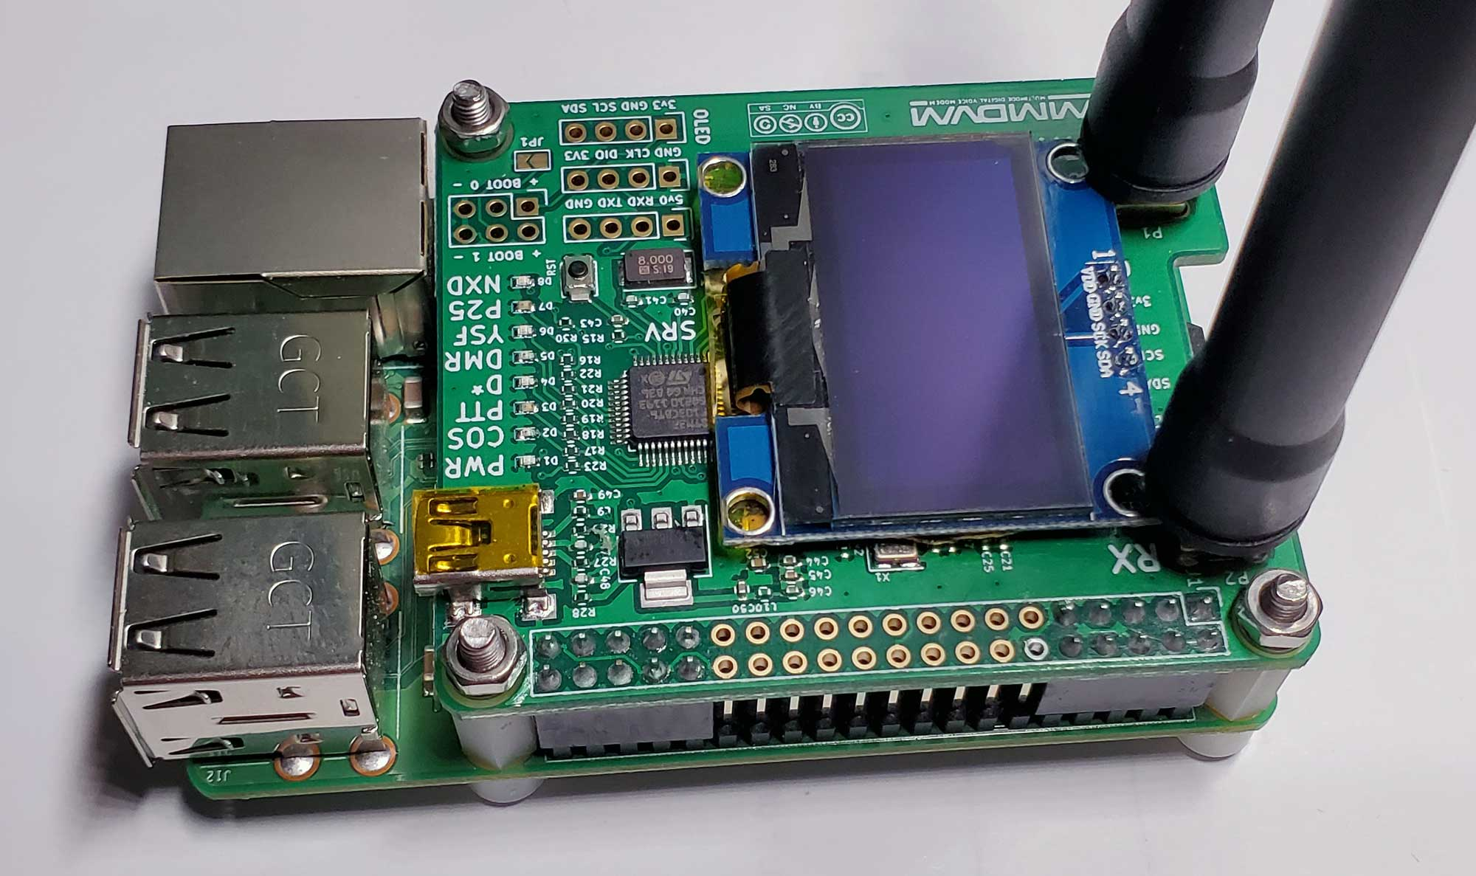
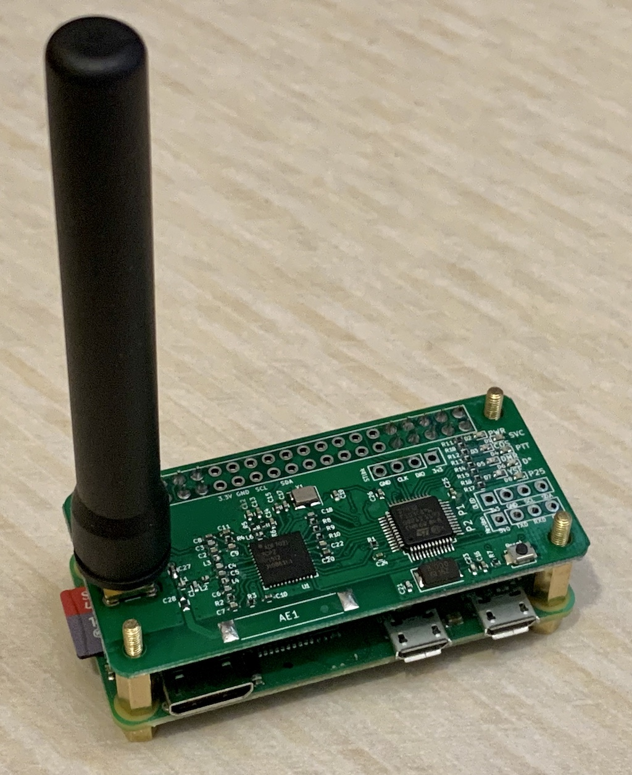
Transmitter Options
MMDVM hotspot
  Low power (<50mW), personal use
  Cheap, readily available, usually just work

Slide 8
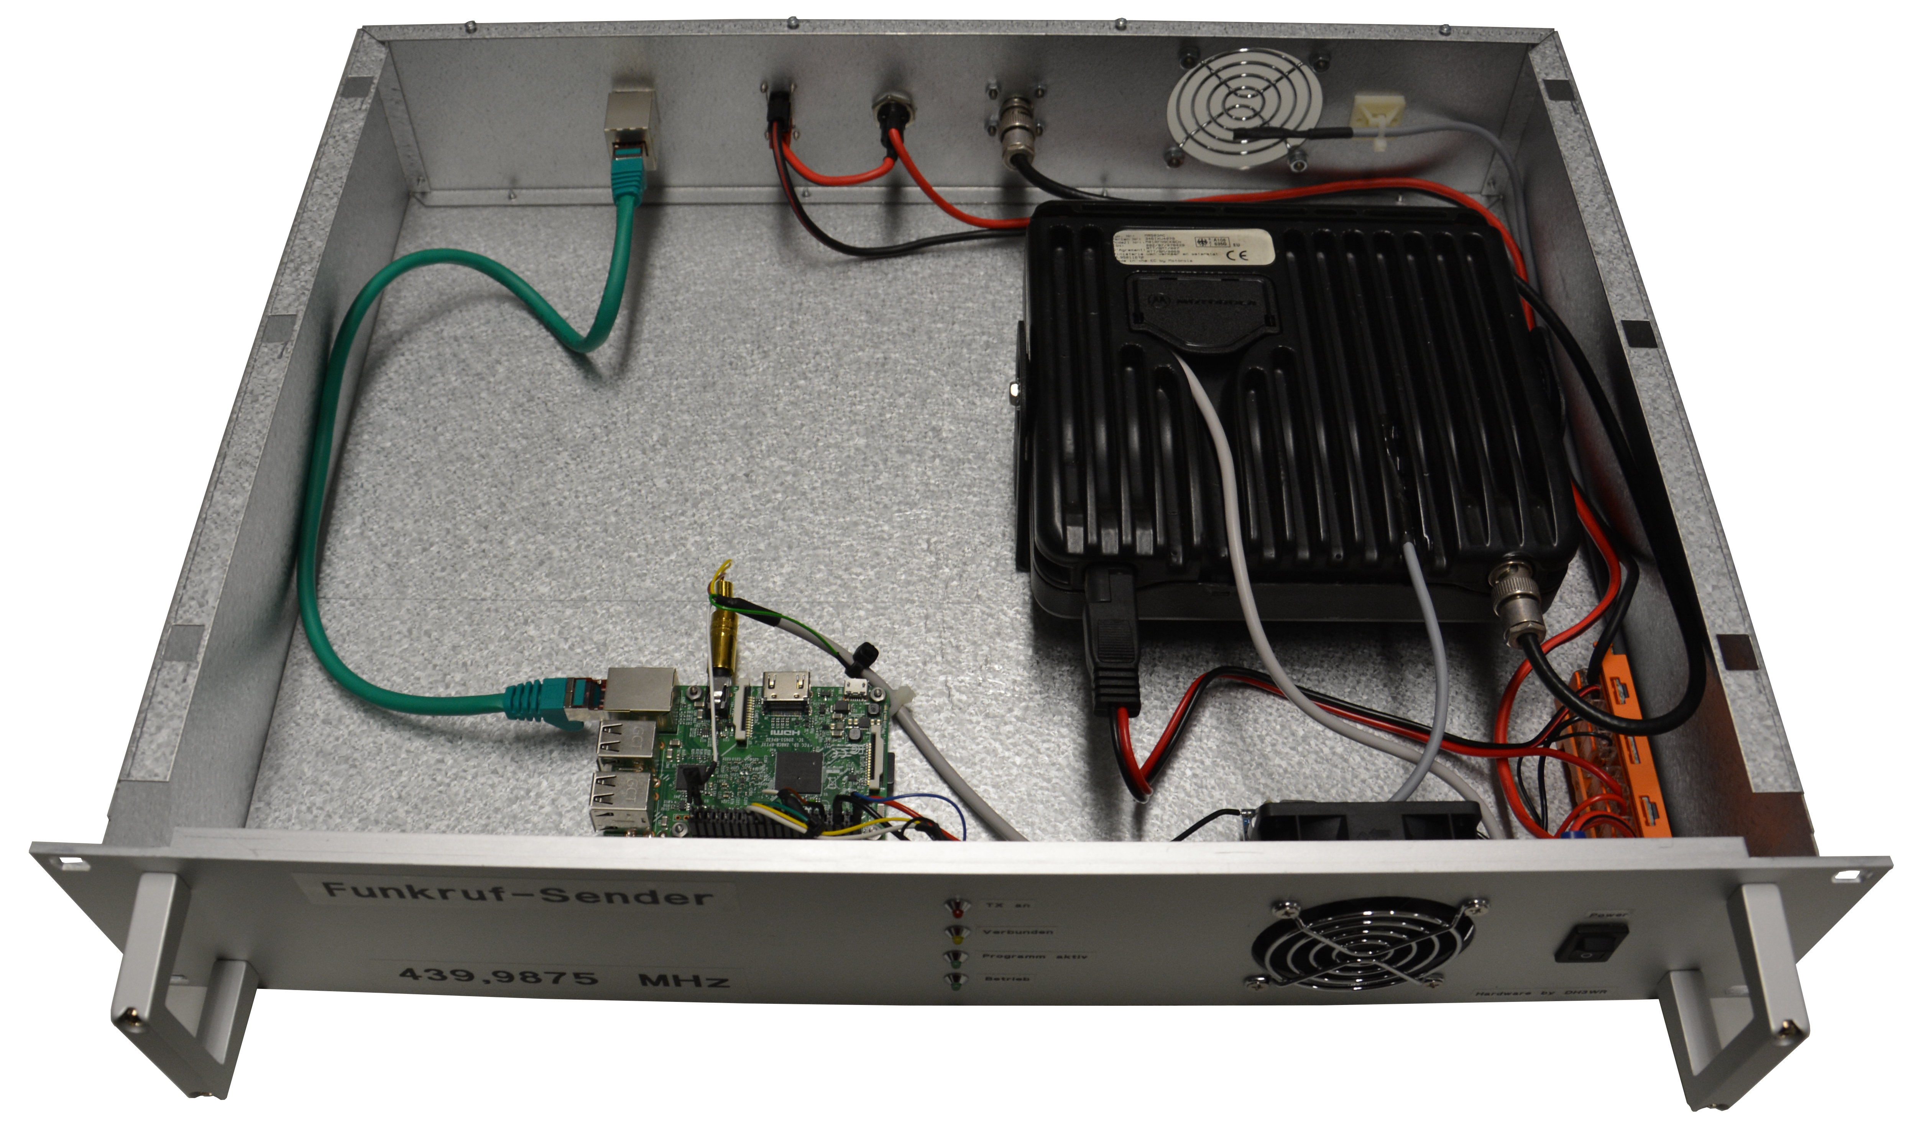
Transmitter Options
UniPager audio based
  Modem connected via audio to off the shelf radio

Slide 9
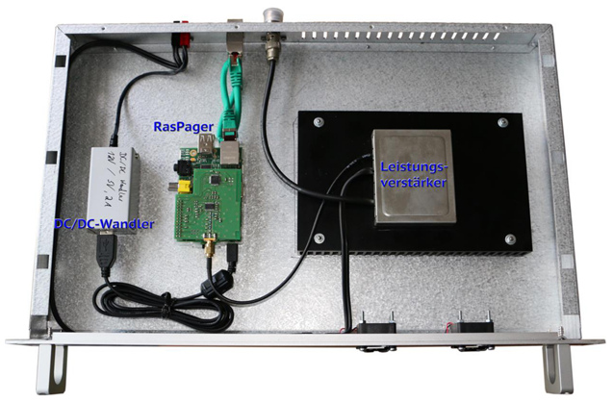
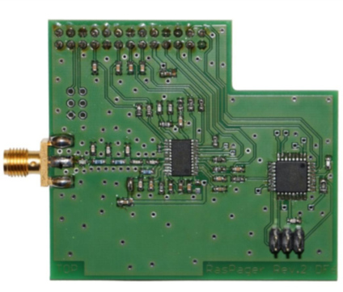
Transmitter Options
Raspager/ADF7012
  Raspberry Pi add on board
  Low power (10mW)

Slide 10
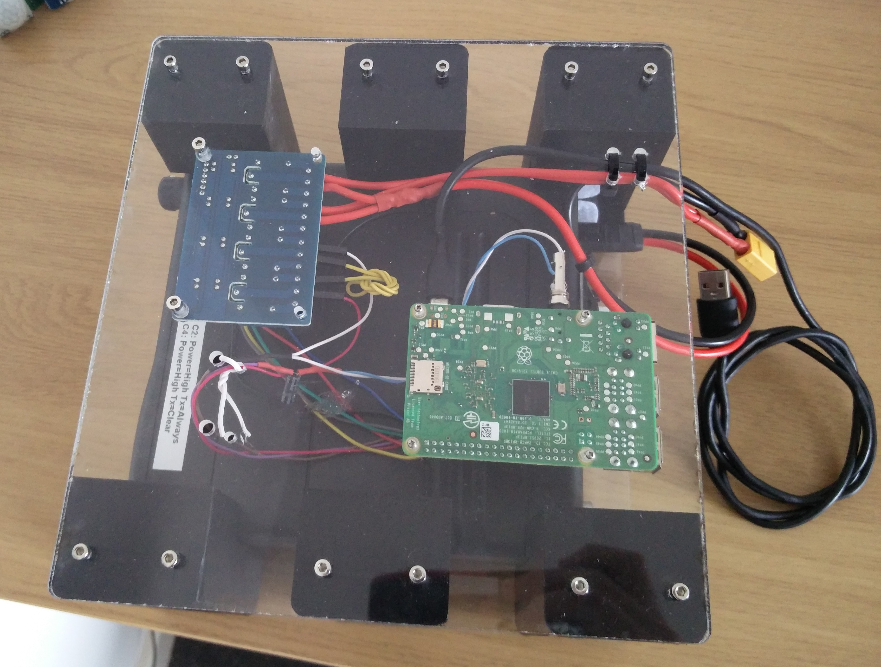
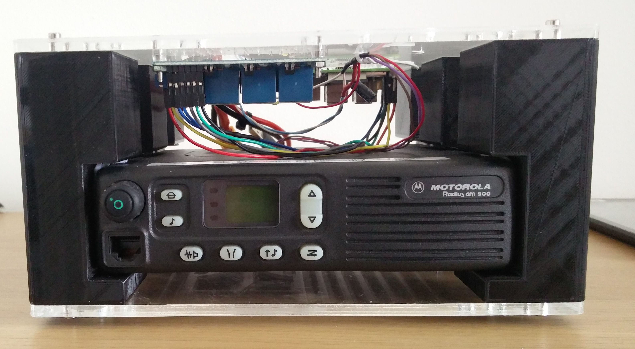
Hardware
Motorola GM900
Raspberry Pi 3B
Very over-engineered case

Slide 11
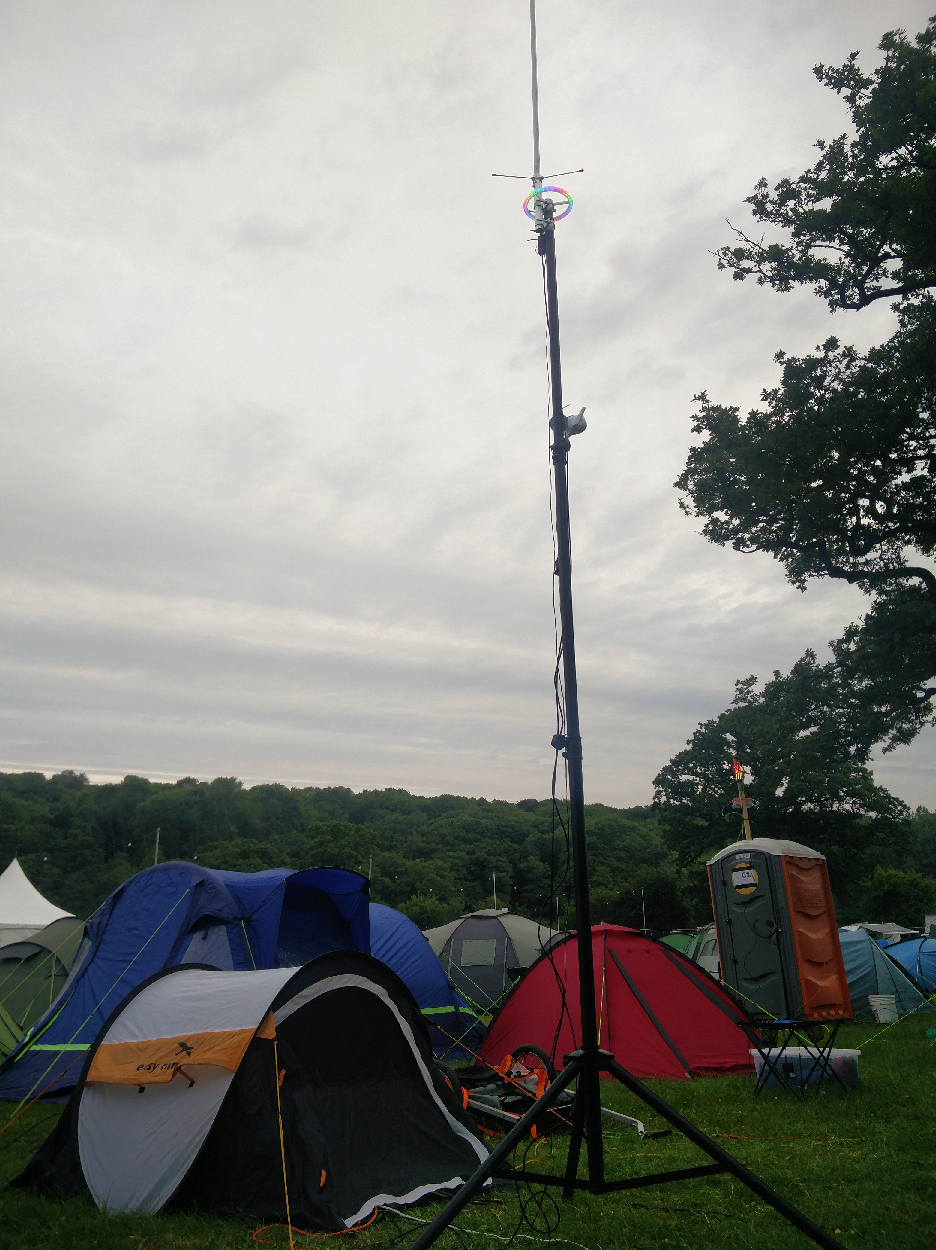
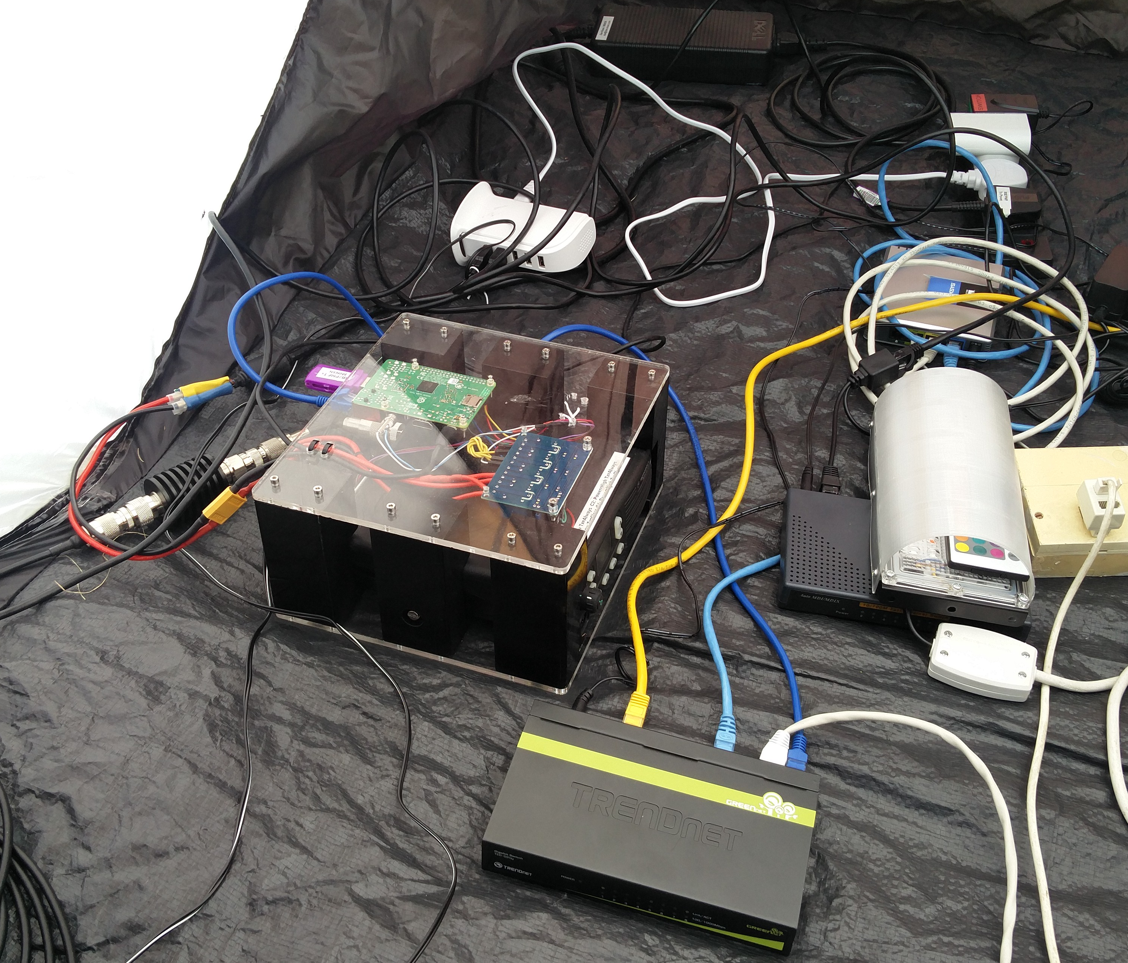
Hardware

Slide 12
Software (I)
UniPager
  Official DAPNET pager transmitter software
  Mostly “just works”

Slide 13
Software (II)
remote-closedown / matrix-remote-closedown
  Provides licence compliance for remote closedown
  Controls transmitter/PA power and PTT enable via a Matrix chatbot
  (Also a handy notification of power/network failures)

Slide 14
Software (III)
mqtt-actor
  Send MQTT messages on a schedule
mqtt-rubric-publisher
  Translates MQTT messages into content for DAPNET rubrics

Slide 15
Software (IV)
config-generator
  Ingests the EMF schedule API and creates plays for mqtt-actor

Slide 16
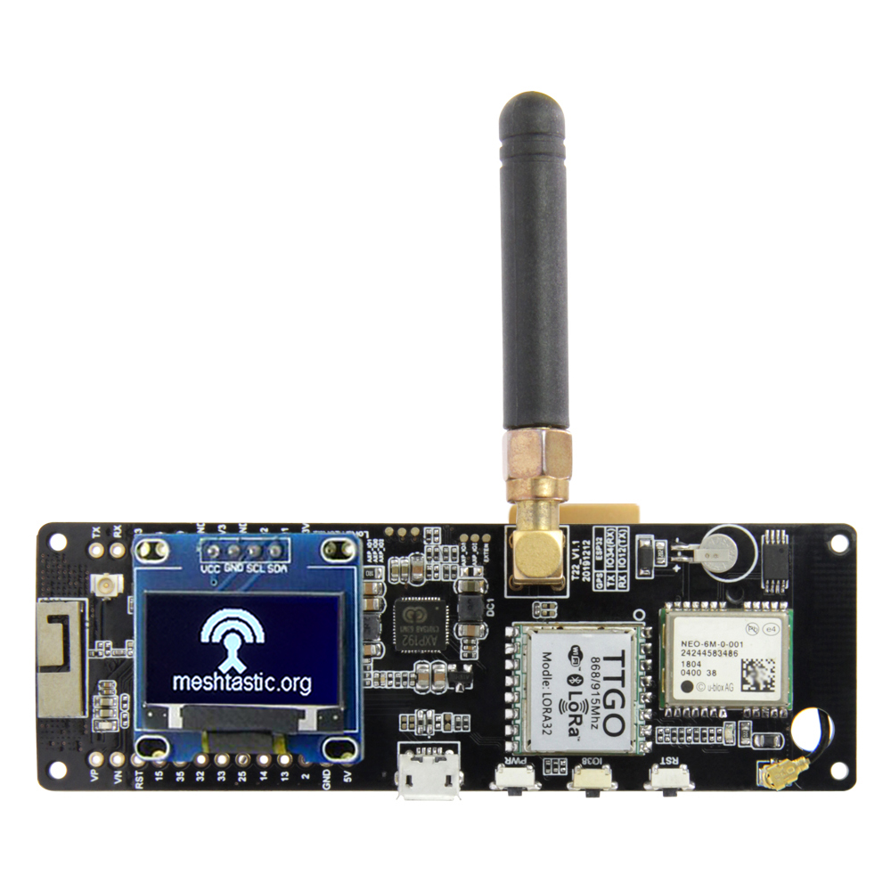
Extra things
T-Beam pager
  SX1278 – FSK decoding
  OLED display
  18650 holder

Slide 17
See also
github.com/DanNixon/emfcamp-2022
dan-nixon.com

