Slide 1
Development of a Team of Simulated Humanoid Robots
Projeto em Engenharia de Computadores e Informática (PECI-M2)
Robotic Football
Daniel Oliveira · Lázaro Sá · Ricardo Carmo · Tiago Brito · Miguel Mota · Pedro Cunha
Orientação: Nuno Lau • Luís Paulo Reis
1

Slide 2
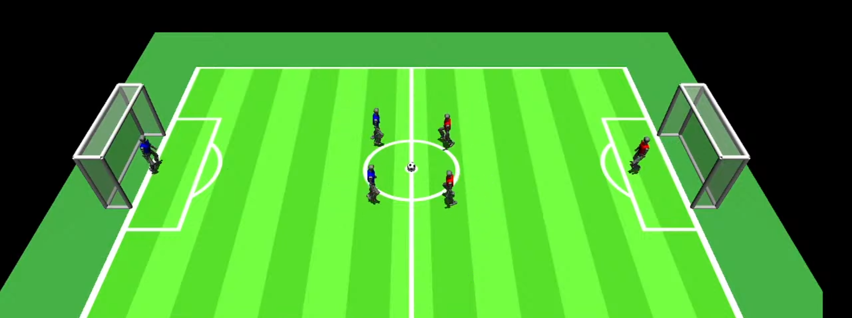
Functional Requirements
RF1 The agents must be able to run, shoot, get up, dribble and intercept the ball.
RF2 The team must coordenate to score goals and avoid conceding.
RF3 Keeper specific behaviours need to be implemented.
2

Slide 3
RNF1 The behaviours must be robust in different game conditions.
RNF2 The computational efficiency must be compatible with the 3D simulator.
RNF3 The integration into the existing FC Portugal codebase must be seemless.
Nonfunctional Requirements
3

Slide 4




Requirements Priority
HIGH
Medium
Low
RF1
RF3
RNF2
Motion & Ball Interaction
Goalkeeper
Computational Efficiency
RF2
RNF1
Team Coordination
Robustness
RNF3
Integration
4

Slide 5
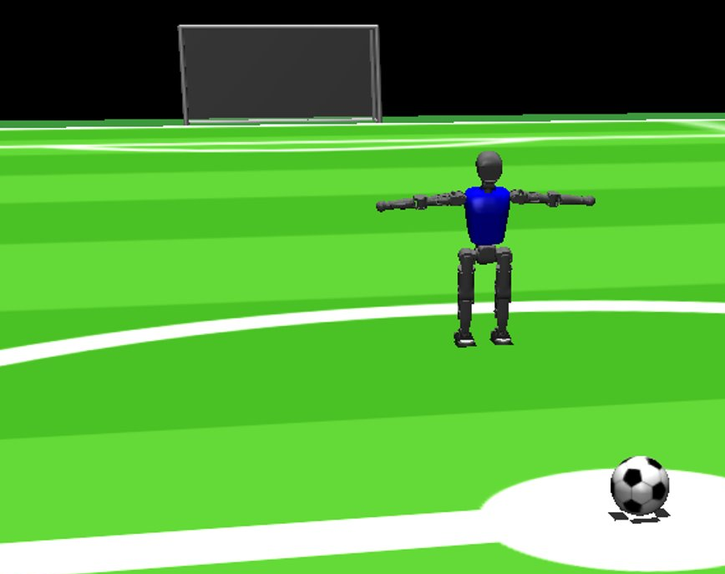
Previous Works
Teams made for the legacy version of the simulator, for example:
  FCPortugal (2004-2025)
  magmaOffenburg (2009-2025)
  ITAndroids (2012-2025)
5

Slide 6
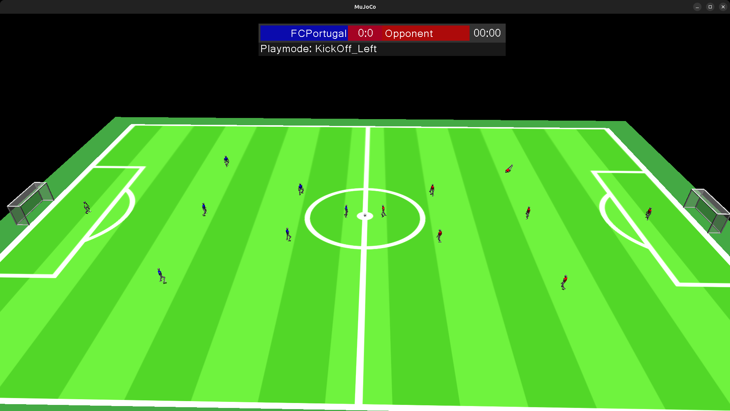
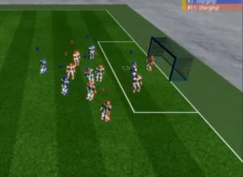
Related Works
3D Simulation League
Rules
Communication Channels
Official Documentation
Simulators
Mujoco (In use)
SimSpark (Legacy)
6

Slide 7
System Arquitecture
Training Layer
World Layer
Simulator Layer
Sends info to
Trains in
Gym environment
FCPortugal player agent
Inter-Robot communication sink
Perceives
Located Inside
Using
Deep Reinforcement Learning:
PPO Algorithm
World : field, ball, goals
RoboCup Soccer Simulator Server
Simulated on
Based on
Physics engine:
Mujoco
7

Slide 8
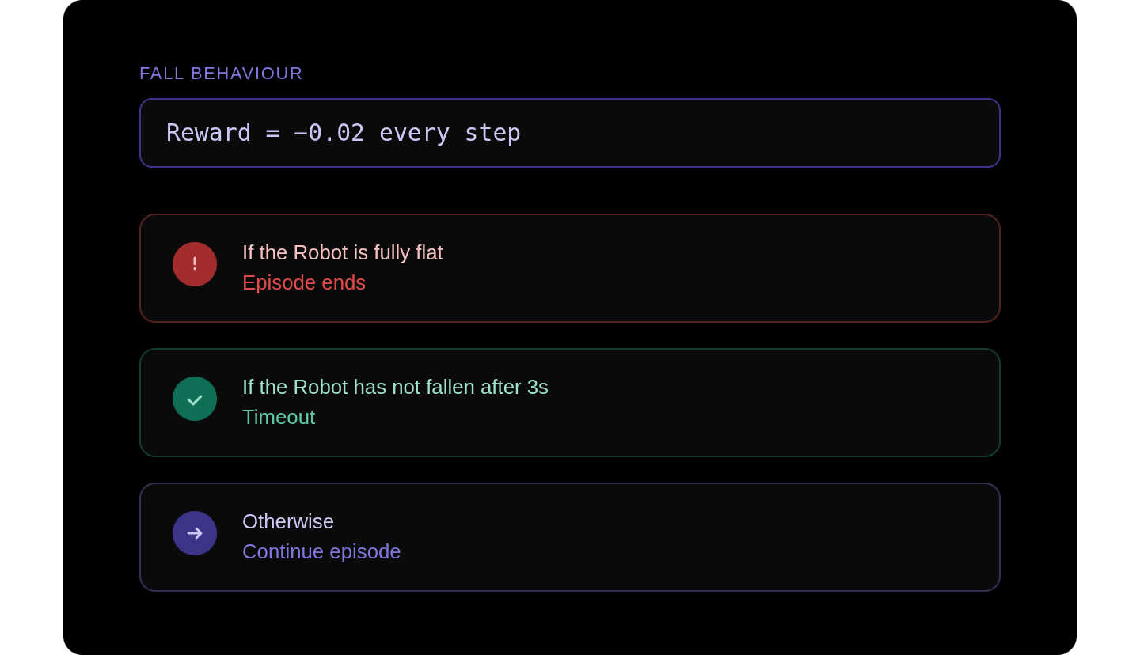
Fall Behaviour - Rewards
8

Slide 9
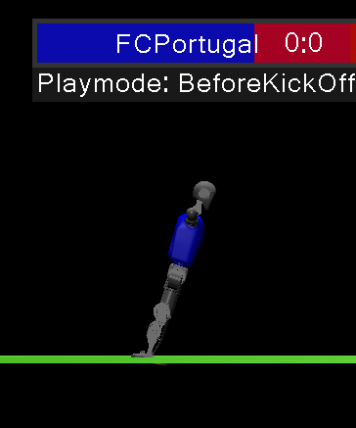
Falling Behaviour - Environment
In the falling behaviour, the agent is initialized with a random tilt around the Y axis, between -30° and +30°, thus simulating the fall.
The simulation runs for 3 seconds (150 steps at 50 Hz).
9

Slide 10
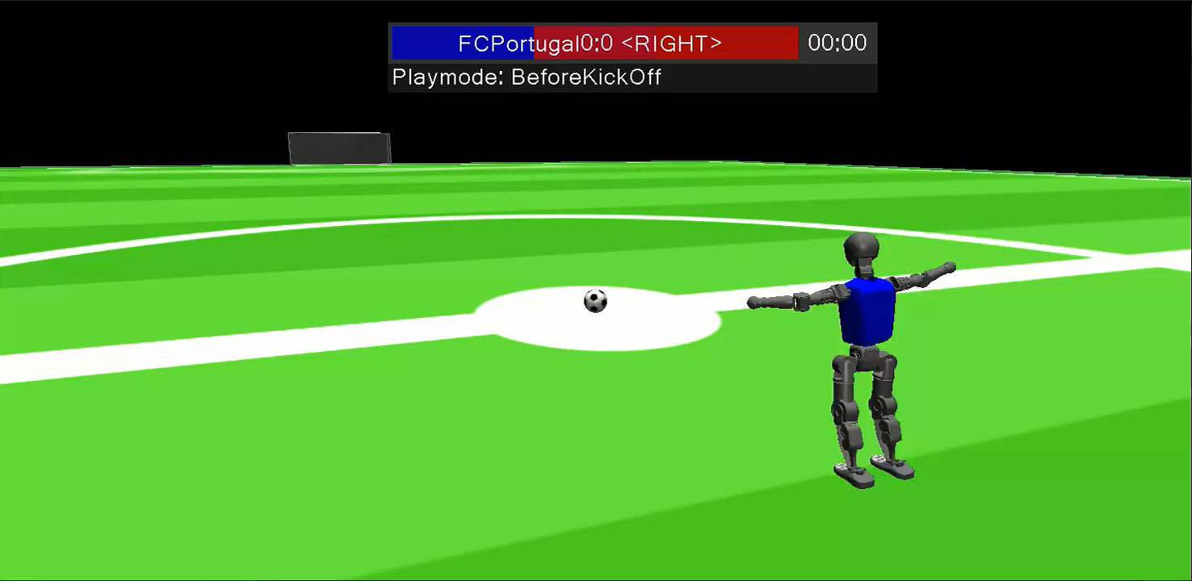
Fall Behaviour
10

Slide 11
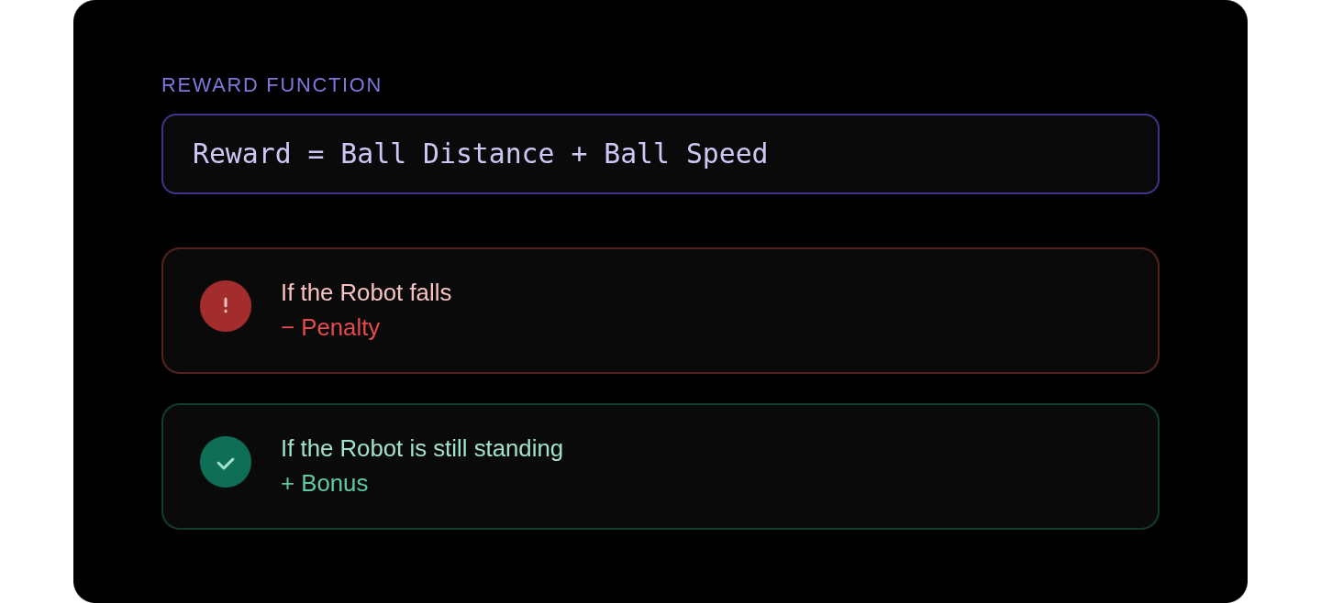
Shooting Behaviour - Rewards
11

Slide 12
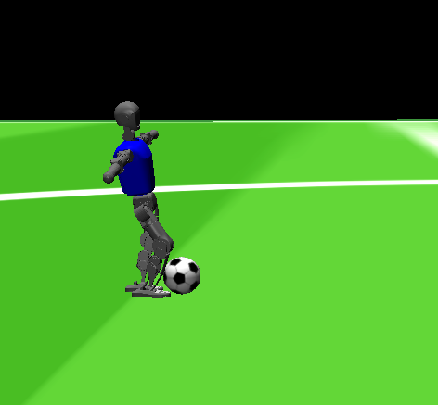
Shooting Behaviour - Environment
Initial Ball Position - Ball placed directly in front of the agent , on the ground.
Preparation for Shot - Pull the right leg back into the preparation pose for the shot.
The simulation runs for 8 seconds.
12

Slide 13
Shooting Behaviour
13

Slide 14



Thank You!

