Slide 1
Length-based Integrated Mixed Effects (LIME) method overview and demonstration
Merrill Rudd
April 18, 2018

Slide 2

Motivation to develop LIME
Issue
First steps towards improvement: Length-based Integrated Mixed Effects (LIME) assessment
Solution
Total catch and age data are too difficult and/or expensive to collect
Length-based
Fit to length data instead of age data
Integrated
Fit to multiple years of length data, catch and abundance index if or when available
Most data-limited methods are meant to be discarded with data improvements
Other length-based methods assume equilibrium conditions
Mixed effects
Treat time-varying recruitment as a random effect

Slide 3

Length-based Integrated Mixed Effects (LIME) overview
Biological Inputs
Natural mortality M
Growth coefficient k
Asymptotic length
Weight-at-age
Length at maturity
Fit to data
Length composition data (min. 1 year)
Optional:
Catch
Abundance index
Estimates
Annual fishing mortality
Length at 50% and 95% selectivity
Recruitment variation
Dirichlet-multinomial parameter
Derives
Dynamic age-structured model
Status
Spawning potential ratio
$$\text{SPR}\text{=}\frac{{\text{Eggs} \text{per} \text{recruit}}_{\text{Fished}}}{{\text{Eggs} \text{per} \text{recruit}}_{\text{Unfished}}}$$
Processes
Outputs of age-structured model
Uncertainty
95% confidence intervals
Rudd and Thorson 2017, CJFAS
Notes:
Relative age – 0:1 where 1 is the maximum age at 1.3* asymptotic length
Length at relative age is a function of how fast the fish grows to asymptotic length based on the MK ratio.

Slide 4
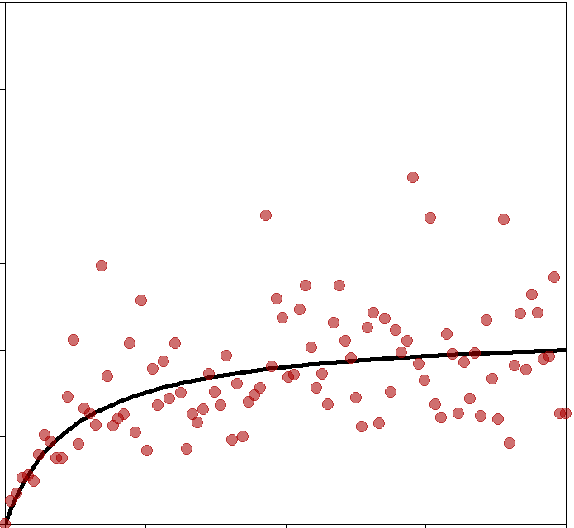
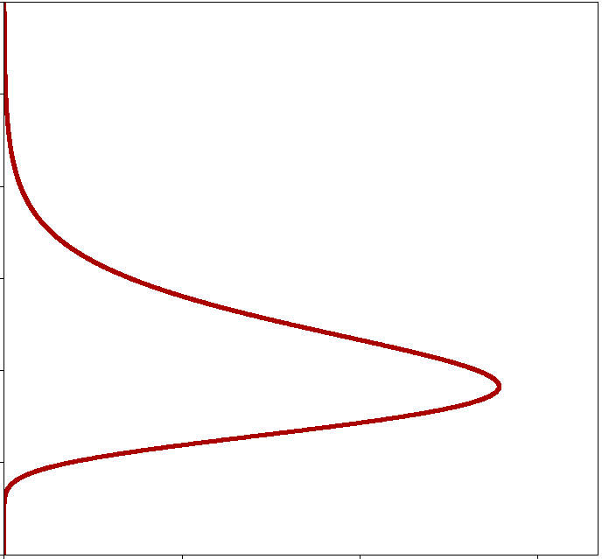
Length-based Integrated Mixed Effects (LIME) overview
How is this different from other methods?
1) Recruitment as a random effect
Recruitment each year ~ Lognormal(expectation, variation)
Recruitment
Spawning Biomass
Likelihood
2) Does not require catch data
* But can fit to an abundance index and catch data if available
Rudd and Thorson 2018, CJFAS
Notes:
Relative age – 0:1 where 1 is the maximum age at 1.3* asymptotic length
Length at relative age is a function of how fast the fish grows to asymptotic length based on the MK ratio.

Slide 5
Continuing to address issues in length-based assessments
Assessment methods for fisheries with length and biological information only have limitations
First steps towards improvement: Length-based Integrated Mixed Effects (LIME) assessment
 | Length-based assessment methods | LIME (circa 2017)
1 | Assume population is in equilibrium | Non-equilibrium: accounts for variable fishing mortality and recruitment
2 | Assume knife-edge or logistic selectivity | Option to estimate logistic selectivity or fix at any relationship (e.g. dome-shape)
3 | Single fleet | Exploring multiple fleets
4 | Rely on accurate estimates of biological parameters (e.g. M, growth) | Also requires accurate biological assumptions

Slide 6
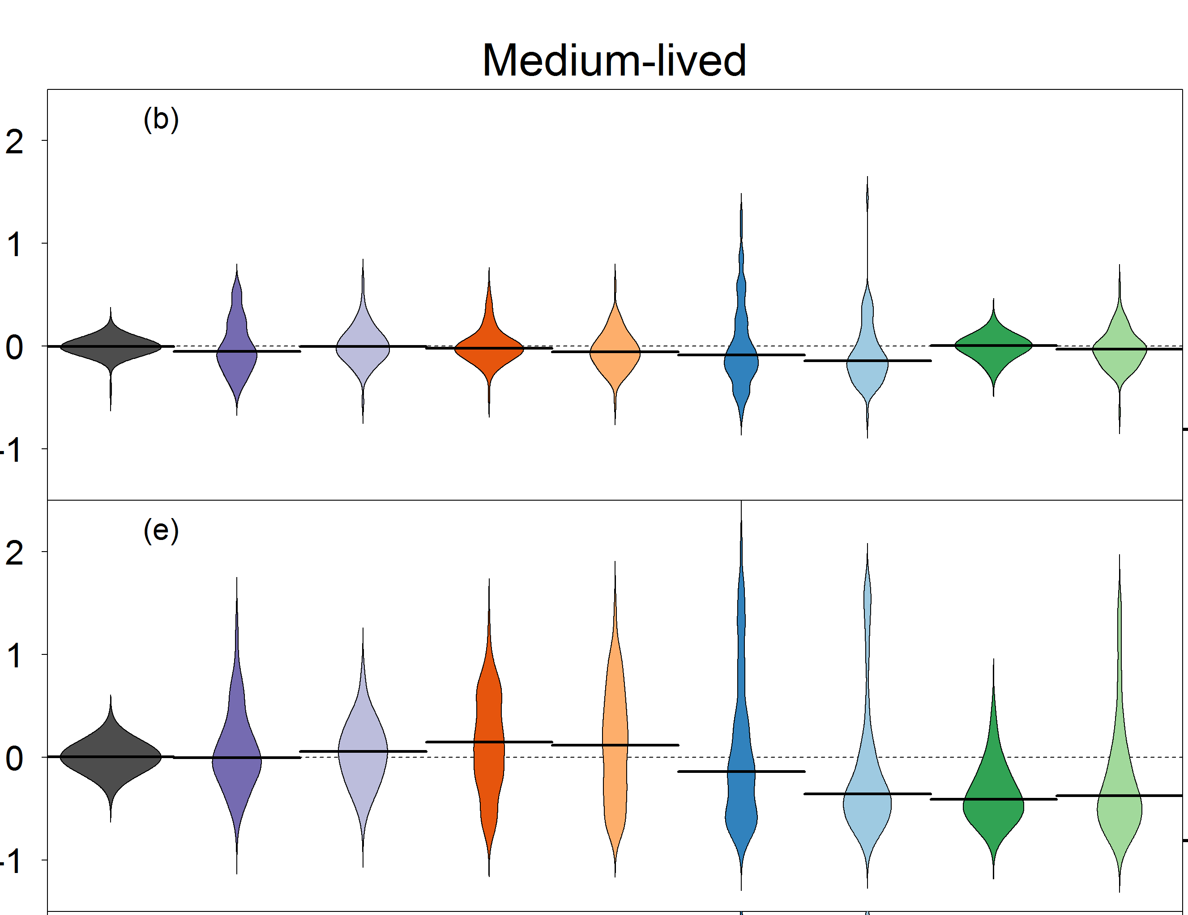
LIME is unbiased across multiple scenarios
Relative error
Equilibrium
Rich
Index
+10
Index
+1
Catch
+10
Catch
+1
LC10
LC1
LBSPR
10
LBSPR
1
Variability
Rich
Index
+10
Index
+1
Catch
+10
Catch
+1
LC10
LC1
LBSPR
10
LBSPR
1
Data availability scenario
Notes:
Pick one or two to compare – short vs. longer
Focus on most interesting of scenarios

Slide 7
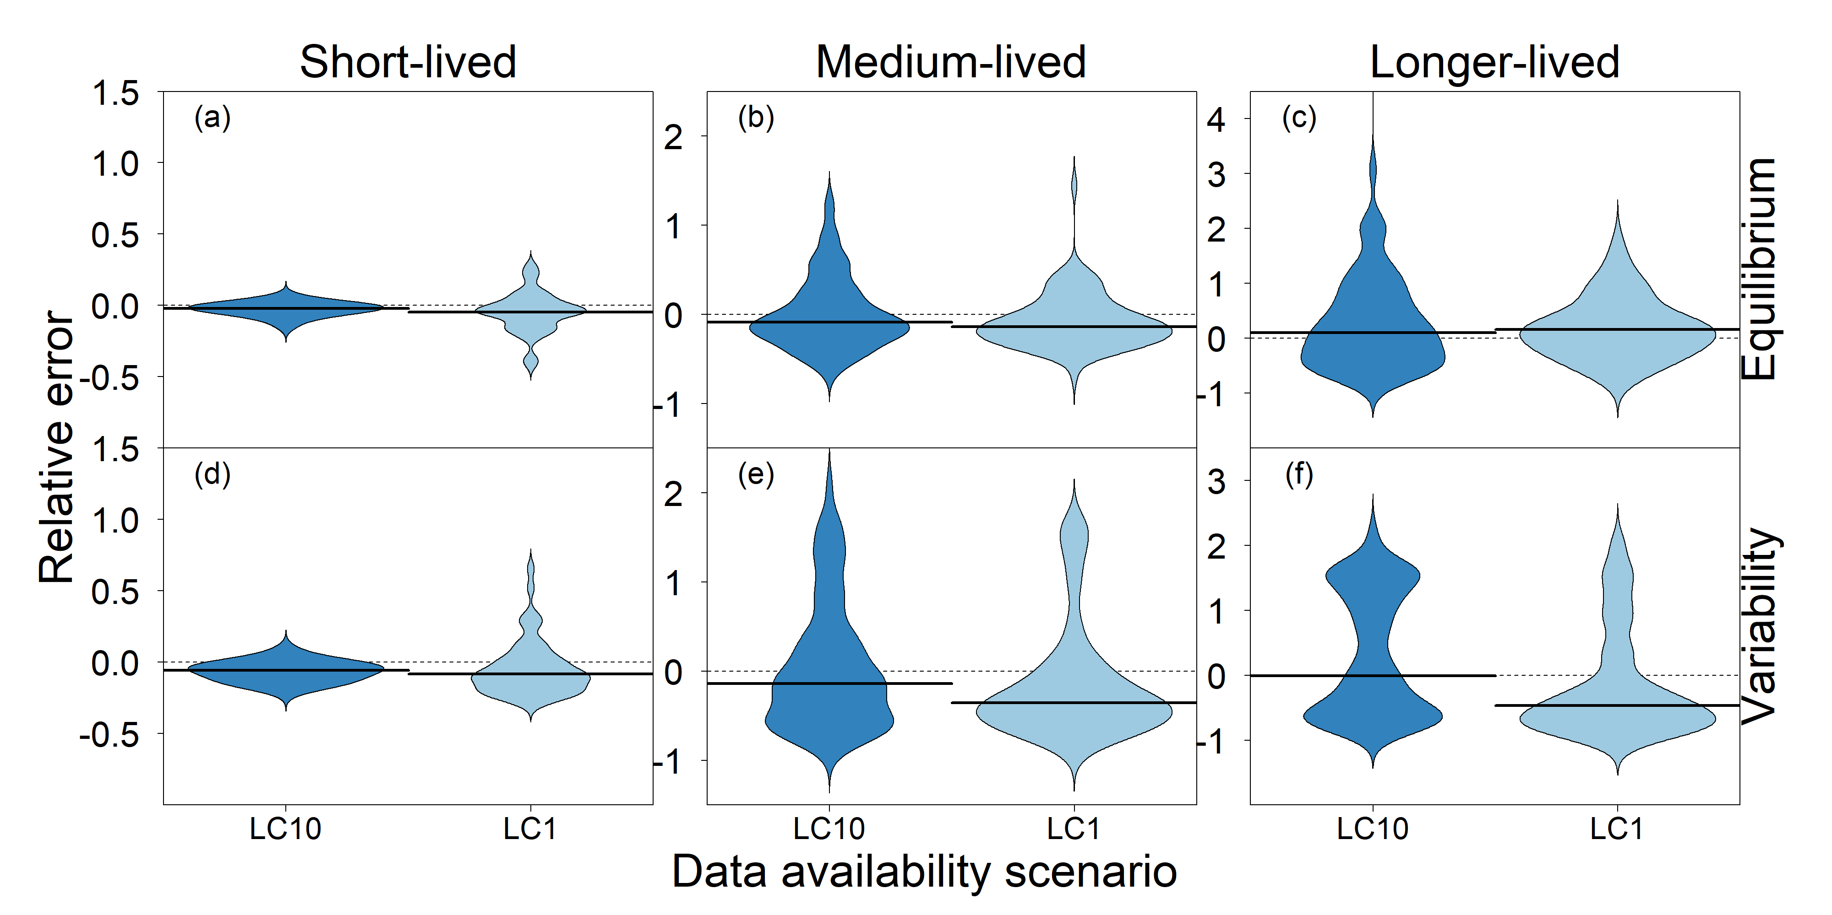
LIME performance varies across life history types
Higher precision
Lower precision
Notes:
Pick one or two to compare – short vs. longer
Focus on most interesting of scenarios

Slide 8
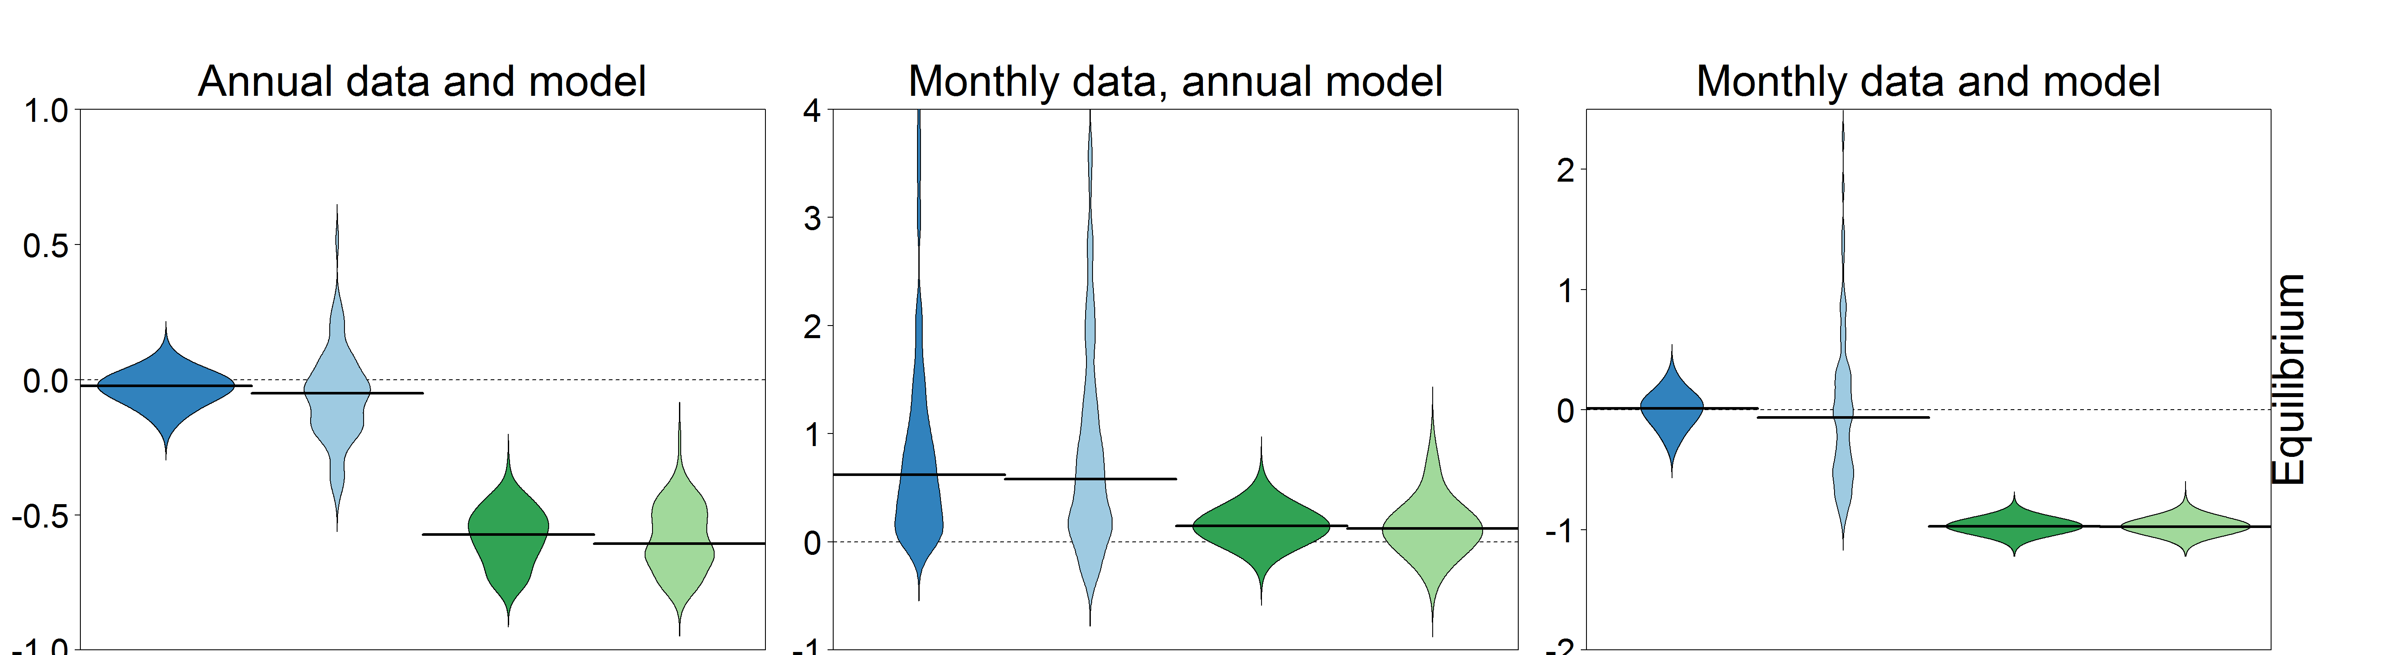
LIME and LB-SPR sensitive to data collection process
Short-lived life history
LIME
10
LIME
1
LBSPR
10
LBSPR
1
LIME
10
LIME
1
LBSPR
10
LBSPR
1
LIME
10
LIME
1
LBSPR
10
LBSPR
1
Notes:
Length composition data for short-lived fish should be collected throughout the year
LIME: run on less than annual time step
LB-SPR : pool together to mimic continuous data collection

Slide 9
Demonstration
https://www.github.com/merrillrudd/LIME
Example code located under:
https://www.github.com/merrillrudd/LIME/LIME_examples/demo

