Slide 1
test

Slide 2

wtf
kiss my ass

Slide 3
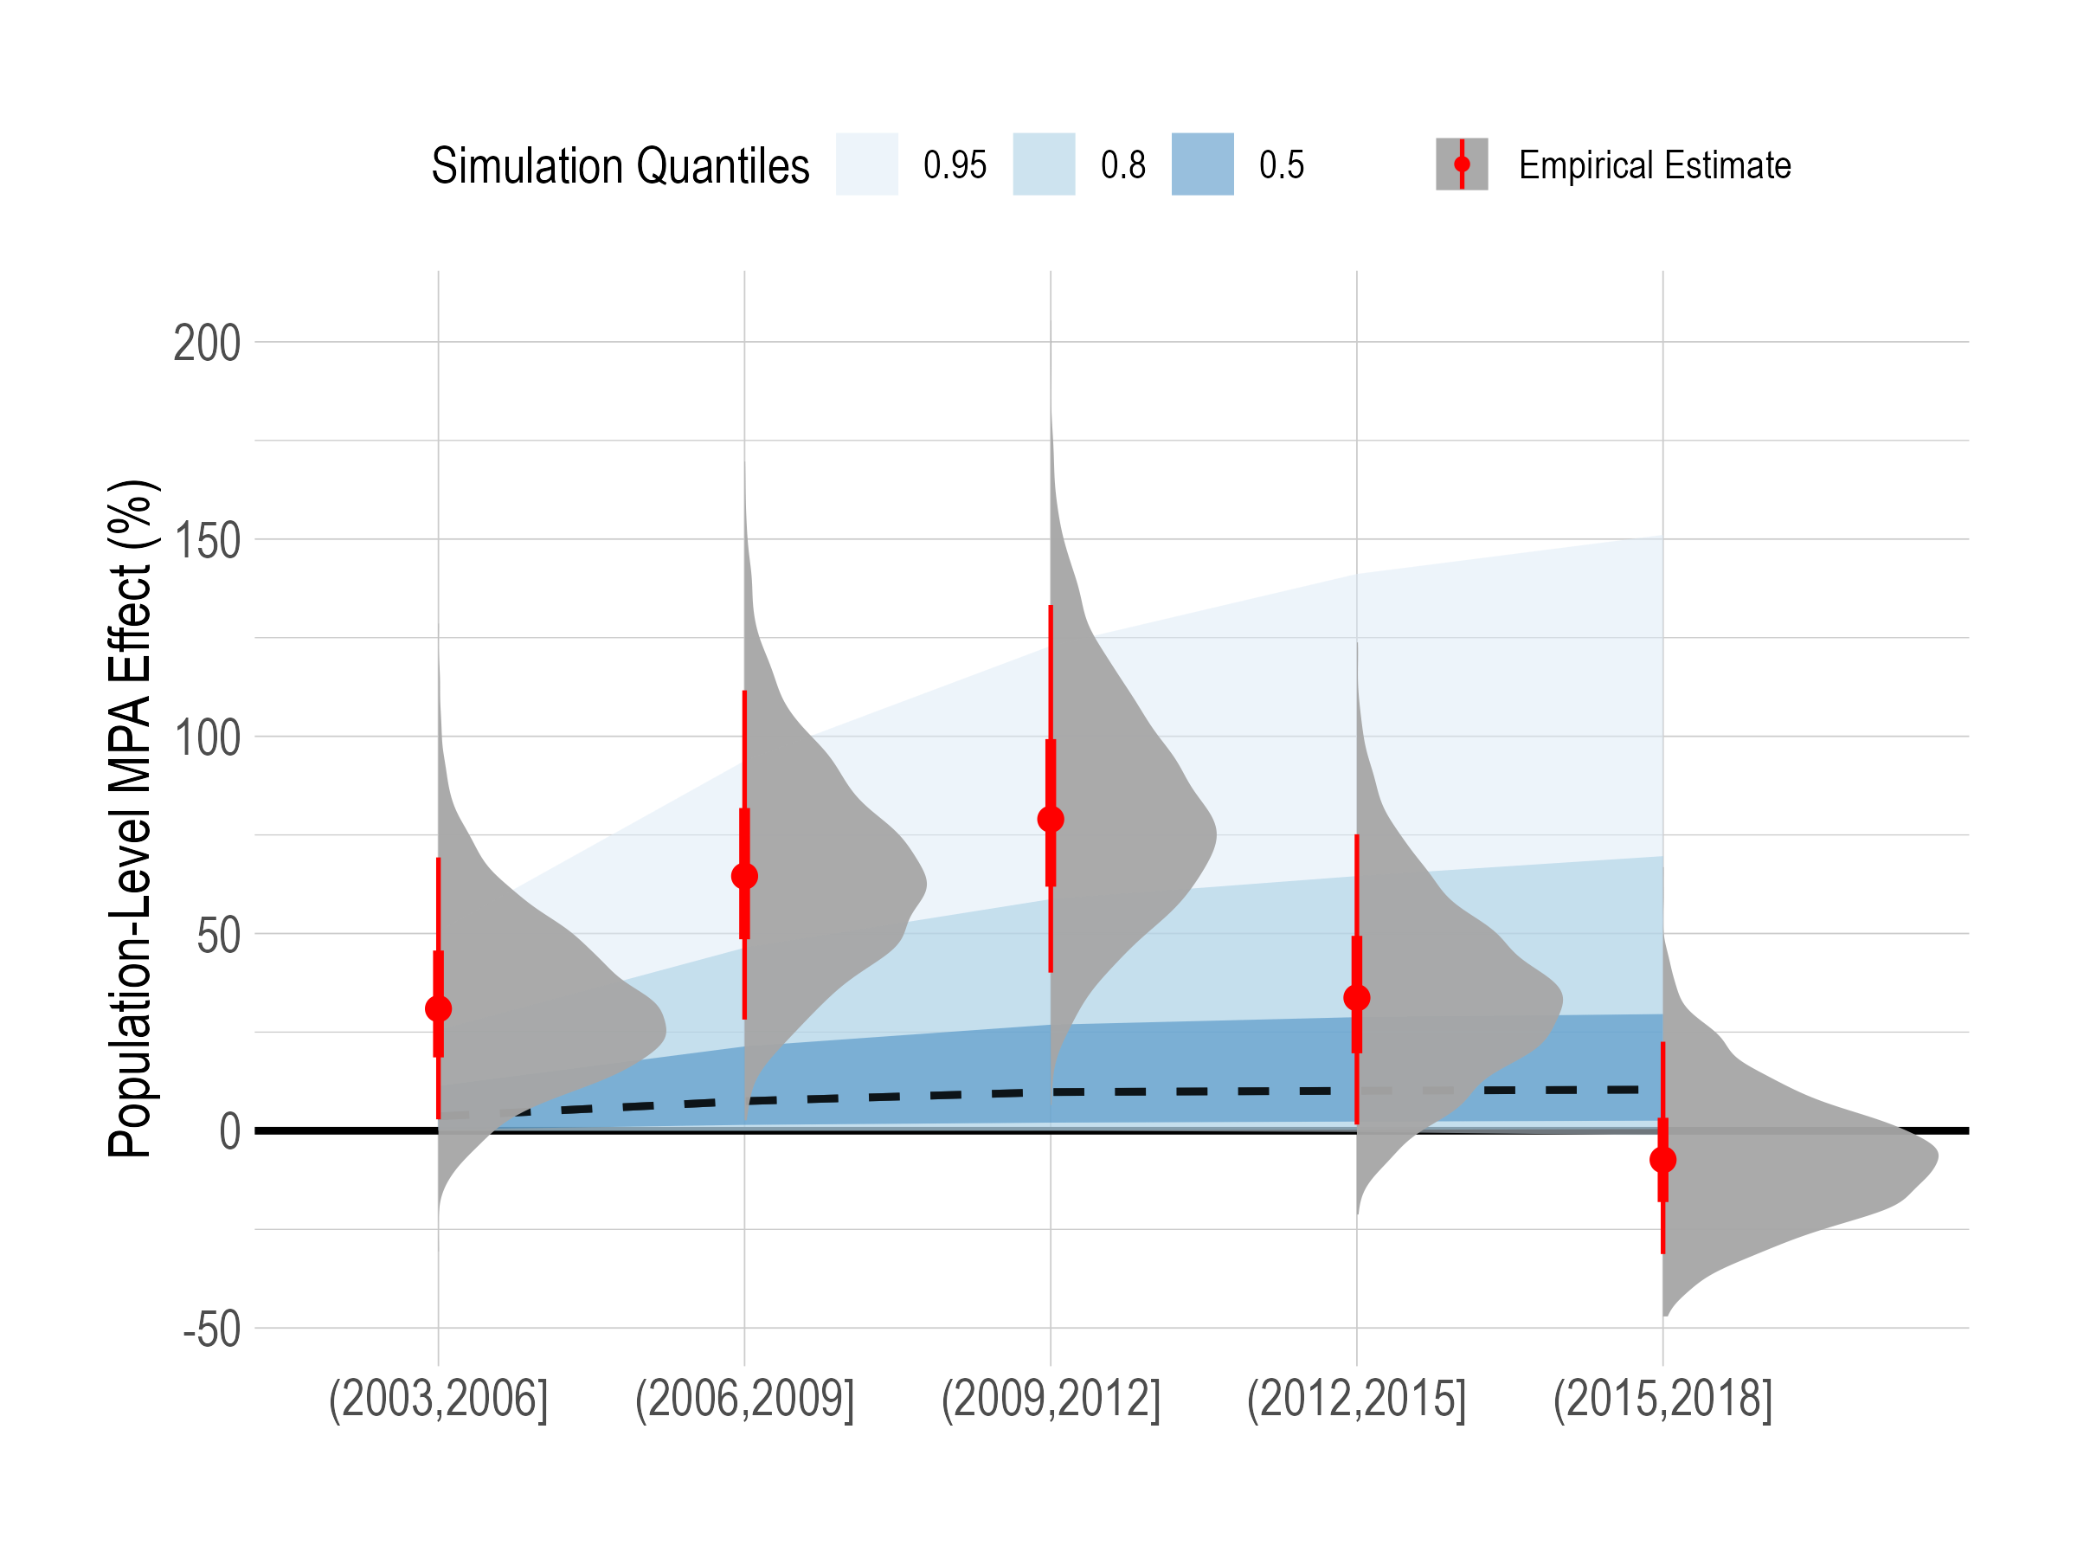
Population-Level Effects of MPAs
What the hell

Slide 4
{.absolute top=20% width = 20%}
Is going on

Slide 5
Huh

Slide 6
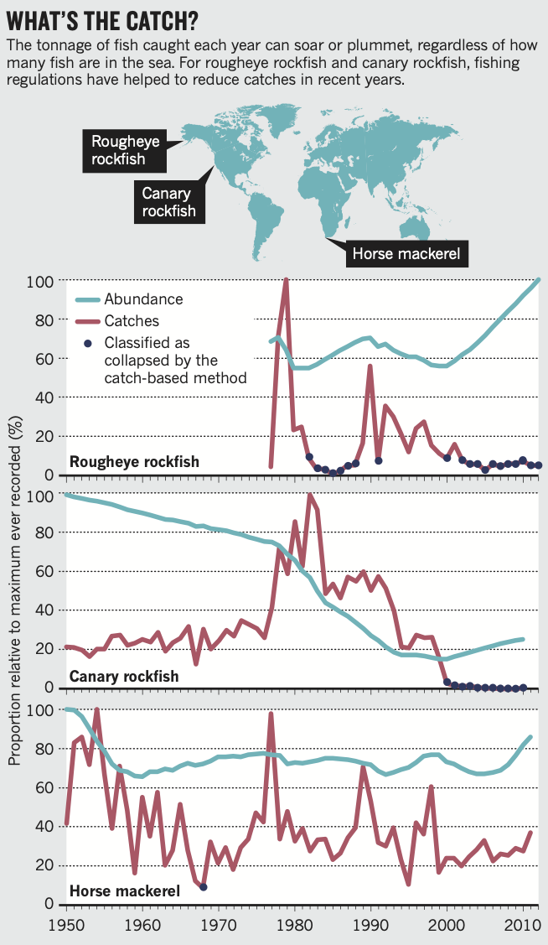
Test 2

Slide 7
bh

Slide 8
Quarto
Quarto enables you to weave together content and executable code into a finished presentation. To learn more about Quarto presentations see https://quarto.org/docs/presentations/.

Slide 9
Bullets
When you click the Render button a document will be generated that includes:
Content authored with markdown
Output from executable code

Slide 10
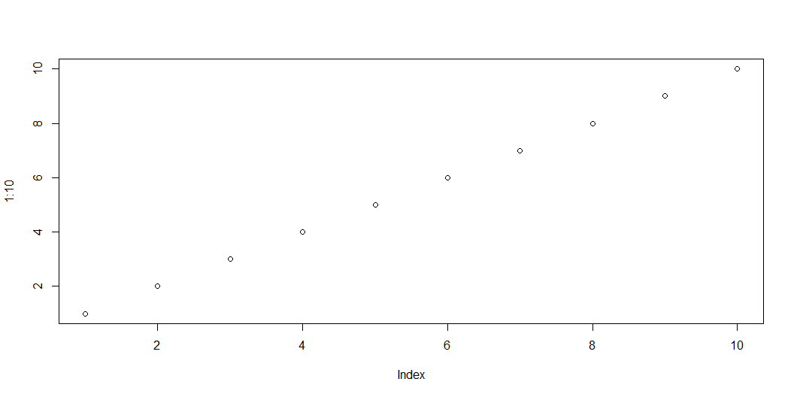
Code
When you click the Render button a presentation will be generated that includes both content and the output of embedded code. You can embed code like this:

