Slide 1
CS520 Advanced Analysis of Algorithms and Complexity
Dr. Ben Choi
Ph.D. in EE (Computer Engineering),
The Ohio State University
System Performance Engineer,
Lucent Technologies - Bell Labs Innovations
Pilot, FAA certified pilot for
airplanes and helicopters
  BenChoi.info

Slide 2
What is a Computer Algorithm?
A computer algorithm is
  a detailed step-by-step method for
  solving a problem
  by using a computer.

Slide 3
Problem-Solving (Science and Engineering)
Analysis
  How does it work?
  Breaking a system down to known components
  How the components relate to each other
  Breaking a process down to known functions
Synthesis
  Building tools and toys!
  What components are needed
  How the components should be put together
  Composing functions to form a process

Slide 4
Problem Solving Using Computers
Problem:
Strategy:
Algorithm:
  Input:
  Output:
  Step:
Analysis:
  Correctness:
  Time & Space:
  Optimality:
Implementation:
Verification:

Slide 5
Example: Search in an unordered array
Problem:
  Let E be an array containing n entries, E[0], …, E[n-1], in no particular order.
  Find an index of a specified key K, if K is in the array;
  return –1 as the answer if K is not in the array.
Strategy:
  Compare K to each entry in turn until a match is found or the array is exhausted.
  If K is not in the array, the algorithm returns –1 as its answer.

Slide 6
Example: Sequential Search, Unordered
Algorithm (and data structure)
  Input: E, n, K, where E is an array with n entries (indexed 0, …, n-1), and K is the item sought. For simplicity, we assume that K and the entries of E are integers, as is n.
  Output: Returns ans, the location of K in E
  (-1 if K is not found.)

Slide 7
Algorithm: Step (Specification)
int seqSearch(int[] E, int n, int K)
1. int ans, index;
2. ans = -1; // Assume failure.
3. for (index = 0; index < n; index++)
4. if (K == E[index])
5. ans = index; // Success!
6. break; // Done!
7. return ans;

Slide 8
Analysis of the Algorithm
How shall we measure the amount of work done by an algorithm?
Basic Operation:
  Comparison of x with an array entry
Worst-Case Analysis:
  Let W(n) be a function. W(n) is the maximum number of basic operations performed by the algorithm on any input size n.
  For our example, clearly W(n) = n.
  The worst cases occur when K appears only in the last position in the array and when K is not in the array at all.

Slide 9
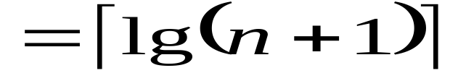
More Analysis of the Algorithm
Average-Behavior Analysis:
  Let q be the probability that K is in the array
  A(n) = n(1 – ½ q) + ½ q
Optimality:
  The Best possible solution?
  Searching an Ordered Array
  Using Binary Search
  W(n) = Ceiling[lg(n+1)]
  The Binary Search algorithm is optimal.
Correctness: (Proving Correctness of Procedures s3.5)

Slide 10
What is CS 520?
Class Syllabus

Slide 11
Algorithm Language (Specifying the Steps)
Java as an algorithm language
Syntax similar to C++
Some steps within an algorithm may be specified in pseudo code (English phrases)
Focus on the strategy and techniques of an algorithm, not on detail implementation

Slide 12
Analysis Tool: Mathematics: Set
A set is a collection of distinct elements.
The elements are of the same “type”, common properties.
“element e is a member of set S” is denoted as
e ∈ S
Read “e is in S”
A particular set is defined by listing or describing its elements between a pair of curly braces:
S₁ = {a, b, c}, S₂ = {x | x is an integer power of 2}
read “the set of all elements x such that x is …”
S₃ = {} = ∅, has not elements, called empty set
A set has no inherent order.

Slide 13
Subset, Superset; Intersection, Union
If all elements of one set, S₁
  are also in another set, S₂,
Then S₁ is said to be a subset of S₂, S₁ ⊆ S₂
  and S₂ is said to be a superset of S₁, S₂ ⊇ S₁.
Empty set is a subset of every set, ∅ ⊆ S
Intersection
S ∩ T = {x | x ∈ S and x ∈ T}
Union
S ∪ T = {x | x ∈ S or x ∈ T}

Slide 14
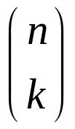
Cardinality
Cardinality
  A set, S, is finite if there is an integer n such that the elements of S can be placed in a one-to-one correspondence with {1, 2, 3, …, n}
  in this case we write |S| = n
How many distinct subsets does a finite set on n elements have? There are 2^{n} subsets.
How many distinct subsets of cardinality k does a finite set of n elements have?
There are C(n, k) = n!/((n-k)!k!), “n choose k”

Slide 15
Sequence
A group of elements in a specified order is called a sequence.
A sequence can have repeated elements.
Sequences are defined by listing or describing their elements in order, enclosed in parentheses.
e.g. S1 = (a, b, c), S2 = (b, c, a), S3 = (a, a, b, c)
A sequence is finite if there is an integer n such that the elements of the sequence can be placed in a one-to-one correspondence with (1, 2, 3, …, n).
If all the elements of a finite sequence are distinct, that sequence is said to be a permutation of the finite set consisting of the same elements.
One set of n elements has n! distinct permutations.

Slide 16
Tuples and Cross Product
A tuple is a finite sequence.
  Ordered pair (x, y), triple (x, y, z),
  quadruple, and quintuple
  A k-tuple is a tuple of k elements.
The cross product of two sets, say S and T, is
S × T = {(x, y) | x ∈ S, y ∈ T}
| S × T | = |S| |T|
It often happens that S and T are the same set, e.g.
N × N
where N denotes the set of natural numbers, {0,1,2,…}

Slide 17
Relations and Functions
A relation is some subset of a (possibly iterated) cross product.
A binary relation is some subset of a cross product,
e.g. R ⊆ S × T
e.g. “less than” relation can be defined as
{(x, y) | x ∈ N, y ∈ N, x < y}
Important properties of relations; let R ⊆ S × S
  reflexive: for all x ∈ S, (x, x) ∈ R.
  symmetric: if (x, y) ∈ R, then (y, x) ∈ R.
  antisymmetric: if (x, y) ∈ R, then (y, x) ∉ R
  transitive: if (x,y) ∈ R and (y, z) ∈ R, then (x, z) ∈ R.
A relation that is reflexive, symmetric, and transitive is called an equivalence relation, partition the underlying set S into equivalence classes [x] = {y ∈ S | x R y}, x ∈ S
A function is a relation in which no element of S (of S x T) is repeated with the relation. (informal def.)

Slide 18
Analysis Tool: Logic
Logic is a system for formalizing natural language statements so that we can reason more accurately.
The simplest statements are called atomic formulas.
More complex statements can be build up through the use of logical connectives: ∧ “and”, ∨ “or”, ¬ “not”, ⇒ “implies” A ⇒ B “A implies B” “if A then B”
A ⇒ B is logically equivalent to ¬ A ∨ B
¬ (A ∧ B) is logically equivalent to ¬ A ∨ ¬ B
¬ (A ∨ B) is logically equivalent to ¬ A ∧ ¬ B

Slide 19
Quantifiers: all, some
“for all x” ∀x P(x) is true iff P(x) is true for all x
  universal quantifier (universe of discourse)
“there exist x” ∃x P(x) is true iff P(x) is true for some value of x
  existential quantifier
∀x A(x) is logically equivalent to ¬ ∃x(¬A(x))
∃x A(x) is logically equivalent to ¬∀x(¬A(x))
∀x (A(x) ⇒ B(x))
“For all x such that if A(x) holds then B(x) holds”

Slide 20
Prove: by counterexample, Contraposition, Contradiction
Counterexample
to prove ∀x (A(x) ⇒ B(x)) is false, we show some object x for which A(x) is true and B(x) is false.
  ¬(∀x (A(x) ⇒ B(x))) ⇔ ∃x (A(x) ∧ ¬B(x))
Contraposition
to prove A ⇒ B, we show (¬ B) ⇒ (¬ A)
Contradiction
to prove A ⇒ B, we assume ¬ B and then prove B.
  A ⇒ B ⇔ (A ∧ ¬B) ⇒ B
  A ⇒ B ⇔ (A ∧ ¬B) is false
  Assuming (A ∧ ¬B) is true,
  and discover a contradiction (such as A ∧ ¬A),
  then conclude (A ∧ ¬B) is false, and so A ⇒ B.

Slide 21
Prove: by Contradiction, e.g.
Prove [B ∧ (B ⇒ C)] ⇒ C
  by contradiction
Proof:
Assume ¬C
¬C ∧ [B ∧ (B ⇒ C)]
⇒ ¬C ∧ [B ∧ (¬ B ∨ C)]
⇒ ¬C ∧ [(B ∧ ¬ B) ∨ (B ∧ C)]
⇒ ¬C ∧ [(B ∧ C)]
⇒ ¬C ∧ C ∧ B
⇒ False, Contradiction
⇒ C

Slide 22
Rules of Inference
A rule of inference is a general pattern that allows us to draw some new conclusion from a set of given statements.
  If we know {…} then we can conclude {…}
If {B and (B ⇒ C)} then {C}
  modus ponens
If {A ⇒ B and B ⇒ C} then {A ⇒ C}
  syllogism
If {B ⇒ C and ¬B ⇒ C} then {C}
  rule of cases

Slide 23
Two-valued Boolean (algebra) logic
1. There exists two elements in B, i.e. B={0,1}
  there are two binary operations + “or, ∨”, · “and, ∧”
2. Closure: if x, y ∈ B and z = x + y then z ∈ B
  if x, y ∈ B and z = x · y then z ∈ B
3. Identity element: for + designated by 0: x + 0 = x
  for · designated by 1: x · 1 = x
4. Commutative: x + y = y + x
  x · y = y · x
5. Distributive: x · (y + z) = (x · y) + (x · z)
  x + (y · z) = (x + y) · (x + z)
6. Complement: for every element x ∈ B,
there exits an element x’ ∈ B
  x + x’ = 1, x · x’ = 0

Slide 24
True Table and Tautologically Implies e.g.
Show [B ∧ (B ⇒ C)] ⇒ C is a tautology:
  B C (B ⇒C) [B ∧ (B ⇒ C)] [B ∧ (B ⇒ C)] ⇒ C
  0 0 1 0 1
  0 1 1 0 1
  1 0 0 0 1
  1 1 1 1 1
For every assignment for B and C,
  the statement is True

Slide 25
Prove: by Rule of inferences
Prove [B ∧ (B ⇒ C)] ⇒ C
  Proof:
  [B ∧ (B ⇒ C)] ⇒ C
  ⇒ ¬[B ∧ (B ⇒ C)] ∨ C
  ⇒ ¬[B ∧ (¬ B ∨ C)] ∨ C
  ⇒ ¬[(B ∧ ¬ B) ∨ (B ∧ C)] ∨ C
  ⇒ ¬ [(B ∧ C)] ∨ C
  ⇒ ¬B ∨ ¬C ∨ C
  ⇒ True (tautology)
Direct Proof:
  [B ∧ (B ⇒ C)] ⇒ [B ∧ C] ⇒ C

Slide 26
Analysis Tool: Probability
Elementary events (outcomes)
  Suppose that in a given situation an event, or experiment, may have any one, and only one, of k outcomes, s₁, s₂, …, s_{k}. (mutually exclusive)
Universe
The set of all elementary events is called the universe and is denoted U = {s₁, s₂, …, s_{k}}.
Probability of s_{i}
associate a real number Pr(s_{i}), such that
0 ≤ Pr(s_{i}) ≤ 1 for 1 ≤ i ≤ k;
Pr(s₁) + Pr(s₂) + … + Pr(s_{k}) = 1

Slide 27
Event
Let S ⊆ U. Then S is called an event, and
Pr(S) = ∑_{si ∈ S} Pr(s_{i})
Sure event U = {s₁, s₂, …, s_{k}}, Pr(U) = 1
Impossible event, ∅ ,Pr(∅) = 0
Complement event “not S” U – S,
Pr(not S) = 1 – Pr(S)

Slide 28
Conditional Probability
The conditional probability of an event S given an event T is defined as
Pr(S | T) = Pr(S and T) / Pr(T)
= ∑_{si ∈ S∩T} Pr(s_{i}) / ∑_{sj ∈ T} Pr(s_{j})
Independent
Given two events S and T, if
Pr(S and T) = Pr(S)Pr(T)
then S and T are stochastically independent, or simply independent.

Slide 29
Random variable and their Expected value
A random variable is a real valued variable that depends on which elementary event has occurred
  it is a function defined for elementary events.
  e.g. f(e) = the number of inversions in the permutation of {A, B, C}; assume all input permutations are equally likely.
Expectation
  Let f(e) be a random variable defined on a set of elementary events e ∈ U. The expectation of f, denoted as E(f), is defined as
E(f) = ∑_{e ∈ U} f(e)Pr(e)
  This is often called the average values of f.
  Expectations are often easier to manipulate then the random variables themselves.

Slide 30
Conditional expectation and
Laws of expectations
The conditional expectation of f given an event S, denoted as E (f | S), is defined as
E(f | S) = ∑_{e ∈ S} f(e)Pr(e | S)
Law of expectations
For random variables f(e) and g(e) defined on a set of elementary events e ∈ U, and any event S:
E(f + g) = E(f) + E(g)
E(f) = Pr(S)E(f | S) + Pr(not S) E(f | not S)

Slide 31
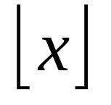
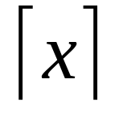
Analysis Tool: Algebra
Manipulating Inequalities
Transitivity: If ((A ≤ B) and (B ≤ C) Then (A ≤ C)
Addition: If ((A ≤ B) and (C ≤ D) Then (A+C ≤ B+D)
Positive Scaling:
If ((A ≤ B) and (α > 0) Then (α A ≤ α B)
Floor and Ceiling Functions
Floor[x] is the largest integer less than or equal to x.
Ceiling[x] is the smallest integer greater than or equal to x.

Slide 32
Logarithms
  For b>1 and x>0,
  log_{b}x (read “log to the base b of x”)
  is that real number L such that b^{L} = x
  log_{b}x is the power to which b must be raised to get x.
Log properties: def: lg x = log₂ x; ln x = log_{e} x
    Let x and y be arbitrary positive real numbers, let a, b any real number, and let b>1 and c>1 be real numbers.
  log_{b} is a strictly increasing function,
  if x > y then log_{b} x > log_{b} y
  log_{b} is a one-to-one function,
  if log_{b} x = log_{b} y then x = y
  log_{b} 1 = 0; log_{b} b = 1; log_{b} xª = a log_{b} x
  log_{b}(xy) = log_{b} x + log_{b} y
  x^{log y} = y^{log x}
  ^{change base:} log_{c}x = (log_{b} x)/(log_{b} c)

Slide 33
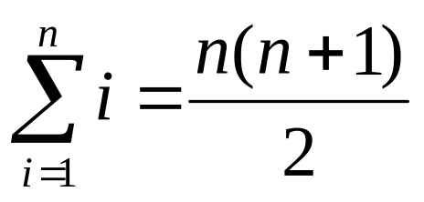
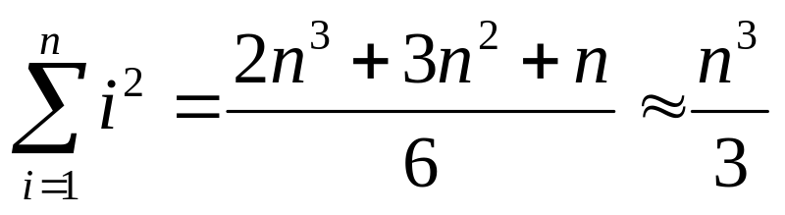
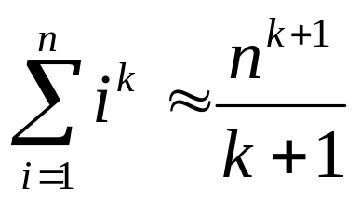
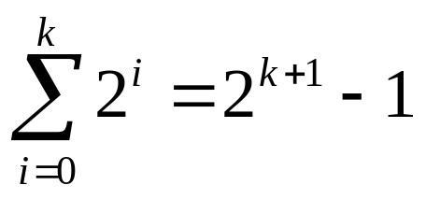
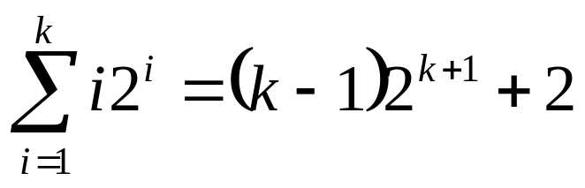
Series
A series is the sum of a sequence.
Arithmetic series
  The sum of consecutive integers
Polynomial Series
  The sum of squares
  The general case is
Power of 2
Arithmetic-
Geometric Series

Slide 34
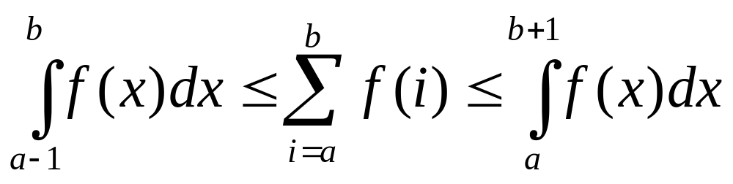
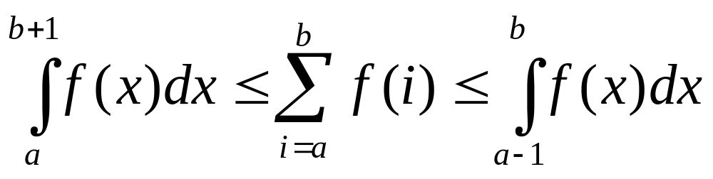
Summations Using Integration
  A function f(x) is said to be monotonic, or nondecreasing, if x ≤ y always implies that f(x) ≤ f(y).
  A function f(x) is antimonotonic, or nonincreasing,
  if –f(x) is monotonic.
If f(x) is nondecreasing then
If f(x) is nonincreasing then

Slide 35
Classifying functions by their
Asymptotic Growth Rates
asymptotic growth rate, asymptotic order, or
order of functions
  Comparing and classifying functions that ignores constant factors and small inputs.
The Sets big oh O(g), big theta Θ(g), big omega Ω(g)
Ω(g): functions that grow at least as fast as g
g
Θ(g): functions that grow at the same rate as g
O(g): functions that grow no faster than g

Slide 36
The Sets O(g), Θ(g), Ω(g)
  Let g and f be a functions from
  the nonnegative integers into the positive real numbers
  For some real constant c > 0 and
  some nonnegative integer constant n₀
O(g) is the set of functions f, such that
f(n) ≤ c g(n) for all n ≥ n₀
Ω(g) is the set of functions f, such that
f(n) ≥ c g(n) for all n ≥ n₀
Θ(g) = O(g) ∩ Ω(g)
  asymptotic order of g
  f ∈Θ(g) read as
  “f is asymptotic order g” or “f is order g”

Slide 37
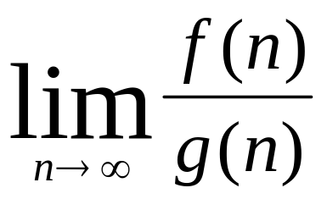
Comparing asymptotic growth rates
Comparing f(n) and g(n) as n approaches infinity,
IF
< ∞, including the case in which the limit is 0 then
f ∈O(g)
> 0, including the case in which the limit is ∞ then
f ∈ Ω(g)
= c and 0 < c < ∞ then
f ∈ Θ(g)
= 0 then f ∈ o(g) //read as “little oh of g”
= ∞ then f ∈ ω(g) //read as “little omega of g”

Slide 38
Properties of O(g), Θ(g), Ω(g)
Transitive: If f ∈O(g) and g ∈O(h), then f ∈O(h)
O is transitive. Also Ω, Θ, o, ω are transitive.
Reflexive: f ∈ Θ(f)
Symmetric: If f ∈ Θ(g), then g ∈ Θ(f)
Θ defines an equivalence relation on the functions.
  Each set Θ(f) is an equivalence class (complexity class).
f ∈O(g) ⇔ g ∈ Ω(f)
O(f + g) = O(max(f, g))
similar equations hold for Ω and Θ

Slide 39
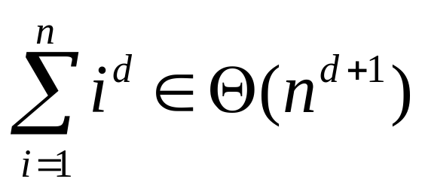
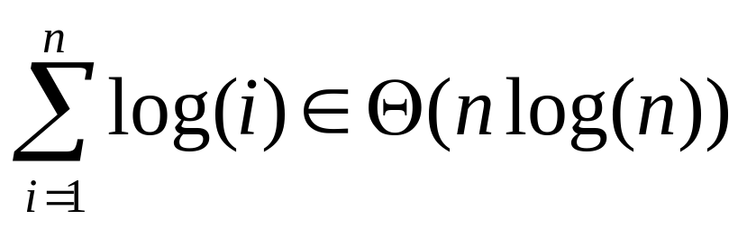
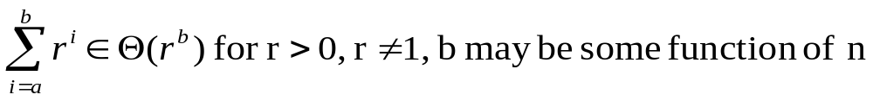
Classification of functions, e.g.
O(1) denotes the set of functions bounded by a constant (for large n)
f ∈ Θ(n), f is linear
f ∈ Θ(n²), f is quadratic; f ∈ Θ(n³), f is cubic
lg n ∈ o(n^{α}) for any α > 0, including factional powers
n^{k} ∈ o(c^{n}) for any k > 0 and any c > 1
  powers of n grow more slowly than
  any exponential function c^{n}

Slide 40
Analyzing Algorithms and Problems
We analyze algorithms with the intention of
improving them, if possible, and
for choosing among several available for a problem.
Correctness
Amount of work done, and space used
Optimality, Simplicity

Slide 41
Correctness can be proved!
An algorithm consists of sequences of steps (operations, instructions, statements) for transforming
inputs (preconditions) to outputs (postconditions)
Proving
  if the preconditions are satisfied,
  then the postconditions will be true,
  when the algorithm terminates.

Slide 42
Amount of work done
  We want a measure of work that tells us something about the efficiency of the method used by the algorithm
  independent of computer, programming language, programmer, and other implementation details.
  Usually depending on the size of the input
Counting passes through loops
Basic Operation
  Identify a particular operation fundamental to the problem
  the total number of operations performed is roughly proportional to the number of basic operations
Identifying the properties of the inputs that affect the behavior of the algorithm

Slide 43
Worst-case complexity
  Let D_{n} be the set of inputs of size n for the problem under consideration, and let I be an element of D_{n}.
  Let t(I) be the number of basic operations performed by the algorithm on input I.
  We define the function W by
W(n) = max{t(I) | I ∈ D_{n}}
  called the worst-case complexity of the algorithm.
  W(n) is the maximum number of basic operations performed by the algorithm on any input of size n.
The input, I, for which an algorithm behaves worst
depends on the particular algorithm.

Slide 44
Average Complexity
  Let Pr(I) be the probability that input I occurs.
  Then the average behavior of the algorithm is defined as
A(n) = Σ_{I ∈ Dn} Pr(I) t(I).
  We determine t(I) by analyzing the algorithm,
  but Pr(I) cannot be computed analytically.
A(n) = Pr(succ)A_{succ}(n) + Pr(fail)A_{fail}(n)
An element I in D_{n} may be thought as a set or equivalence class that affect the behavior of the algorithm. (see following e.g. n+1 cases)

Slide 45
e.g. Search in an unordered array
int seqSearch(int[] E, int n, int K)
1. int ans, index;
2. ans = -1; // Assume failure.
3. for (index = 0; index < n; index++)
4. if (K == E[index])
5. ans = index; // Success!
6. break; // Done!
7. return ans;

Slide 46
Average-Behavior Analysis e.g.
A(n) = Pr(succ)A_{succ}(n) + Pr(fail)A_{fail}(n)
There are total of n+1 cases of I in D_{n}
  Let K is in the array as “succ” cases that have n cases.
  Assuming K is equally likely found in any of the n location, i.e. Pr(I_{i} | succ) = 1/n
  for 0 <= i < n, t(I_{i}) = i + 1
  A_{succ}(n) = Σ_{i=0}^{n-1}Pr(I_{i} | succ) t(I_{i})
  = Σ_{i=0}^{n-1}(1/n) (i+1) = (1/n)[n(n+1)/2] = (n+1)/2
  Let K is not in the array as the “fail” case that has 1 cases, Pr(I | fail) = 1
  Then A_{fail}(n) = Pr(I | fail) t(I) = 1 n
Let q be the probability for the succ cases
  q [(n+1)/2] + (1-q) n

Slide 47
Space Usage
If memory cells used by the algorithms depends on the particular input,
  then worst-case and average-case analysis can be done.
Time and Space Tradeoff.

Slide 48
Optimality “the best possible”
Each problem has inherent complexity
  There is some minimum amount of work required to solve it.
To analyze the complexity of a problem,
  we choose a class of algorithms, based on which
  prove theorems that establish a lower bound on the number of operations needed to solve the problem.
Lower bound (for the worst case)

Slide 49
Show whether an algorithm is optimal?
Analyze the algorithm, call it A, and found the Worst-case complexity W_{A}(n), for input of size n.
Prove a theorem starting that,
  for any algorithm in the same class of A
  for any input of size n, there is some input for which the algorithm must perform
  at least W_{[A]}(n)
  (lower bound in the worst-case)
If W_{A}(n) == W_{[A]}(n)
  then the algorithm A is optimal
  else there may be a better algorithm
  OR there may be a better lower bound.

Slide 50
Optimality e.g.
Problem
  Fining the largest entry in an (unsorted) array of
  n numbers
Algorithm A
  int findMax(int[] E, int n)
  1. int max;
  2. max = E[0]; // Assume the first is max.
  3. for (index = 1; index < n; index++)
  4. if (max < E[index])
  5. max = E[index];
  6. return max;

Slide 51
Analyze the algorithm, find W_{A}(n)
Basic Operation
  Comparison of an array entry with another array entry or a stored variable.
Worst-Case Analysis
  For any input of size n, there are exactly n-1 basic operations
  W_{A}(n) = n-1

Slide 52
For the class of algorithm [A], find W_{[A]}(n)
Class of Algorithms
  Algorithms that can compare and copy the numbers, but do no other operations on them.
Finding (or proving) W_{[A]}(n)
  Assuming the entries in the array are all distinct
    (permissible for finding lower bound on the worst-case)
  In an array with n distinct entries, n – 1 entries are not the maximum.
  To conclude that an entry is not the maximum, it must be smaller than at least one other entry. And, one comparison (basic operation) is needed for that.
  So at least n-1 basic operations must be done.
  W_{[A]}(n) = n – 1
Since W_{A}(n) == W_{[A]}(n), algorithm A is optimal.

Slide 53
Simplicity
Simplicity in an algorithm is a virtue.

Slide 54
Designing Algorithms
Problem solving using Computer
Algorithm Design Techniques
  divide-and-conquer
  greedy methods
  depth-first search (for graphs)
  dynamic programming

Slide 55
Problem and Strategy A
Problem: array search
  Given an array E containing n and given a value K, find an index for which K = E[index] or, if K is not in the array, return –1 as the answer.
Strategy A
  Input data and Data structure: unsorted array
  sequential search
Algorithm A
  int seqSearch(int[] E, int n, int k)
Analysis A
  W(n) = n
  A(n) = q [(n+1)/2] + (1-q) n

Slide 56
Better Algorithm and/or Better Input Data
Optimality A
  for searching an unsorted array
  W_{[A]}(n) = n
  Algorithm A is optimal.
Strategy B
  Input data and Data structure: array sorted in nondecreasing order
  sequential search
Algorithm B.
  int seqSearch(int[] E, int n, int k)
Analysis B
  W(n) = n
  A(n) = q [(n+1)/2] + (1-q) n

Slide 57
Better Algorithm
Optimality B
  It makes no use of the fact that the entries are ordered
  Can we modify the algorithm so that it uses the added information and does less work?
Strategy C
  Input data and Data structure: array sorted in nondecreasing order
  sequential search:
  as soon as an entry larger than K is encountered, the algorithm can terminate with the answer –1.

Slide 58
Algorithm C: modified sequential search
int seqSearchMod(int[] E, int n, int K)
1. int ans, index;
2. ans = -1; // Assume failure.
3. for (index = 0; index < n; index++)
4. if (K > E[index])
5. continue;
6. if (K < E[index])
7. break; // Done!
8. // K == E[index]
9. ans = index; // Find it
10. break;
11. return ans;

Slide 59
Analysis C
W(n) = n + 1 ≈ n
Average-Behavior
  n cases for success:
  A_{succ}(n) = Σ_{i=0}^{n-1}Pr(I_{i} | succ) t(I_{i})
  = Σ_{i=0}^{n-1}(1/n) (i+2) = (3 + n)/2
  n+1 cases or (gaps) for fail: <E[0]<>E[1]…E[n-1]>
A_{fail}(n) = Pr(I _{i} | fail) t(I_{i} ) =
Σ_{i=0}^{n-1}(1/(n+1)) (i+2) + n/(n+1)
A(n) = q (3+n)/2 + (1-q) ( n /(n+1) + (3+n)/2 )
≈ n/2

Slide 60
Let’s Try Again! Let’s divide-and-conquer!
Strategy D
  compare K first to the entry in the middle of the array
  -- eliminates half of the entry with one comparison
  apply the same strategy recursively
Algorithm D: Binary Search
  Input: E, first, last, and K, all integers, where E is an ordered array in the range first, …, last, and K is the key sought.
  Output: index such that E[index] = K if K is in E within the range first, …, last, and index = -1 if K is not in this range of E

Slide 61
Binary Search
int binarySearch(int[] E, int first, int last, int K)
1. if (last < first)
2. index = -1;
3. else
4. int mid = (first + last)/2
5. if (K == E[mid])
6. index = mid;
7. else if (K < E[mid])
8. index = binarySearch(E, first, mid-1, K)
9. else
10. index = binarySearch(E, mid+1, last, K);
11. return index

Slide 62
Worst-Case Analysis of Binary Search
  Let the problem size be n = last – first + 1; n>0
Basic operation is a comparison of K to an array entry
  Assume one comparison is done with the three-way branch
  First comparison, assume K != E[mid], divides the array into two sections, each section has at most Floor[n/2] entries.
  estimate that the size of the range is divided by 2 with each recursive call
  How many times can we divide n by 2 without getting a result lest than 1 (i.e. n/(2^{d}) >= 1) ?
  d <= lg(n), therefore we do Floor[lg(n)] comparison following recursive calls, and one before that.
  W(n) = Floor[lg(n)] + 1 = Ceiling[lg(n + 1)] ∈ Θ(log n)

Slide 63
Average-Behavior Analysis of Binary Search
  There are n+1 cases, n for success and 1 for fail
Similar to worst-case analysis, Let n = 2^{d} –1
A_{fail} = lg(n+1)
Assuming Pr(I_{i} | succ) = 1/n for 1 <= i <= n
  divide the n entry into groups, S_{t} for 1 <= t <= d,
  such that S_{t} requires t comparisons
  (capital S for group, small s for cardinality of S)
  It is easy to see (?) that (members contained in the group)
  s₁ = 1 = 2⁰, s₂ = 2 = 2¹, s₃ = 4 = 2², and
  in general, s_{t} = 2^{t-1}
  The probability that the algorithm does t comparisons is s_{t}/n
  A_{succ}(n) = Σ_{t=1}^{d} (s_{t}/n) t = ((d –1)2^{d} + 1)/n
  d = lg(n+1)
  A_{succ}(n) = lg(n+1) – 1 + lg(n+1)/n
A(n) ≈ lg(n+1) – q, where q is probability of successful search

Slide 64
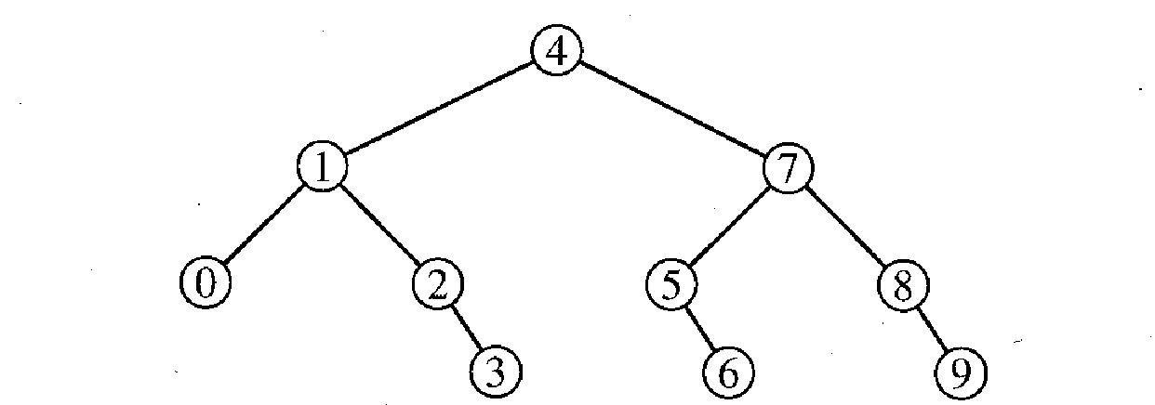
Optimality of Binary Search
So far we improve from θ(n) algorithm to θ(log n)
  Can more improvements be possible?
Class of algorithm: comparison as the basic operation
Analysis by using decision tree, that
  for a given input size n is a binary tree whose nodes are labeled with numbers between 0 and n-1 as e.g.
distance 0
distance 1
distance 2
distance 3

Slide 65
Decision tree for analysis
The number of comparisons performed in the worst case is the number of nodes on a longest path from the root to a leaf; call this number p.
Suppose the decision tree has N nodes
N <= 1 + 2 + 4 + … + 2^{p-1}
N <= 2^{p} – 1
2^{p} >= (N + 1)
Claim N >= n if an algorithm A works correctly in all cases
  there is some node in the decision tree labeled i for each i from 0 through n - 1

Slide 66
Prove by contradiction that N >= n
Suppose there is no node labeled i for some i in the range from 0 through n-1
  Make up two input arrays E1 and E2 such that
  E1[i] = K but E2[i] = K’ > K
  For all j < i, make E1[j] = E2[j] using some key values less than K
  For all j > i, make E1[j] = E2[j] using some key values greater than K’ in sorted order
  Since no node in the decision tree is labeled i, the algorithm A never compares K to E1[i] or E2[i],
  but it gives same output for both
  Such algorithm A gives wrong output for at least one of the array and it is not a correct algorithm
Conclude that the decision has at least n nodes

Slide 67
Optimality result
2^{p} >= (N+1) >= (n+1)
p >= lg(n+1)
Theorem: Any algorithm to find K in an array of n entries (by comparing K to array entries) must do at least Ceiling[lg(n+1)] comparisons for some input.
Corollary: Since Algorithm D does Ceiling[lg(n+1)] comparisons in the worst case, it is optimal.

