Slide 1
Dynamic Sets and Searching
Analysis Technique
  Amortized Analysis
  // average cost of each operation
  in the worst case
Dynamic Sets
// Sets whose membership varies during computation
  Array Doubling
  Implementing Stack with array doubling
Searching
// Exist or not, in where
  Binary Search Trees
  Hashing

Slide 2
Amortized Analysis
Provides average cost of each operation
in the worst case for successive operations
Aggregate method
  show for a sequence of n operations takes worst-case time T(n) in total
  In the worst case, the average cost, or amortized cost, per operation is therefore T(n)/n
Accounting method // spreading a large cost over time
  amortized cost = actual cost + accounting cost
  assign different accounting cost to different operations
    1. the sum of accounting costs is nonnegative for any legal sequence of operations
    2. to make sure it is feasible to analyze the amortized cost of each operation

Slide 3
Array Doubling
We don’t know how big an array we might need when the computation begins
If not more room for inserting new elements,
  allocating a new array that is twice as large as the current array
  transferring all the elements into the new array
Let t be the cost of transferring one element
  suppose inserting the (n+1) element triggers an array-doubling
  cost t*n for this array-doubling operation
  cost t*n/2 + t*n/4 + t*n/8 + … for previous array-doubling, i.e. cost less than t*n
  total cost less than 2t*n
  The average cost for each insert operation = 2t

Slide 4
Implementing Stack with array doubling
Array doubling is used behind the scenes to enlarge the array as necessary
  Assuming actual cost of push or pop is 1
    when no enlarging of the array occurs
  the actual cost of push is 1 + t*n
    when array doubling is required
Accounting scheme, assigning
  accounting cost for a push to be 2t
    when no enlarging of array occurs
  accounting cost for push to be –t*n + 2t
    when array doubling is required
The amortized cost of each push operation is 1+2t
From the time the stack is created, the sum of the accounting cost must never be negative.

Slide 5
Searching: Binary Search Trees
Binary Search Tree property
  A binary tree in which the nodes have keys from an ordered set has the binary search tree property
  if the key at each node is greater than all the keys in its left subtree and
  less than or equal to all keys in its right subtree
  In this case the binary tree is called a binary search tree
An inorder traversal of a binary search tree produces a sorted list of keys.

Slide 6
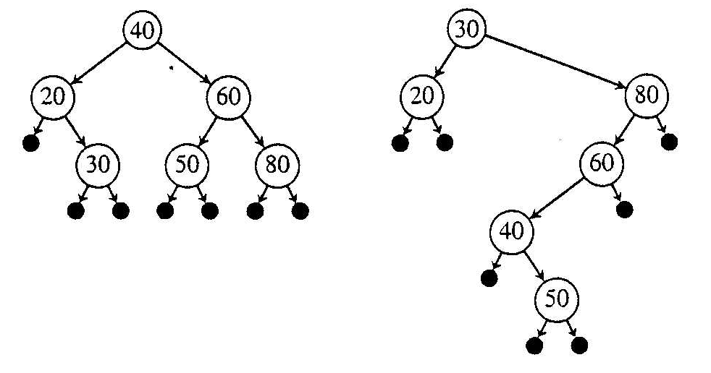
Binary Search Trees, e.g.
Binary Search trees with different degrees of balances
Black dots denote empty trees

Slide 7
Binary Search Tree Retrieval
Element bstSearch(BinTree bst, Key K)
  Element found
  if (bst == nil)
    found = null;
  else
    Element root = root(bst);
    If (K == root.key)
      found = root;
    else if (K < root.key)
      found = bstSearch (leftSubtree(bst), K);
    else
      found = bstSearch(rightSubtree(bst), K);
  return found;

Slide 8
Analysis of Binary Search Tree Retrieval
use the number of internal nodes of the tree that are examined which searching for key
  let it be n
For a long chain tree structure, θ(n)
For a tree as balanced as possible, θ(lg n)
>> The objective is to make the tree as balanced as possible
  Technique: Binary Tree Rotations

Slide 9
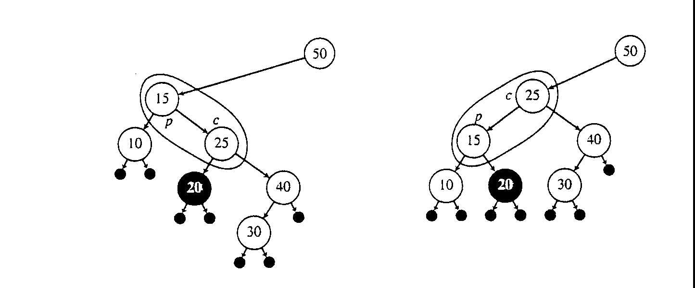
Binary Tree Rotations
Left Rotation on (15, 25)

Slide 10
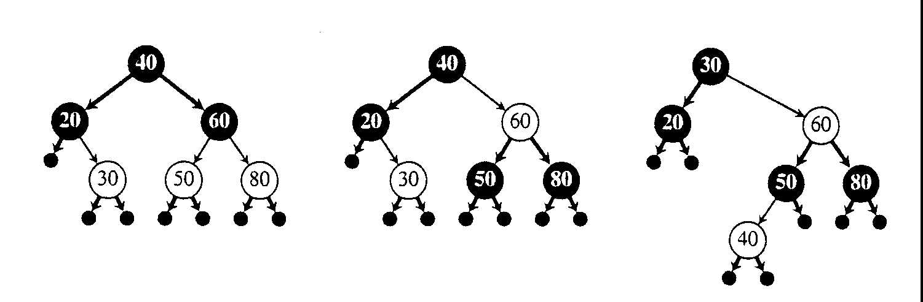
Making binary search trees as balanced as possible
Red-Black Tree
  Let T be a red-black tree with n internal nodes. Then no node has depth greater than 2 lg(n + 1).

Slide 11
Hashing to aid searching-hashing too
Imagine that we could assign a unique array index to every possible key that could occur in an application.
  locating, inserting, deleting elements could be done very easily and quickly
  key space is much too large
The purpose of hashing is to translate (by using hash function) an extremely large key space into a reasonable small range of integers (called hash code).
Hash Table
  an array H on indexes (hash code) 0, …, h-1
  hash function maps a key
  into an integer in the range 0, …, h-1
  Each entry may contain one or more keys!
    Hash function is a many-to-one function

Slide 12
Hash Table, e.g.
data k: 1055, 1492, 1776, 1812, 1918, and 1945
hash function
  hashCode(k) = 5k mod 8
hashCode: key
  0: 1776
  1:
  2:
  3: 1055
  4: 1492, 1812 // Collision!
  5: 1945
  6: 1918
  7:

Slide 13
Handling Collisions: Closed Address Hashing
H[i] is a linked list
hashCode: key
  0: -> 1776
  1: ->
  2: ->
  3: ->1055
  4: ->1492 -> 1812
  5: ->1945
  6: ->1918
  7: ->
To search a given key K, first compute its hash code, say i, then search through the linked list at H[i], comparing K with the keys of the elements in the list.

Slide 14
Analysis of Closed Address Hashing
Searching for a key
Basic Operation: comparisons
  Assume computing a hash code equals a
  units of comparisons
  there are total n elements stored in the table,
  each elements is equally likely to be search
Average number of comparison for an unsuccessful search (after hashing) equal
  A_{u}(n) = n/h
Average cost of a successful search
  when key i = 1, …, n, was inserted at the end of a linked list, each linked list had average length given by (i – 1)/h
  expected number of key comparisons = 1 + comparisons make for inserting an element at the end of a linked list
  A_{s}(n) = 1/n ∑{i=1 to n}( 1 + (i - 1)/h ) = 1 + n/(2h) + 1/(2h)

Slide 15
Assuming uniformly distribution of hash code
hash code for each key in our set is equally likely to be any integer in the range 0, …, h-1
If n/h is a constants then
  O(1) key comparisons can be achieved, on average,
  for successful search and unsuccessful search.
Uniformly distribution of hash code depends on the choice of Hash Function

Slide 16
Choosing a Hash Function
// for achieve uniformly distribution of hash code
If the key type is integer
  hashCode(K) = (a K) mod h(size of array)
Choose h as a power of 2, and h >= 8
Choose a = 8 Floor[h/23] + 5 (no need to remember)
If the key type is string of characters, treat them as sequence of integers, k1, k2, k3, …, kl
  hashCode(K) = (a^{l} k1 + a^{l-1} k2 + …+a kl) mod h
Use array doubling whenever n/h (called load factor, where n is the number of elements in the table) gets high, say 0.5

Slide 17
Handling Collisions: Open Address Hashing
is a strategy for storing all elements in the array of the hash table, rather than using linked lists to accommodate collisions
  if the hash cell corresponding to the hash code is occupied by a different elements,
  then a sequence of alternative locations for the current element is defined (by rehashing)
Rehashing by linear probing
  rehash(j) = (j+1) mod h
  where j is the location most recently probed,
  initially j = i, the hash code for K
Rehashing by double hashing
  rehash(j, d) = (j + d) mod h
  e.g. d = hashIncr(K) = (2K + 1) mod h
  // computing an odd increment ensures that whole hash table is accessed in the search (provided h is a power of 2)

Slide 18
Open Address Hashing, e.g. Linear probing
hashCode: key
  0: 1776
  1:
  2:
  3: 1055
  4: 1492
  5: 1945
  6: 1918
  7:
Now insert 1812, hashcode(1812) = 4, i.e. i = 4
  h = 8, initially j = i = 4
  rehash(j) = (j+1) mod h
  rehash(4) = (4+1) mod 8 = 5 // collision again
  rehash(5) = (5+1) mod 8 = 6 // collision again
  … put in 7

Slide 19
Retrieval and
Deletion under open addressing hashing
Retrieval procedure imitates the insertion procedure, stop search as soon as emptyCell is encountered.
Deletion of a key
  cannot simply delete the the key and assign the cell to emptyCell // cause problem for retrieval procedure
  need to assign the cell to a value indicating “obsolete”
  -this

