Slide 1
NP-Complete Problems
Problems
  Abstract Problems
    Decision Problem, Optimal value, Optimal solution
  Encodings
    //Data Structure
  Concrete Problem
    //Language
Class of Problems
  P
  NP
  NP-Complete
    NP-Completeness Proofs
Solving hard problems
  Approximation Algorithms

Slide 2
Abstract Problems-this stuff
  a formal notion of what a “problem” is
  high-level description of a problem
We define an abstract problem Q to be
  a binary relation on
  a set I of problem instances, and
  a set S of problem solutions.
  Q ∈ I × S
Three Kinds of Problems
  Decision Problem
    e.g. Is there a solution better than some given bound?
  Optimal Value
    e.g. What is the value of a best possible solution?
  Optimal Solution
    e.g. Find a solution that achieves the optimal value.

Slide 3
Encodings
  // Data Structure
  describing abstract problems (for solving by computers)
  in terms of data structure or binary strings
An encoding of a set S of abstract objects is-def
  a mapping e from S to the set of binary strings.
Encoding for Decision problems
  Problem instances, e : I → {0, 1}*
  Solution, e : S → {0, 1}
“Standard” encoding
  computing time may be a function of encoding
    // The size of the input (the number of bit to represent one input)
  polynomially related encodings
  assume encoding in a reasonable concise fashion

Slide 4
Concrete Problem
  problem instances and solutions are represented in data structure or binary strings
  // Language (in formal-language framework)
We call a problem whose instance set (and solution set) is the set of binary strings a concrete problem.-def
Computer algorithm solves concrete problems!
  solves a concrete problem in time O(T(n))
  if provided a problem instance i of length n = |i|,
  the algorithm can produce the solution
  in a most O(T(n)) time.
A concrete problem is polynomial-time solvable-def
  if there exists an algorithm to solve it in time O(n^{k})
  for some constant k. (also called polynomially bounded)

Slide 5
Class of Problems-this stuff
  // What makes a problem hard?
  // Make simple: classify decision problems
Definition: The class P
  P is the class of decision problems that are Polynomially bounded.
    // there exist a deterministic algorithm: with every input, it follows one single path from beginning to end every time.
Definition: The class NP
NP is the class of decision problems for which there is a polynomially bounded non-deterministic algorithm.
    The name NP comes from “Non-deterministic Polynomially bounded.”
    // there exist a non-deterministic algorithm: input sometimes has multiple paths that it can take, can change.
Theorem: P ⊆ NP

Slide 6
The Class NP
NP is a class of decision problems for which
  a given proposed solution (called certificate) for
  a given input
  can be checked quickly (in polynomial time)
  to see if it really is a solution.
A non-deterministic algorithm
  The non-deterministic “guessing” phase.
    Some completely arbitrary string s, “proposed solution”
    each time the algorithm is run the string may differ
  The deterministic “verifying” phase.
    a deterministic algorithm takes the input of the problem and the proposed solution s, and
    return value true or false
  The output step.
    If the verifying phase returned true, the algorithm outputs yes. Otherwise, there is no output.

Slide 7
The Class NP-Complete-this
A problem Q is NP-complete(the problem itself is inside NP)
  if it is in NP and
  it is NP-hard.
A problem Q is NP-hard-inside NP-complete so define this if defining NP-complete
  if every problem in NP
  is reducible to Q.(Q is most difficult problem in NP)
A problem P is reducible to a problem Q if
  there exists a polynomial reduction function T such that
    For every string x,
    if x is a yes input for P, then T(x) is a yes input for Q
    if x is a no input for P, then T(x) is a no input for Q.
    T can be computed in polynomially bounded time.

Slide 8
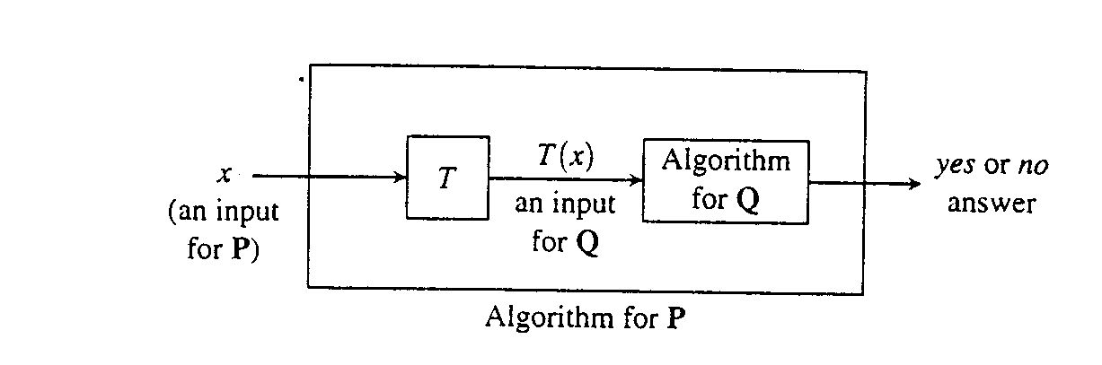
Polynomial Reductions-this
Problem P is reducible to Q
  P ≤p(dont pay attention to p) Q
  P is less complicated or as complicated to Q
  Transforming inputs of P
    to inputs of Q
Reducibility relation is transitive.

Slide 9
Circuit-satisfiability problem is NP-Complete
Circuit-satisfiability problem
  belongs to the class NP, and
  is NP-hard, i.e.
    every problem in NP is reducible to circuit-satisfiability problem!
Circuit-satisfiablity problem
  we say that a one-output Boolean combinational circuit is satisfiable
    if it has a satisfying assignment,
    a truth assignment (a set of Boolean input values) that
    causes the output of the circuit to be 1
Proof…

Slide 10
NP-Completeness Proofs
  Once we proved a NP-complete problem
To show that the problem Q is NP-complete,
  choose a know NP-complete problem P
  reduce P to Q
The logic is as follows:
  since P is NP-complete,
    all problems R in NP are reducible to P, R ≤p P.
  show P ≤p Q
  then all problem R in NP satisfy R ≤p Q,
    by transitivity of reductions
  therefore Q is NP-complete

Slide 11
Solving hard problems:
Approximation Algorithms
  an algorithm that returns near-optimal solutions
  may use heuristic methods
    e.g. greedy heuristics
Definition:Approximation algorithm
  An approximation algorithm for a problem is
  a polynomial-time algorithm that,
  when given input I, outputs an element of FS(I).
Definition: Feasible Solution set
  A feasible solution is
  an object of the right type but
  not necessarily an optimal one.
  FS(I) is the set of feasible solutions for I.

Slide 12
Approximation Algorithm e.g. Bin Packing
  How to pack or store objects of various sizes and shapes
  with a minimum of wasted space
Bin Packing
  Let S = (s₁, …, s_{n})
    where 0 < s_{i} <= 1 for 1 <= i <= n
  pack s₁, …, s_{n} into as few bin as possible
    where each bin has capacity one
Optimal solution for Bin Packing
  considering all ways to
  partition S into n or fewer subsets
  there are more than
  (n/2)^{n/2} possible partitions

Slide 13
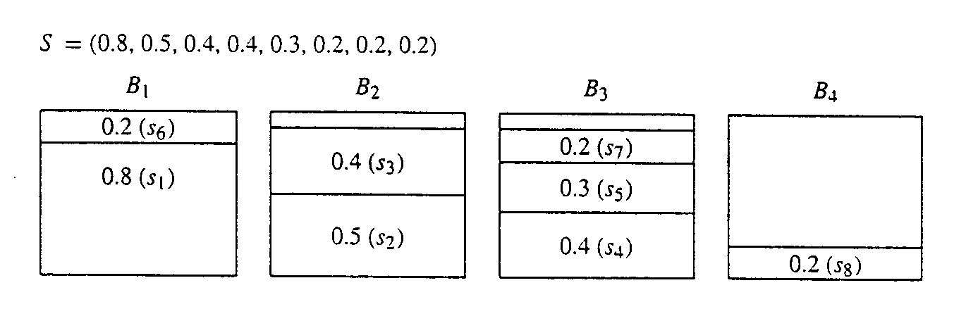
Bin Packing: First fit decreasing strategy
  places an object in the first bin in which it fits
  W(n) in θ(n²)
  Each bin has space of 1

Slide 14
Algorithm: Bin Packing (first fit decreasing)
  Input: A sequence S=(s_{1,….,}s_{n}) of type float, where 0<s_{i}<1 for 1<=i<=n. S represents the sizes of objects {1,...,n} to be placed in bins of capacity 1.0 each.
  Output: An array bin where for 1<=i<=n, bin[i] is the number of the bin into which object i is placed.For simplicity,objects are indexed after being sorted in the algorithm.The array is passed in and the algorithm fills it.
binpackFFd(S,n,bin)
float[] used=new float[n+1];
//used[j] is the amount of space in bin j already used up.
int i,j;
Initialize all used entries to 0.0
Sort S into descending(nonincreasing)order,giving the sequence s₁>=S₂>=…>=S_{n.}
for(i=1;i<=n;i++)
//Look for a bin in which s[i] fits.
for(j=1;j<=n;j++)
if(used[j]+s_{i}<+1.0)
bin[i]=j;
used[j] += s_{i};
break; //exit for(j)
//continue for(i).

Slide 15
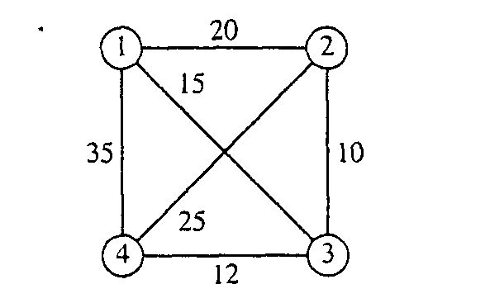
The Traveling Salesperson Problem
  given a complete, weighted graph
  find a tour (a cycle through all the vertices) of
  minimum weight
e.g.

Slide 16
Approximation algorithm for TSP
The Nearest-Neighbor Strategy
  as in Prim’s algorithm …
NearestTSP(V, E, W)
  Select an arbitrary vertex s to start the cycle C.
  v = s;
  While there are vertices not yet in C:
    Select an edge vw of minimum weight, where w is not in C.
    Add edge vw to C;
    v = w;
  Add the edge vs to C.
  return C;
W(n) in O(n²)
    where n is the number of vertices

