Slide 1
Breaking Intuition

Slide 2



The limits of human intuition
  “Causal Stories”

Slide 3

The limits of human intuition
  “Causal Stories”
  Human vs. Computing Minds
672 * 58 = 38,976

Slide 4

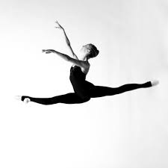
The limits of human intuition
  Practiced vs. Substitutive Intuition

Slide 5


The limits of human intuition
  Practiced vs. Substitutive Intuition
  Halo Effects

Slide 6
The limits of human intuition
  Hindsight Bias

Slide 7

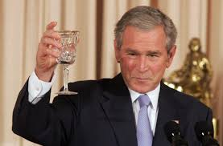
The limits of human intuition
  Hindsight Bias

Slide 8

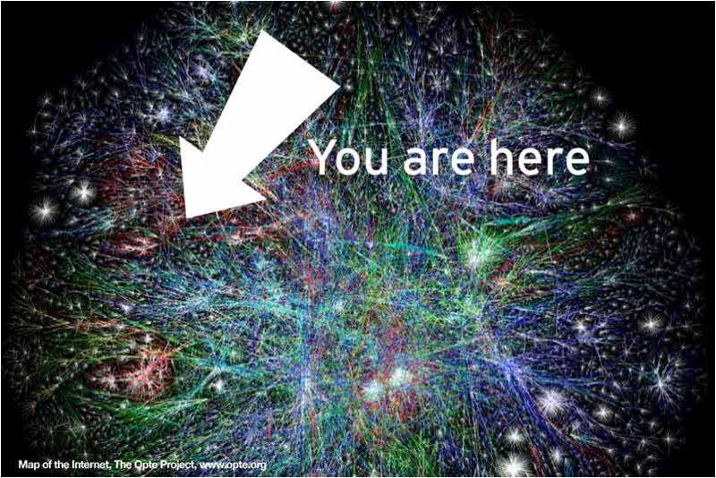
The limits of human intuition
  Hindsight Bias
  Reduction of system complexity (why you're sitting here)

Slide 9
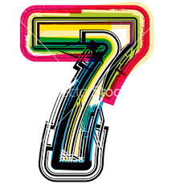
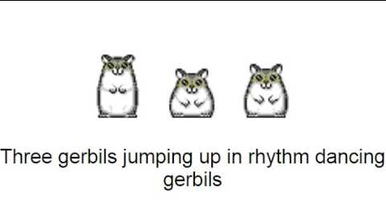
The limits of human intuition
  Hindsight Bias
  Reduction of system complexity (why you're sitting here)

Slide 10
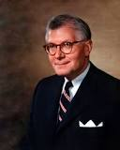
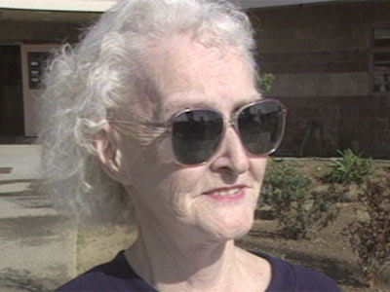
The limits of human intuition
  What you see is all there is.

Slide 11
The limits of human intuition
  What you see is all there is.
William Dietrich II
Slow Hiker
Dorothea Puente Wonderful Grandma

Slide 12

The limits of human intuition
  What you see is all there is.
  “We have unlimited capacity to ignore our own ignorance.”
William Dietrich II
Philanthropist
Dorothea Puente Serial Killer

Slide 13

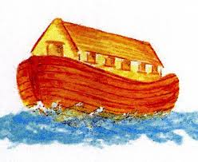
The limits of human intuition
  Associative Bias

Slide 14

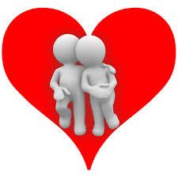
The limits of human intuition
  Associative Bias
  Mood Heuristics

Slide 15

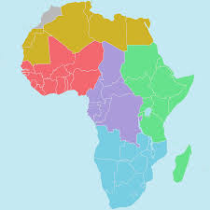
The limits of human intuition
  Associative Bias
  Mood Heuristics
  Anchoring

Slide 16
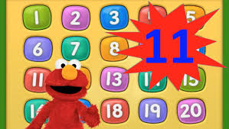
Elmo says there are at least...
...ways the mind is fundamentally flawed.

Slide 17
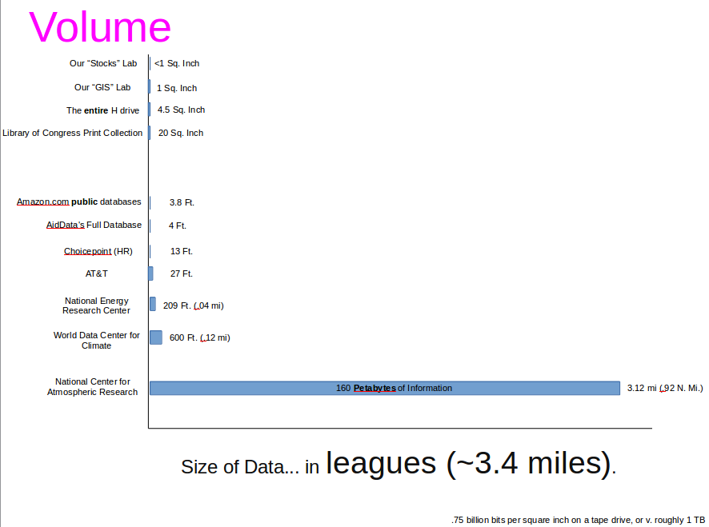
Why does this matter?

Slide 18
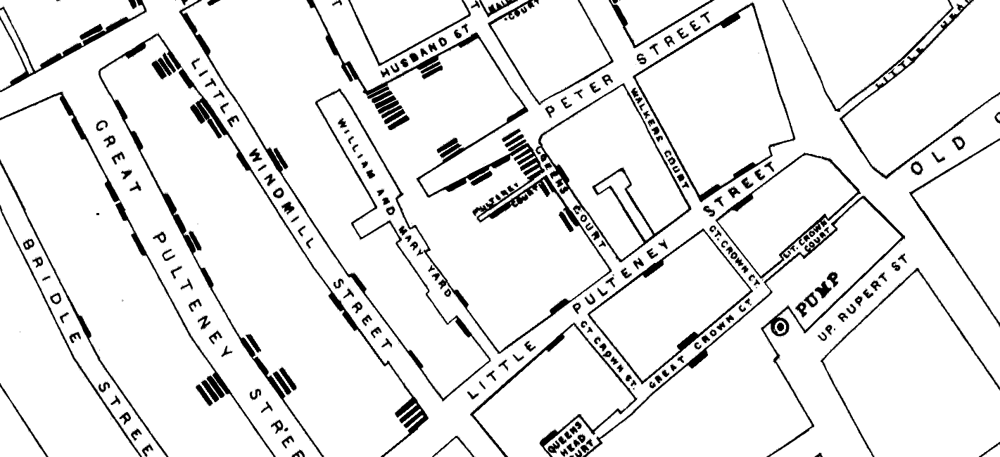
Why does this matter?

Slide 19

Why does this matter?

Slide 20
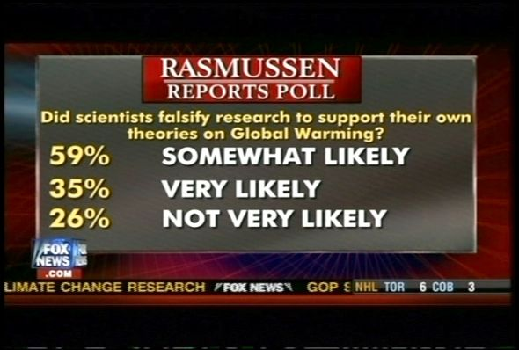

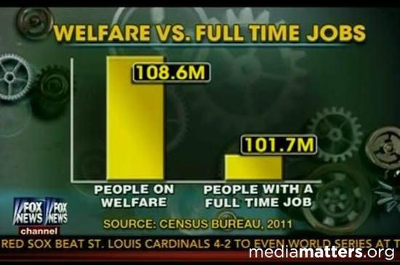
Weaponized Data*
The illusion of objectivity.
The delusion of validity.
The assumption of generalizability.
The danger of simplification.
*Dr. Jondou Chen coined this phrase, and should be praised for it for all time (at least in this footnote). Vu Le gets mad props for this slide as well.

Slide 21
Another Recap
Intro Lab – Basic downloading of data, entering it into R
Why W&M – Basic manipulation of data, visualization
QGIS / Building a Villa – Basic manipulation of [real!] satellite data, maps, spatial data (GIS)
Business Analytics – real-time stock-data downloading, basic analysis
Social Networks – basics of how to use data to visualize and analyze data from social networks
Climate Change & Urban Growth – how to retrieve and manipulate temporal data, create and use interactive websites using data.
Final – real-world social network (Twitter) data analysis

Slide 22
Putting it together
Human Intuition & It's Limits
  Critical thinking skills to understand what's possible / feasible with data across a wide variety of disciplines.
  Red flags for when you might be taken advantage of others – or when you can use data to take advantage!
Basic “Data Science” Skills
  Basic skills so you can either have a leg-up if you want to do CS yourself, or so you can communicate to more technically-inclined folk your working with!

Slide 23
Now, let's tie this up nicely
Life as a Story
The Future of Algorithms
Why these things are connected.

Slide 24
Think Back.. a long, long time ago...
To Monday.
  Did you have a good day, overall? Rank it from 0 to 6 (6 being the best day ever). Write this down.

Slide 25
Think Back.. a long, long time ago...
To Monday.
  Did you have a good day, overall? Rank it from 0 to 6 (6 being the best day ever). Write this down.
  What did you do? Think about it like scenes in a movie. Write down at least 4, and indicate roughly how long they were.

Slide 26
Think Back.. a long, long time ago...
To Monday.
  Did you have a good day, overall? Rank it from 0 to 6 (6 being the best day ever). Write this down.
  What did you do? Think about it like scenes in a movie. Write down at least 4, and indicate roughly how long they were.
  Rank them from 0 to 6 in terms of two feelings: engagement (6 being very engaged) and anger (6 being really angry).

Slide 27
Life as a Story
Just like a computer hard drive, our mind has all sorts of technical issues with how it records events.
  Duration Neglect
  Peak-end effects
This is in addition to the many limitations we've discussed throughout this course.
  Poor system 2 barely has a chance.

Slide 28
Intuition is Broken: Computers and Data to the Rescue?
Hopefully by now you well and truly believe our minds are flawed in many important ways.

Slide 29
Intuition is Broken: Computers and Data to the Rescue?
Hopefully by now you well and truly believe our minds are flawed in many important ways.
Everything we believe we know is effectively poorly-remembered stories – frequently reduced in complexity – that allow us to feel comfortable in the world.

Slide 30
Intuition is Broken: Computers and Data to the Rescue?
Hopefully by now you well and truly believe our minds are flawed in many important ways.
Everything we believe we know is effectively poorly-remembered stories – frequently reduced in complexity – that allow us to feel comfortable in the world.
Computers don't have any of these limitations – but they certainly have their own!

Slide 31

Breaking Computers
Amazon.com price wars
Lack of Creativity

Slide 32
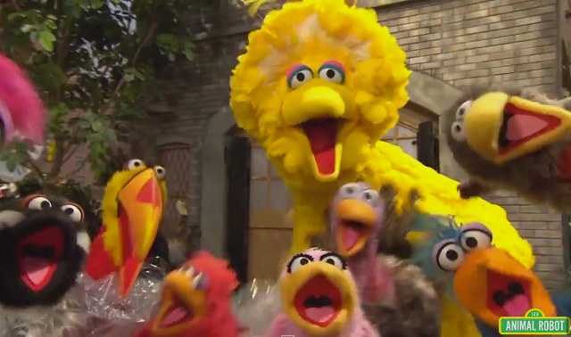
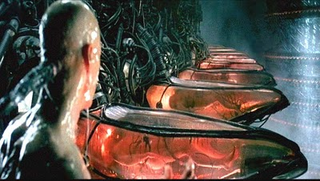
Breaking Computers
Difficulty of interpretation (where is a bird vs. what is the animal in this picture?)
  Our brain uses associative intuition here – it has feathers and a beak, we've seen something that looks like that before, thus it must be a bird.

Slide 33
Breaking Computers
Difficulty of interpretation (where is a bird vs. what is the animal in this picture?)
  Our brain uses associative intuition here – it has birds and a beak, we've seen something that looks like that before, thus it must be a bird.
Expensive (brains are relatively cheap by processing power)

Slide 34
Breaking Computers
Data-dependent (unwilling/able to go outside the bounds of available information).
Programmed by flawed humans.

Slide 35
Alright, great.. so we're all broken
The future of algorithms
  Computers fail in many of the places humans succeed
  Humans fail in many of the places computers succeed.
Think to your Twitter lab
  Could the computer have decided that you need to search for “Donald Trump” to contrast to Hillary Clinton? Maybe, but it would be very hard.
  Could you have read every tweet you downloaded and built word clouds and social networks of those tweets? Figured out the general sentiment? Maybe, but it would be very hard.

Slide 36

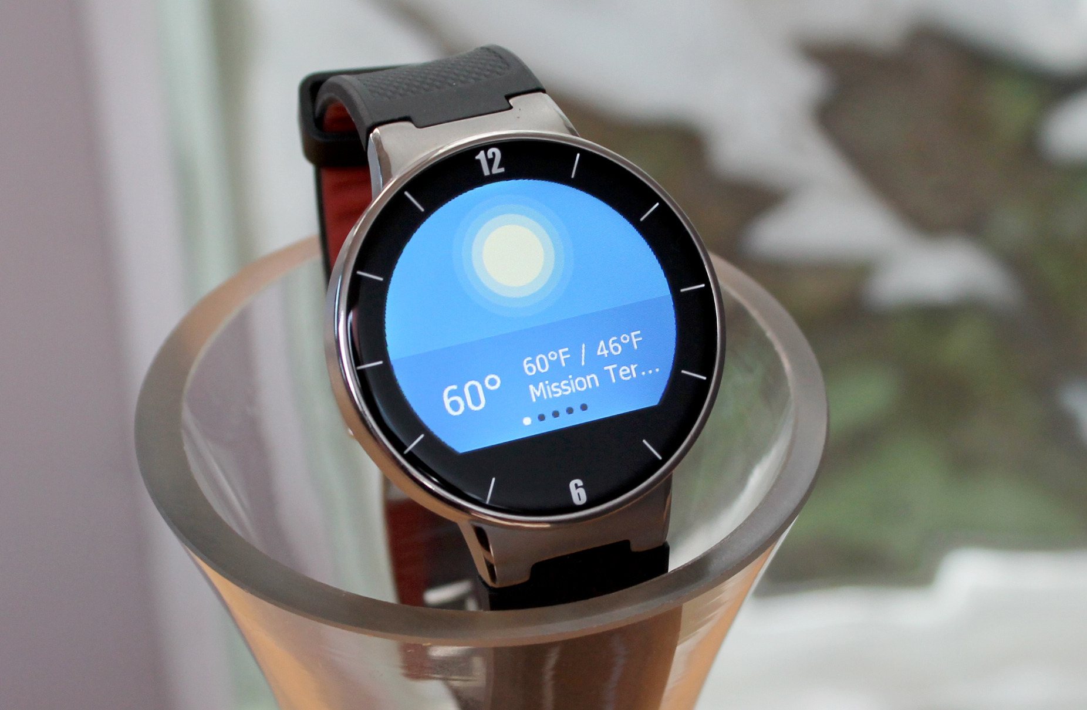

Slide 37
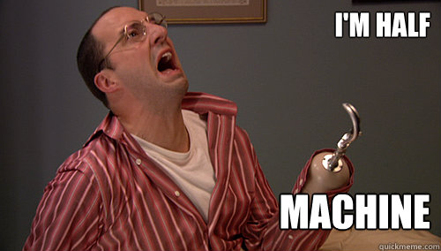

Slide 38
What humans are just about to do
Patterns of speech and power
  Analyze millions of email chains to figure out who's in charge, social networks, “followers” vs. “followed”. Target marketing at the leaders. Based on words used and the general tendency for word usage to (over time) replicate your bosses.

Slide 39
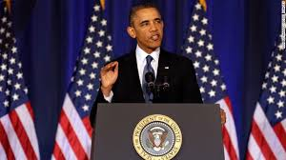
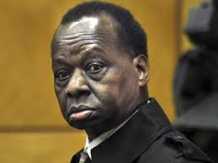
What humans are just about to do
Patterns of speech and power
  Analyze millions of email chains to figure out who's in charge, social networks, “followers” vs. “followed”. Target marketing at the leaders. Based on words used and the general tendency for word usage to (over time) replicate your bosses.
  Intuitive answers to who runs the show (Obama) vs. who has more measurable influence (Obama's Uncle).

Slide 40
What humans are just about to do
Patterns of speech and power
  Analyze millions of email chains to figure out who's in charge, social networks, “followers” vs. “followed”. Target marketing at the leaders. Based on words used and the general tendency for word usage to (over time) replicate your bosses.
  Intuitive answers to who runs the show (Obama) vs. who has more measurable influence (Obama's Uncle).
  Computer would never dream to ask these questions; they would be impossible for a human to answer due to the volume of data required for analysis.

Slide 41
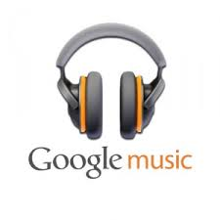


What humans are just about to do
Art in the Machine
  Think about spotify, google music, songza. How are songs selected? How does that drive the future of human art forms?
  Computers can't make (very good) music. But they can control what it's future looks like.

Slide 42

What humans are just about to do
Dozens of Industries are on the Brink of a Revolution by overcoming limitations of minds and machines...
  Automated Cars
  Medical Diagnostics
  Law – automated penalties for common offenses; Legal discovery
    The chance you'll go to prison, determined by algorithms (Real company – Blackstone Discovery)
  Writing
    Narrative Science – automatically take statistics and write story's out of them. Big Ten used automated software like this.
    “Wisconsin appears to be in the driver's seat en route to a win, as it leads 51-10 after the third quarter.”

Slide 43
    “Technological Unemployment”
Warning from the 1920s – John Maynard Keynes.
“Math-science death march” - Dr. David Goldberg
  We're very good at keeping students engaged in science and math in High School, and then send them through three semesters of “weed out” math, science, chemistry, CS.
  Then, we wonder why we aren't graduating enough engineers.

Slide 44
“There's going to be a lot of work in the future for those who can write code.
If you can also conceive intricate algorithms, all the better – you may just be able to take over the world.
That is, if a bot doesn't do it first.”
-Christopher Steiner, Automate This

Slide 45
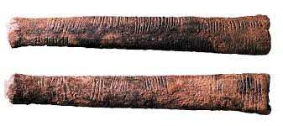
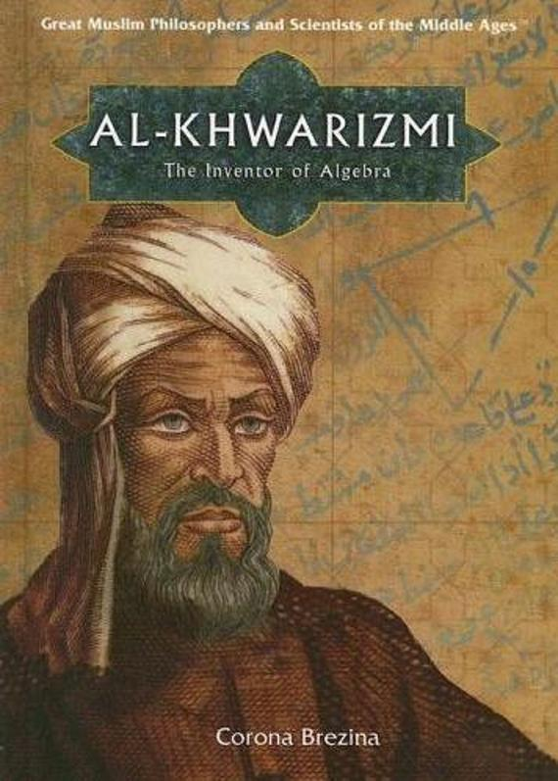
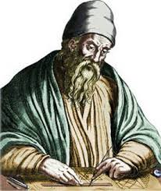

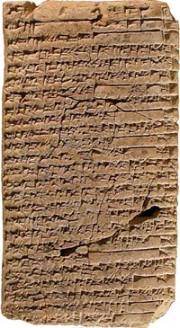
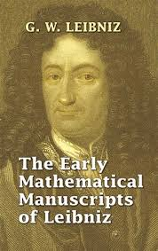
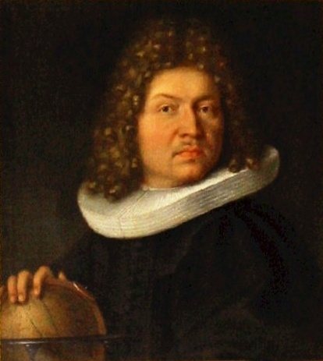
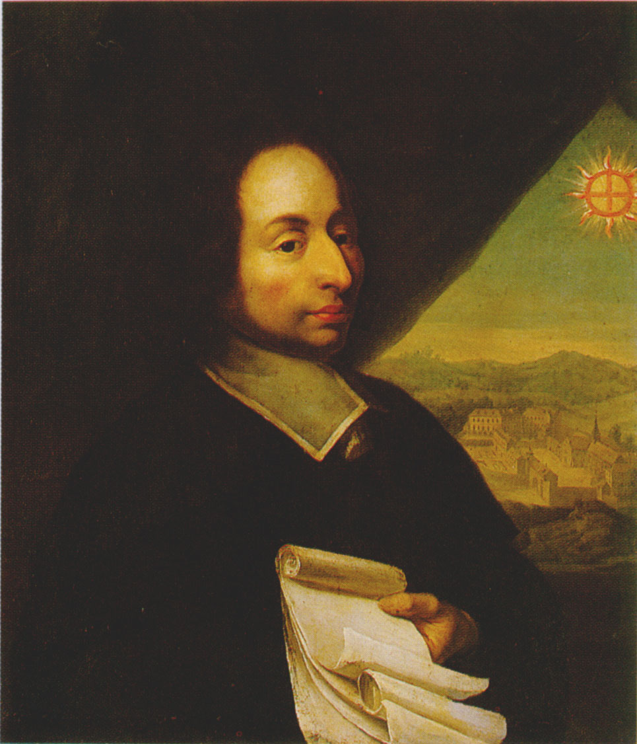
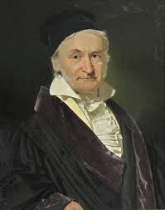
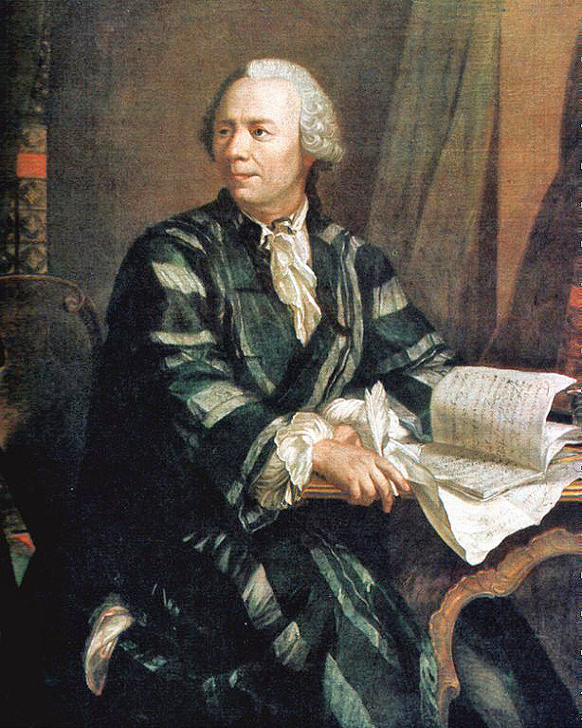
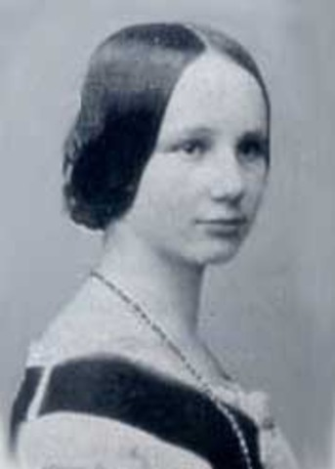
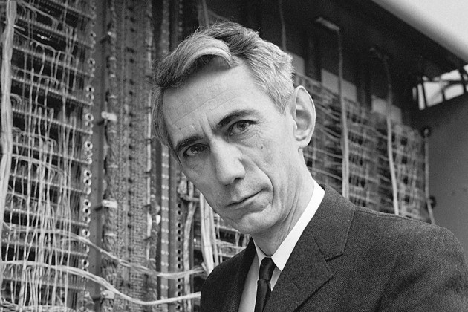
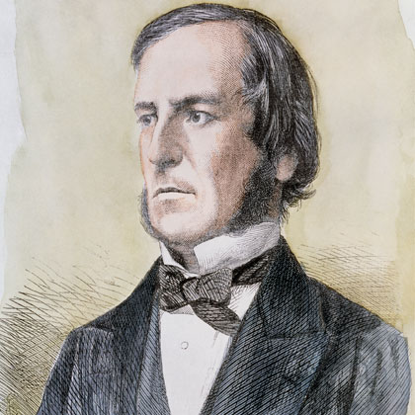
This Class and Ya'll

