Slide 1
The Power of Data Visualization
Perception and Knowledge

Slide 2
Why bother with Data Visualization?
Let it be known: Ya'll hate being forced to be creative.
  “More instructions on what to include vs. say "be creative"
  “Ambiguity; not a lot of instruction is given”
  “Visual appeal requirements for labs..”
  “The Q mapmaker was pretty terrible to make a good looking map...”

Slide 3
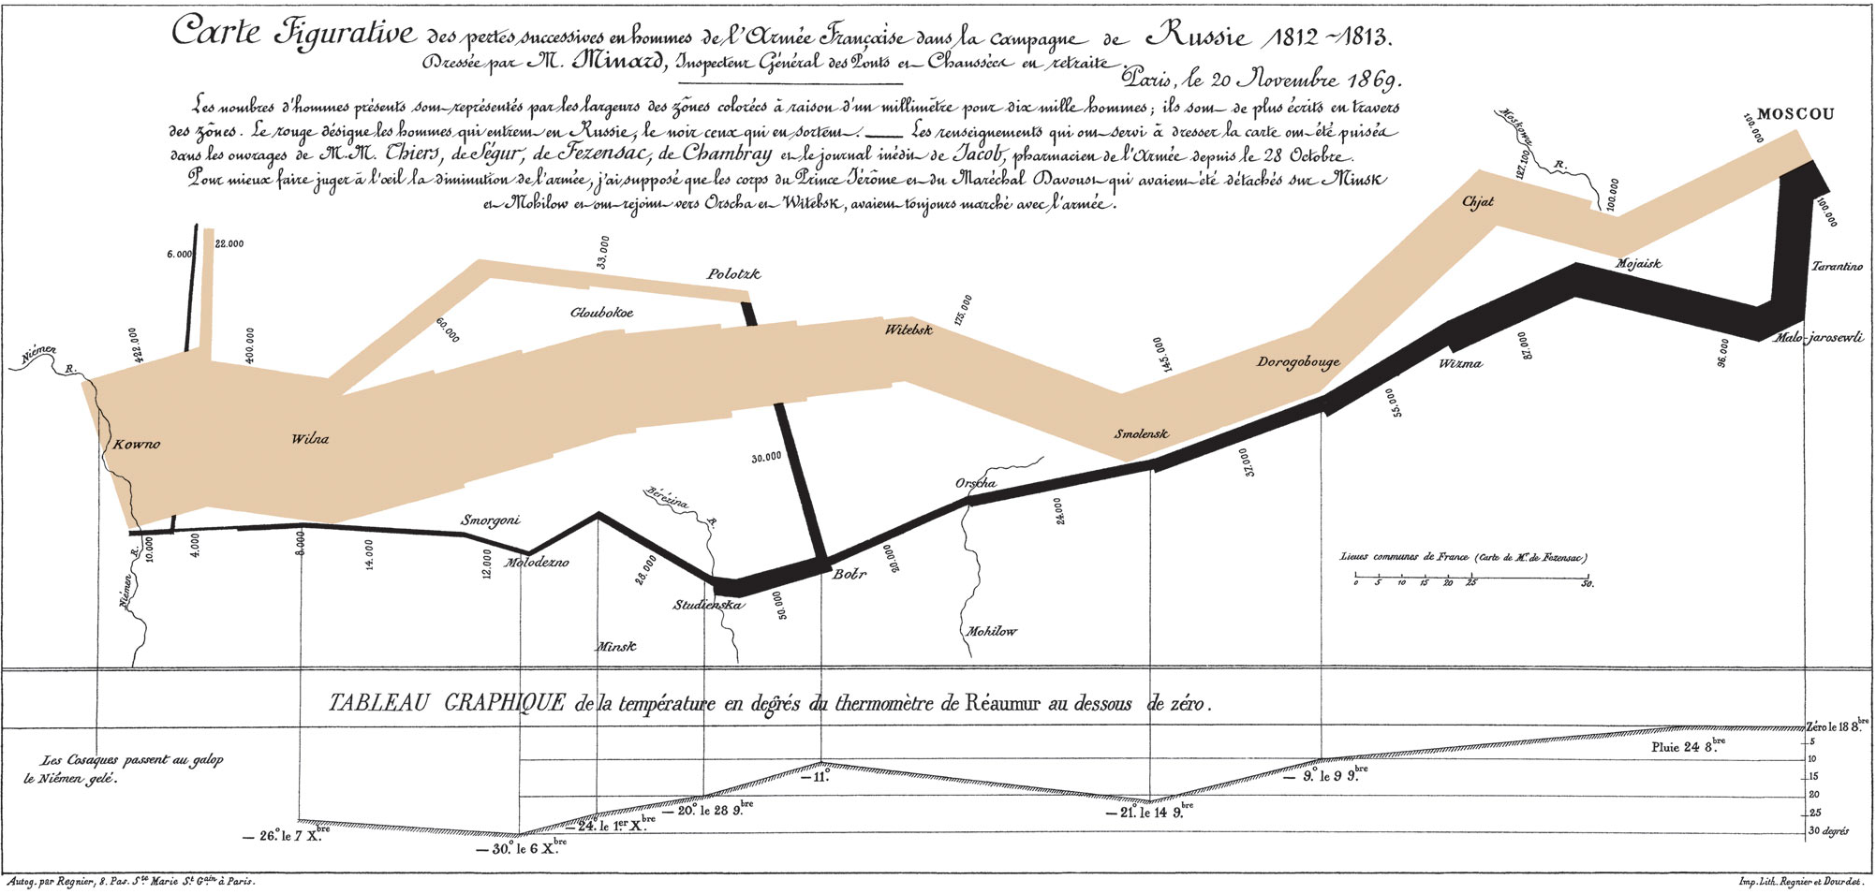
1812: Napoleon

Slide 4
1812: Napoleon
Charles Minard illustrated that data visualization can be used to overcome limits of human perception.

Slide 5
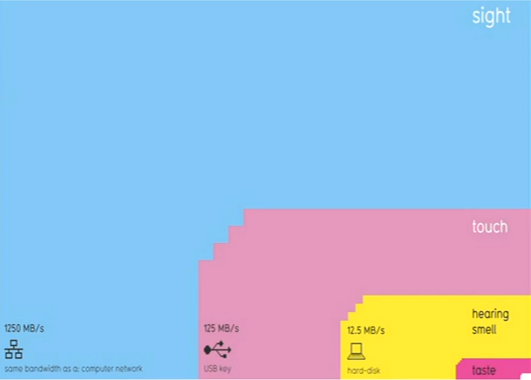
“Like coming across a clearing in the jungle”

Slide 6
Two Languages (sound familiar?)
Language of the Eye
Language of the Mind
What data viz can combine these two?

Slide 7
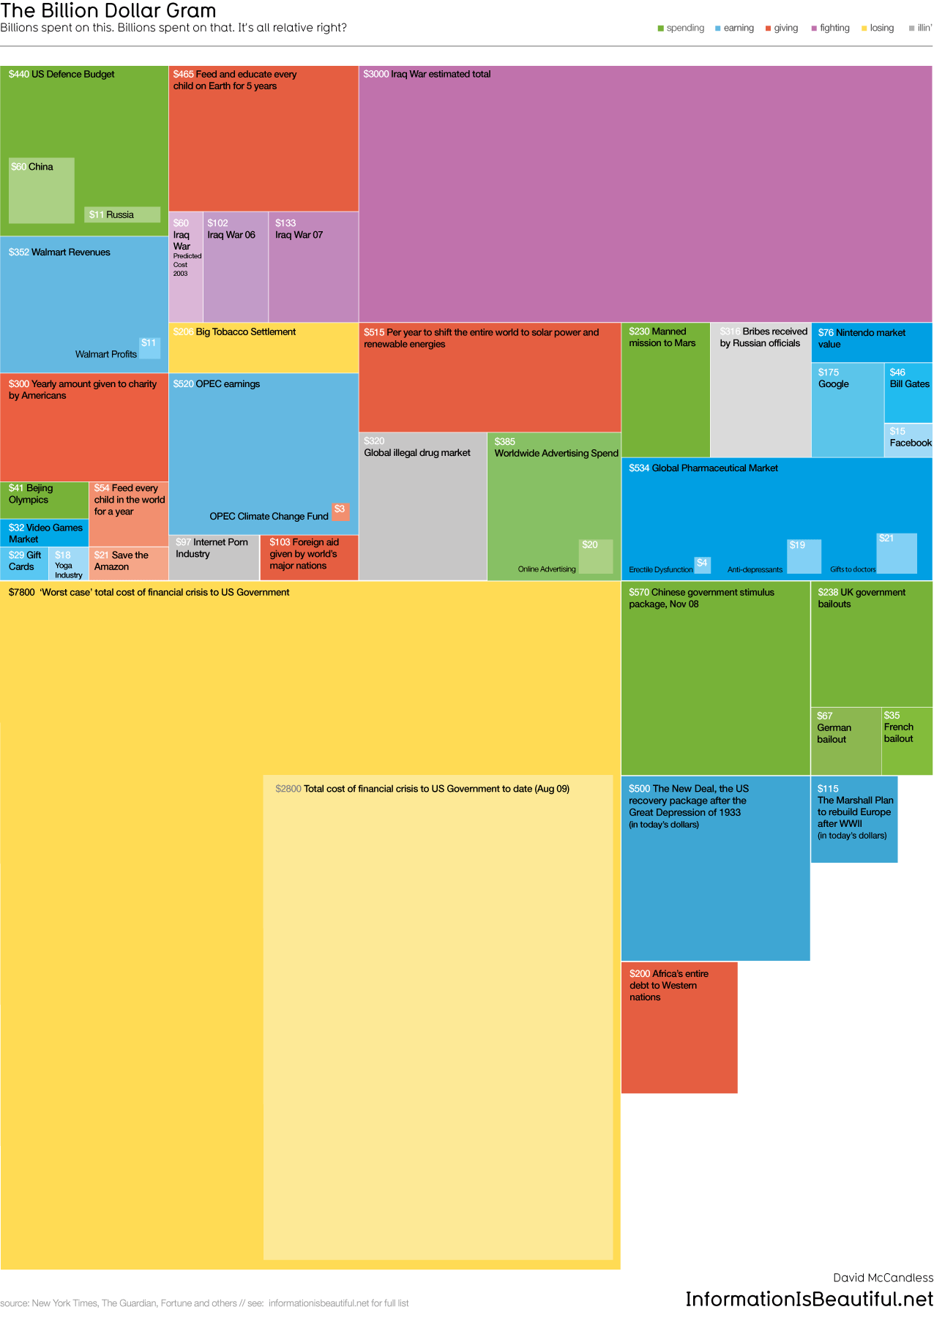
http://www.informationisbeautiful.net/visualizations/the-billion-dollar-gram/

Slide 8
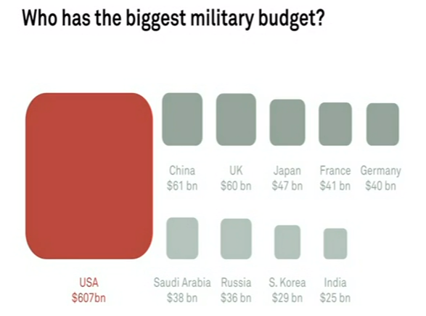

Slide 9
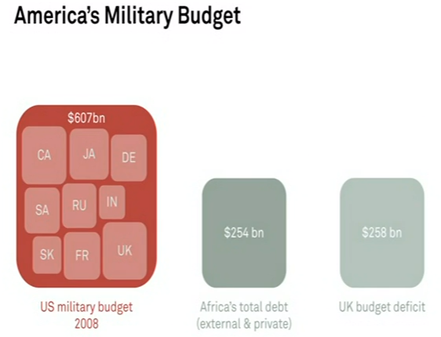

Slide 10
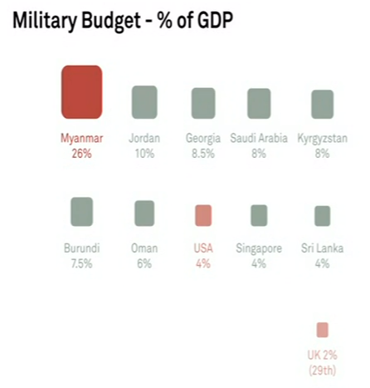

Slide 11
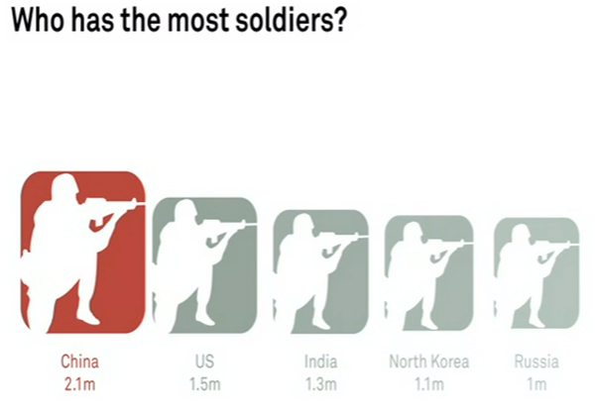

Slide 12
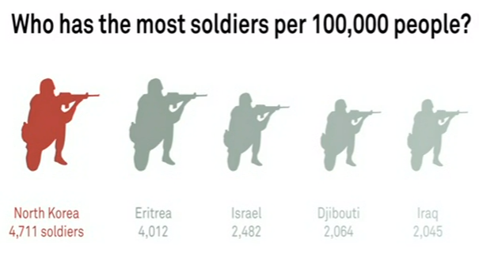

Slide 13
Data Viz Alone can Change the World

Slide 14


Slide 15
Just by knowing where sickness occurred, deaths were prevented.

Slide 16
Hans Rosling
“Let the dataset change your mindset”
www.bit.ly/1Q3J0l1
www.bit.ly/1fsOp6b

Slide 17
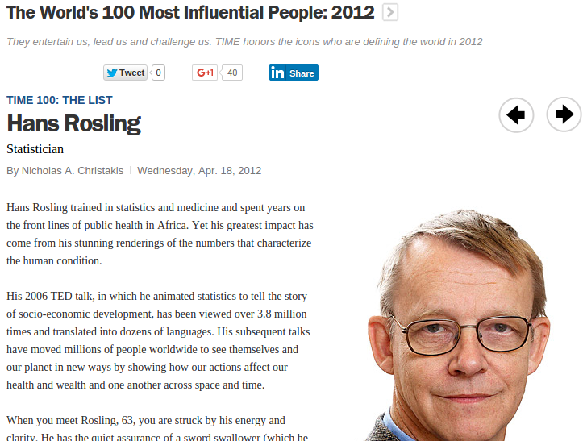
Hans' graphics are regularly seen at UN conferences, and his work is frequently attributed to changing global policies.

Slide 18
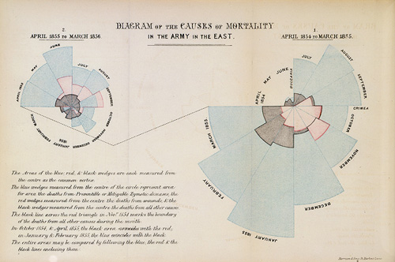
Florence Nightingale

Slide 19
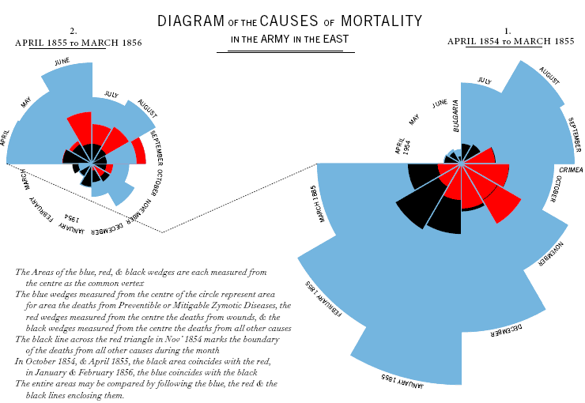
Florence Nightingale, 1855

Slide 20
Florence Nightingale
Florence Nightingale is credited with convincing a nation to invest in hospitals and medical care, rather than guns, to win a war.

Slide 21
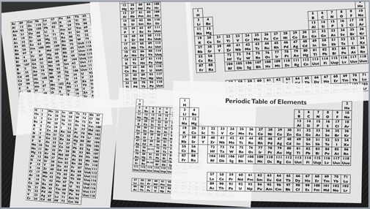
1869, Dmitri Mendeleev

Slide 22
Dmitri Mendeleev predicted “blanks” in his early table would be filled in later – a trend that continues today.

Slide 23
LaToya Egwuekwe - Unemployment
https://www.youtube.com/watch?v=hwWGzQ_FUtQ

Slide 24
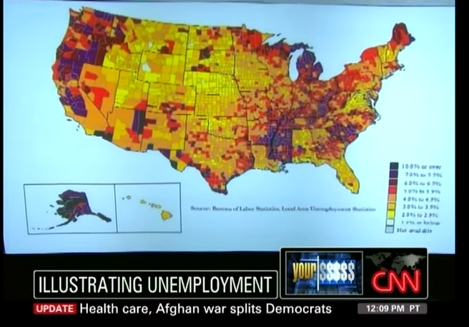
LaToya Egwuekwe - Unemployment
https://www.youtube.com/watch?v=hwWGzQ_FUtQ

Slide 25
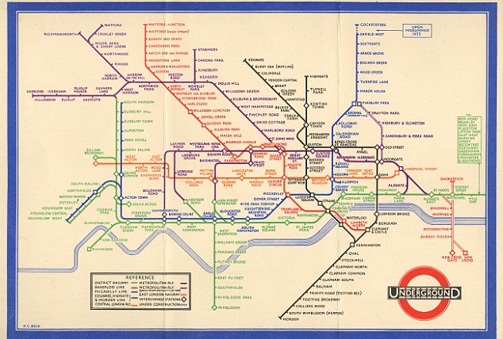
Harry Beck – Electrical Engineer

Slide 26
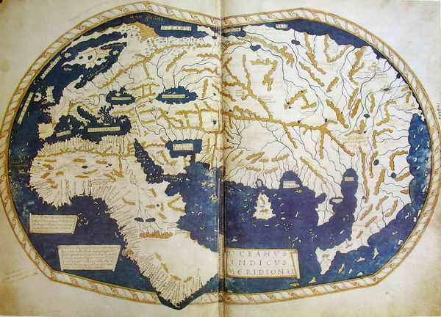
Henricus Martellus (1490)

Slide 27
Henricus Martellus (1490)
Though some controversy exists, this map was used by Columbus (you know, fall break Columbus) to convince Ferdinand of Aragon that Europe wasn't really that far from China.

Slide 28
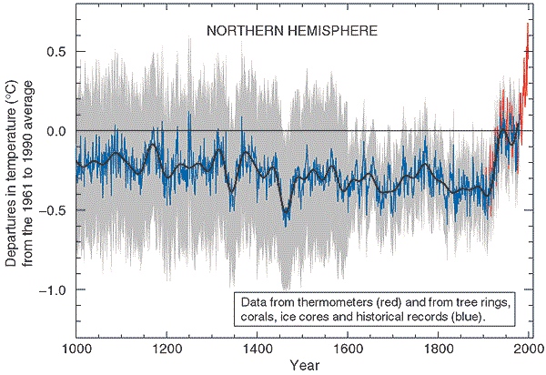
Michael Mann – Climate Change

Slide 29
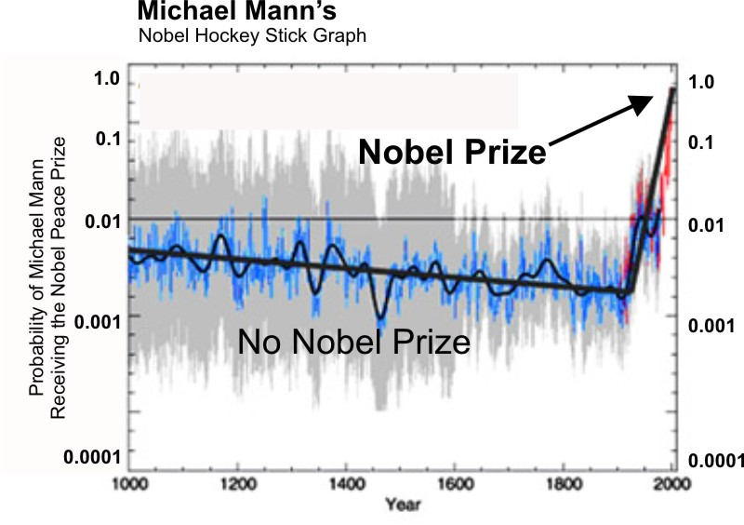
Michael Mann – Climate Change

Slide 30
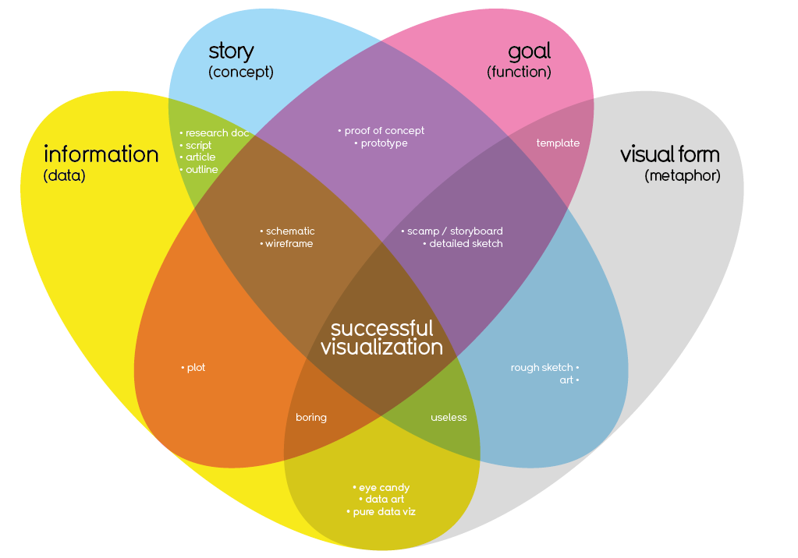

Slide 31
Solving “Data Problems”
Data Overload / Saturation
Trust and Reliability
Lack of Transparency
“Interestingness”

Slide 32
What are the Ramifications of Data?
What if you can't access data?
What if you can't interpret it?
What if you can't visualize it to make an argument?

Slide 33
Quick ways YOU can visualize data
(i.e., really cool things too easy for a lab).

Slide 34
GDELT (http://analysis.gdeltproject.org/)
News Articles from Dem Debate:
http://data.gdeltproject.org/analytics_user/20151015150501.2938.heatmap.html

Slide 35
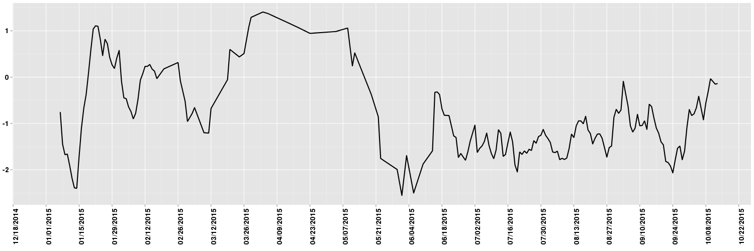
Donald Trump Sentiment

Slide 36
NOAA
NTL:
http://www.nnvl.noaa.gov/view/#BLUE?timespan=yearly&date=2001-12-31&lat=36.988353179083&lon=-71.971991991222&zoom=6

Slide 37
United Nations
http://unctadstat.unctad.org/wds/ReportFolders/reportFolders.aspx?sCS_ChosenLang=en

Slide 39
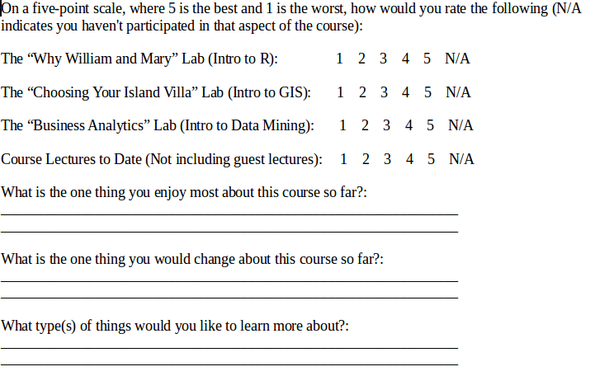
The Survey

Slide 40
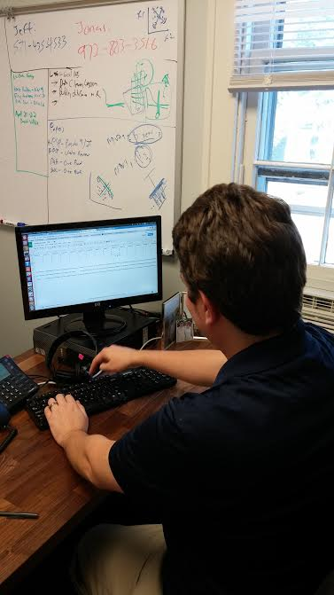
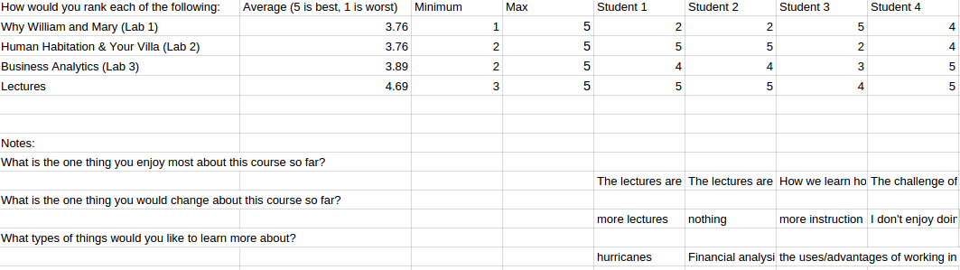
Cleaning the Data...
(a picture of a scientist in his natural habitat)

Slide 41
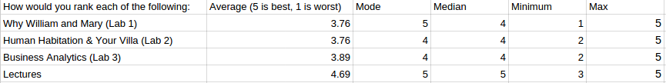
Describe the Data
Basic Statistics: Averages, Medians, Modes

Slide 42
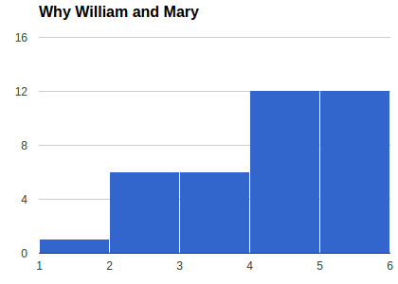
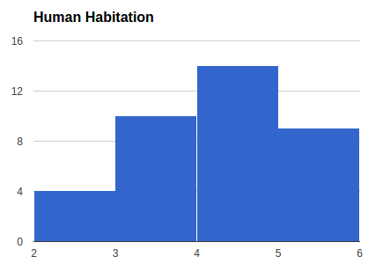
Describe the Data
Basic Statistics: Averages, Means, Modes
Let's check out the distributions...

Slide 43
“The Process” - According to McCandless
Have a question! Don't let the data run your day.
Collect and Clean the data
Describe the Data
Analyze the Data (...if relevant!)
Visualize the Data – iterate, iterate, iterate.

Slide 44
Viz Example: Course Reviews
Information
  Data collected from COLL 100 students on how much they enjoy this course.
Story
  What are the key things we can learn from the student surveys?
Goal
  Learn to improve lectures and labs to get better student scores on the final surveys.
Visual Form
  This is what you all hate doing. “Creativity” and such nonsense.

Slide 45
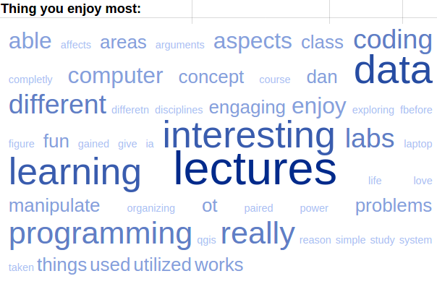
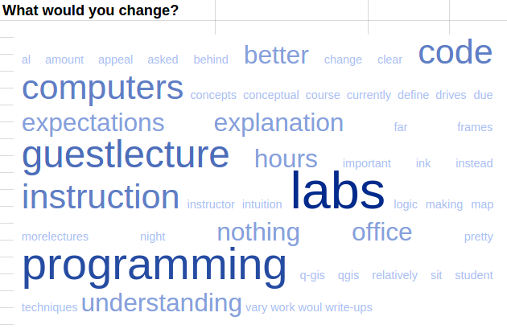
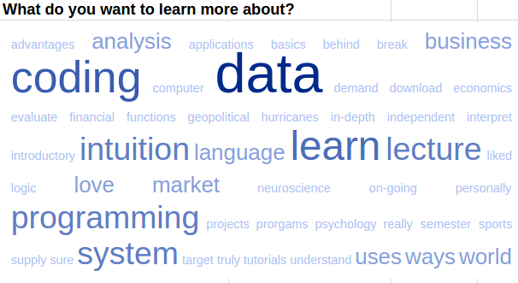
Iterate, Iterate, Iterate

Slide 46
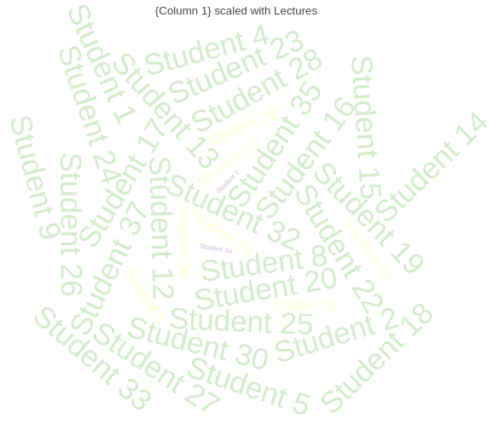
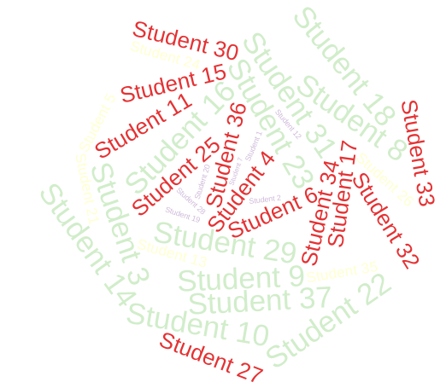
Why W&M?

Slide 47


