Slide 1
The Application of Knowledge

Slide 2
With Big Data Comes Big Responsibility...
(With bad references comes lecture material)

Slide 3


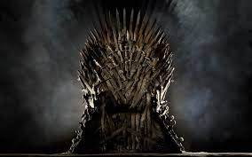
With Big Data Comes Big Responsibility...
(With bad references comes awesome lecture material)

Slide 4
Control over data grants...
The ability to analyze the data to tell your story.

Slide 5
Control over data grants...
The choice to reveal or retain observed results.

Slide 6
Control over data grants...
The choice of method.

Slide 7
Control over data grants...
“First Mover” capabilities
  You're right until someone proves you wrong!

Slide 8
Control over data grants...
How and what you measure

Slide 9
Control over data grants...
How you standardize (and who you lock out)

Slide 10
Control over data grants...
The ability to analyze the data to tell your story.
The choice to reveal or retain observed results.
The choice of method.
“First Mover” capabilities
  You're right until someone proves you wrong!
How and what you measure
How you standardize (and who you lock out)
Ultimately, power.

Slide 11
Seriously Big Responsibility
Who has access to data?

Slide 12
Seriously Big Responsibility
Who has access to hardware to process data?

Slide 13
Seriously Big Responsibility
Who has access to hardware to process data?
Software?

Slide 14
Seriously Big Responsibility
Who has access to hardware to process data?
Software?
Skills?

Slide 15
Seriously Big Responsibility
Who can challenge results?

Slide 16
Seriously Big Responsibility
Who is impacted by the data?

Slide 17
Seriously Big Responsibility
Who has access to data?
Who has access to hardware to process data?
Software?
Skills?
Who can challenge results?
Who is impacted by the data?

Slide 18
Weaponized Data*
The illusion of objectivity.
The delusion of validity.
The assumption of generalizability.
The danger of simplification.
*Dr. Jondou Chen coined this phrase, and should be praised for it for all time (at least in this footnote). Vu Le gets mad props for this slide as well.

Slide 19
Weaponized Data*
The illusion of objectivity.
*Dr. Jondou Chen coined this phrase, and should be praised for it for all time (at least in this footnote). Vu Le gets mad props for this slide as well.

Slide 20
Weaponized Data*
The delusion of validity.
*Dr. Jondou Chen coined this phrase, and should be praised for it for all time (at least in this footnote). Vu Le gets mad props for this slide as well.

Slide 21
Weaponized Data*
The assumption of generalizability.
*Dr. Jondou Chen coined this phrase, and should be praised for it for all time (at least in this footnote). Vu Le gets mad props for this slide as well.

Slide 22
Weaponized Data*
The danger of simplification.
*Dr. Jondou Chen coined this phrase, and should be praised for it for all time (at least in this footnote). Vu Le gets mad props for this slide as well.

Slide 23
Simpson's Paradox Here

Slide 24
Take Aim...
The Dragon's Hoard of Data
Gatekeeping.
“Blame the Data”
Convenient Gapfinding
Vu Le gets mad props for this slide.

Slide 25
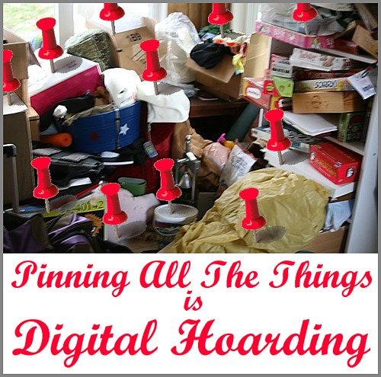
FIRE!
Actually on Wikipedia
(“Digital Hoarding”)
The Dragon's Hoard of Data
Vu Le gets mad props for this slide.

Slide 26

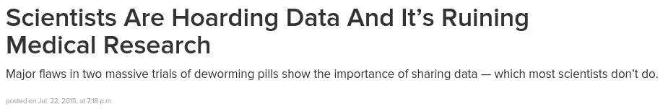
FIRE!
The Dragon's Hoard of Data
Vu Le gets mad props for this slide.

Slide 27
FIRE!
Director of the National Institute for Mental Health (part of NIH):
  “There are so many reasons not to share scientific data – in industry, among academics, and even for some patients. For pharmaceutical companies, data are usually considered proprietary, with sharing limited by intellectual property rules.”
  “And patients may not want their private medical information shared. Particularly when that information includes a diagnosis of a mental illness or personal history, protecting privacy becomes even more important.”
http://www.nimh.nih.gov/about/director/2012/time-matters-why-we-care-so-much-about-data-sharing.shtml

Slide 28
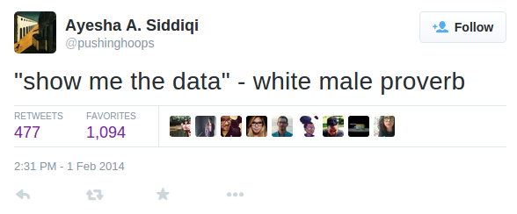
FIRE!
Gatekeeping.
Vu Le gets mad props for this slide.

Slide 29
FIRE!
“Blame the Data”
Vu Le gets mad props for this slide.

Slide 30
FIRE!
Convenient Gapfinding
Vu Le gets mad props for this slide.

Slide 31
Medical Evac!
“Stop making decisions about us without us”
Community Engagement around Data
What is “good data”?
  Is it about measurement?
  Design?
  Standards?
  Quality Assurance?
  Interpretability by different audiences?
  Statistical Soundness...

