Slide 1
Why We're Generally Wrong

Slide 2
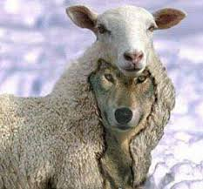
“A grad school class in sheep's clothing”

Slide 3
Rabbit Holes we're going down today:
A brief return to / more explicit specification of our intuitive minds – unpacking System 1 a bit farther.
Simpson's Paradox and the need for “Fancy Math”
How to correct our general wrongness
A venture into why we're still wrong

Slide 4
“Different Types of Intuition”
Practiced Intuition

Slide 5

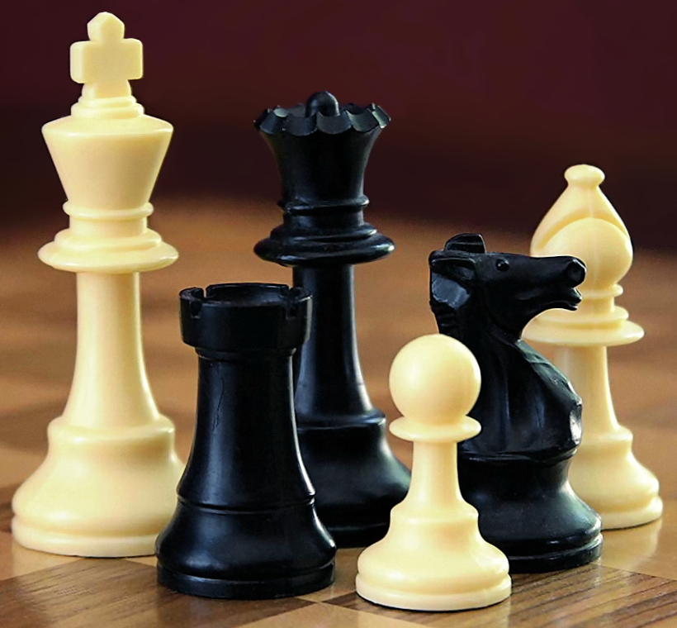
“Different Types of Intuition”
Practiced Intuition
  Repeated Experience
    Sports, Chess

Slide 6

“Different Types of Intuition”
Practiced Intuition
  Repeated Experience
    Sports, Chess
    Looking for the misspelled variable in R when the error “Arbitrary fault on line 2390495 due to inexplicable issue with noncompiler function in goobly-ridiculous method 5.”
    appears.

Slide 7
“Different Types of Intuition”
Practiced Intuition
  Repeated Experience
    Sports, Chess
    Looking for the misspelled variable in R when the error “Arbitrary fault on line 2390495 due to inexplicable issue with noncompiler function in goobly-ridiculous method 5.”
    appears.
    Generally doesn't conflict with system 2 - “practice makes perfect”.
      Examples?

Slide 8
“Different Types of Intuition”
Substitutive Intuition

Slide 9
Substitutive Intuition
Your hair-brained professor assigns you a lab that asks you to plot out climate records for countries around the world. You observed a trend in climate over time. What do you think the temperature in your country will be in that country in 10 years, higher or lower? Why might this be the case?

Slide 10
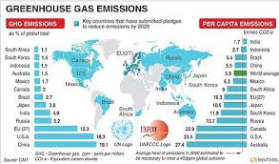
Substitutive Intuition
Consider what you really need to know to answer that question (we've done this once before!):
A causal mechanism (i.e., greenhouse gas emissions) that fluctuates over time, for which you understand the mechanics and have measurements.

Slide 11
Substitutive Intuition
Consider what you really need to know to answer that question (we've done this once before!):
A causal mechanism (i.e., greenhouse gas emissions) that fluctuates over time, for which you understand the mechanics and have measurements.
The likelihood of cataclysmic events changing these trajectories, including wars, politics, asteroids, and anything else.

Slide 12
Substitutive Intuition
Consider what you really need to know to answer that question (we've done this once before!):
A causal mechanism (i.e., greenhouse gas emissions) that fluctuates over time, for which you understand the mechanics and have measurements.
The likelihood of cataclysmic events changing these trajectories, including wars, politics, asteroids, and anything else.
The likelihood that Julie's parents were divorced after she had a high GPA in elementary school, leading to her having a low GPA in high school, thus she didn't get into college and invent the crucial magic climate antidote that saved humanity while letting us continue to pump as much oil into the atmosphere as we want to. Really, Julie was on to something big there, but it just didn't work out for humanity.

Slide 13
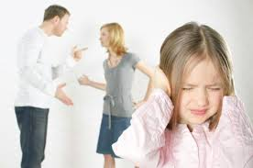
Substitutive Intuition
Consider what you really need to know to answer that question (we've done this once before!):
A causal mechanism (i.e., greenhouse gas emissions) that fluctuates over time, for which you understand the mechanics and have measurements.
The likelihood of cataclysmic events changing these trajectories, including wars, politics, asteroids, and anything else.
The likelihood that Julie's parents were divorced after she had a high GPA in elementary school, leading to her having a low GPA in high school, thus she didn't get into college and invent the crucial magic climate antidote that saved humanity while letting us continue to pump as much oil into the atmosphere as we want to. Really, Julie was on to something big there, but it just didn't work out for humanity.

Slide 14

Substitutive Intuition
Consider what you really need to know to answer that question (we've done this once before!):
A causal mechanism (i.e., greenhouse gas emissions) that fluctuates over time, for which you understand the mechanics and have measurements.
The likelihood of cataclysmic events changing these trajectories, including wars, politics, asteroids, and anything else.
The likelihood that Julie's parents were divorced after she had a high GPA in elementary school, leading to her having a low GPA in high school, thus she didn't get into college and invent the crucial magic climate antidote that saved humanity while letting us continue to pump as much oil into the atmosphere as we want to. Really, Julie was on to something big there, but it just didn't work out for humanity.

Slide 15
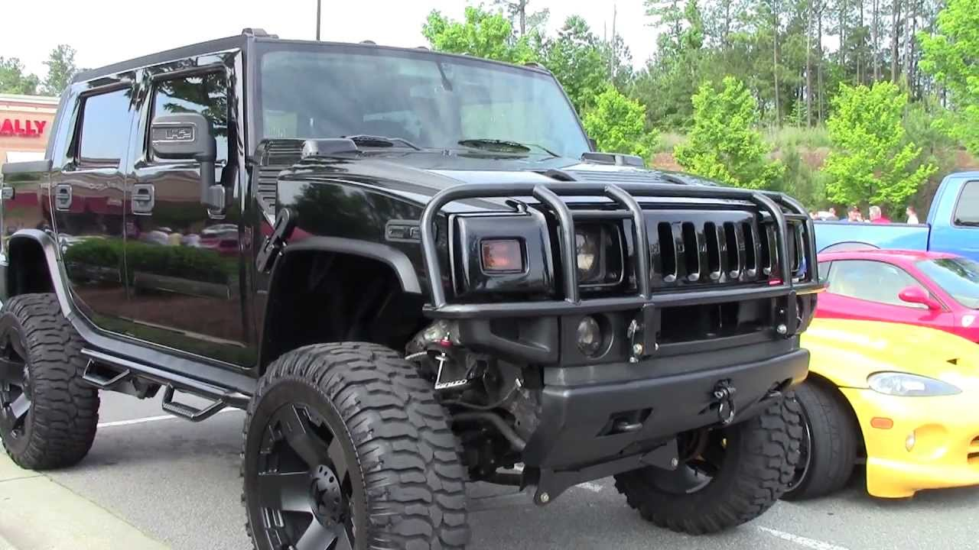
Substitutive Intuition
Consider what you really need to know to answer that question (we've done this once before!):
A causal mechanism (i.e., greenhouse gas emissions) that fluctuates over time, for which you understand the mechanics and have measurements.
The likelihood of cataclysmic events changing these trajectories, including wars, politics, asteroids, and anything else.
The likelihood that Julie's parents were divorced after she had a high GPA in elementary school, leading to her having a low GPA in high school, thus she didn't get into college and invent the crucial climate antidote that saved humanity while letting us continue to pump as much oil into the atmosphere as we want to. Really, Julie was on to something big there, but it just didn't work out for humanity.

Slide 16
Substitutive Intuition
Consider what you really need to know to answer that question (we've done this once before!):
A causal mechanism (i.e., greenhouse gas emissions) that fluctuates over time, for which you understand the mechanics and have measurements.
The likelihood of cataclysmic events changing these trajectories, including wars, politics, asteroids, and anything else.
The likelihood that Julie's parents were divorced after she had a high GPA in elementary school, leading to her having a low GPA in high school, thus she didn't get into college and invent the crucial climate antidote that saved humanity while letting us continue to pump as much oil into the atmosphere as we want to. Really, Julie was on to something big there, but it just didn't work out for humanity.

Slide 17
Substitutive Intuition
So, what is substitutive intuition?

Slide 18
Substitutive Intuition
So, what is substitutive intuition?
  Substituting a simpler problem that our system 1 can engage with for a much, much more complicated one.
  It has multiple identified steps:
    Is there a reasonable, but very simple, causal story?
      Temperatures are going up, scientists are mad about climate change, they'll probably keep going up.

Slide 19
Substitutive Intuition
So, what is substitutive intuition?
  Substituting a simpler problem that our system 1 can engage with for a much, much more complicated one.
  It has multiple identified steps:
    Is there a reasonable, but very simple, causal story?
      Temperatures are going up, scientists are mad about climate change, they'll probably keep going up.
    Does the data reflect our norms?
      Did I observe temperatures going up? Are those scientists liars?

Slide 20
Substitutive Intuition
So, what is substitutive intuition?
  Substituting a simpler problem that our system 1 can engage with for a much, much more complicated one.
  It has multiple identified steps:
    Is there a reasonable, but very simple, causal story?
      Temperatures are going up, scientists are mad about climate change, they'll probably keep going up.
    Does the data reflect our norms?
      Did I observe temperatures going up? Are those scientists liars?
    Substitution / Intensity Matching
      If the above two work out, I can just accept those stories and substitute in a much simpler question (“Does my data agree with what I've heard about climate change?”).

Slide 21
Substitutive Intuition
So, what is substitutive intuition?
  Substituting a simpler problem that our system 1 can engage with for a much, much more complicated one.
  It has multiple identified steps:
    Is there a reasonable, but very simple, causal story?
      Temperatures are going up, scientists are mad about climate change, they'll probably keep going up.
    Does the data reflect our norms?
      Did I observe temperatures going up? Are those scientists liars?
    Substitution / Intensity Matching
      If the above two work out, I can just accept those stories and substitute in a much simpler question (“Does my data agree with what I've heard about climate change?”).
    Translation
      Based on that simpler question, what is the answer I will give?

Slide 22
“Fancy Math”
Substitutive Intuition is where the majority of problems come in – we reduce “System 2” problems down to “System 1”.

Slide 23
“Fancy Math”
Let's go back to Julie. I originally posed this hypothetical [...which I stole from Kahneman]:
Julie is currently a senior in high school. She read fluently when she was four years old. What is her grade point average (GPA)?
What's your intuition and why is it wrong?

Slide 24
“Fancy Math”
Let's consider what really goes on:
GPA = reading_age + [allThoseOtherThings]
AllThoseOtherThings = {divorce, genetics, disease, wealth, tutoring, chance, teachers, interest, wellbeing, creativity, luck, and a trillion other things}

Slide 25
“Fancy Math”
So, scientists try to use data to model those relationships.
  Percent variance explained and prediction
  Case Studies and Causal Mechanisms

Slide 26
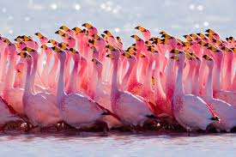
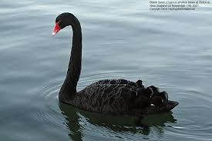
Why we're still wrong

Slide 27
The Illusion of Understanding
  Halo Effect
  Understanding of Non-events
  Our Changing Mind
  Hindsight Bias
  The power of ignoring our ignorance
  Phenomenology

Slide 28

Halo Effect
We believe we understand causal mechanisms in very specific orders.
  Does A cause B or B cause A?

Slide 29
Halo Effect
Called the “Halo Effect” due to the frequent occurrence in how one individual's performance is attributed to large groups of people – and vice-versa.
  Was Steve Jobs the reason for Apple's success?
  Is Larry Paige the reason for Google's success?
  Is Apple the reason for Steve Jobs' success?
  ...or, are the stories much, much more complicated?

Slide 30
Halo Effect
Take the Google Story for Example:
  Two Stanford Grads
  Make an awesome algorithm
  Someone offers them $1 million bucks to sell, they say no.
  They make Google, go on to become rich, wealthy, famous.

Slide 31
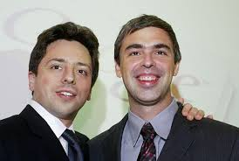
Halo Effect
Take the Google Story for Example:
  Two Stanford Grads
  Make an awesome algorithm
  Someone offers them $1 million bucks to sell, they say no.
  They make Google, go on to become rich, wealthy, famous.
Are Larry and Sergey geniuses? Lucky? Both? Neither?

Slide 32
The Importance of Non-Events
Our mind is terrible at retaining information on non-events.
  i.e., do you remember the last time Dan might have broken his leg giving a lecture?
  You might have failed to wake up for a lecture, but didn't?

Slide 33
The Importance of Non-Events
Our mind is terrible at retaining information on non-events.
  i.e., do you remember the last time Dan might have broken his leg giving a lecture?
  You might have failed to wake up for a lecture, but didn't?
We remember the things that happened – and consider those. You probably remember when you did wake up for a lecture on time.

Slide 34
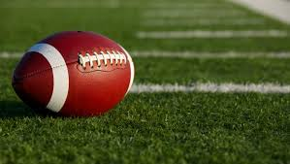
Sports, non-events, and our changing minds.
Two teams.
Team A: 5-5 record.
Team B: 5-5 record.
Going head to head at a neutral location.
All fans have been arrested for smuggling alcohol in.

Slide 35
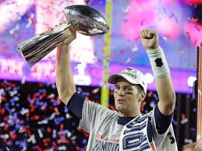
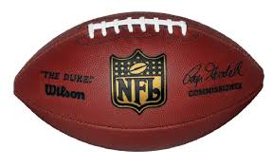
Sports!
Team A wins! 65 – 0.
Team B goes and finds the stashed alcohol.

Slide 36
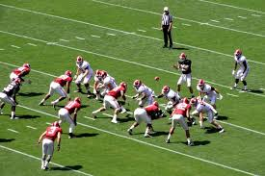
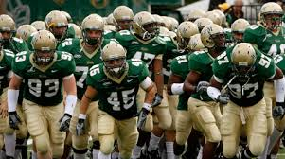
First – Non-events
In the game, what probably didn't happen that could have impacted the outcome?
Which team is the stronger team?

Slide 37
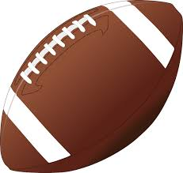
Second, Changing Minds. For real. They Change.
Team B is a much weaker team than Team A.
  After all, they were dominated.
  But – we actually have very little information to secure this view – one game event.
Very hard for us to remember our prior opinion of Team B.

Slide 38
Hindsight Bias
On July 10, 2001, the CIA obtained information that al-Qaeda was likely planning a major attack on the US. The information was passed on to Condoleezza Rice, but not the president.

Slide 39
Hindsight Bias
Decision makers have a very hard life.
“It seems to me elementary that if you've got the story that's going to dominate history you might as well go right to the president.”
-Ben Bradlee, The Washington Post

Slide 40
And Finally, Into the Deep End
  Ignoring our ignorance
    Everything is really, really, really complicated.
    For thirty seconds, write down everything you can think of that resulted in you sitting in this classroom right now.

Slide 41
And Finally, Into the Deep End
  Ignoring our ignorance
    Everything is really, really, really complicated.
    For thirty seconds, write down everything you can think of that resulted in you sitting in this classroom right now.
  And, are we even sure we know what we know?
    Touch the desk you're sitting in. What do you perceive when you touch it?

Slide 42
And Finally, Into the Deep End
  Ignoring our ignorance
    Everything is really, really, really complicated.
    For thirty seconds, write down everything you can think of that resulted in you sitting in this classroom right now.
  And, are we even sure we know what we know?
    Touch the desk you're sitting in. What do you perceive when you touch it? Is that perception the same as your neighbors? Is it more or less relevant than your neighbors?

Slide 43
And Finally, Into the Deep End
  Ignoring our ignorance
    Everything is really, really, really complicated.
    For thirty seconds, write down everything you can think of that resulted in you sitting in this classroom right now.
  And, are we even sure we know what we know?
    Touch the desk you're sitting in. What do you perceive when you touch it? Is that perception the same as your neighbors? Is it more or less relevant than your neighbors? If your perception is different from someone else, can it be “real”? Or is “real” only relative to your particular norms and background? Poor philosophers.

Slide 44
I owe you extra credit
And, I haven't forgotten. But it won't be today like I promised. Breaking your intuitive expectations that Dan will keep his word – you should know better!
Coming very soon, because I'll need the data for your final lab (hint, hint).

