Slide 1
We're All Wrong, All The Time.
(and, why that's really a good thing)

Slide 2
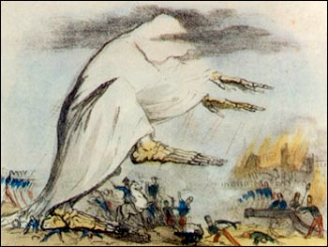
On 31 August 1854, a major outbreak of cholera struck Soho.
By 10 September, 500 people had died and the mortality rate was 12.8 percent in some parts of the city. By the end of the outbreak, 616 people had died.

Slide 3
The community wanted to know why. The best scholars in the pub came together, spent billions, and turned to “Miasma” theory:
Disease was more prevalent in lower-class neighborhoods because they stank more, and because the supposed moral depravity of poor people weakened their constitutions and made them more vulnerable to disease.

Slide 4


Slide 5
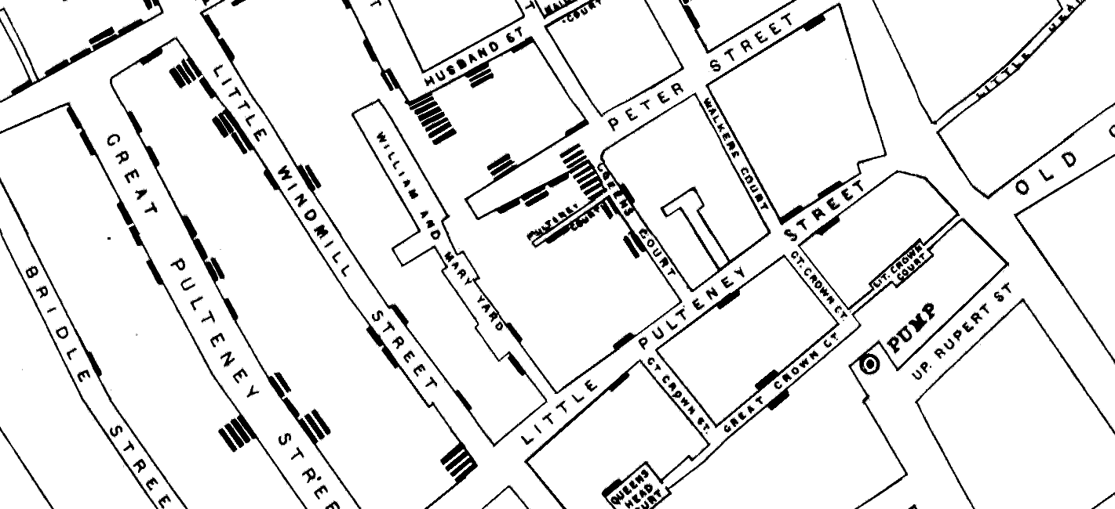
Disease was more prevalent in lower-class neighborhoods because they stank more, and because the supposed moral depravity of poor people weakened their constitutions and made them more vulnerable to disease.
Steven Johnson's 2006 book The Ghost Map: the Story of London's Most Terrifying Epidemic, and How it Changed Science, Cities and the Modern World (available in paperback) is a highly entertaining account of the epidemic and Snow's analysis of it.

Slide 6
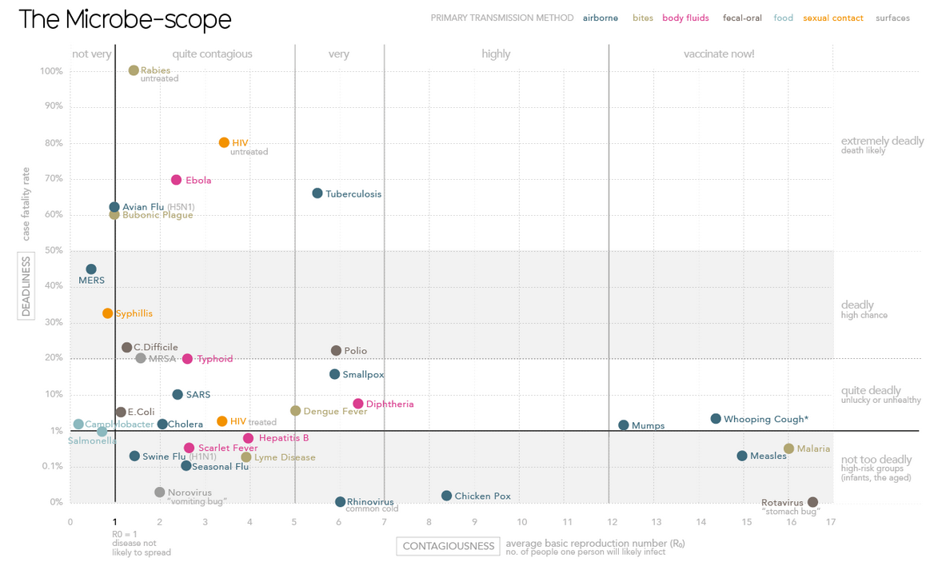

Slide 7
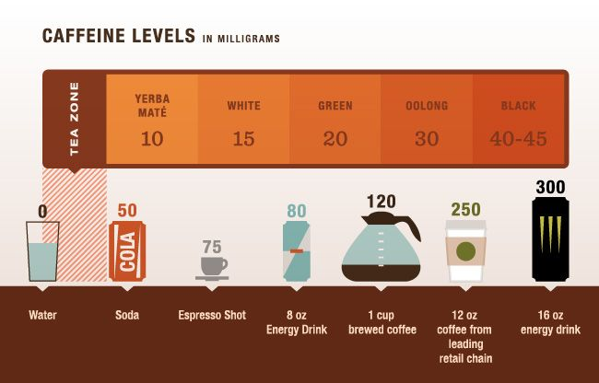
http://www.datadriventhoughts.com/2015/07/23/find-out-how-long-caffeine-will-stay-in-your-system-tool/

Slide 8
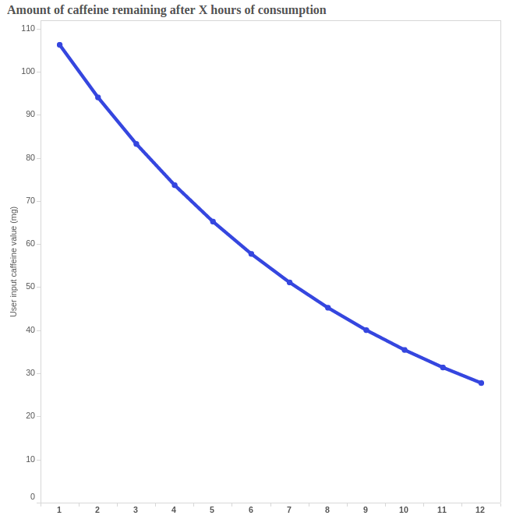
http://www.datadriventhoughts.com/2015/07/23/find-out-how-long-caffeine-will-stay-in-your-system-tool/

Slide 9
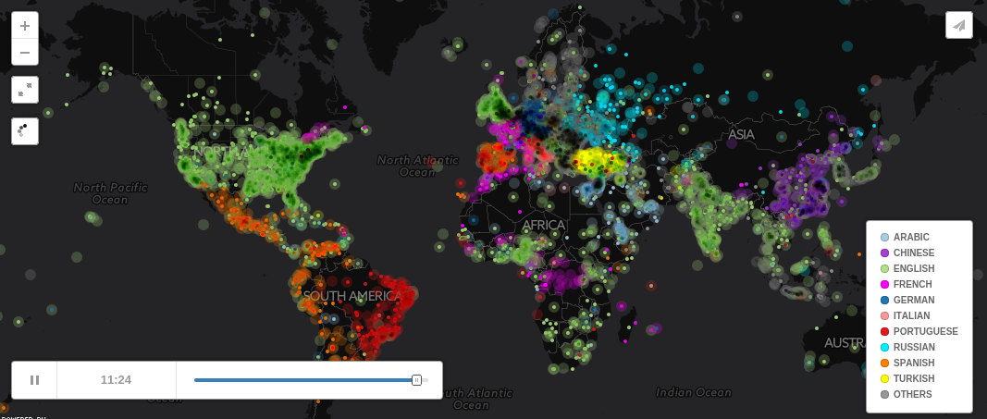
Understanding the Media
The GDELT Project

Slide 10
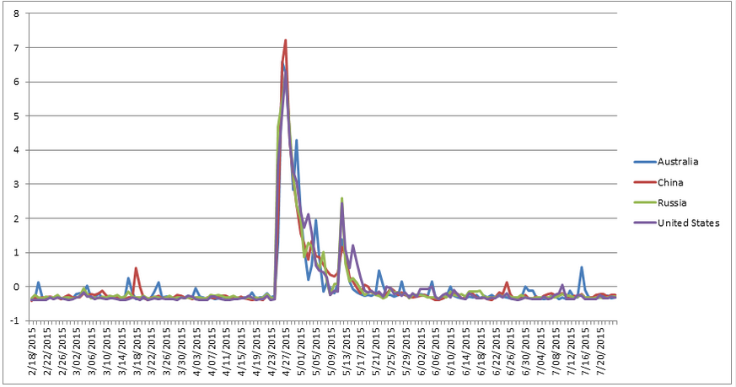
Understanding the Media: Nepal
The GDELT Project

Slide 11

“Real Time” Big Data: Nepal

Slide 12

FinViz

Slide 13
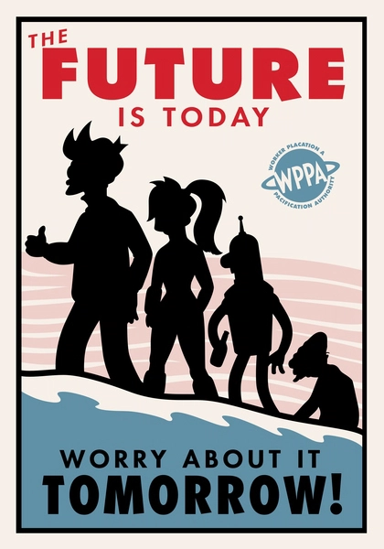

What are we really trying to do?

Slide 14
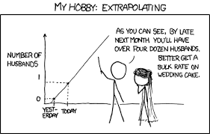
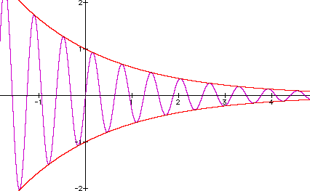
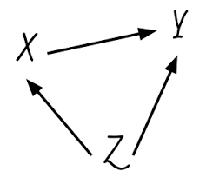
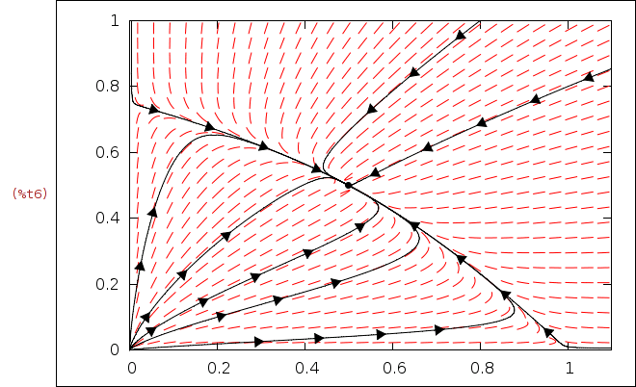
Prediction and Understanding

Slide 15
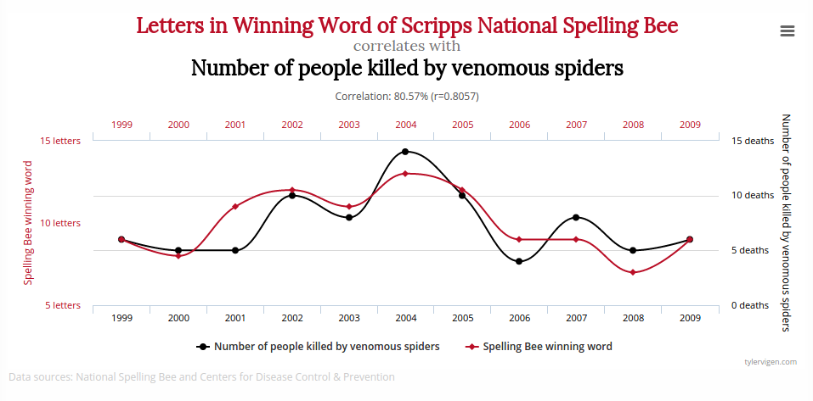

Slide 16

Machine “Learning”?
Supercalifragilisticexpialidocious

Slide 17
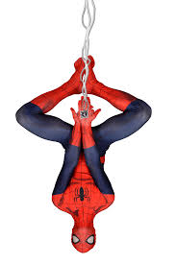





Machine “Learning”?
Supercalifragilisticexpialidocious

Slide 18
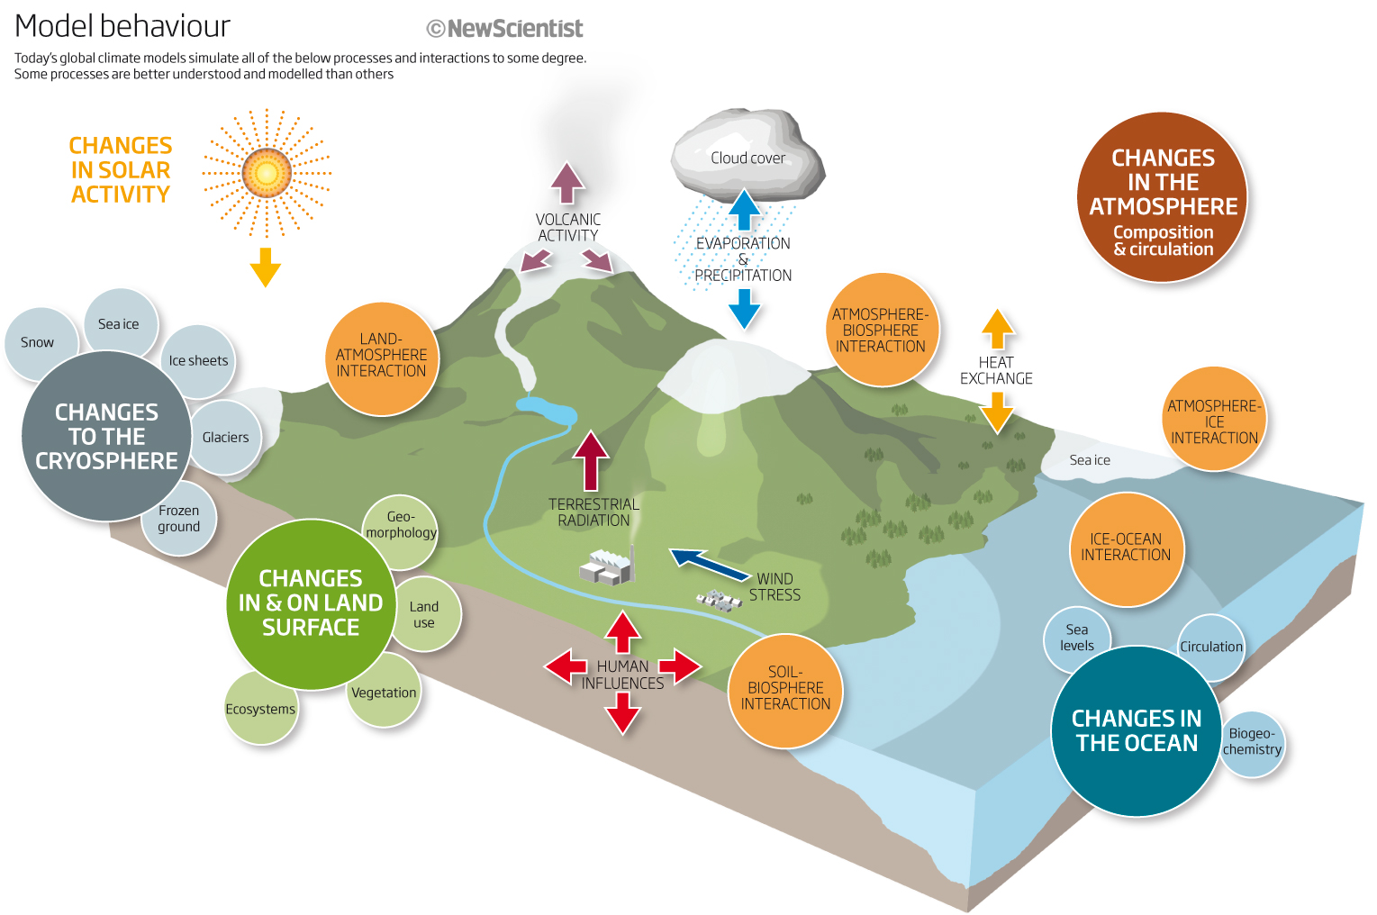
Human “Understanding”

Slide 19
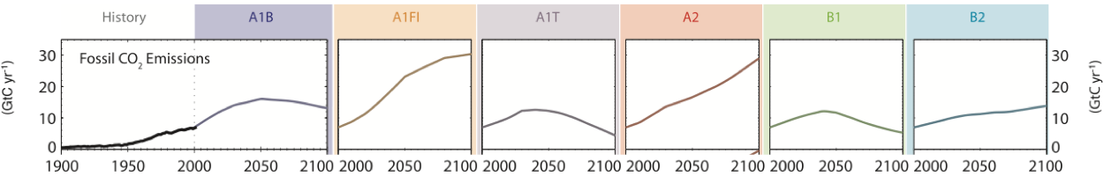
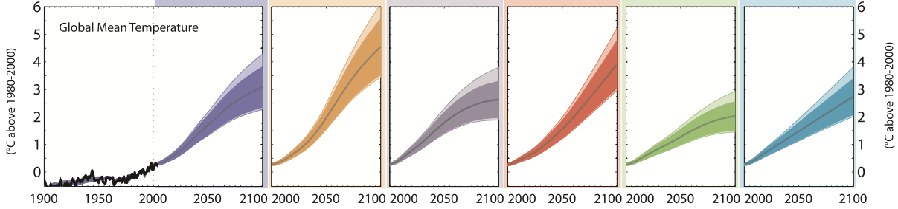

Slide 20
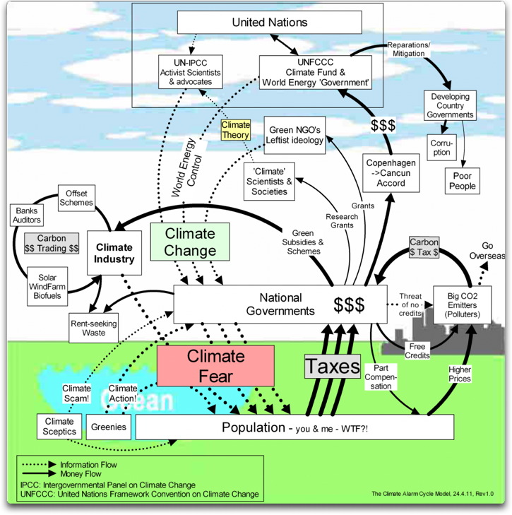

Slide 21
What are we really trying to do?
Understand for understandings sake?
Use understanding and prediction to promote change?

Slide 22
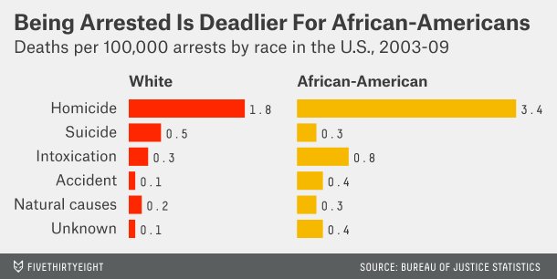

Slide 23
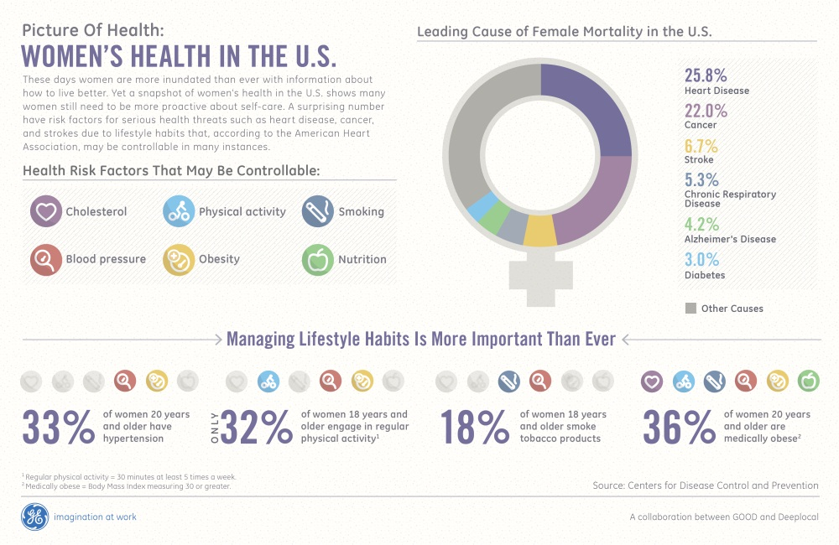

Slide 24
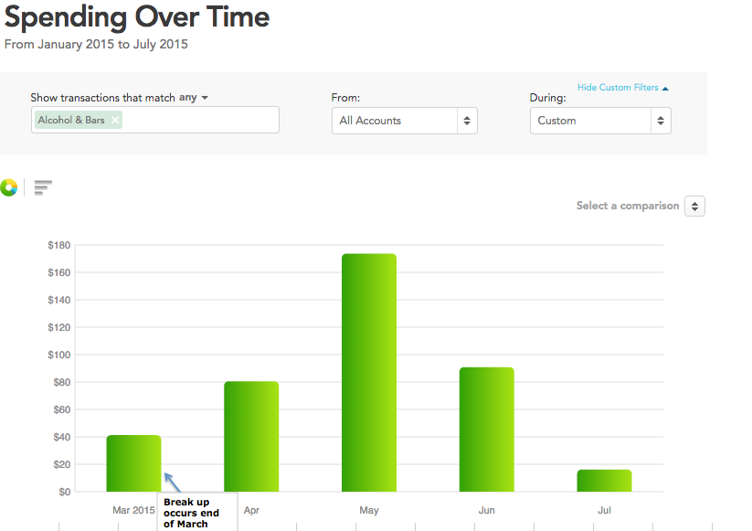

Slide 25
We're All Wrong, All The Time.
But your labs are still going to be graded.
Let's talk about the syllabus.

