Slide 1
Life, The Universe, and Everything:
The History of Man and Data

Slide 2
At the beginning...

Slide 3
At the beginning...
20,000 Years Ago...

Slide 4
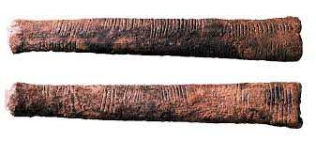
THE ISHANGO BONE!
Interpreted as a Lunar Calendar

Slide 5
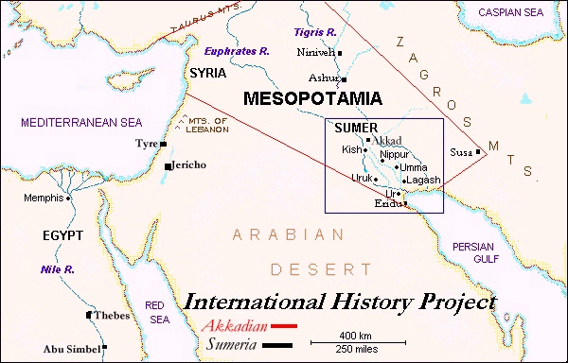
...Skipping ahead around 15,500 years

Slide 6
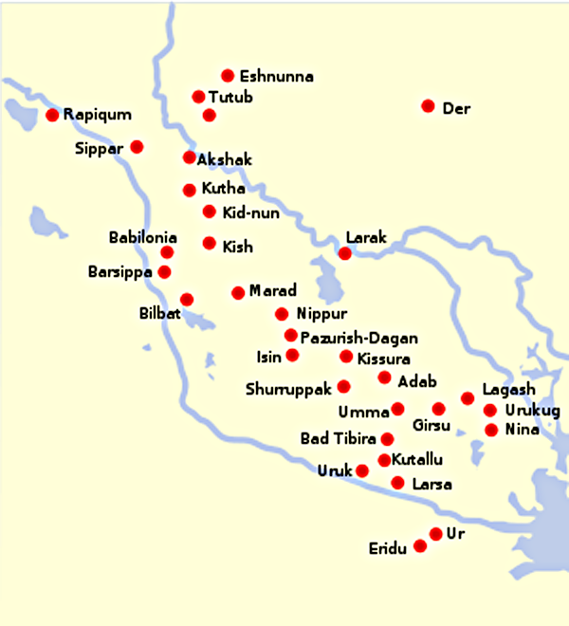

Slide 7
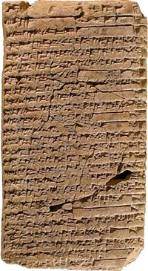


Slide 8
(Skipping ahead about 3,600 years)

Slide 9
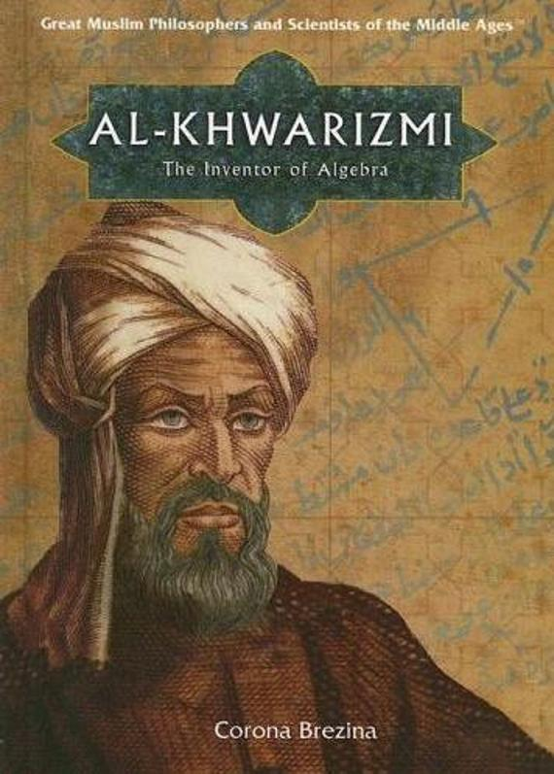
(Skipping ahead about 3,600 years)
Abu Abdullah
Muhammad ibn
Musa
Al-Khwarizmi
(a.k.a. Algorism) al-Jabr, the Prince of Persia

Slide 10
(Just 600 years later, in 300 BC)

Slide 11
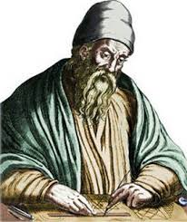
(Just 600 years later, in 300 BC)
Euclid
The bane of middle school math

Slide 12
The Innovation you Never Think About

Slide 13

The Innovation you Never Think About

Slide 14

The Innovation you Never Think About

Slide 15

The Book of Calculation - 1202

Slide 16
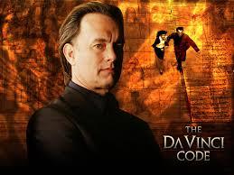
The Book of Calculation - 1202

Slide 17

The Book of Calculation - 1202

Slide 18
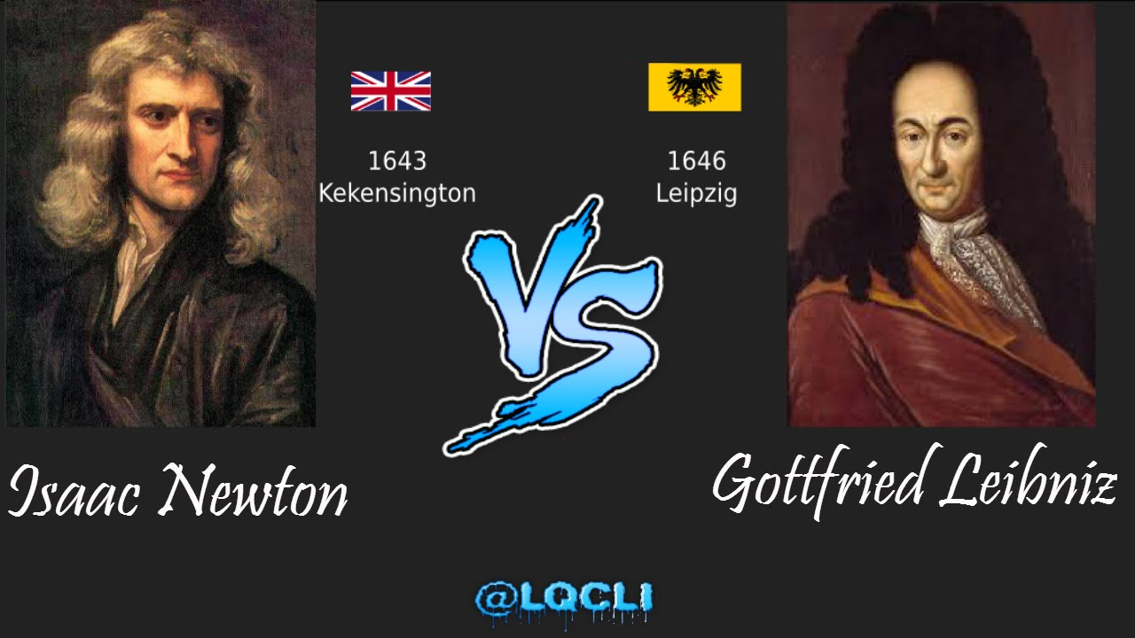

Slide 19

Gottfried Leibniz
The Godfather

Slide 20

0 and 1

Slide 21
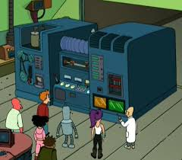
0 and 1

Slide 22
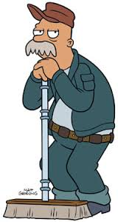
0 and 1

Slide 23
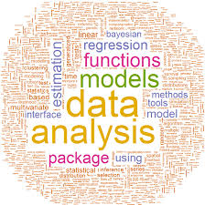
Gottfried Leibniz
Not Done Yet

Slide 24
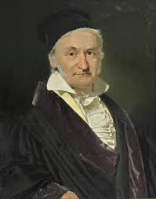
Carl “Friedrich” Gauss
Not so ordinary after all!

Slide 25
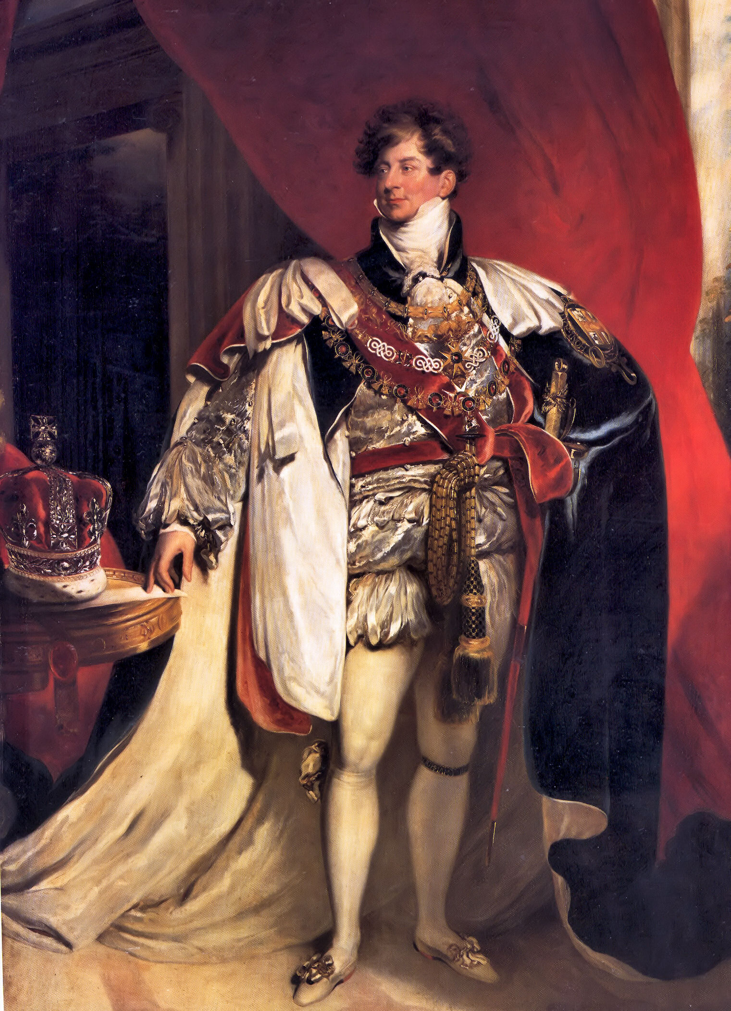
King George IV
Sorry, not William

Slide 27
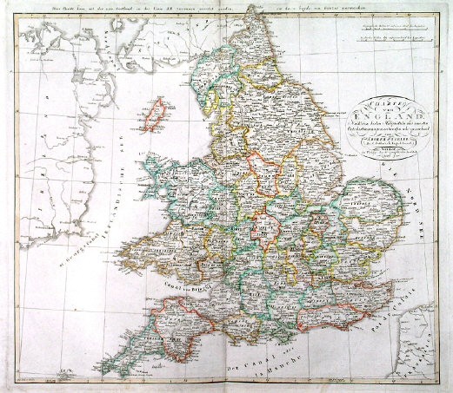

Slide 28
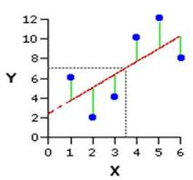

Slide 29
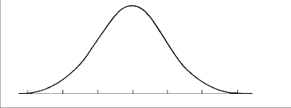

Slide 30
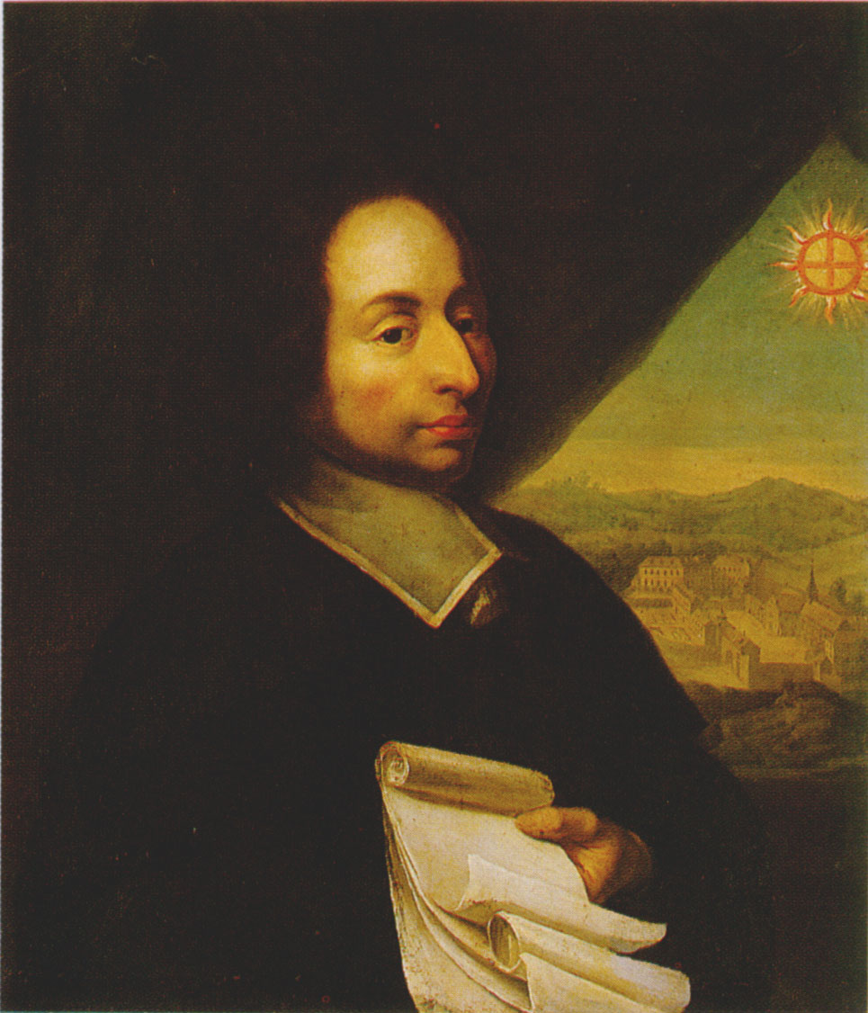
Blaise Pascal
Leaving Poker Games Early Since 1654

Slide 31
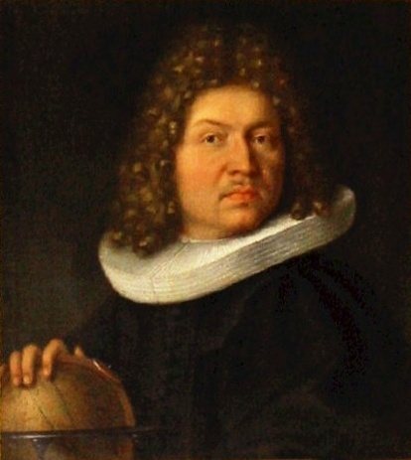
Jacob Bernoulli
Staying in the Poker Game since 1659

Slide 32
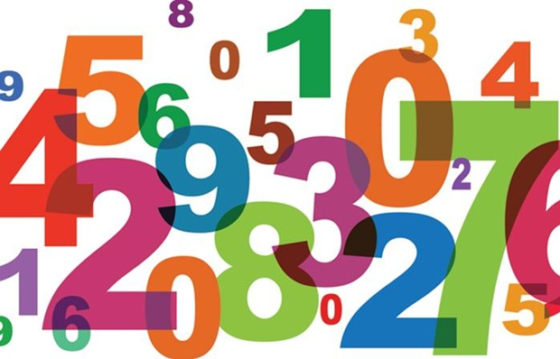
The Law of...

Slide 33
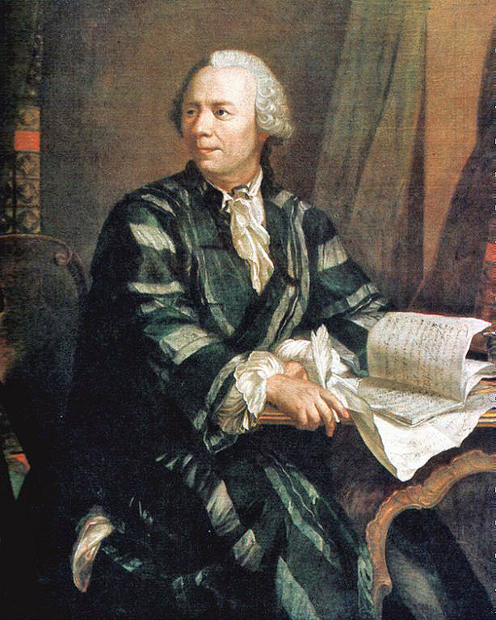
Leonhard Euler
The Tollmaster

Slide 34
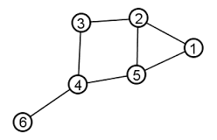

Slide 35
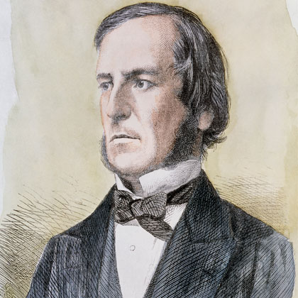
George Boole
If, And, Or, Not

Slide 36
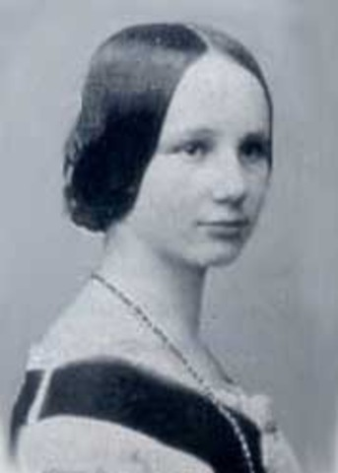
Ada Lovelace
Machines that Feel – in 1842

Slide 37
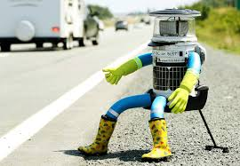

Slide 38
And, finally..
And, finally..

Slide 39
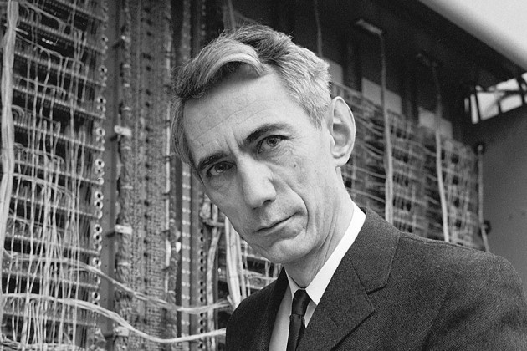
Claude Shannon
Posing in Front of Supercomputers Since 1930

Slide 40
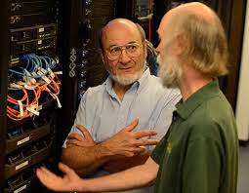
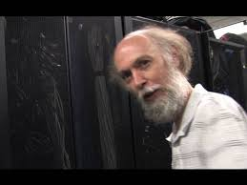
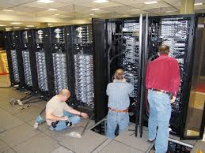
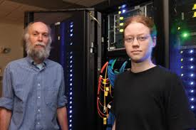

Slide 42
This Class and Ya'll
Learning Data on Day 1

