Slide 1
What is Intuition?
(And, how can we break it?)

Slide 2


A bat and ball costs $1.10
The bat costs $1 more than the ball.
How much is the ball?

Slide 3
Fifteen, Ten, a few years ago, John was 20 years old, single, outspoken, and a genius. He majored in Geography with a minor in Computer Science. He was deeply interested in teaching about human intuition at William and Mary.
Which is more probable today?
1. John is a professor at William and Mary.
2. John is a professor at William and Mary and teaching a course about human intuition.

Slide 4
Nina just graduated from High School, and was able to fluently read by the age of 3 and ½. What do you think her GPA was?

Slide 5
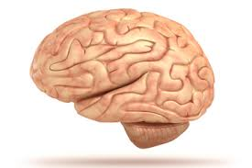
(1) Bat and the Ball
(2) John and Probability
(3) Nina and “thinking fast”.

Slide 6
Why doesn't our brain stop?
Daniel Kahneman's “Thinking Fast and Slow”

Slide 7
Why doesn't our brain stop?
System 1 – Quick thinking, with very little voluntary control.

Slide 8
Why doesn't our brain stop?
System 1 – Quick thinking, with very little voluntary control.
What's 2+2?

Slide 9
Why doesn't our brain stop?
System 1 – Quick thinking, with very little voluntary control.
What's 2+2?
Why did you just read this sentence?

Slide 10
When does our Brain Stop?
System 1 sometimes trips up, and turns over to System 2. System 2 likes to deliberate.

Slide 11
When does our Brain Stop?
System 1 sometimes trips up, and turns over to System 2. System 2 likes to deliberate.
What's 45 x 60?

Slide 12
When does our Brain Stop?
System 1 sometimes trips up, and turns over to System 2. System 2 likes to deliberate.
What's 45 x 60?
What did you eat for lunch two days ago?

Slide 13
Why are these systems important?
Every day, you (and every other human) make quite a few decisions.
  What am I going to eat today? Will I go rob a bank? Why should I go to that class about intuition? Should I wear a jacket? Can I hire a new intern? What major should I choose?

Slide 14
Why are these systems important?
Every day, you (and every other human) make quite a few decisions.
  What am I going to eat today? Will I go rob a bank? Why should I go to that class about intuition? Should I wear a jacket? Can I hire a new intern? What major should I choose?
And yet, the majority of decisions we make doesn't consider how system 1 and 2 interact with one another.

Slide 15
The Traveling Salesman

Slide 16
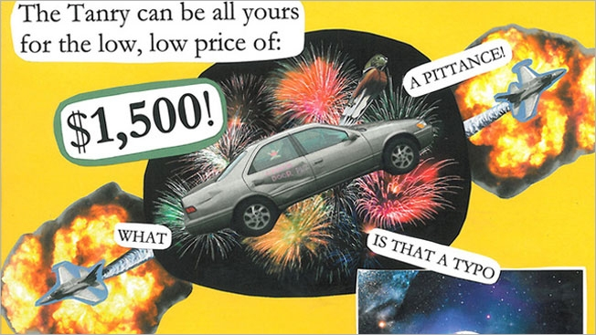
The Traveling Salesman

Slide 17
The Traveling Salesman
Salesmen are very good at taking advantage of the disconnects between System 1 and System 2.
System 2 is “work.” It is very hard to think hard about things for prolonged periods of time.
We prefer to use System 1, because “intuition” is much easier.

Slide 18
Add 1.

Slide 19

Add 1.

Slide 20
All characters are red.
All animals are cold.
Animals are characters.
Therefore, all animals are red.

Slide 21
Some flowers fade over time.
All Roses are Flowers.
Some Roses fade over time.

Slide 22
Alright! Enough already.
The way we think has critical implications for the way the world around us works.
Decision Makers have limited capacity to think using either system 1 or system 2.
Data – and products made from data – must carefully consider which system they are built for.

Slide 23
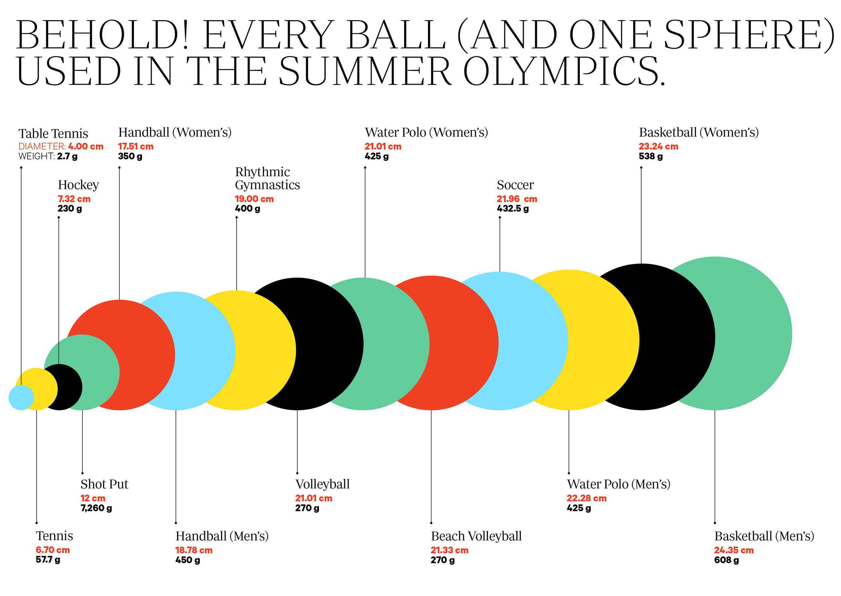
Examples of System 1 Products

Slide 24
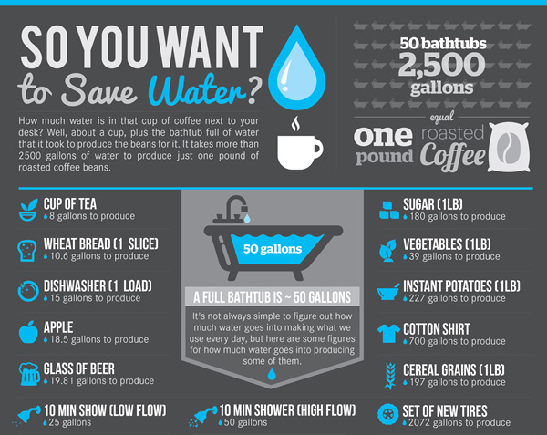

Slide 25
If System 2 is so hard to Engage, why make products for it?
Sometimes the world simply isn't simple.
Costs to produce effective infographics can be high, and require assumptions on the part of the producer.
If your trying to solve a problem that forces you to engage system 2 anyway, system 2 won't mind a little help from the data.

Slide 26
Back to COLL
Why will system 1 and 2 matter?
  We want to learn how to use them together to use data to make compelling arguments.
  Just using your system 2 isn't enough: you need to be able to communicate to others by taking advantage of their system 1!

Slide 27
Intro Weeks
What is the “System 1” product you're turning in next Friday?
What “System 2” analysis did you need to conduct to make that?

Slide 28
Why W&M Lab
One Document – Word Document
Copy R code into it
Put your Name into it
Answer all questions as relevant
Include the Infographic as a separate attachment

Slide 29
Rubrics and Grading
COLL 100 Rubric is now available on blackboard, and will be included in future assignments.
Assignment 1 was easy – explicit answers to questions.
Future assignments will be judged based on a wide range of criteria – including creativity, ability to acquire data, critical thinking, and persuasive arguments.

Slide 30
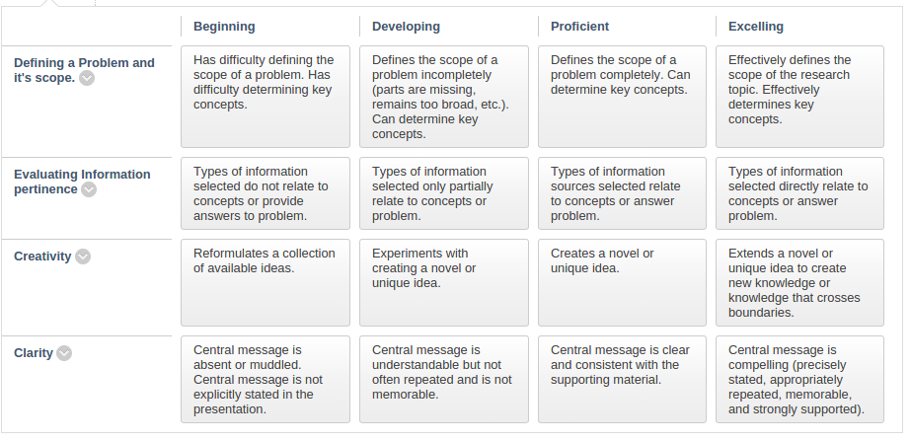

Slide 31
The Long List
Intro: Infographic (System 1); R processing (System 2)
Part 2: Human History & Intuition; Maps (System 1); GIS (System 2)
Part 3: Business; Excel Stock Modeling (System 2)
Part 4: Social Networks; 'Big' Data Visualization (System 1); R processing (System 2)
Part 5: Maps and Cities; Maps and Data Visualization (System 2); Land Change Considerations (System 2)
Part 6: Machine Learning; Visualizing Words Clouds & Sentiment (System 1); R processing (System 2); Infographic (System 1)

