Slide 1
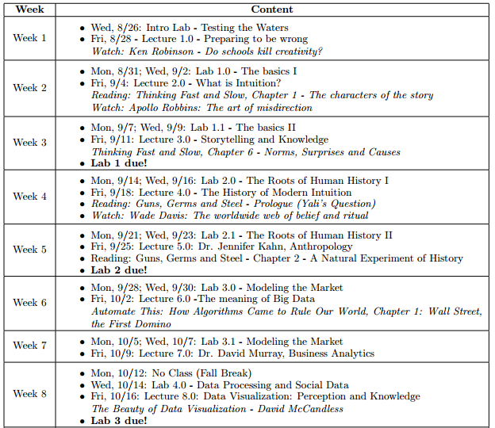

Slide 2
Storytelling as Knowledge

Slide 3
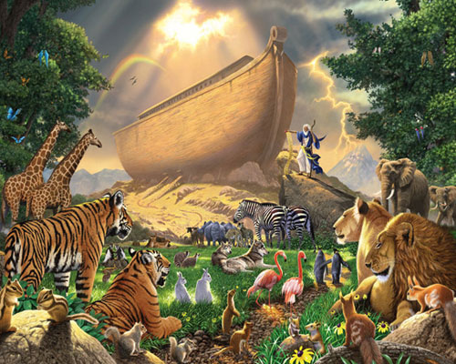
How many of each animal did Moses take on to the Ark?

Slide 4
Storytelling as Knowledge
To construct these norms, our brains obsess over causality.
  But system 1, as arrogant as it is, isn't very good at drawing reasonable causal arguments.

Slide 5
Association and Norms
Our brain searches for linkages across things we know – what's “normally” related.

Slide 6
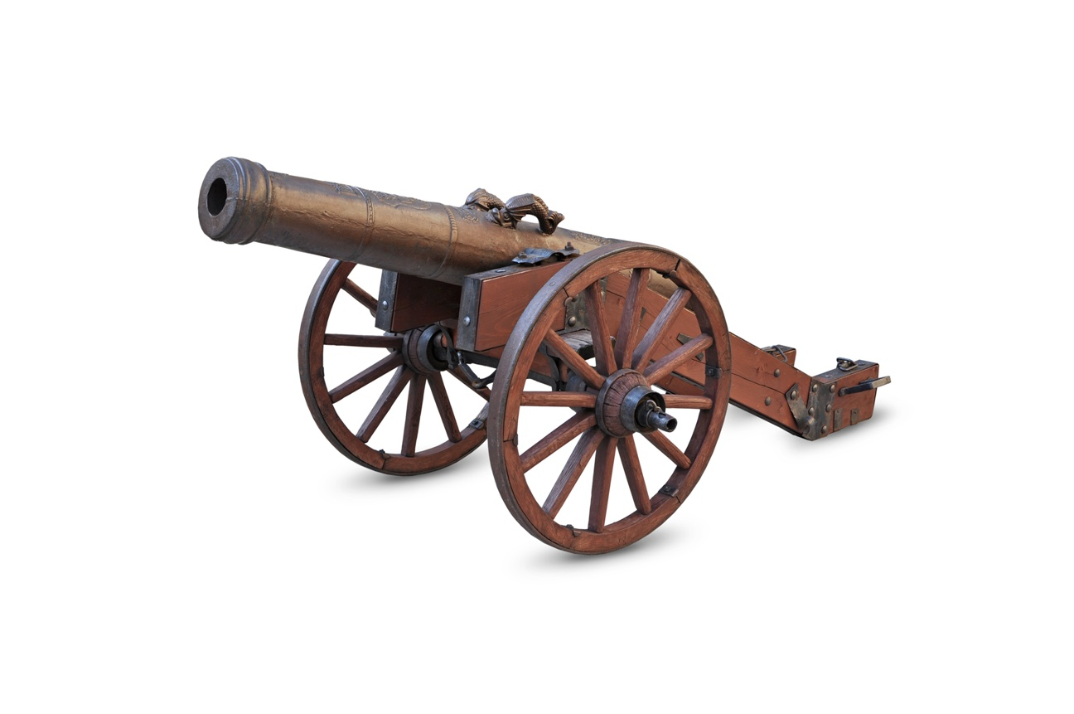
Association and Norms
Our brain searches for linkages across things we know – what's “normally” related.
In Colonial Williamsburg, a Cannon fires every day around 5:15PM. What would you do if you heard the same noise in your hometown?

Slide 7
But, how do these norms manifest?

Slide 8
Storytelling as Knowledge
https://www.youtube.com/watch?v=n9TWwG4SFWQ

Slide 9
Storytelling as Knowledge
To construct these norms, our brains obsess over causality.
  But system 1, as arrogant as it is, isn't very good at drawing reasonable causal arguments.

Slide 10
We do this all the time.
And we use System 1 to do it more often than not – and frequently when we shouldn't.

Slide 11
We do this all the time.
And we use System 1 to do it more often than not – and frequently when we shouldn't.
“Jumping to Conclusions” - how coherent of a story can System 1 come up with? Is it coherent enough to keep System 2 out of the loop?

Slide 12
We do this all the time.
And we use System 1 to do it more often than not – and frequently when we shouldn't.
“Jumping to Conclusions” - how coherent of a story can System 1 come up with? Is it coherent enough to keep System 2 out of the loop?
“What you See is All There Is”

Slide 13
For Example: WYSIATI
Anita Marka accidentally may have given highly confidential information away.
Joel Miller has employed thousands of individuals for decades.
Both Anita and Joel are interested in a promotion into the same job. Who would you choose?

Slide 14
For Example: WYSIATI
Hillary Clinton accidentally may have given highly confidential information away.
Donald Trump has employed thousands of individuals for decades.
Both Hillary and Donald are interested in a promotion into the same job. Who would you choose?

Slide 15
How can we take advantage?
WYSIATI
Consider your “Why William and Mary” Infographic.
  If you are trying to illustrate that a good student:teacher ratio is an attribute of William and Mary, would you write:
  “The average classroom size at William and Mary is 8 to 1”, OR
  “The average classroom size at William and Mary is 15 to 1, contrasted to the national average of 27:1”

Slide 16
For Example: Framing Effect
Relative to all schools in the United States, William and Mary ranks 41st in % of dollars going towards classroom instruction.
Relative to all schools in Virginia, William and Mary ranks 2nd in % of dollars going towards classroom instruction.
William and Mary ranks 2nd in % of dollars going towards classroom instruction.*
*Compared to all schools in Virginia.

Slide 17
For Example: Framing Effect
Relative to all schools in the United States, William and Mary ranks 41st in % of dollars going towards classroom instruction.
Relative to all schools in Virginia, William and Mary ranks 2nd in % of dollars going towards classroom instruction.
William and Mary ranks 2nd in % of dollars going towards classroom instruction.*
William and Mary ranks 1st in % of dollars going towards classroom instruction.**
*Compared to all schools in Virginia.
**Compared to all schools in Virginia except that one that ranks better.

Slide 18
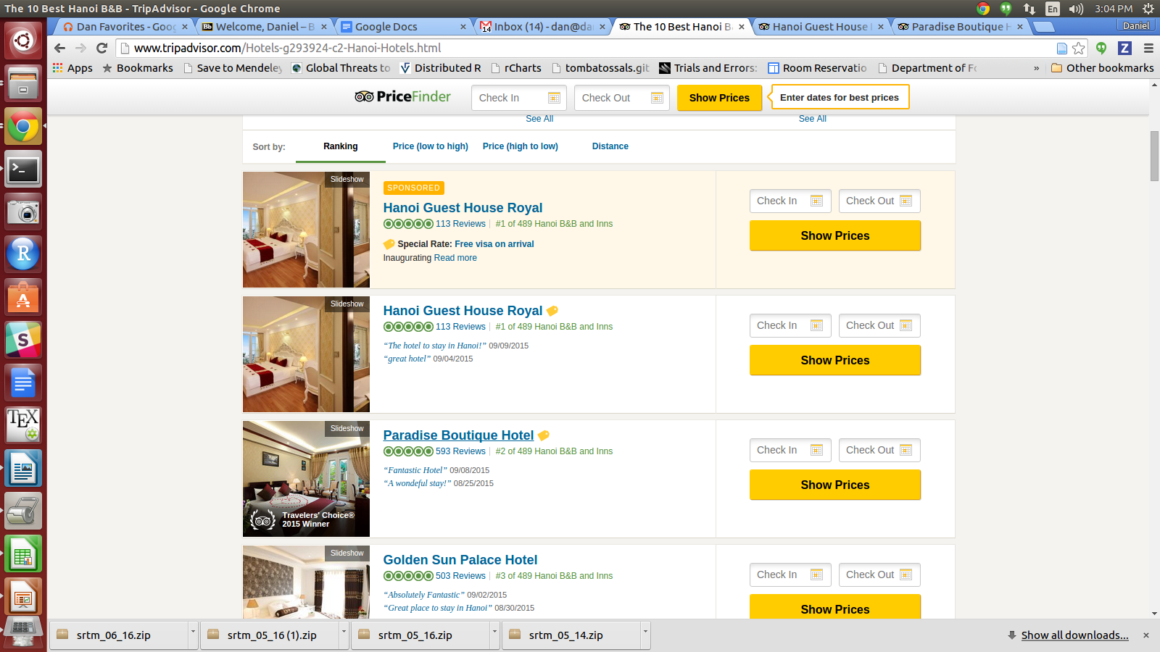

Slide 19
For Example...
Left half (your left) of the room, put your head to your desk and don't look.
Right half of the room, raise your hand as prompted by the powerpoint but don't say anything out loud.

Slide 20
Did you have breakfast or lunch today?
Raise your hand if “Yes”
Leave your hand down if “No”.
Keep watching, you have one more slide...

Slide 21
Are you hungry now?
Raise your hand if “Yes”
Leave your hand down if “No”.

Slide 22
Swap Sides!

Slide 23
Are you hungry now?
Raise your hand if “Yes”
Leave your hand down if “No”.
Keep watching, you have one more slide...

Slide 24
Did you have breakfast or lunch today?
Raise your hand if “Yes”
Leave your hand down if “No”.
Keep watching, you have one more slide...

Slide 25
Alright, all done.
Let's see how fast Dan can count...

Slide 26
“Mood Heuristic”
Two groups of individuals were asked two questions:
  How many dates did you have last month?
  How happy are you these days?

Slide 27
“Mood Heuristic”
Two groups of individuals were asked two questions:
  How many dates did you have last month?
  How happy are you these days?
Order of the questions were reversed; if “dates” was asked first it correlated strongly with happiness; otherwise, no such correlation was observed.

Slide 28
Mid-point Summary
“Moses Illusion”, Norms and Stories
Brain obsesses with Causality
  We don't pay as much attention to “Moses” as we do “2 of each animal” - after all, you need 2 of those.
System 1 automatically makes up causal stories – sometimes they're even believable, so System 2 doesn't get involved.

Slide 29
Mid-point Summary
WYSIATI
Framing Effects
“Mood Heuristics”

Slide 30
Mid-point Summary: Why this matters!
WYSIATI + Framing + Mood Heuristics:
  Choose what frames the question you want to answer. “W&M has a great teacher:student ratio” vs. “W&M has a great educational quality.” Which is easier to answer? Which is more convincing to you?
  Make a compelling case with the least information possible – WYSIATI. Less information is better – it makes it less likely “System 2” gets triggered.

Slide 31
Mid-point Summary
“Moses Illusion”, Norms and Stories
Brain obsesses with Causality
  We don't pay as much attention to “Moses” as we do “2 of each animal” - after all, you need 2 of those.
System 1 automatically makes up causal stories – sometimes they're even believable, so System 2 doesn't get involved.

Slide 32
System 1 Hates Statistics
A study of new diagnoses of kidney cancer across 3,141 counties in the U.S. revealed something remarkable: the counties in which incidence of kidney cancer is lowest are mostly rural, sparsely populated, and located in traditionally Republican States in the Midwest, South, and West.
*example blatantly stolent from page 109 of Kaneman's Thinking Fast and Slow.

Slide 33
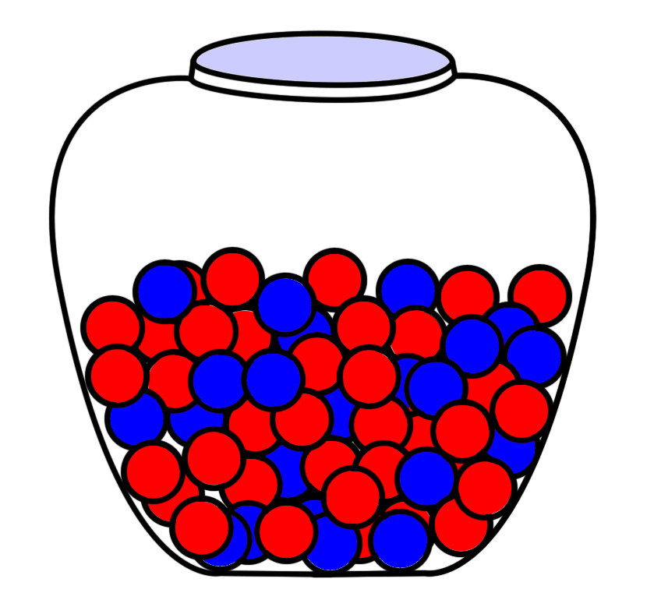

Slide 34
Kidneys and Marbles
Drawing 4 marbles each time, after N draws you'll eventually get to 50% blue and 50% red on average, with a 12.5% chance you'll draw an extreme (all blue and all red).
Drawing 7 marbles each time, after N draws you'll still get 50% blue and 50% red, with a 1.56% chance you'll get extremes (all blue/red).

Slide 35
Extremes are more frequent in small samples. Large #s are more reliable.
Just like it was more common to get an extreme in the smaller sample drawn from the marble jar, it's also more common to get an extreme in smaller, rural counties.
In this case, that extreme just happens to be kidney cancer.
System 1 – by default – really wants their to be a causal story. It's how we're wired. But System 2 can illustrate that, in fact, the explanation is not causal.

Slide 36
Belief in the Law of Small Numbers
System 1 is active in all of us – extensive studies have shown that even authors of statistics books will intuitively estimate things such as statistical sample sizes incorrectly.
In a telephone poll of 100 students, 60% support President Reveley.

Slide 37
Heads down again! Same groups.

Slide 38
72% all nations are located outside of Africa.
How many are African countries are members of the UN?
  Hold your hand up if you believe more than three-fourths of the countries in Africa are in the UN.

Slide 39
Swap!

Slide 40
28% of all nations are in Africa.
How many are African countries are members of the UN?
  Hold your hand up if you believe more than three-fourths of the countries in Africa are in the UN.

Slide 41
More Math...

Slide 42
Anchoring
We tend to interpret numbers relative to numbers we perceived earlier. If you see a number around 25%, you're much more likely to guess a number around or near that value.
Think about a car sale – the initial number you are presented with is the “Anchor” number.
The activity you just did was replicating a study done where a completely random number (10 or 65) was generated, and the same question asked afterwards. Those who saw 10 guessed 25% of nations; those who saw 65 guessed 45%.

Slide 43
Memory Lane...
WYSIATI
Framing Effects
“Mood Heuristics”
Belief in Small Numbers
Anchoring

Slide 44
Important Note!
Office hours for tomorrow (Friday) will be over at 424 Scotland Street from 2-5PM with Tyler (downstairs). Ashley is sick so will not be able to hold her usual hours in the SSRMC.

