Slide 1
What is this “Big Data” thing?
And why must we break intuition?

Slide 2
What is this “Big Data” thing?
Mercilessly Stolen from Dan Ariely (Duke; Psychology)
It's a whole lot like teenage sex.
  Everyone talks about it.
  Nobody really knows how to do it.
  Everyone thinks everyone is doing it.
  So, everyone claims they are doing it.

Slide 3
More than just “Lots of Data”
Volume
Velocity
Variety

Slide 4
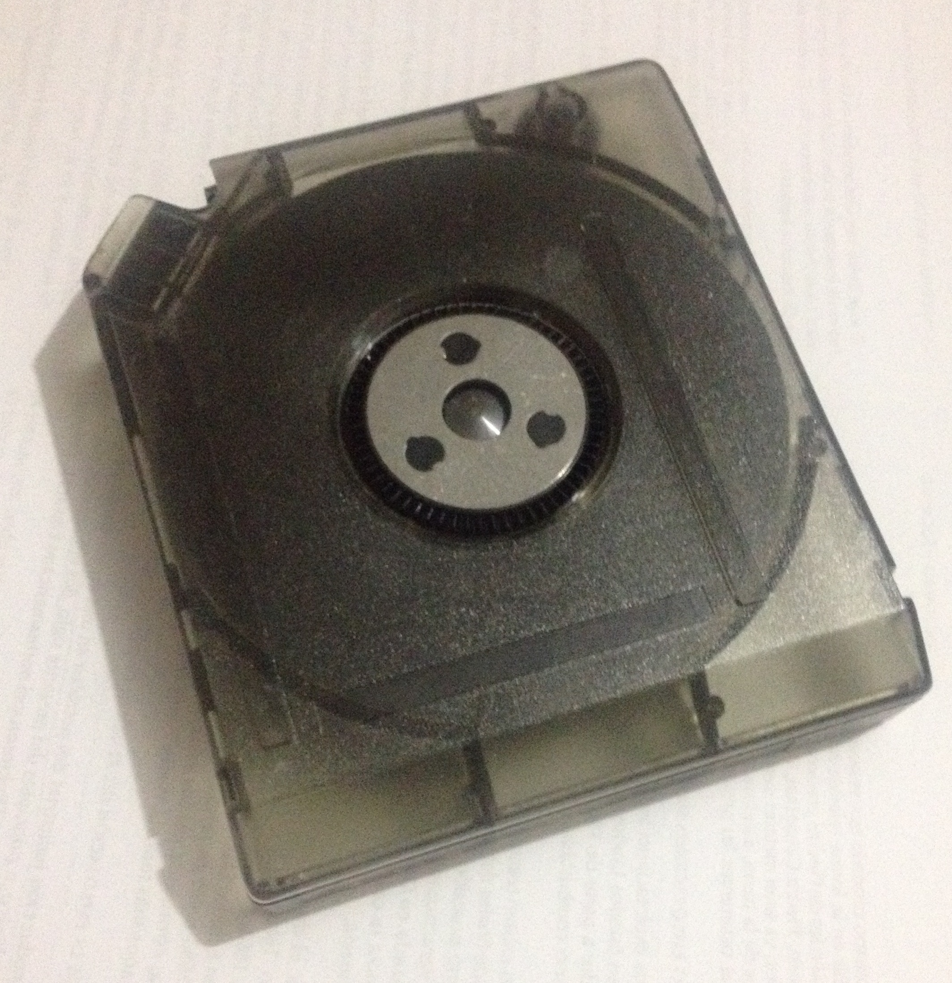
Volume
Our “Stocks” Lab
<1 Sq. Inch
Our “GIS” Lab
1 Sq. Inch
The entire H drive
4.5 Sq. Inch
Library of Congress Print Collection
10 Terabytes of Information
20 Sq. Inch
Size of Data... in inches.
.75 billion bits per square inch on a tape drive, or roughly 1 TB

Slide 5
Volume
Our “Stocks” Lab
<1 Sq. Inch
Our “GIS” Lab
1 Sq. Inch
The entire H drive
4.5 Sq. Inch
Library of Congress Print Collection
20 Sq. Inch
Amazon.com public databases
3.8 Ft.
AidData's Full Database
50 Terabytes of Information
4 Ft.
Size of Data... in feet.
.75 billion bits per square inch on a tape drive, or roughly 1 TB

Slide 6
Volume
Our “Stocks” Lab
<1 Sq. Inch
Our “GIS” Lab
1 Sq. Inch
The entire H drive
4.5 Sq. Inch
Library of Congress Print Collection
20 Sq. Inch
Amazon.com public databases
3.8 Ft.
AidData's Full Database
4 Ft.
Choicepoint (HR)
13 Ft.
AT&T
323 Terabytes of Information
27 Ft.
Size of Data... in more feet.
.75 billion bits per square inch on a tape drive, or v. roughly 1 TB

Slide 7
Volume
Our “Stocks” Lab
<1 Sq. Inch
Our “GIS” Lab
1 Sq. Inch
The entire H drive
4.5 Sq. Inch
Library of Congress Print Collection
20 Sq. Inch
Amazon.com public databases
3.8 Ft.
AidData's Full Database
4 Ft.
Choicepoint (HR)
13 Ft.
AT&T
27 Ft.
National Energy Research Center
~2 Petabytes of Information
209 Ft. (.04 mi)
World Data Center for Climate
6 Petabytes of Information
600 Ft. (.12 mi)
Size of Data... in miles.
.75 billion bits per square inch on a tape drive, or v. roughly 1 TB

Slide 8
Volume
Our “Stocks” Lab
<1 Sq. Inch
Our “GIS” Lab
1 Sq. Inch
The entire H drive
4.5 Sq. Inch
Library of Congress Print Collection
20 Sq. Inch
Amazon.com public databases
3.8 Ft.
AidData's Full Database
4 Ft.
Choicepoint (HR)
13 Ft.
AT&T
27 Ft.
National Energy Research Center
209 Ft. (.04 mi)
World Data Center for Climate
600 Ft. (.12 mi)
National Center for Atmospheric Research
160 Petabytes of Information
3.12 mi (.92 N. Mi.)
Size of Data... in leagues (~3.4 miles).
.75 billion bits per square inch on a tape drive, or v. roughly 1 TB

Slide 9
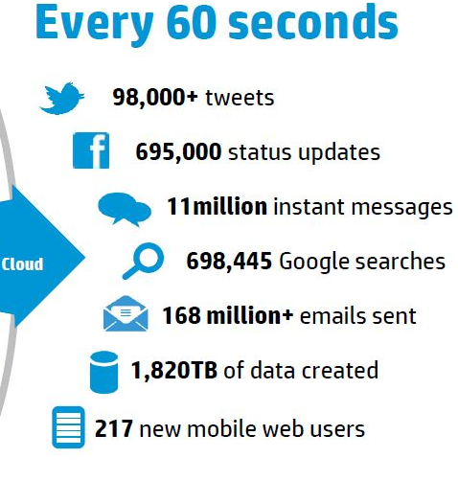
Velocity
  (HP)

Slide 10



Velocity
31,579 Stocks
1 Stock Update
1 gigabyte of data created
Every 15 minutes
  (HP)
  (Us)

Slide 11

Variety

Slide 12

Variety

Slide 13


Variety

Slide 14

Variety

Slide 15
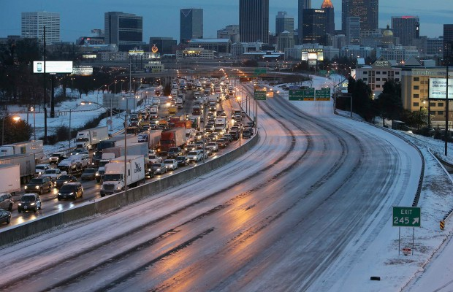
Variety

Slide 16
Variety

Slide 17
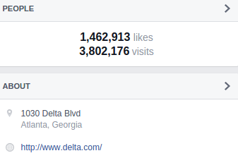

Variety

Slide 18
Variety

Slide 19
More than just “Lots of Data”
..but, we still have to analyze it!
Volume
Velocity
Variety

Slide 20
Most key “Big Data” Tech is not new!
Data Mining and Analytics – Think Peterffy in Wall Street, 1969!

Slide 21
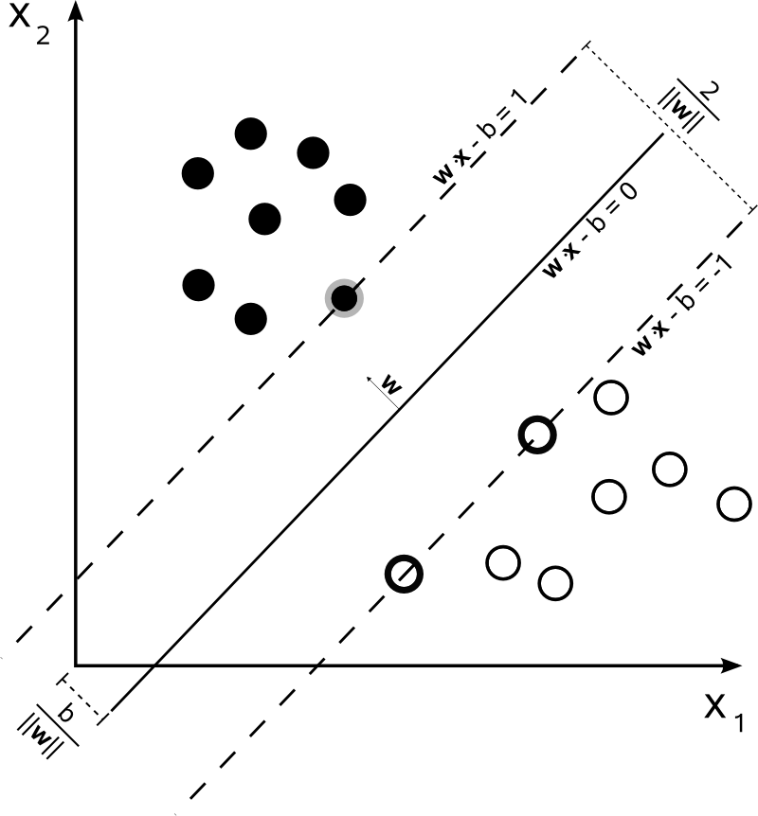
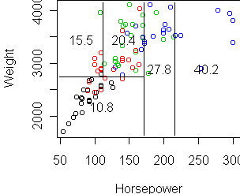
Most key “Big Data” Tech is not new!
Data Mining and Analytics – Think Peterffy in Wall Street, 1969!
Machine Learning – Roots in 1980s AI; Took off in the 1990s

Slide 22
Most key “Big Data” Tech is not new!
Data Mining and Analytics – Think Peterffy in Wall Street, 1969!
Machine Learning – Roots in 1980s AI; Took off in the 1990s

Slide 23
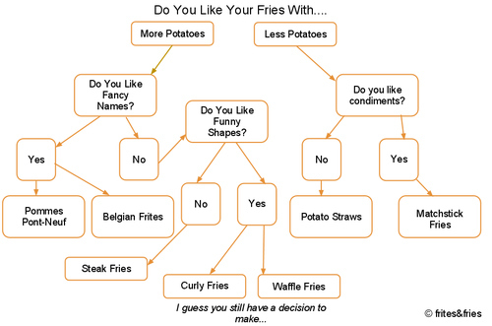
Most key “Big Data” Tech is not new!
Data Mining and Analytics – Think Peterffy in Wall Street, 1969!
Machine Learning – Roots in 1980s AI; Took off in the 1990s

Slide 24

Most key “Big Data” Tech is not new!
Data Mining and Analytics – Think Peterffy in Wall Street, 1969!
Machine Learning – Roots in 1980s AI; Took off in the 1990s
Data Distribution – J.C.R. Licklider & the “Galactic Network” in 1962
  Also Al Gore
  And about a hundred other key names

Slide 25
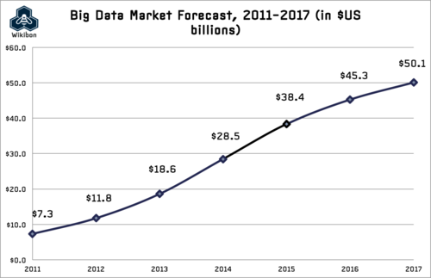
No Small thing

Slide 26
Fields we see Big Data In
Operations Analysis (think Logistics; Walmart; Target)
Predictive Modeling (think Wallstreet; Climate)
Fraud Detection & Security (think Visa and those automated phone calls)
Customer Relationship Management (Recommended Things to Buy; Preferred Means of Communication)
Physics and High-Energy Modeling

Slide 27
Big Data @ W&M
How can we apply Big Data to new fields?
  Government (Social Networks; Text Mining)
  International Development (AidData)
  Neuroscience / Biology (Brain Deformation)
  Anthropology (LIDAR)
  History (Text Mining)
  Business (Business Analytics)

Slide 28
Big Data @ W&M
How can we apply Big Data to new fields?
  Government (Social Networks; Text Mining)
  International Development (AidData)
  Neuroscience / Biology (Brain Deformation)
  Anthropology (LIDAR)
  History (Text Mining)
  Business (Business Analytics)

Slide 29
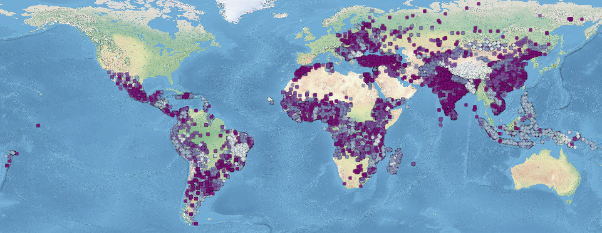
There are millions of ideas
in international development.

Slide 30
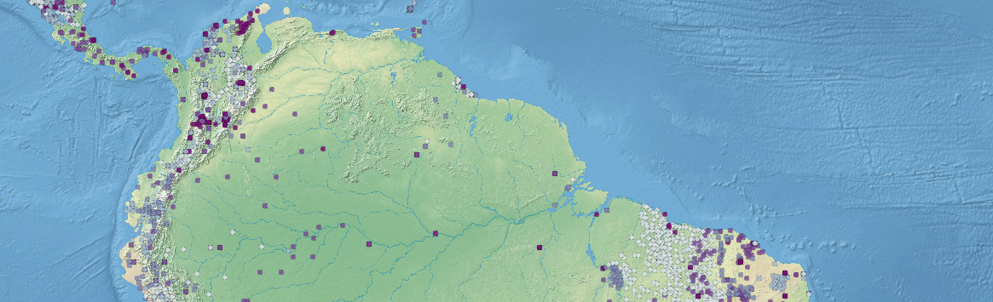
How can we tell good from bad in
a cost effective way?

Slide 31
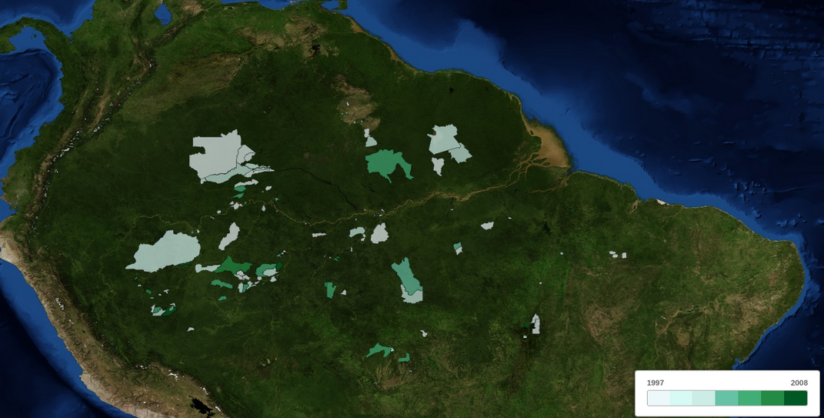
Estimating Impact
Using Satellite Data
& Aid Location

Slide 32
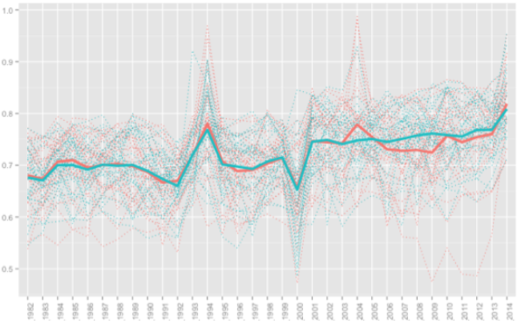

Slide 33
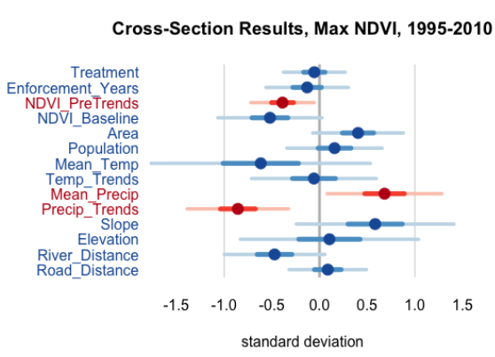

Slide 34
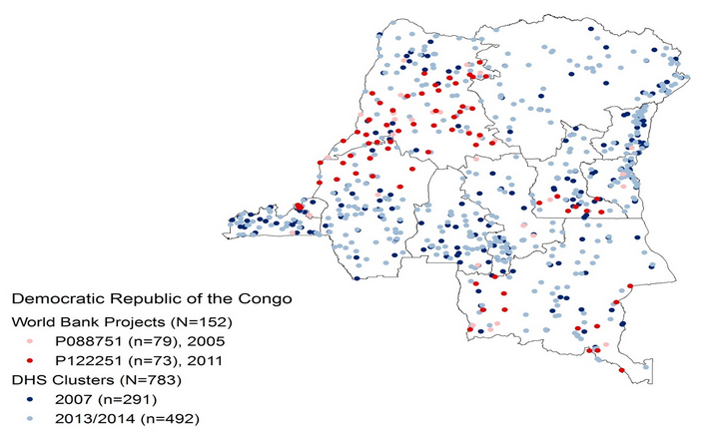

Slide 35
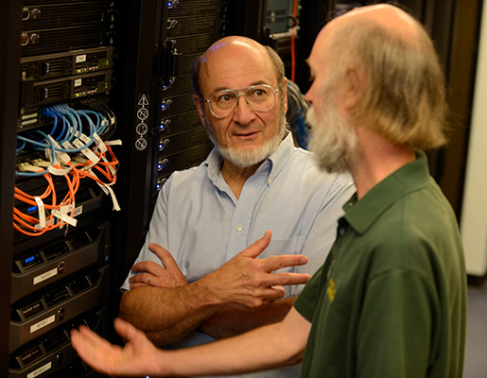


Enter the machines...

Slide 36

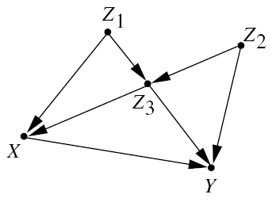
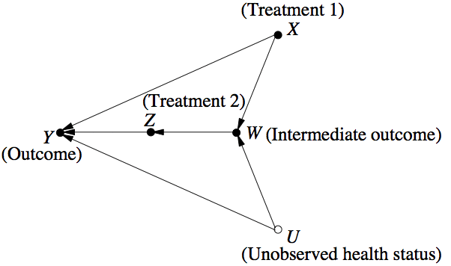
Judea Pearl & Causality

Slide 37



Slide 38


Slide 39
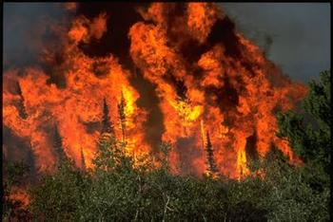

Slide 40


Slide 41


Slide 42
Soil Quality
Slope
Elevation

Slide 43
Land
Tenure
GDP
Conflict
Global
Econ
Local
Economy
Pop
Soil Quality
Slope
Elevation

Slide 44
Land
Tenure
GDP
Conflict
Global
Econ
Local
Economy
Pop
Soil Quality
Slope
Elevation

Slide 45
Land
Tenure
GDP
Conflict
Global
Econ
Local
Economy
Pop
Soil Quality
Slope
Elevation

Slide 46
Land
Tenure
GDP
Conflict
Global
Econ
Local
Economy
Pop
Soil Quality
Slope
Elevation

Slide 47
Land
Tenure
GDP
Conflict
Global
Econ
Local
Economy
Pop
Soil Quality
Slope
Elevation

Slide 48
Land
Tenure
GDP
Conflict
Global
Econ
Local
Economy
Pop
Soil Quality
Slope
Elevation

Slide 49
Land
Tenure
GDP
Conflict
Global
Econ
Local
Economy
Pop
Soil Quality
Slope
Elevation

Slide 50
Land
Tenure
GDP
Conflict
Global
Econ
Local
Economy
Pop
Soil Quality
Slope
Elevation

Slide 51
Land
Tenure
GDP
Conflict
Global
Econ
Local
Economy
Pop
Soil Quality
Slope
Elevation

Slide 52
Land
Tenure
GDP
Conflict
Global
Econ
Local
Economy
Pop
Soil Quality
Slope
Elevation

Slide 53

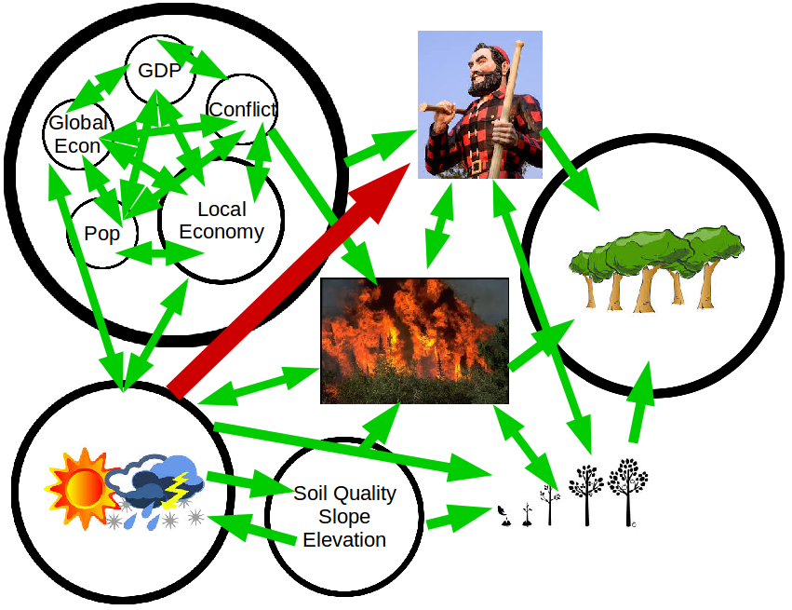
Land
Tenure
“Hey, Peter, would you do me a quick favor?”
- Dan Runfola, 2015

Slide 54
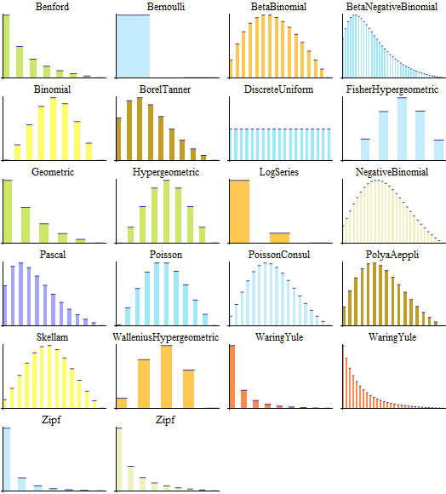

Slide 55

Peter Kemper
Jianing Zhao
kemper@cs.wm.edu
jzhao02@email.wm.edu
Orig. Cor: 0.75
Adj. Cor: 0.25

Slide 56
Land
Tenure
GDP
Conflict
Global
Econ
Local
Economy
Pop
Soil Quality
Slope
Elevation

Slide 57
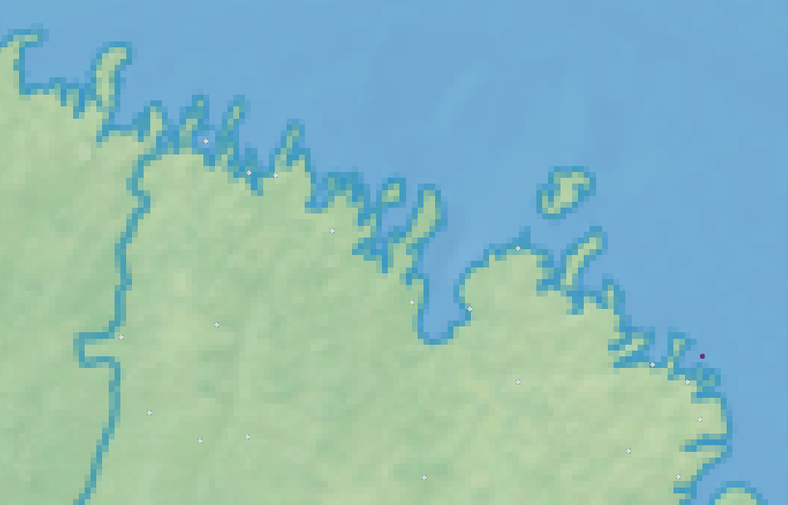

Slide 59
Low Impact
on Forest Cover
High Impact
on Forest Cover

