Slide 1
Prologue: Steps in Decision Making

Slide 2
Steps
Step 1: Characterize Goals
Step 2: Collect Data
Step 3: Survey
Step 4: Integrate Information
Step 5: Forecast
Step 6: Analysis
Step 7: Option Analysis
Step 8: Post-decision Assessment

Slide 3

The problem
USACE (United States Army Corps of Engineers) has thousands of projects throughout the country
Only some of them can be improved
These improvements must be chosen in light of uncertainty in the future!

Slide 4

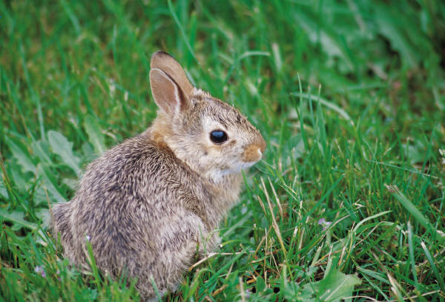
Step 1: Characterize Goals
This (real world) example will focus on just two groups in USACE, flood risk and ecosystem restoration.
Flood risk seeks to spend money on projects which MINIMIZE the risk of potential flooding events.
Ecosystem Restoration seeks to spend money on projects which MAXIMIZES environmental carrying capacity.

Slide 5

Step 2: Collect Data
During this step, we collected environmental data (“indicators”) that gave us information on Flood Risk and Ecosystem Restoration:
How many people live in different flood plains?
We could target spending at areas with higher flood plain populations.
What species are at risk in different areas?
We could target spending at
areas with higher risk.

Slide 6
Step 3: Survey
Identify impacts or additional risk factors that may not be directly related to the task at hand (e.g., legal restrictions on funding; economic information)
Participation in flood insurance programs (how much would the occurrence of a flood impact a community?)
The level of protection already granted to some areas (no need to fund already well protected species)

Slide 7

Step 4: Integrate Information
All of this information was combined using a variety of database technologies (Both GIS and Tabular).
While easy to describe, this step is frequently the most time consuming in a project.

Slide 8


Step 5: Forecast
For each indicator that was collected, how that indicator would change over time was projected for a variety of scenarios.
Scenario – A set of assumptions about the future. E.g., the Special Report on Emissions Scenarios (SRES).
In our case: how many people do we expect to move in to flood plains?

Slide 9
Step 6: Analysis
At this stage, each area had information on flood risk and ecosystem restoration
But how to combine these indicators into actionable information?
Methods:
Analytical Hierarchy Process for Weighting – how important are things relative to each other?
Aggregation techniques (Data Envelopement Analysis / Ordered Weighted Ordered Aggregation)

Slide 10

Step 7: Option Analysis
Once the relative importance of each area is known, investments can be made.
However, many different investment options (e.g., do we build a damn or a levy?)
Tools such as AHP, Cost-benefit analysis, and game theory can help to select the best options.

Slide 11
Step 8: Post-decision Assessment
After the decision is made and implemented, funding to assess how accurate the decision making process was can be helpful in anticipating uncertainty in future projects.
A sensitivity analysis is also generally warranted at this step.

Slide 12
Summary
Step 1: Characterize Goals
Step 2: Collect Data
Step 3: Survey
Step 4: Integrate Information
Step 5: Forecast
Step 6: Analysis
Step 7: Option Analysis
Step 8: Post-decision Assessment

Slide 13
Introduction to Data-driven Decision Methods
“More than ever we need to learn what works and what does not, and to determine what is required to address the most important environmental and health risks of the early twenty-first century”
- Michael E. Kraft

Slide 14
Today’s Goals
When are decision methods helpful?
What are some different types of strategies for decision making?

Slide 15
Data Reduction
The name of the game!
Humans are very bad at interpreting large amounts of information at once.
Which option, or combination of options, is best?
Proposal | Cost (Millions) | Location | Length (Years) | Carbon Sequest.
A | 60 | New York | 5 | 500
B | 70 | Atlanta | 6 | 400
C | 90 | Chicago | 10 | 1000

Slide 16
Where does funding go?
The EPA in 1990: Funding represents public perception of environmental risk, rather than scientific findings.
Are visible problems (e.g., superfunds!) more important, or less visible (e.g., greenhouse emissions).
“Science vs. the Public” or “The Public vs. Public interests”?

Slide 17
What are the costs and benefits?
Different environmental programs have estimated total costs (in economic terms), and benefits (e.g., public health).
Which have been the most effective?
Costs for who?
Benefits for who?
Environmental Justice Considerations

Slide 18
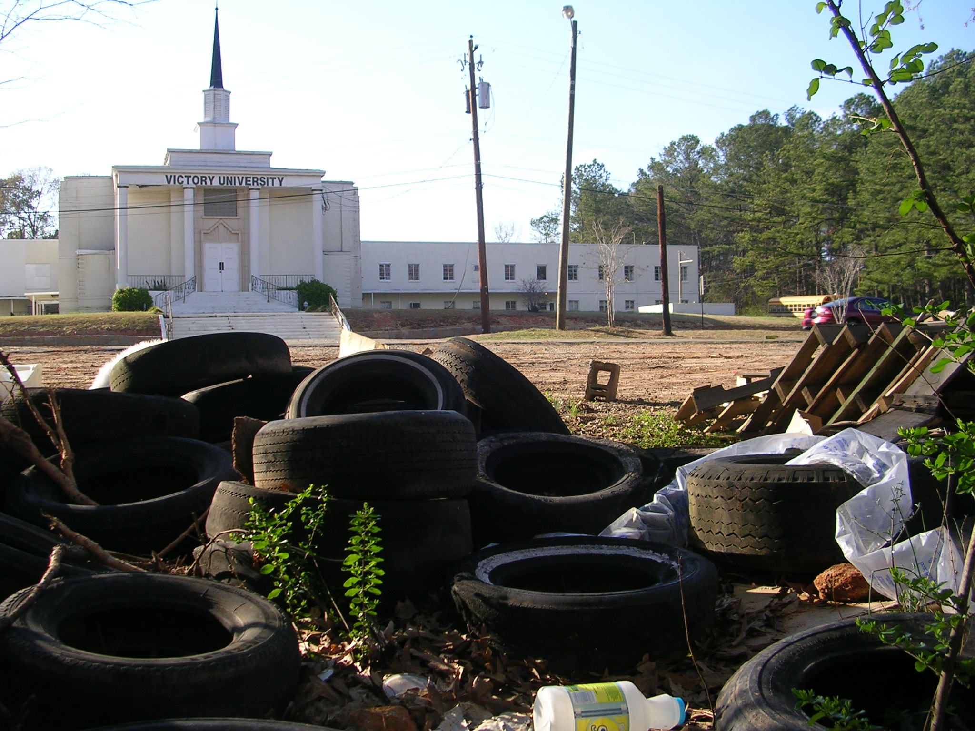

Slide 19
Today’s Goals
When are decision methods helpful?
What are some different types of strategies for decision making?

Slide 20
Cost/Benefit Analysis
Use: Choosing between different options
Strengths: Widely used, simple to describe
Weaknesses: Hard to quantify costs/benefits in many situations.

Slide 21

Decision Trees
Use: Choosing options; understanding the implications of choices
Strengths: Can be used to examine complex decision paths and the costs/risks potentially associated with them.
Weaknesses: Probabilities and costs can be very subjective. Path-dependency can be problematic.

Slide 22
Analytical Hierarchy Process
Use: Weighting various choices when strengths may not be evident.
Strengths: Can be used to make preferences evident, easy to teach users.
Weaknesses: Difficult for decision makers to implement.

Slide 23

Linear Programming
Use: Find an optimal solution given a set of parameters.
Strengths: Allows for the single “best” solution to be identified, given many different allocations of funding.
Weaknesses: Requires all inputs to be quantified. Can be sensitive to optimization algorithm choice.

Slide 24
Geographic Information Systems
Use: Display data using a geographic representation to identify spatial patterns.
Strengths: Allows for the identification of spatial patterns in data (e.g., areas with a high concentration of superfund sites).
Weaknesses: Requires specialized training. Software can be expensive.

Slide 25
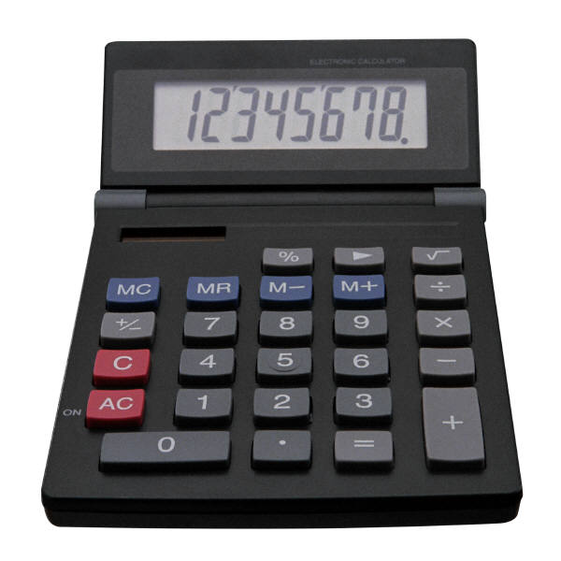
Aggregation Techniques
Use: Combine disparate measures into single indexes
Strengths: Allows individuals to reduce many data sources into single, easily interpretable measures. Very helpful for communicating to policy makers.
Weaknesses: Can be mathematically complex, require preference weighting, can mask important information.

Slide 26
Different Methods / Strategies
Cost/Benefit Analysis
Decision Trees
Analytical Hierarchy Process
Linear Programming
Geographic Information Systems
Aggregation Techniques

Slide 27
Assignment 1 Discussion

Slide 28
Goals
When are decision methods helpful?
Data Reduction
Navigate differences in opinion of different people
Overcome perception of environmental risks
Establish costs/benefits for different methods, as well as who receives benefits and who pays the costs.
What are some different types of strategies for environmental decision making?
Cost/Benefit Analysis; Decision Trees; AHP; Linear Programming; GIS; Aggregation

Slide 29
“Kudzu, an exotic plant introduced into the southeastern United States to prevent soil erosion, has grown out of control, covering in some places not only the ground but also trees, telephone poles, and buildings.”
- Mary R. English

Slide 30
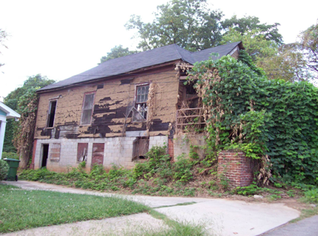

Slide 31
Goals
What is a common process for environmental decision making?
How do I choose what tool to use?

Slide 32
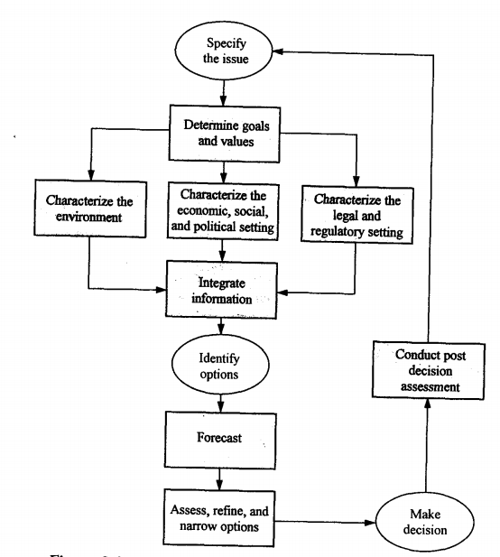
The Decision Making Process
Specify the Issue
Determine Goals and Values
Characterize the decision making context
Integrate Information
Identify options
Forecast
Assess options
Make decisions
Conduct post-decision assessments

Slide 33
Determine Goals and Values
What exactly is the goal?
A hard question!
Different groups WILL have different goals.
Preference Analysis can be helpful here (e.g., AHP! We’ll learn this later).
Example:
We want to minimize vulnerability to floods
What is vulnerability?

Slide 34
Characterize the Context
How quickly does the decision need to be made?
Are their specific approaches that are dictated by law (e.g., cost/benefit)?
Who will bear the costs and the benefits of options?
What is the type of decision?
Emergency (Pre-appointed Managers / Rapid)
Routine (Relies on familiarity with the situation)
Analysis-Centered (One ultimate decision maker)
Elite Corps (Very slow long term / multiple decision makers)
Conflict Management (What is sufficient information?)
Collaborative Learning

Slide 35
Integrate Information
What data is needed to measure the chosen issue?
Example: What is the best location to build a new building on Clark’s campus?
What type of database is most appropriate (GIS? Tabular? Relational?)

Slide 36
Identify Options
What are the potential options?
What are the attributes of each option (costs, benefits)?
What are secondary attributes of each option (e.g., environmental justice concerns)?

Slide 37
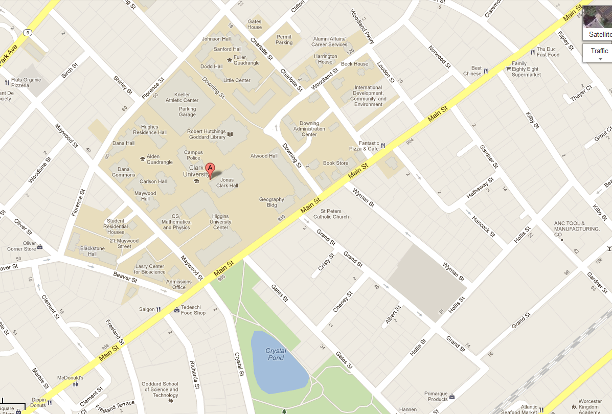
Identify Options
A
C
B

Slide 38
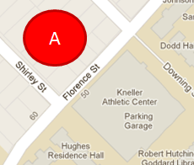
Primary Attributes
Option A: Purchase and Remove Housing
Expensive ($500,000 for land; $2,000,000 for building)
Borders existing Campus
Environmental net benefit (more trees will be planted in the area)

Slide 39
Secondary Attributes
Option A: Purchase and Remove Housing
Likely limited opposition from local groups
May reduce traffic in the area

Slide 40
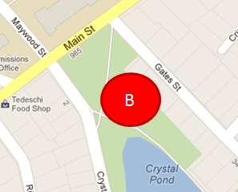
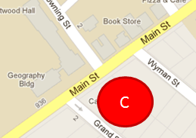
Identify Options
Site | Cost | Distance | Environment | Local Sentiment | Traffic
A | High | Close | Neutral | Neutral | Mid
B | Low | Far | Negative | Negative | High
C | Medium | Close | Neutral | Negative | High

Slide 41
Forecast
What will the information you collected look like in the future under each potential option?
What do short and long-term costs and benefits look like?

Slide 42
Forecast
Option A: Purchase and Remove Housing
Scenario A: Clark grows rapidly (6000 new students in 2020)
Scenario B: Clark stays at the same enrollment (~3000 students in 2020)
Scenario C: Clark enrollment shrinks (2000 students total in 2020)

Slide 43
What will each option look like under the “more students” scenario?
 | Cost | Distance | Environment | Local Sentiment | Traffic
A | High | Close | Positive | Negative | High
B | Low | Close | Negative | Negative | High
C | Medium | Close | Neutral | Negative | High

Slide 44
Make Decisions
Make a decision based on the given decision strategy.
Cost-benefit analysis
Probabilistic Risk Assessment
Decision Tree Analysis
Linear Programming / Optimization

Slide 45
Which option do we want to choose?
“Low” enrollment scenario
 | Cost | Distance | Environment | Local Sentiment | Traffic
A | High | Close | Positive | Positive | Low
B | Low | Far | Negative | Negative | High
C | Medium | Close | Neutral | Negative | High
“High” enrollment scenario
 | Cost | Distance | Environment | Local Sentiment | Traffic
A | High | Close | Positive | Negative | High
B | Low | Close | Negative | Negative | High
C | Medium | Close | Neutral | Negative | High
“Current” enrollment scenario
Site | Cost | Distance | Environment | Local Sentiment | Traffic
A | High | Close | Neutral | Neutral | Mid
B | Low | Far | Negative | Negative | High
C | Medium | Close | Neutral | Negative | High

Slide 46
Which option do we want to choose?
“Low” enrollment scenario (Probability = 20%)
 | Cost | Distance | Environment | Local Sentiment | Traffic
A | High | Close | Positive | Positive | Low
B | Low | Far | Negative | Negative | High
C | Medium | Close | Neutral | Negative | High
“High” enrollment scenario (Probability = 20%)
 | Cost | Distance | Environment | Local Sentiment | Traffic
A | High | Close | Positive | Negative | High
B | Low | Close | Negative | Negative | High
C | Medium | Close | Neutral | Negative | High
“Current” enrollment scenario (Probability = 60%)
Site | Cost | Distance | Environment | Local Sentiment | Traffic
A | High | Close | Neutral | Neutral | Mid
B | Low | Far | Negative | Negative | High
C | Medium | Close | Neutral | Negative | High

Slide 47
Which option do we want to choose?
“Low” enrollment scenario (Probability = 20%)
 | Cost | Distance | Environment | Local Sentiment | Traffic
A | High (1) | Close (3) | Positive (3) | Positive (3) | Low (3)
B | Low (3) | Far (1) | Negative (1) | Negative (1) | High (1)
C | Medium (2) | Close (3) | Neutral (2) | Negative (1) | High (1)

Slide 48
Which option do we want to choose?
“Low” enrollment scenario (Probability = 20%)
 | Cost | Distance | Environment | Local Sentiment | Traffic
A | 1 | 3 | 3 | 3 | 3
B | 3 | 1 | 1 | 1 | 1
C | 2 | 3 | 2 | 1 | 1
“High” enrollment scenario (Probability = 20%)
 | Cost | Distance | Environment | Local Sentiment | Traffic
A | 1 | 3 | 3 | 1 | 1
B | 3 | 3 | 1 | 1 | 1
C | 2 | 3 | 2 | 1 | 1
“Current” enrollment scenario (Probability = 60%)
Site | Cost | Distance | Environment | Local Sentiment | Traffic
A | 1 | 3 | 2 | 2 | 2
B | 3 | 1 | 1 | 1 | 1
C | 2 | 3 | 2 | 1 | 1

Slide 49
Which option do we want to choose?
“Low” enrollment scenario (Probability = 20%)
 | Cost | Distance | Environment | Local Sentiment | Traffic
A | 1 | 3 | 3 | 3 | 3
B | 3 | 1 | 1 | 1 | 1
C | 2 | 3 | 2 | 1 | 1
Benefits

Slide 50
Which option do we want to choose?
“Low” enrollment scenario (Probability = 20%)
 | Distance | Environment | Local Sentiment | Traffic | Sum
A | 3 | 3 | 3 | 3 | 12
B | 1 | 1 | 1 | 1 | 4
C | 3 | 2 | 1 | 1 | 7
Benefits
Sum

Slide 51
Which option do we want to choose?
“Low” enrollment scenario (Probability = 20%)
 | Distance | Environment | Local Sentiment | Traffic | Sum
A | 3 | 3 | 3 | 3 | 12 * (0.2)
B | 1 | 1 | 1 | 1 | 4 * (0.2)
C | 3 | 2 | 1 | 1 | 7 * (0.2)
Benefits
Sum

Slide 52
Which option do we want to choose?
“Low” enrollment scenario (Probability = 20%)
 | Benefit of Low Enrollment Scenario
A | 12 * (0.2) = 2.4
B | 4 * (0.2) = 0.8
C | 7 * (0.2) = 1.4

Slide 53
Which option do we want to choose?
“Low” enrollment scenario (Probability = 20%)
 | Cost | Distance | Enviro | Sent | Traffic | Sum
A | 1 | 3 | 3 | 3 | 3 | 12 * (0.2) = 2.4
B | 3 | 1 | 1 | 1 | 1 | 4 * (0.2) = 0.8
C | 2 | 3 | 2 | 1 | 1 | 7 * (0.2) = 1.4
“High” enrollment scenario (Probability = 20%)
 | Cost | Distance | Enviro | Sent | Traffic | Sum
A | 1 | 3 | 3 | 1 | 1 | 10 * (0.2) = 2
B | 3 | 3 | 1 | 1 | 1 | 9 * (0.2) = 1.8
C | 2 | 3 | 2 | 1 | 1 | 10 * (0.2) = 2
“Current” enrollment scenario (Probability = 60%)
Site | Cost | Distance | Enviro | Sent | Traffic | Sum
A | 1 | 3 | 2 | 2 | 2 | 10 * (0.6) = 6
B | 3 | 1 | 1 | 1 | 1 | 7 * (0.6) = 4.2
C | 2 | 3 | 2 | 1 | 1 | 9 * (0.6) = 5.4

Slide 54
Which option do we want to choose?
“Low” enrollment scenario (Probability = 20%)
 | Cost | Sum
A | 1 | 12 * (0.2) = 2.4
B | 3 | 4 * (0.2) = 0.8
C | 2 | 7 * (0.2) = 1.4
“High” enrollment scenario (Probability = 20%)
 | Low | High | Current | Sum
A | 2.4 | 2 | 6 | 10.4
B | 0.8 | 1.8 | 4.2 | 6.8
C | 1.4 | 2 | 5.4 | 8.8
 | Cost | Sum
A | 1 | 10 * (0.2) = 2
B | 3 | 9 * (0.2) = 1.8
C | 2 | 10 * (0.2) = 2
“Current” enrollment scenario (Probability = 60%)
Site | Cost | Sum
A | 1 | 10 * (0.6) = 6
B | 3 | 7 * (0.6) = 4.2
C | 2 | 9 * (0.6) = 5.4

Slide 55
Post-Decision Analysis
Sensitivity analysis: What is the confidence in your proposed decision, in the context of uncertainty?
How well did the solution perform?
Why did it perform well?

Slide 56
Summary: Decision Making Process
Specify the Issue
Determine Goals and Values
Characterize the decision making context
Integrate Information
Identify options
Forecast
Assess options
Make decisions
Conduct post-decision assessments

Slide 57
Today’s Goals
What is a common process for environmental decision making?
How do I choose what tool to use?

Slide 58
What tool to use?
Honesty
Freedom from Bias
Intelligibility
Complementarity
Proportionality
Flexibility
Time
Cost
Training
Equipment

Slide 59
Honesty
Does the method convey uncertainties?
How precise is the analysis? Is this communicated?

Slide 60
Freedom from Bias
How sensitive is the method to subjective decisions?
Can all potential impacts be quantified and included?
Are you intentionally discluding any type(s) of data because it does not fit into a given framework?

Slide 61
Intelligibility
Can you convey the methods and results to non-experts?
Can the method be used for both small and large scale decision making?
CRITICAL!!!

Slide 62
Complementarity, Proportionality, Flexibility
Tools selected should be efficient:
Complementarity: They should complement other tools used
Proportionality: The precision of the tool should be considered (e.g., if subjective decisionmaking is important to the tool, very precise data may be unnecessary or misleading)
Flexibility: The tool should be flexible in accompanying changes to the project.

Slide 63
Time, Cost, Training and Equipment
Tools selected need to make sense!
Time! Methods take a variable amount of time to implement. Don’t take a method which will take 6-months for a decision that needs to be made in a week!
Cost Solutions which are appropriate for very large institutions may not be appropriate for neighborhood organizations.
Training How long will it take to learn the method? How much will it cost? Do you have staff available that know it already? Will executives need to be trained?
Equipment Do you need any specialized equipment? How much will it cost? How long will it take to arrive and configure?

Slide 64
What tool to use?
Honesty
Freedom from Bias
Intelligibility
Complementarity
Proportionality
Flexibility
Time
Cost
Training
Equipment

