Slide 1
GIS: The Basics
A true Whirlwind Tour
With many thanks to Ron Briggs for great examples.

Slide 2
Spatial and Attribute Data
Spatial data (where)
  specifies location
  stored in a shape file, geodatabase or similar geographic file
Attribute (descriptive) data (what, how much, when)
  specifies characteristics at that location, natural or human-created
  stored in a data base table
GIS systems traditionally maintain spatial and attribute data separately, then “join” them for display or analysis
  for example, in ArcView, the Attributes of … table is used to link a shapefile (spatial structure) with a data base table containing attribute information in order to display the attribute data spatially on a map

Slide 3
Representing Data with Raster and Vector Models
Raster Model
area is covered by grid with (usually) equal-sized, square cells
attributes are recorded by assigning each cell a single value based on the majority feature (attribute) in the cell, such as land use type.
Image data is a special case of raster data in which the “attribute” is a reflectance value from the geomagnetic spectrum
  cells in image data often called pixels (picture elements)
Vector Model
The fundamental concept of vector GIS is that all geographic features in the real work can be represented either as:
points or dots (nodes): trees, poles, fire plugs, airports, cities
lines (arcs): streams, streets, sewers,
areas (polygons): land parcels, cities, counties, forest, rock type
Because representation depends on shape, ArcView refers to files containing vector data as shapefiles

Slide 4
Concept of
Vector and Raster
Real World
Raster Representation
Vector Representation
point
line
polygon

Slide 5
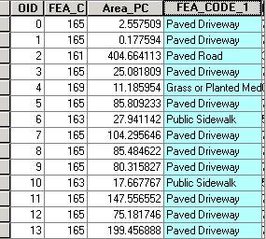
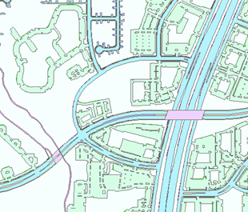
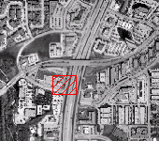
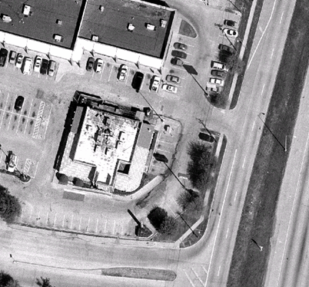
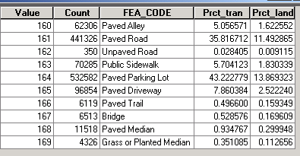
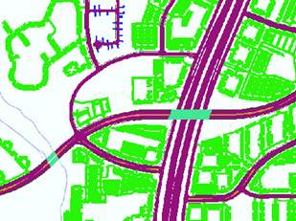
Dumb Images
& Smart GIS Data
Smart Vector—Pavement polygons
Smart Raster—5 feet grids
Images—dumb rasters
(although they look good!)

Slide 6
Projection, Scale, Accuracy and Resolution the key properties of spatial data
Projection: the method by which the curved 3-D surface of the earth is represented by X,Y coordinates on a 2-D flat map/screen
  distortion is inevitable
Scale: the ratio of distance on a map to the equivalent distance on the ground
  in theory GIS is scale independent but in practice there is an implicit range of scales for data output in any project
Accuracy: how well does the database info match the real world
  Positional: how close are features to their real world location?
  Consistency: do feature characteristics in database match those in real world
    is a road in the database a road in the real world?
  Completeness: are all real world instances of features present in the database?
    Are all roads included.
Resolution: the size of the smallest feature able to be recognized
  for raster data, it is the pixel size
The tighter the specification, the higher the cost.

Slide 7
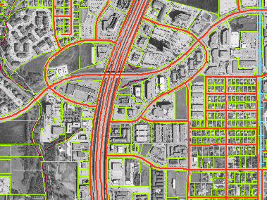
Overlay based on Common Geographic Location

Slide 8
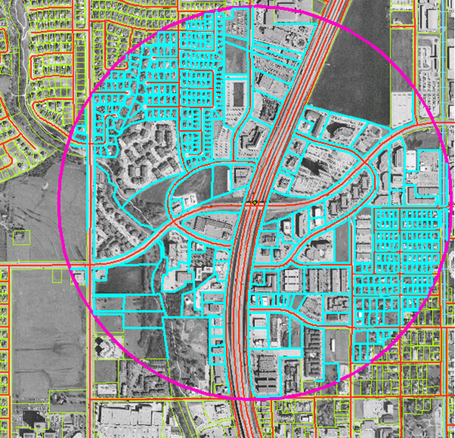
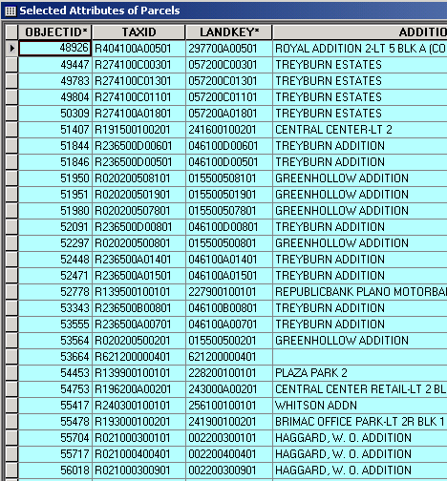
Analysis
Data Table
Scanned Drawing
Photographic Image
Parcels within a half mile buffer of Park and Central

Slide 9
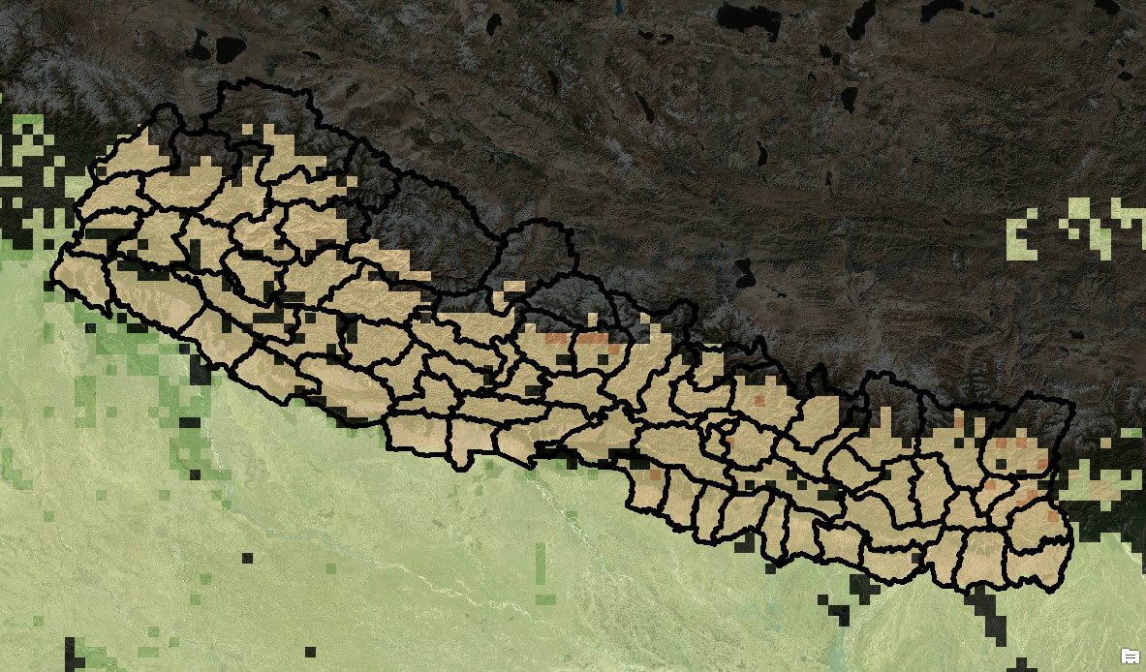

Practical Example for Ya'll:
Agricultural Gap Ratio

Slide 10
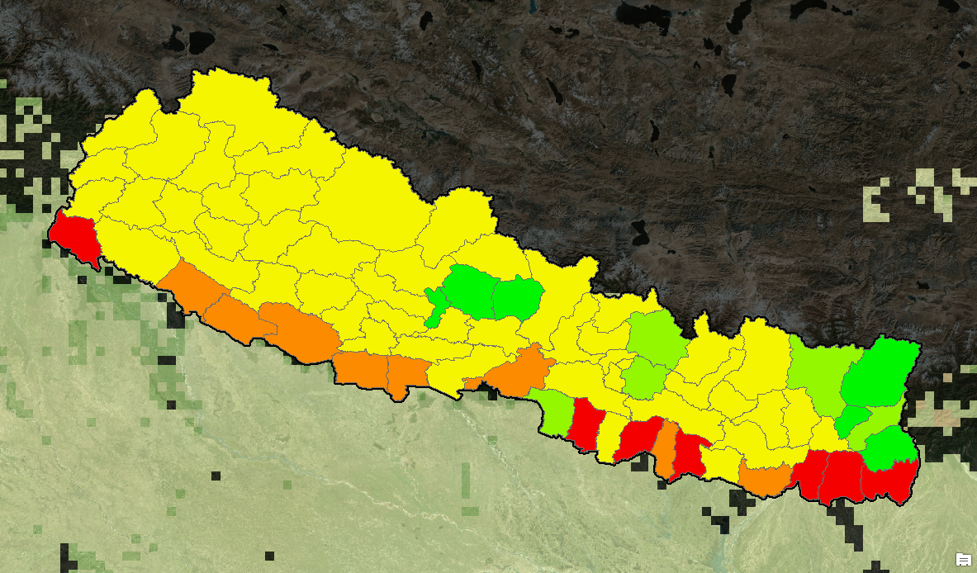

Agricultural Gap Ratio

Slide 11
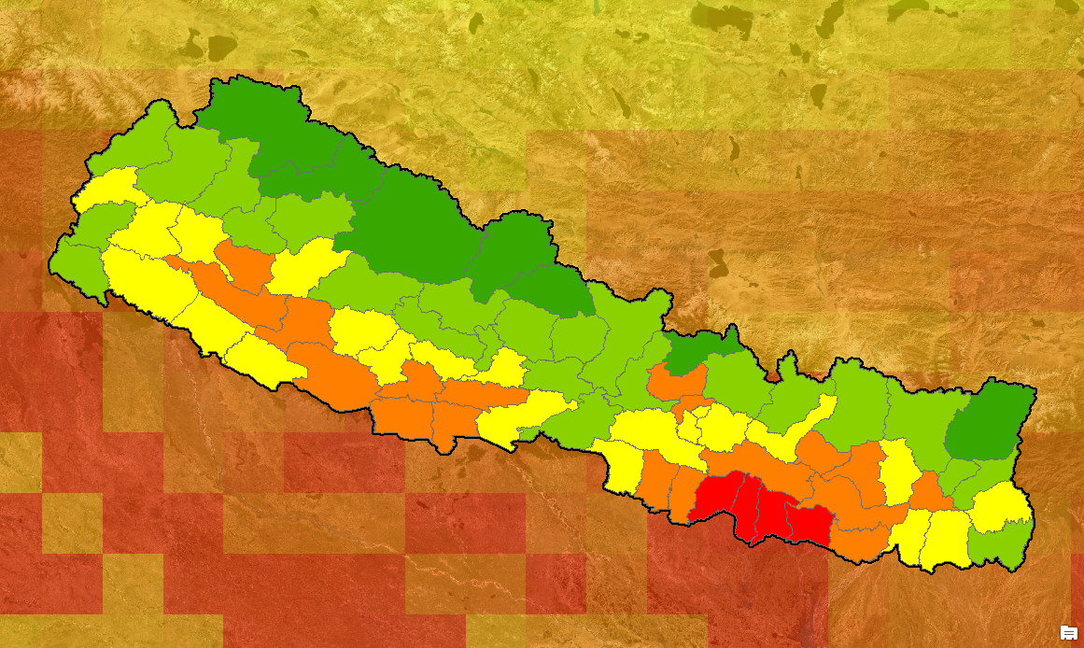

Human Watershed Stress

Slide 12
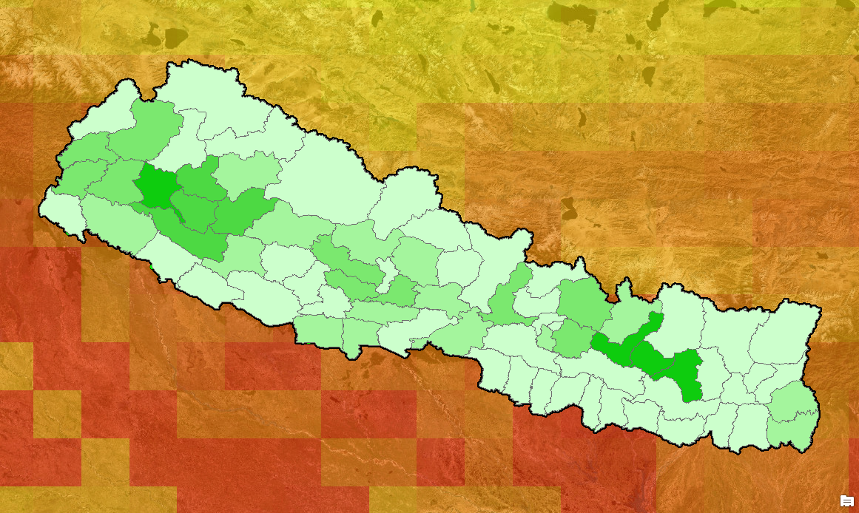

Current Aid Allocation

Slide 13
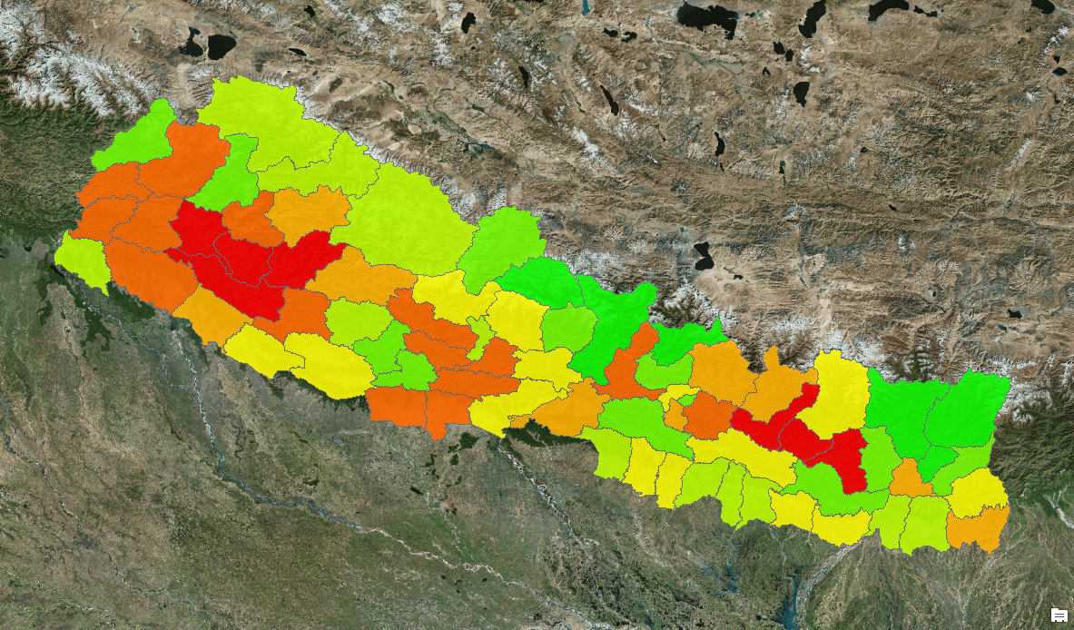
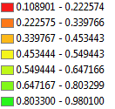

Weighting Indicators (AHP)

Slide 14
How to Actually Do This:
A Live Example that Might
Break a Few Times

