Slide 1
Project 1

Slide 2
Reading Assignment 1

Slide 3
Bayes vs. Frequentist
A coin ends up heads with probability p and tails 1-p.
You flip a coin 14 times. It’s heads 10 times.
I bet you $100 that, for the next two tosses, you will get two heads in a row.
http://www.behind-the-enemy-lines.com/2008/01/are-you-bayesian-or-frequentist-or.html

Slide 4
Frequentist
You flip a coin 14 times. It’s heads 10 times.
What’s the probability of heads the next 2 times?
http://www.behind-the-enemy-lines.com/2008/01/are-you-bayesian-or-frequentist-or.html

Slide 5
Frequentist
You flip a coin 14 times. It’s heads 10 times.
What’s the probability of heads the next 2 times?
10 / 14 = .714; .714^2 = 0.51
http://www.behind-the-enemy-lines.com/2008/01/are-you-bayesian-or-frequentist-or.html

Slide 6
Bayes
You flip a coin 14 times. It’s heads 10 times.
What’s the probability of heads the next 2 times?
http://www.behind-the-enemy-lines.com/2008/01/are-you-bayesian-or-frequentist-or.html

Slide 7
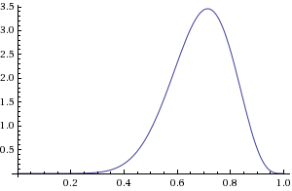
Bayes
First, estimate the distribution – i.e., solve a function from which the coins you tossed came from. Example: beta(11,5) (those a,b parameters).
Now, use this distribution to solve for the probability of two heads in a row. Requires hard distributional assumptions (“priors”).
http://www.behind-the-enemy-lines.com/2008/01/are-you-bayesian-or-frequentist-or.html

Slide 8
Prompt
Layman’s description on Bayesian vs. Frequentist methods?

Slide 9
Prompt
Operating Model
(aka, “Data Generation Process”)
vs.
Approximating Model

Slide 10
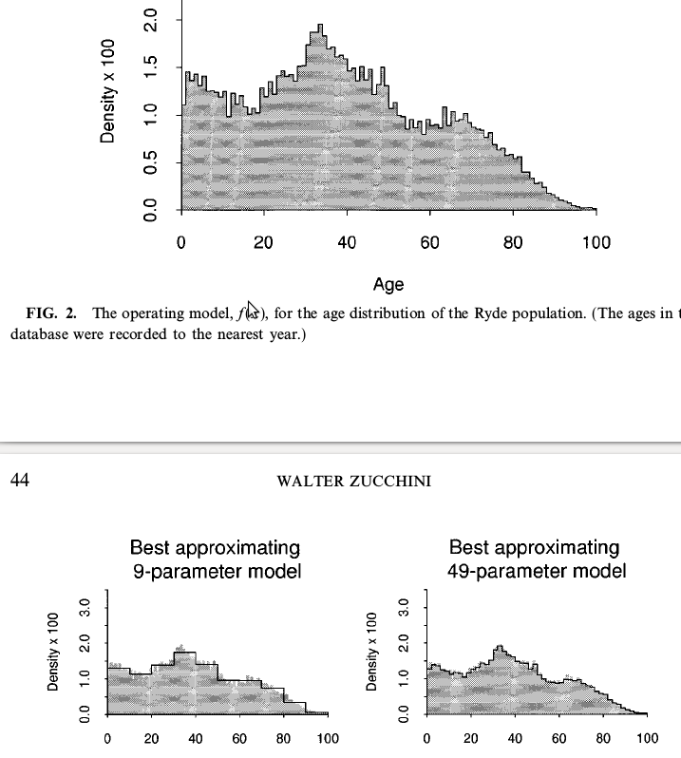
Prompt

Slide 11
Prompt
Bootstrap
vs.
Cross-Validation

Slide 12
Prompt
Parameterization of Models : how to choose the right number of parameters? What trade offs to consider?

Slide 13
Prompt
Accuracy gain – complexity vs. information loss

Slide 14
Prompt
Analysis based discrepancies – under what conditions does accuracy in your model matter?

Slide 15
Prompt
Ways to measure model fit
  How well likely is it that a model replicates the observed data?

