Slide 1
Week 3:
Asking the Right Questions

Slide 2
Prompt 1
Types and sources of Algorithmic Power?

Slide 3
Prompt 2
Example Cases

Slide 4
Prompt 3
Do all algorithms matter?

Slide 5
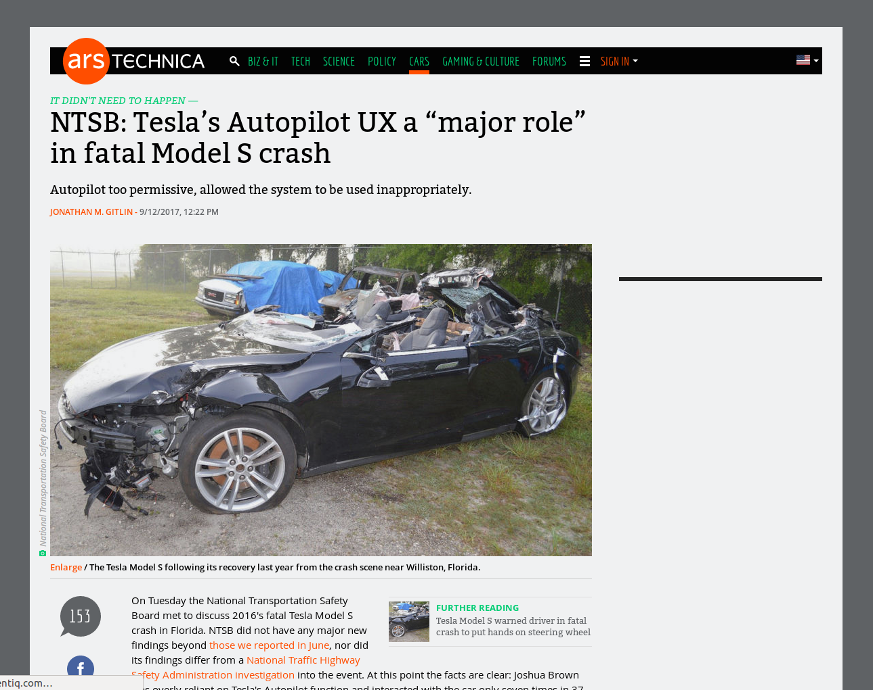

Slide 6
Prompt 4
Legality of Reverse Engineering

Slide 7
Prompt 6
Ethical and Moral Versions

Slide 8
Prompt 7
Costs of Transparency & RE

Slide 9
Github & Versioning

Slide 10
All about Modules

Slide 11
Project 1 Example

