Slide 1
Ranking Multiple Objectives :
Simple Multi-attribute
Rating Technique (SMART)
Analytical Hierarchy Process (AHP)
“It should be emphasized that the main role of our analysis is to enable the decision maker to gain an increased understanding of his or her decision problem.”
- Goodwin and Wright

Slide 2
Logistics
Lecture today and Monday
In-class work next Wed/Fri as usual
  Assignment 3 starting next Wed
    WOWA, SMART/AHP,
    GIS, Unc., Sens.
  Assignment 2 due next Friday
Assignment 1 grades are on blackboard.

Slide 3
Today’s Goals
What terminology is important?
What is an example of a multi-objective problem?

Slide 4
What is SMART?
Simple Multi-Attribute Rating Technique
Allows for multiple objectives to be weighted according to decision maker preferences.
HUC | Cost | Flood | Rain | Urban
104 | 10000 | 1 | 1 | 3
204 | 5000 | 2 | 3 | 2
1810 | 7500 | 3 | 2 | 1
Which of the above should we choose?

Slide 5
Terminology
Objective (Book Definition) – “Indication of the preferred direction of movement”.
Objective (Better Definition) – The goal(s) of your project.

Slide 6
Example Objectives
“Minimize the total costs”
“Minimize the distance between homes and fire stations”
“Maximize the exposure of a television advertisement”
“Minimize climate-related risks”

Slide 7
Terminology
Attribute – Something used to measure progress towards an objective.
Proxy Attribute – An indirect measurement of progress towards an objective.
Frequently referred to by many different names – indicators, attributes, measurements, data, columns...

Slide 8
Example Attributes
Objective: “Minimize the total costs”
Attribute: Total dollars spent on the project.
Objective: “Minimize the distance between homes and fire stations”
Attribute: Distance in meters between homes.
Objective:
“Maximize the exposure of a television advertisement”
(Proxy) Attribute:
Number of people surveyed who recall advertisement.

Slide 9
Terminology
Utility – The total worth of a course of action under risk and uncertainty (because you ALWAYS have risk and uncertainty!!!)

Slide 10
Today’s Goals
What terminology is important?
What is an example of a multi-objective problem using SMART?

Slide 11
What is SMART?
8 Stages of SMART:
Identify Decision Maker
Identify Alternative Courses of Action
Identify Relevant Attributes
Assign values to measure performance of the alternatives on that attribute
Determine a weight for each attribute
Take a weighted average of the values for each alternative
Make a provisional decision
Perform sensitivity analysis

Slide 12
What is SMART?
We (well, Dan!) prefers Mary English's steps, but thinks SMART has some helpful tools:
Identify Decision Maker
Identify Alternative Courses of Action
Identify Relevant Attributes
Assign values to measure performance of the alternatives on that attribute
Determine a weight for each attribute
Take a weighted average of the values for each alternative
Make a provisional decision
Perform sensitivity analysis

Slide 13
SMART Example: Which Office to Buy?
Location of office Annual rent ($)
Addison Square 30 000
Bilton Village 15 000
Corlisle Walk 5 000
Denver Street 12 000
Elton Street 30 000
Filton Village 15 000
Gorton Square 10 000

Slide 14
SMART Example: Which Office to Buy?
Identify Decision Maker – Us!
Identify Alternative Courses of Action – Different buildings we could buy are already identified.
Identify Relevant Attributes – What are the buildings like? All we know about them is price right now.

Slide 15
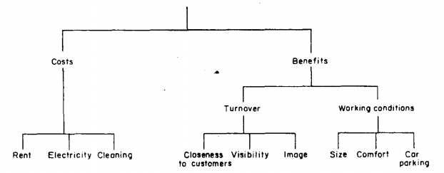
SMART: (3) Identify Relevant Attributes
Using a Value Tree:
Contains attributes of a decision.

Slide 16
SMART: (3) Using a Value Tree
A Value Tree Should Have Five(ish) Characteristics:
  Complete: All relevant attributes included.
  Operational: Need to be able to quantify “leaf” nodes.
  Decomposable / No Redundancy: Attributes must not overlap.
  Minimum size: Larger trees can become impossible to interpret.

Slide 17
Office | Rent | Electric | Cleaning | Closeness | Visibility | Image | Size | Comfort | Car Parking
Addison Square | 30,000
Bilton Village | 15,000
Corlisle Walk | 5,000
Denver Street | 12,000
Elton Street | 30,000
Filton Village | 15,000
Gorton Square | 10,000

Slide 18
SMART Example: Which Office to Buy?
Identify Decision Maker – Us!
Identify Alternative Courses of Action – Different buildings we could buy are already identified.
Identify Relevant Attributes – Value Tree.
Assign values to measure performance of the alternatives on that attribute

Slide 19
SMART: (4) Assigning Values
You can measure many attributes directly, e.g. Costs, Size (sq. feet), Distance to Customers (miles), Car Parking (# of Spaces), Visibility (number of cars/hour)
Office | Rent | Electric | Cleaning | Distance to Customers | Visibility | Image | Size | Comfort | Car Parking
Addison Square | 30,000 | 2,000 | 3,000 | 0 | 60 |  | 1000 |  | 90
Bilton Village | 15,000 | 800 | 2,000 | 4 | 80 |  | 550 |  | 30
Corlisle Walk | 5,000 | 700 | 1,000 | 1 | 70 |  | 400 |  | 100
Denver Street | 12,000 | 1,100 | 1,000 | 1.2 | 50 |  | 800 |  | 90
Elton Street | 30,000 | 2,300 | 2,500 | 2 | 60 |  | 1500 |  | 70
Filton Village | 15,000 | 2,600 | 1,000 | 8 | 0 |  | 400 |  | 0
Gorton Square | 10,000 | 900 | 1,100 | 1.3 | 100 |  | 700 |  | 80

Slide 20
SMART: (4) Assigning Values
What about things like “Image”, or “Comfort”, though?
Office | Rent | Electric | Cleaning | Distance to Customers | Visibility | Image | Size | Comfort | Car Parking
Addison Square | 30,000 | 2,000 | 3,000 | 0 | 60 |  | 1000 |  | 90
Bilton Village | 15,000 | 800 | 2,000 | 4 | 80 |  | 550 |  | 30
Corlisle Walk | 5,000 | 700 | 1,000 | 1 | 70 |  | 400 |  | 100
Denver Street | 12,000 | 1,100 | 1,000 | 1.2 | 50 |  | 800 |  | 90
Elton Street | 30,000 | 2,300 | 2,500 | 2 | 60 |  | 1500 |  | 70
Filton Village | 15,000 | 2,600 | 1,000 | 8 | 0 |  | 400 |  | 0
Gorton Square | 10,000 | 900 | 1,100 | 1.3 | 100 |  | 700 |  | 80

Slide 21
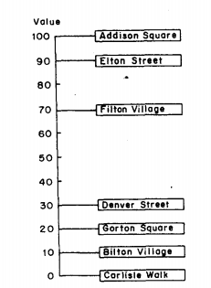
SMART: (4) Assigning Values
What about things like “Image”, or “Comfort”, though?
Rank the alternatives
Establish how big an improvement each is relative to the worst performing (e.g., the improvement from Corlisle to Filton is 7x the improvement from Corlisle to Bilton).
Check for internal consistency: is the improvement from Corlisle to Gorton comprable to Bilton to Denver?

Slide 22
SMART: (4) Assigning Values
What about things like “Image”, or “Comfort”, though?
Office | Rent | Electric | Cleaning | Distance to Customers | Visibility | Image | Size | Comfort | Car Parking
Addison Square | 30,000 | 2,000 | 3,000 | 0 | 60 | 100 | 1000 | 0 | 90
Bilton Village | 15,000 | 800 | 2,000 | 4 | 80 | 10 | 550 | 100 | 30
Corlisle Walk | 5,000 | 700 | 1,000 | 1 | 70 | 0 | 400 | 10 | 100
Denver Street | 12,000 | 1,100 | 1,000 | 1.2 | 50 | 30 | 800 | 30 | 90
Elton Street | 30,000 | 2,300 | 2,500 | 2 | 60 | 90 | 1500 | 60 | 70
Filton Village | 15,000 | 2,600 | 1,000 | 8 | 0 | 70 | 400 | 80 | 0
Gorton Square | 10,000 | 900 | 1,100 | 1.3 | 100 | 20 | 700 | 50 | 80

Slide 23
SMART: (4) Assigning Values
BUT! The improvement in an office for a 1 sq. ft. increase is better for smaller sizes than larger (at some point, additional size is irrelevant).
Office | Rent | Electric | Cleaning | Distance to Customers | Visibility | Image | Size | Comfort | Car Parking
Addison Square | 30,000 | 2,000 | 3,000 | 0 | 60 | 100 | 1000 | 0 | 90
Bilton Village | 15,000 | 800 | 2,000 | 4 | 80 | 10 | 550 | 100 | 30
Corlisle Walk | 5,000 | 700 | 1,000 | 1 | 70 | 0 | 400 | 10 | 100
Denver Street | 12,000 | 1,100 | 1,000 | 1.2 | 50 | 30 | 800 | 30 | 90
Elton Street | 30,000 | 2,300 | 2,500 | 2 | 60 | 90 | 1500 | 60 | 70
Filton Village | 15,000 | 2,600 | 1,000 | 8 | 0 | 70 | 400 | 80 | 0
Gorton Square | 10,000 | 900 | 1,100 | 1.3 | 100 | 20 | 700 | 50 | 80

Slide 24
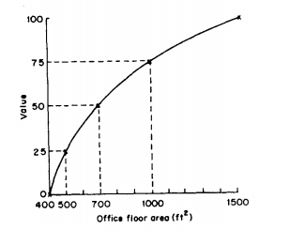
SMART: (4) Assigning Values
BUT! The improvement in an office for a 1 sq. ft. increase is better for smaller sizes than larger (at some point, additional size is irrelevant).
  Identify a subjective “turning” point between smallest area (400 sq. ft.) and the largest area (1500 sq. ft). At which point is an increase less valuable?
  Establish “quarter points” in between this turning point and the largest and smallest values.
  Plot these points out to create the value function
Office | Size
Addison Square | 1000
Bilton Village | 550
Corlisle Walk | 400
Denver Street | 800
Elton Street | 1500
Filton Village | 400
Gorton Square | 700
Turning Point | Value
400 | 0
500 | 25
700 | 50
1000 | 75
1500 | 100

Slide 25
SMART: (4) Assigning Values
By following the value functions, we can revise these two columns of data to reflect preferences.
Office | Rent | Electric | Cleaning | Distance to Customers | Visibility | Image | Size | Comfort | Car Parking
Addison Square | 30,000 | 2,000 | 3,000 | 100 | 60 | 100 | 75 | 0 | 90
Bilton Village | 15,000 | 800 | 2,000 | 20 | 80 | 10 | 30 | 100 | 30
Corlisle Walk | 5,000 | 700 | 1,000 | 80 | 70 | 0 | 0 | 10 | 100
Denver Street | 12,000 | 1,100 | 1,000 | 70 | 50 | 30 | 55 | 30 | 90
Elton Street | 30,000 | 2,300 | 2,500 | 40 | 60 | 90 | 100 | 60 | 70
Filton Village | 15,000 | 2,600 | 1,000 | 0 | 0 | 70 | 0 | 80 | 0
Gorton Square | 10,000 | 900 | 1,100 | 60 | 100 | 20 | 50 | 50 | 80

Slide 26
What is SMART?
8 Stages of SMART:
Identify Decision Maker
Identify Alternative Courses of Action
Identify Relevant Attributes
Assign values to measure performance of the alternatives on that attribute
Determine a weight for each attribute
Things we (and Mary English) already covered, so we're ignoring for now:
Take a weighted average of the values for each alternative
Make a provisional decision
Perform sensitivity analysis

Slide 27
-Interlude-
Analytical Hierarchy Process (AHP)
The basic idea: comparing two things at once is easier than ranking many things on a scale.

Slide 28
What is AHP?
5 Steps:
Set up a “decision hierarchy” (nearly identical to a Value Tree).
Make pairwise comparisons of attributes and alternatives
Transform pairwise comparisons into weights, check consistency
Use weights to obtain scores and make a provisional decision
Sensitivity analysis (surprise!)

Slide 29
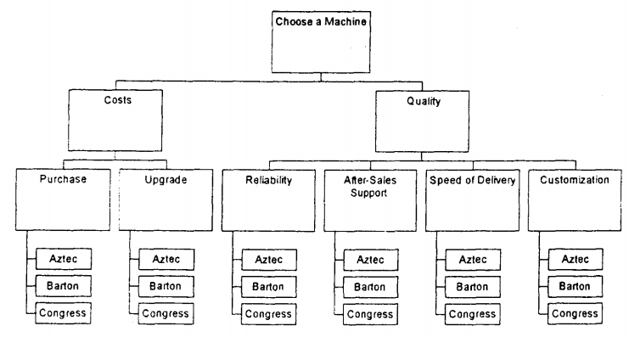
Step (1): Set Up Decision Hierarchy

Slide 30
Step (2): Make Pairwise Comparisons
Start from the top: Are Costs or Quality more important?

Slide 31
What is AHP?
5 Steps:
Set up a “decision hierarchy” (nearly identical to a Value Tree).
Make pairwise comparisons of attributes and alternatives
Transform pairwise comparisons into weights, check consistency
Use weights to obtain scores and make a provisional decision
Sensitivity analysis (surprise!)

Slide 32
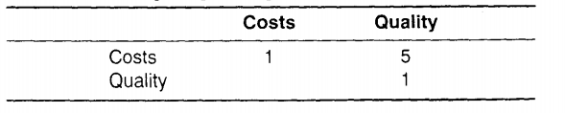
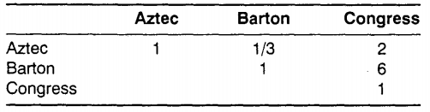
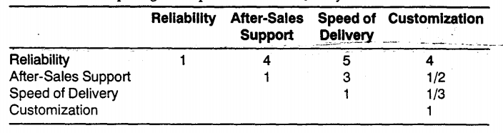
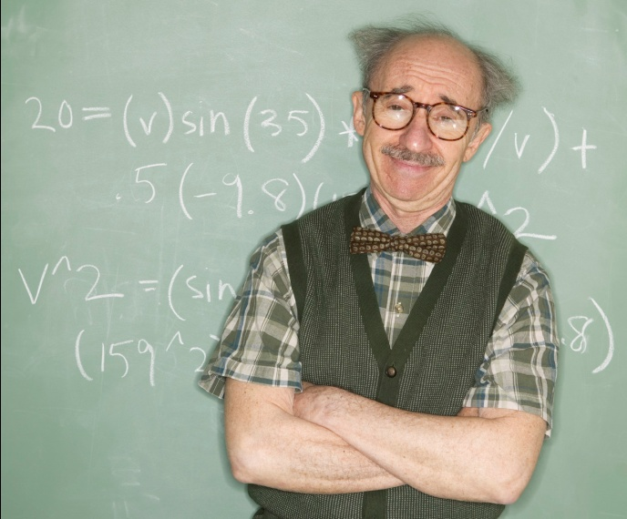
Step (3): Create Weights
Excel
Weights

Slide 33
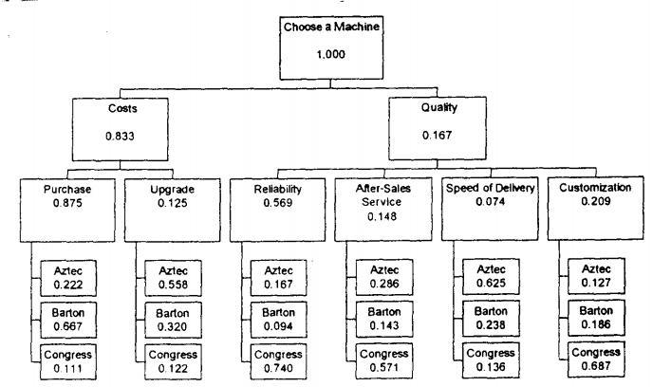
Step (3): Create Weights

Slide 34
Step (3): Examine Inconsistency
Transitivity: The decision makers preferences are consistent (e.g., A > B, C > B, Thus C > A).
Summation: If B is 3 times more important than A, and C is 2 times more important than B, C should be 6 times more important than A.

Slide 35
Step (3): Examine Inconsistency
“Inconsistency” Index: 0 indicates perfect consistency in choices; “rule of thumb” that values > 0.1 are worrisome.
More important that you understand inconsistency and how it might influence results. Correcting inconsistency may not be that important!

Slide 36
What is AHP?
5 Steps:
Set up a “decision hierarchy” (nearly identical to a Value Tree).
Make pairwise comparisons of attributes and alternatives
Transform pairwise comparisons into weights, check consistency
Use weights to obtain scores and make a provisional decision
Sensitivity analysis (surprise!)

Slide 37
Step (5): Sensitivity Analysis
Introduce uncertainty into each weight.
One rule of thumb for AHP is to use the “inconsistency” index to decide the level of uncertainty you should model within the Monte Carlo (the “consistency ratio”).

Slide 38
Today’s Goals
What terminology is important?
What is an example of a multi-objective problem?

Slide 39
Strengths of AHP
Formal structuring of the problem: The value tree itself aid in decision making.
Simplicity of pairwise comparisons
You can check the consistency of preferences

Slide 40
Weaknesses of AHP
Subjectivity in Preferences: You have to translate comments such as “This is MUCH more important than that” on to a numerical scale.
Inconsistency due to scale: AHP limits something to being 9 times as important as something else. This can cause inconsistency.
New alternatives can cause the entire process to need to be redone.
Number of comparisons can be large

Slide 41
SMART: (6) Applying Weights
Office | Distance to Customers | Visibility | Image | Size | Comfort | Car Parking | Aggregate Benefits
Weights | 32 | 26 | 23 | 10 | 6 | 3
Addison Square | 100 | 60 | 100 | 75 | 0 | 90 | 8,080
Bilton Village | 20 | 80 | 10 | 30 | 100 | 30 | 3,940
Corlisle Walk | 80 | 70 | 0 | 0 | 10 | 100 | 4,740
Denver Street | 70 | 50 | 30 | 55 | 30 | 90 | 5,230
Elton Street | 40 | 60 | 90 | 100 | 60 | 70 | 6,480
Filton Village | 0 | 0 | 70 | 0 | 80 | 0 | 2,090
Gorton Square | 60 | 100 | 20 | 50 | 50 | 80 | 6,020

Slide 42
What is SMART?
8 Stages of SMART:
Identify Decision Maker
Identify Alternative Courses of Action
Identify Relevant Attributes
Assign values to measure performance of the alternatives on that attribute
Determine a weight for each attribute
Take a weighted average of the values for each alternative
Make a provisional decision
Perform sensitivity analysis

Slide 43
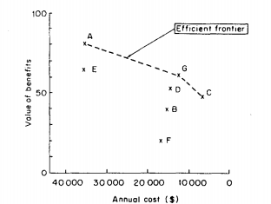
SMART: (7) Provincial Decision
Office | Aggregate Benefits | Aggregate Costs
Addison Square | 8080 | 35000
Bilton Village | 3940 | 17800
Corlisle Walk | 4740 | 6700
Denver Street | 5230 | 14100
Elton Street | 6480 | 34800
Filton Village | 2090 | 18600
Gorton Square | 6020 | 12000

Slide 44
SMART: (7) Provincial Decision
Addison, Gorton, and Corlisle represent “non-dominated” choices.
All other choices are dominated, or bested in both costs and benefits by
another choice.
Office | Aggregate Benefits | Aggregate Costs | Cost : Benefit
Addison Square | 8080 | 35000 | 4.3
Corlisle Walk | 4740 | 6700 | .7
Gorton Square | 6020 | 12000 | 1.99

Slide 45
What is SMART?
8 Stages of SMART:
Identify Decision Maker
Identify Alternative Courses of Action
Identify Relevant Attributes
Assign values to measure performance of the alternatives on that attribute
Determine a weight for each attribute
Take a weighted average of the values for each alternative
Make a provisional decision
Perform sensitivity analysis

Slide 46
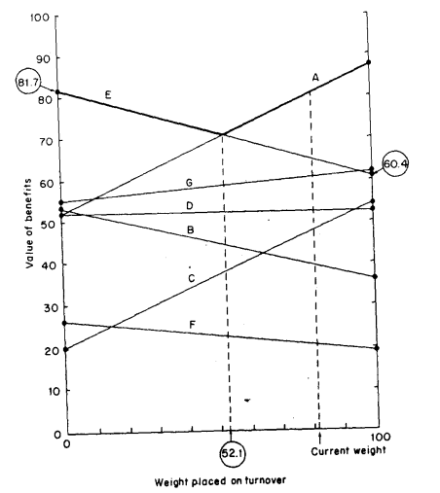
SMART: (8) Sensitivity Analysis
Identical to how we might perform analyze sensitivity for a cost : benefit analysis.
We will explore this in lab on Monday.
Needlessly Complicated Figure 2.7!

Slide 47
SMART: Summary
8 Stages of SMART:
Identify Decision Maker
Identify Alternative Courses of Action
Identify Relevant Attributes
Assign values to measure performance of the alternatives on that attribute
Determine a weight for each attribute
Take a weighted average of the values for each alternative
Make a provisional decision
Perform sensitivity analysis

Slide 48
Assumptions of SMART
Decidability: We assume the decision maker has preferences.
Transitivity: The decision makers preferences are consistent (e.g., A > B, C > B, Thus C > A).
Summation: The interval between A and B is smaller than the interval between A and C in terms of preferences.
Solvability: Preferences can be determined (this may not always be true).
Finite upper and lower bounds of value: For example, to use methods like this the EPA *must* have a value of human life less than infinity.

Slide 49
The Analytical Hierarchy Process (AHP)
“The analytical hierarchy process (AHP) offers an alternative approach to SMART when a decision maker is faced with a problem involving multiple objectives”
- Goodwin and Wright

Slide 50
Today’s Goals
What is AHP?
What are some strengths / weaknesses of AHP?

